Slide 1


Earth System Science Pathfinder Program Overview
Greg Stover
2023-08-22
1

Slide 2


Strategic Guidance
“
Strategic Objective 1.1: Understand the Earth system and its climate.”
Science 2020-2024 Priority 1 Exploration And Scientific Discovery: Earth Science
The second DS was released in 2017 : “Thriving on Our Changing Planet: A Decadal Strategy for Earth Observations from Space”
Notes:
Earth Science Questions:
How is the global Earth system changing? (Characterize)
What causes these changes in the Earth system? (Understand)
How will the Earth system change in the future? (Predict)
How can Earth system science provide societal benefit? (Apply)

Slide 3
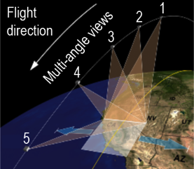
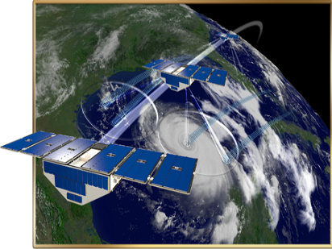
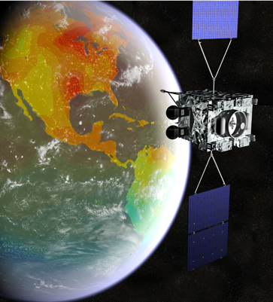
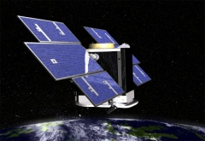
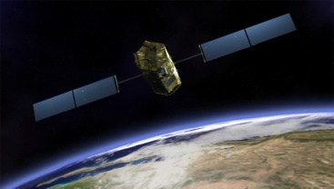
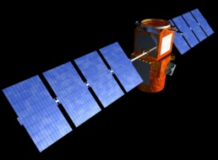
ESSP Program Overview
The goal is to stimulate new scientific understanding of the global Earth system by:
  developing and operating remote-sensing missions
  conducting investigations using data from these missions
  addressing unique, specific, highly focused requirements in Earth science research
Projects in the ESSP portfolio are:
  Science‐driven
  PI-led investigations
  Competitively selected
  Orbital or sub-orbital
  Implemented within cost‐ and schedule‐constraints
https://essp.nasa.gov/latest-news/

Slide 4
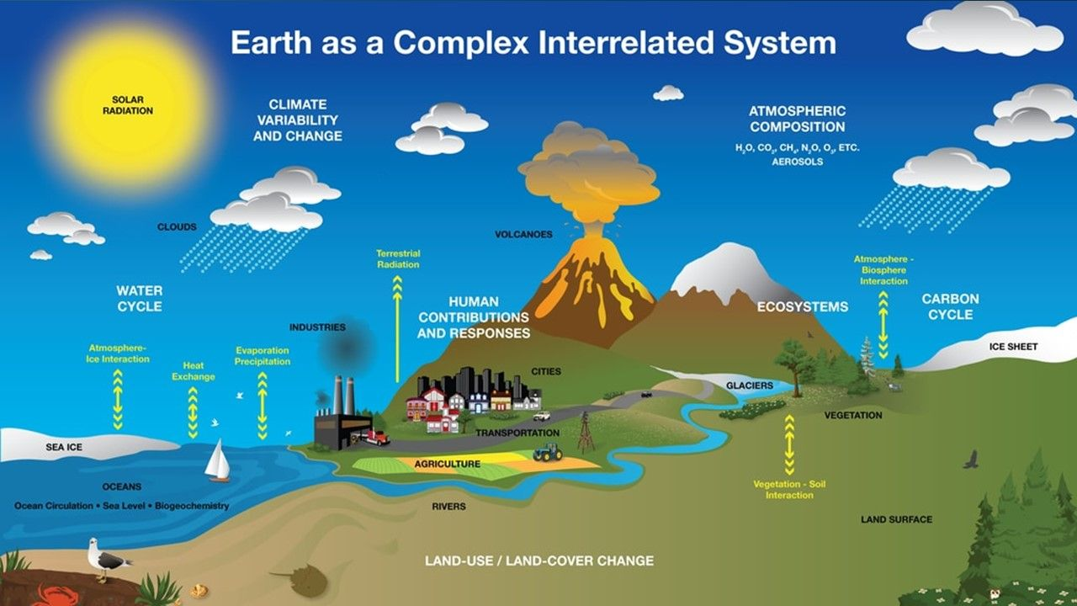

Interior - Surface
Interaction
EARTH’S
INTERIOR
Notes:
B

Slide 5
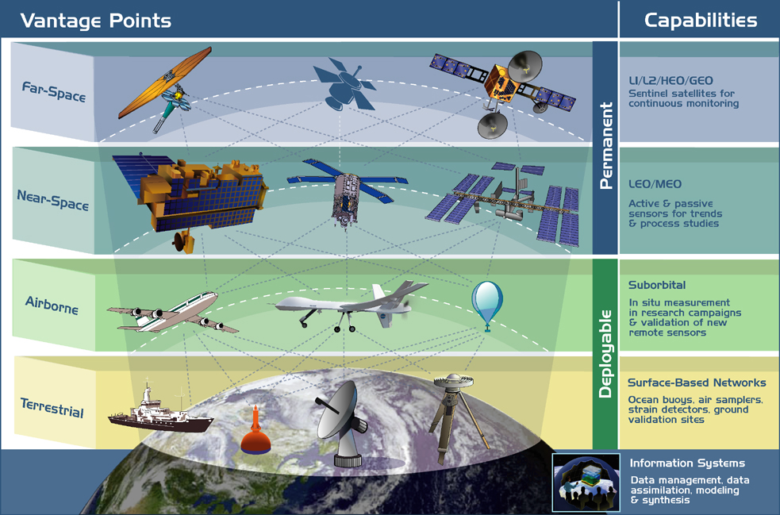
ESSP Earth Observing Vantage Points
Far-Space
Near-Space
Measurement Domains for ESSP Projects
Airborne
Terrestrial

Slide 6










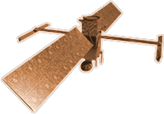





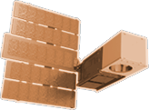











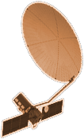









2020
SENTINEL-6
MICHAEL FREILICH
ICESAT-2
GRACE-FO (2)
CYGNSS (8)
LANDSAT-9
2015
LIS
NISTAR, EPIC
SWOT
SAGE III
SMAP
EARTH FLEET
TSIS-1
TEMPO
ECOSTRESS
OCO-2
INVEST/CUBESATS
TROPICS (4)
GEDI
GPM
NACHOS 2022
CTIM 2022
NACHOS-2 2022
MURI-FD 2023
SNOOPI* 2024
HYTI* 2024
ARGOS* 2024
OCO-3
LANDSAT 7
LANDSAT 8
PACE
TERRA
EMIT
AQUA
SUOMI NPP
PREFIRE (2)
AURA
2000
CLOUDSAT
CALIPSO
JPSS INSTRUMENTS
CLARREO-PF
NISAR
2010
OMPS-LIMB 2022
LIBERA 2027
OMPS-LIMB 2027
OMPS-LIMB 2032
TSIS-2
2005
MAIA
ISS INSTRUMENTS
2025
SENTINEL-6B
KEY
GLIMR*
INCUS*
MISSIONS
INTERNATIONAL PARTNERS
U.S. PARTNER
ISS INSTRUMENT
JPSS INSTRUMENT
CUBESAT
LAUNCH DATE TBD
CRISTAL*
POLSIR*
ESO: MASS CHANGE*
(PRE) FORMULATION
IMPLEMENTATION
OPERATING
EXTENDED
ESO: STORM*
ESO: SBG*
ESO: SKY*
LANDSAT NEXT*
07.06.23
2030

Slide 7

2020
SENTINEL-6
MICHAEL FREILICH
ICESAT-2
GRACE-FO (2)
CYGNSS (8)
LANDSAT-9
2015
LIS
NISTAR, EPIC
SWOT
SAGE III
SMAP
EARTH FLEET
TSIS-1
TEMPO
ECOSTRESS
OCO-2
INVEST/CUBESATS
TROPICS (4)
GEDI
GPM
NACHOS 2022
CTIM 2022
NACHOS-2 2022
MURI-FD 2023
SNOOPI* 2024
HYTI* 2024
ARGOS* 2024
OCO-3
LANDSAT 7
LANDSAT 8
PACE
TERRA
EMIT
AQUA
SUOMI NPP
PREFIRE (2+1)
AURA
2000
CLOUDSAT
CALIPSO
JPSS INSTRUMENTS
CLARREO-PF
NISAR
2010
OMPS-LIMB 2022
LIBERA 2027
OMPS-LIMB 2027
OMPS-LIMB 2032
TSIS-2
2005
MAIA
ISS INSTRUMENTS
2025
SENTINEL-6B
KEY
GLIMR*
INCUS*
MISSIONS
INTERNATIONAL PARTNERS
U.S. PARTNER
ISS INSTRUMENT
JPSS INSTRUMENT
CUBESAT
LAUNCH DATE TBD
CRISTAL*
POLSIR*
ESO: MASS CHANGE*
(PRE) FORMULATION
IMPLEMENTATION
OPERATING
EXTENDED
ESO: STORM*
ESO: SBG*
ESO: SKY*
LANDSAT NEXT*
07.06.23
2030

Slide 8
Timeline of Current and Future Earth Science Missions
JPSS-1
DSCOVR
*OMPS-L
EPIC
CERES
PREFIRE
CloudSat
NISTAR
ISS
*Landsat 9
NISAR
Aqua
SMAP
SAGE III
CALIPSO
*Landsat 8
TSIS-1
ISS
TROPICS (PF)
TEMPO
Sentinel 6B
LIS
OCO-3
2002
2006
2013
2015
2017
2019
2021
2023
2026
1999
2004
2011
2014
2016
2018
2020
2022
2024
2027
2033
Terra
Aura
Suomi-NPP
OCO-2
CYGNSS (8)
ICESat-2
Sentinel-6
Michael Freilich
TROPICS (4)
ISS
JPSS-3
CLARREO-PF
GPM
GRACE-FO
JPSS-2
PACE
*OMPS-L
*Landsat 7
ISS
*OMPS-L
JPSS-4
ISS
EMIT
*OMPS-L
GEDI
Libera
ECOSTRESS
SWOT
Launch Dates TBD
NASA Earth Science Focus Areas
MAIA
GeoCarb
GLIMR
TSIS-2
Atmospheric Composition |  |  | Earth Surface and Interior
Carbon Cycle and Ecosystems |  |  | Water and Energy Cycle
Climate Variability and Change |  |  | Weather and Atmospheric Dynamics
ESO 1, 2, 3, 4
*Landsat Next
INCUS
01.31.22
*Operations not funded by ESD
Notes:
Below are timeline edits, reviewed by Charles, for your incorporation into the fleet timeline slide. Instrument delivery dates are indicated with an asterisk* and can be noted as “instrument complete” on the timeline. This list is by calendar year and based on ABC dates, unless otherwise noted, as Sandra suggested previously.
Regarding your previous questions, Charles recommends listing the instrument delivery date for instruments until launch dates are known. The OMPS-Limb and Libera instruments would stay listed by instrument delivery until JPSS launch dates are confirmed (estimated JPSS launches are listed in blue for reference only). TROPICS now has a contract in place with a launch date so is listed in 2022 vs the 2020 instrument delivery.
2019
*OMPS-L (JPSS-2) (no ABC; year delivered to the integrated sensor suite (ISS))
2020
2021
Landsat 9
*OMPS-L (JPSS-3) (no ABC; year expected to be delivered to the integrated sensor suite (ISS))
2022
TROPICS (contract Launch)
*EMIT (ISS) (New ABC instrument delivery is Aug 22 and LRD is Oct 22)
*OMPS-L (JPSS-4) (no ABC; year expected to be delivered to the integrated sensor suite (ISS))
*MAIA (New ABC instrument delivery is Feb 22)
JPSS-2 with OMPS-Limb [JPSS-2 does not have an ABC but their Launch Commitment Date according to their latest DM is the end of 2022 (Q1FY23)]
2023
GeoCarb (Current ABC; this may change after DPMC; new date TBD)
PREFIRE (ABC Cubesat delivery is Jul 23 and ABC LRD is Sep 23)
SWOT (New ABC LRD is June 23)
TEMPO (New ABC LRD is March 23)
NISAR (New ABC LRD is Sep 23)
TSIS-2 (Does not have an ABC yet; MA on ScienceWorks in Dec 2023; KDP-C scheduled for July)
*CLARREO-PF (ISS) (New ABC instrument delivery is Dec 2023)
2024
PACE (Current ABC; this may change after DPMC; new date TBD)
2025
*Libera (JPSS-3) (Does not have an ABC yet; KDP-B Agency Agreement for instrument delivery is May-Nov 2025; LRD Dec 2027-Dec 2028)
2026
Sentinel 6B
GLIMR (Does not have an ABC yet; though GLIMR is an instrument, NASA article from Aug 19 says it is expected to launch “in the 2026-2027 timeframe”)
2027
JPSS-3 with Libera and OMPS-Limb [JPSS-3 does not have an ABC but the Launch Commitment Date according to their latest DM is the end of 2027 (Q1FY28)]
2032
JPSS-4 with OMPS-Limb [JPSS-4 does not have an ABC but their Launch Commitment Date according to their latest DM is the end of 2032 (Q1FY33)]

Slide 9




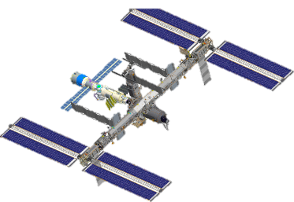
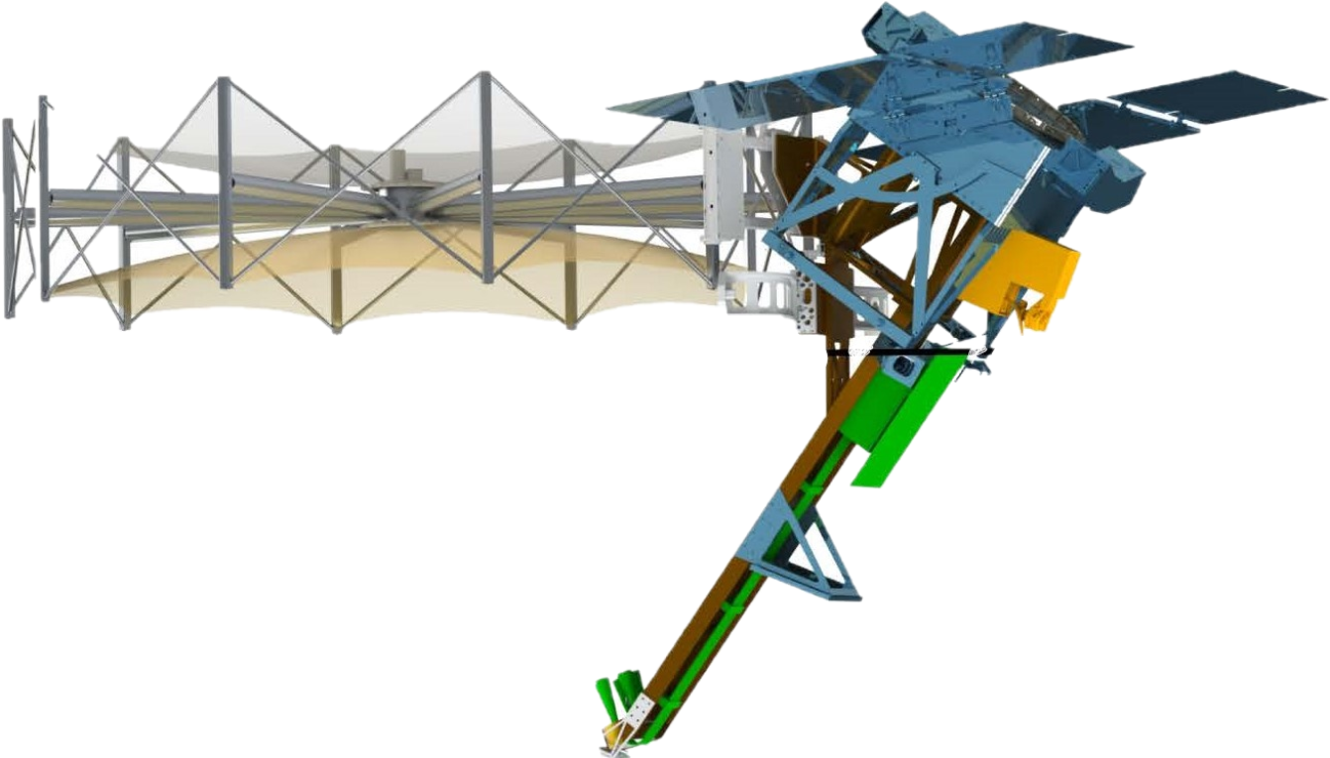



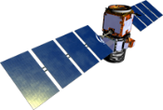



ESSP-PO Has 22 Active Projects
GLIMR
GeoCARB
TEMPO
PREFIRE (2)
MAIA
ISS Instruments
OCO-3
ECOSTRESS
GEDI
EMIT
INCUS (3)
PolSIR (2)
CloudSat
CYGNSS (8)
CALIPSO
EVS-3
IMPACTS
ACTIVATE
Delta-X
DCOTSS
S-MODE
TROPICS (4+PF)
OCO-2
Libera
NTS

