Slide 1
NASA’s
Open-Source Science Strategy
Supporting a more equitable, impactful, and efficient scientific future
Kevin Murphy
SMD Chief Science Data Officer
NASA Headquarters
kevin.j.murphy@nasa.gov

Slide 2
Agenda
Open Science
Open Source Science Initiative
Earth Science Data

Slide 3
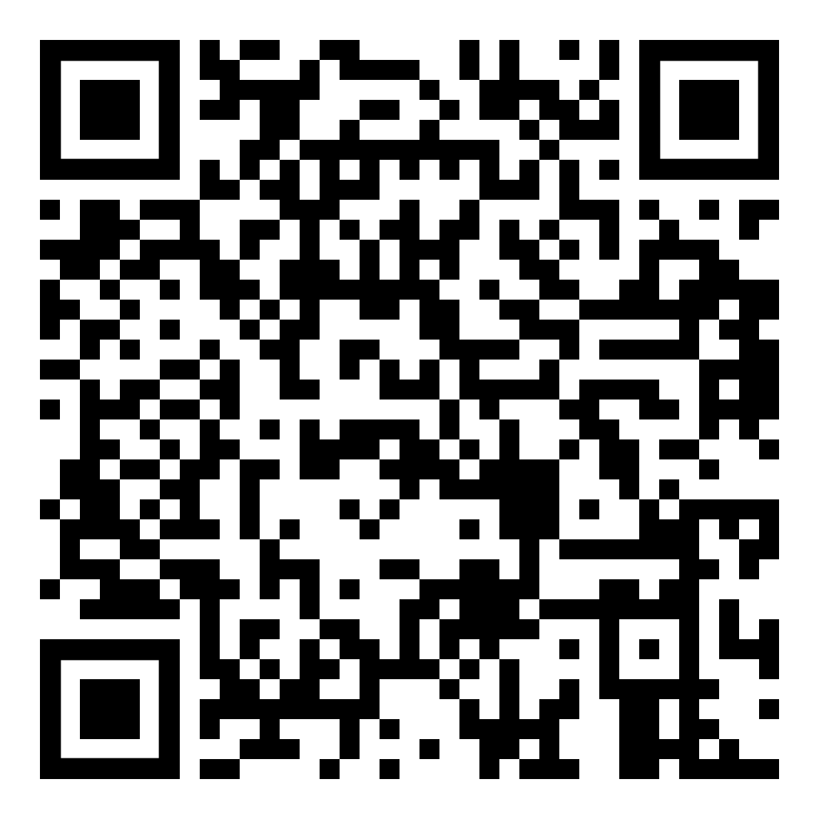
The White House announces
2023 A Year of Open Science
CDC ✦ DOA ✦ DOC ✦ DOE ✦ DOS ✦ DOT ✦ NASA ✦ NEH ✦ NIH ✦ NIST ✦ NOAA ✦ NSF ✦ SI ✦ USDA ✦ USGS
A multi-agency (15) initiative across the US Federal Government to spark change and inspire open science engagement through events and activities that will advance adoption of open science.
Website: https://open.science.gov/
Notes:
2023 is the spark to accelerate adoption of open science. We need to open the process of doing science AND the results because sharing knowledge advances us all and that is why the White House is dedicating 2023 as a Year of Open Science and federal agencies and a large coalition of universities are join in. There are 4 goals that anyone can adopt --- for your research team, your department, your institution or organizations. First, think about open science and develop a plan to be more open. Next, think about all the different types of reviews you are involved with and how to improve the equity of them. Asking is powerful - so ask about open science activities and account for them in evaluations. And through all of this engage with underrepresented communities to ensure that we create a more equitable, impactful, efficient scientific future.
Links to share: https://open.science.gov/

Slide 4
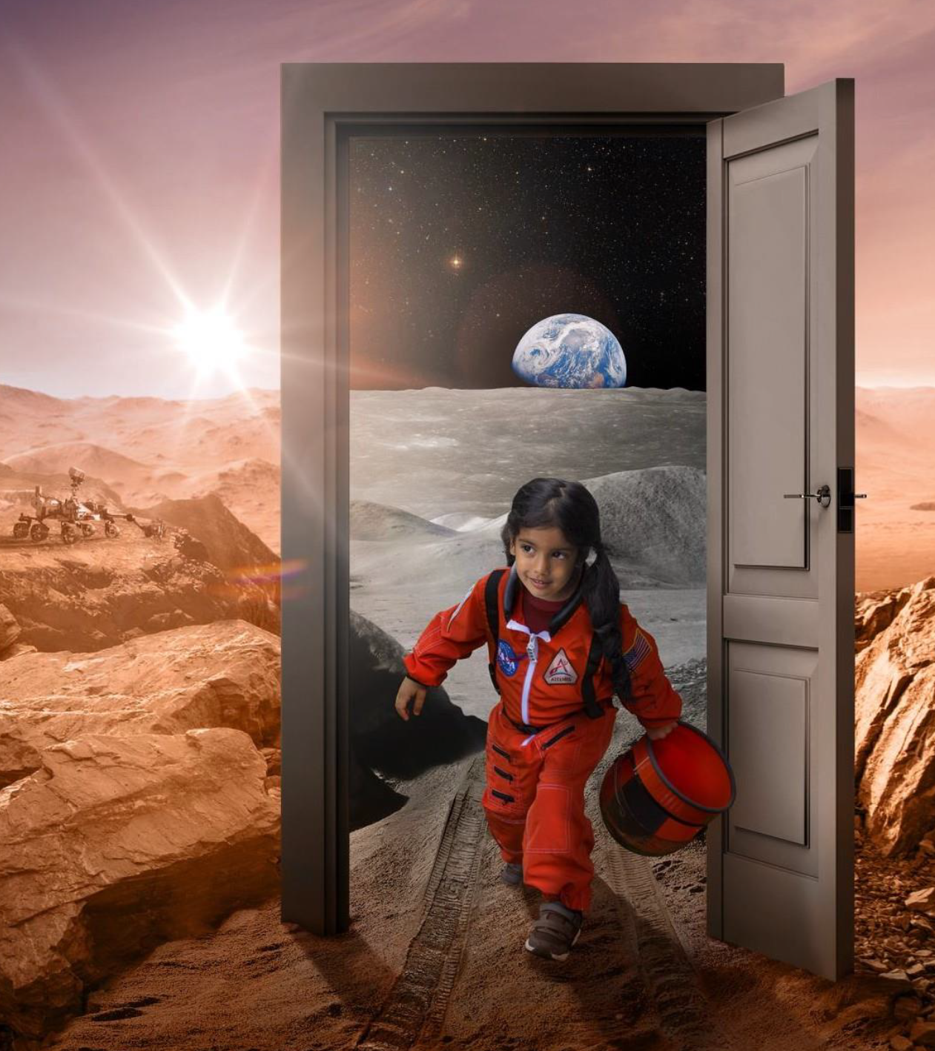
Open Science
is the principle and practice of making research products and processes available to all, while respecting diverse cultures, maintaining security and privacy, and fostering collaborations, reproducibility and equity.

Slide 5
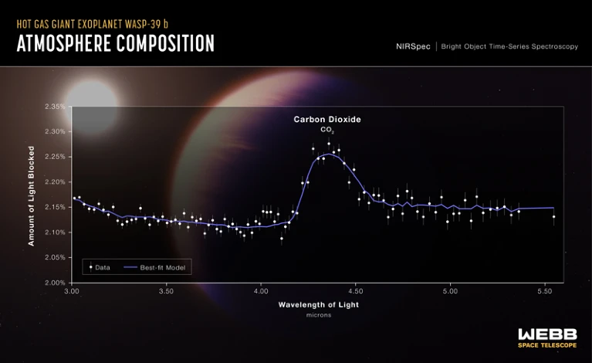
First evidence of CO2 in exoplanet atmosphere
“NASA’s open science guiding principles are centered in our Early Release Science work, supporting an inclusive, transparent, and collaborative scientific process.”
– co-author
Dr. Natasha Batalha
https://www.nature.com/articles/d41586-022-02350-2
Notes:
Spotting carbon dioxide in a planet’s atmosphere is a stepping stone towards detecting life beyond Earth. In September astronomers found the first evidence of CO2 in an exoplanet atmosphere. These results were possible because of NASA’s Open science principles embraced by this exoplanet community. This enabled this rapid Discovery using the new James Webb Space Telescope data. And this discovery wasn't just enabled by them deciding to do open science in one day. There was an open collaboration that was advertised in the Years leading up to the data with an open slack community of 341 people. The data from James Webb Space Telescope was made public immediately upon collection everyone had access to it with no embargo.. All the data reduction and scientific interpretation could be reproduced through open software and data that were archives in a Zenodo community collection for James Webb Space Telescope. The article was immediately open on the archived preprint server and then published in nature open access.

Slide 6
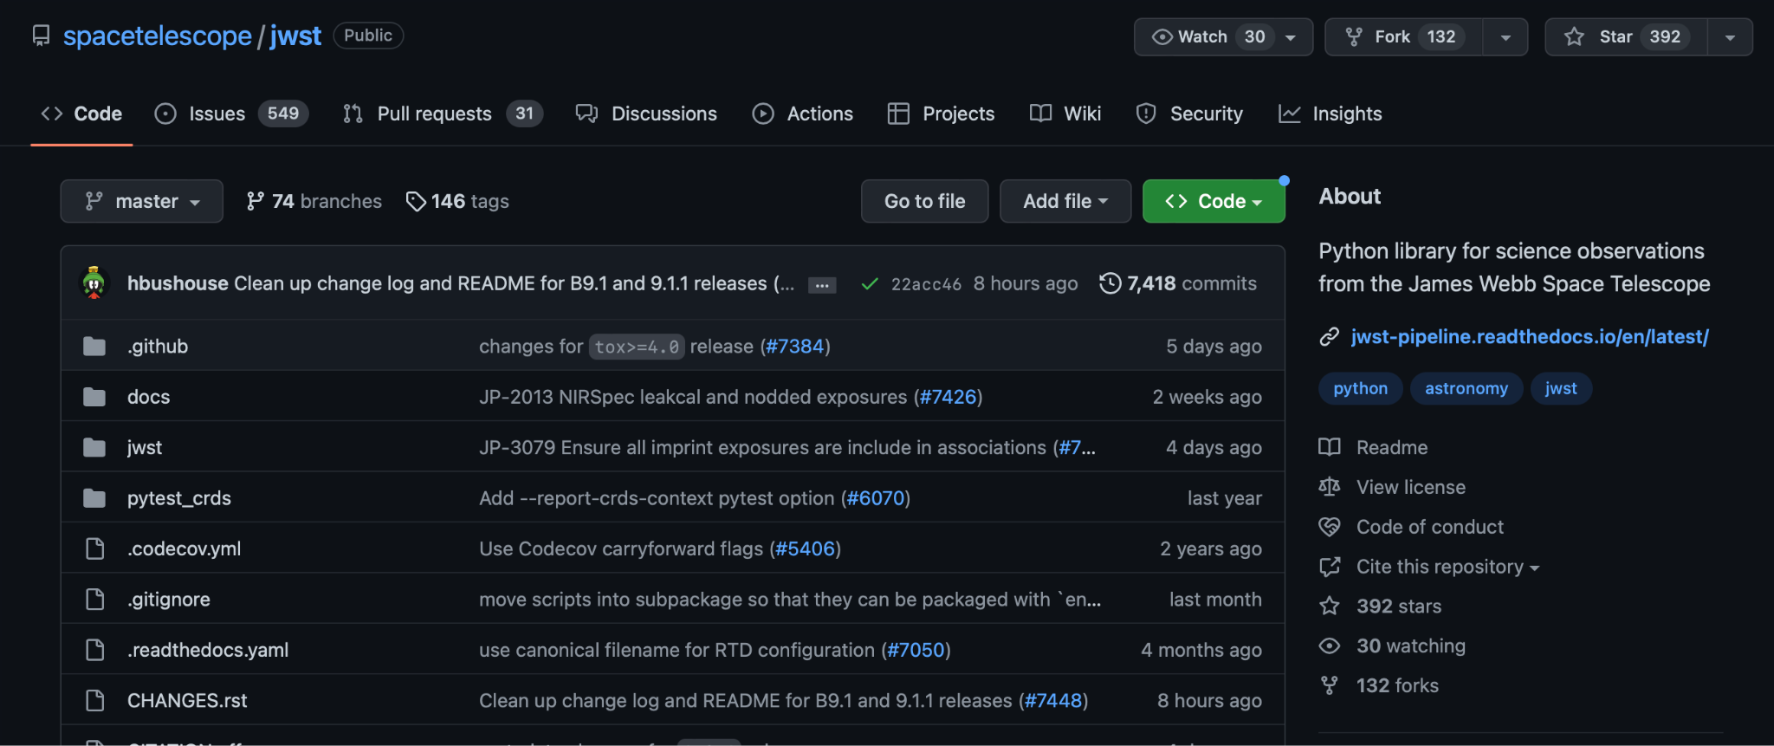
NASA Open-Source Science Initiative
JWST Calibration Software
Developed openly
on GitHub.
Enables scientists to
test their projects.
Builds on the scientific Python environment and contributes back to the community.
https://github.com/spacetelescope/jwst
https://github.com/readme/featured/webb-telescope-astropy

Slide 7
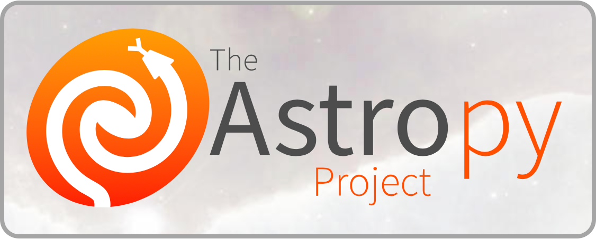
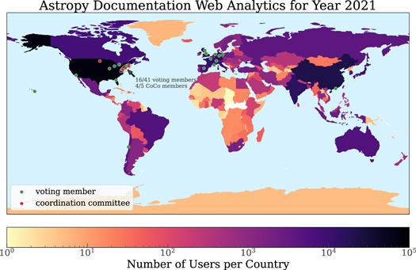
NASA Open-Source Science Initiative
Common Python library for astronomy; builds on NumPy.
Started in 2011 from an astronomy and Python mailing list.
Original contributors
include Hubble and Chandra
Space Telescopes.
Has been cited by over
10,000 publications.
https://www.astropy.org/
Astropy Collaboration et al. 2022

Slide 8
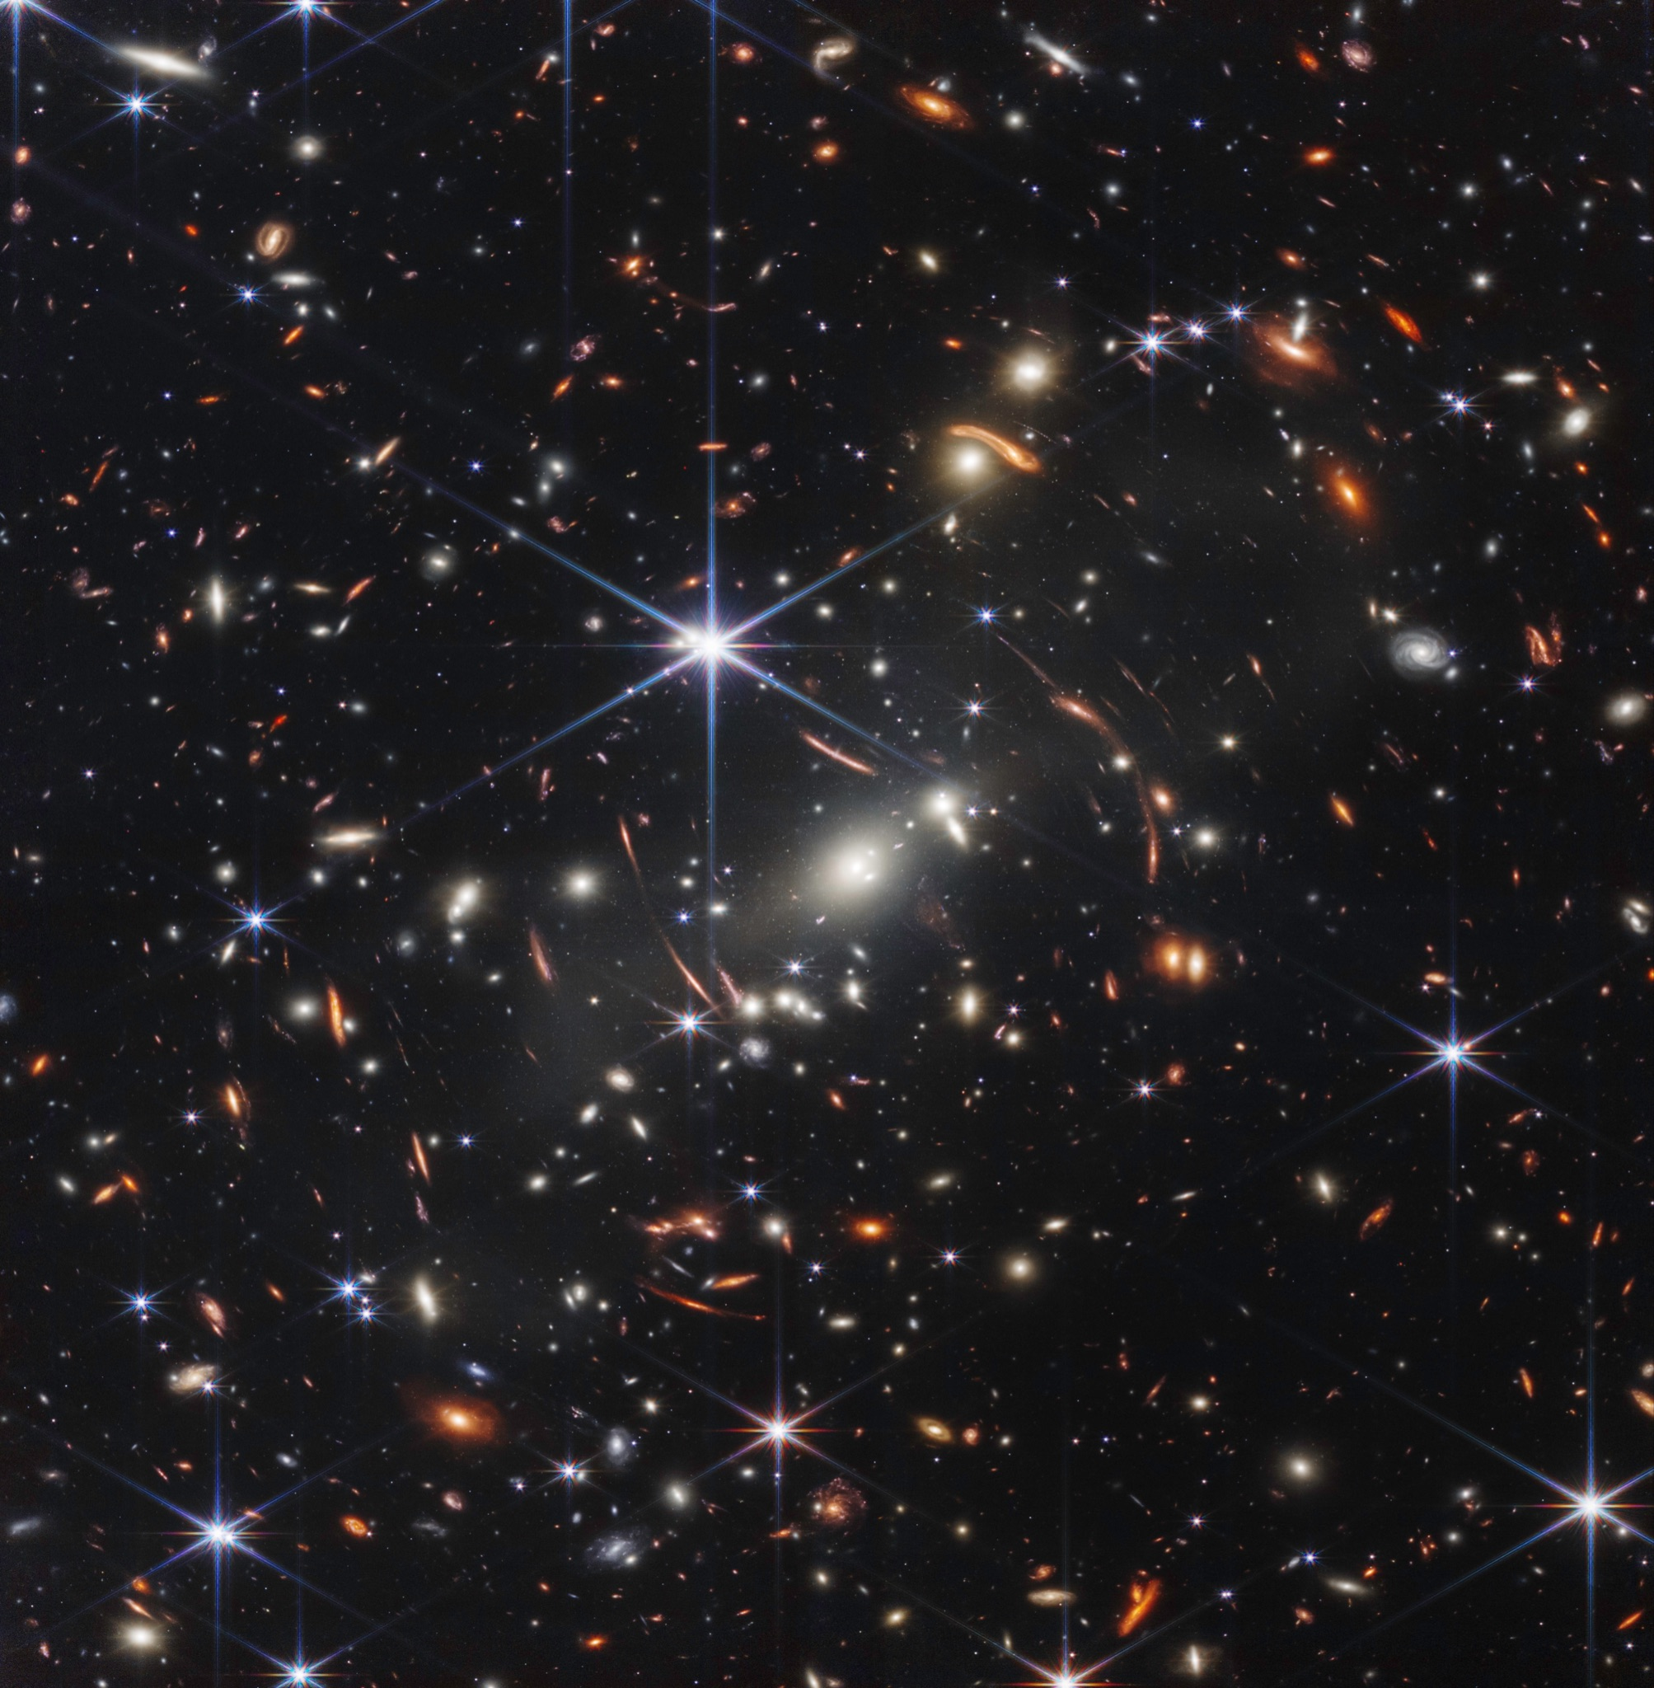
Notes:
Thousands of galaxies flood this near-infrared image of galaxy cluster SMACS 0723. High-resolution imaging from NASA’s James Webb Space Telescope combined with a natural effect known as gravitational lensing made this finely detailed image possible.
First, focus on the galaxies responsible for the lensing: the bright white elliptical galaxy at the center of the image and smaller white galaxies throughout the image. Bound together by gravity in a galaxy cluster, they are bending the light from galaxies that appear in the vast distances behind them. The combined mass of the galaxies and dark matter act as a cosmic telescope, creating magnified, contorted, and sometimes mirrored images of individual galaxies.
Clear examples of mirroring are found in the prominent orange arcs to the left and right of the brightest cluster galaxy. These are lensed galaxies – each individual galaxy is shown twice in one arc. Webb’s image has fully revealed their bright cores, which are filled with stars, along with orange star clusters along their edges.
Not all galaxies in this field are mirrored – some are stretched. Others appear scattered by interactions with other galaxies, leaving trails of stars behind them.
Webb has refined the level of detail we can observe throughout this field. Very diffuse galaxies appear like collections of loosely bound dandelion seeds aloft in a breeze. Individual “pods” of star formation practically bloom within some of the most distant galaxies – the clearest, most detailed views of star clusters in the early universe so far.
One galaxy speckled with star clusters appears near the bottom end of the bright central star’s vertical diffraction spike – just to the right of a long orange arc. The long, thin ladybug-like galaxy is flecked with pockets of star formation. Draw a line between its “wings” to roughly match up its star clusters, mirrored top to bottom. Because this galaxy is so magnified and its individual star clusters are so crisp, researchers will be able to study it in exquisite detail, which wasn’t previously possible for galaxies this distant.
The galaxies in this scene that are farthest away – the tiniest galaxies that are located well behind the cluster – look nothing like the spiral and elliptical galaxies observed in the local universe. They are much clumpier and more irregular. Webb’s highly detailed image may help researchers measure the ages and masses of star clusters within these distant galaxies. This might lead to more accurate models of galaxies that existed at cosmic “spring,” when galaxies were sprouting tiny “buds” of new growth, actively interacting and merging, and had yet to develop into larger spirals. Ultimately, Webb’s upcoming observations will help astronomers better understand how galaxies form and grow in the early universe.
NIRCam was built by a team at the University of Arizona and Lockheed Martin’s Advanced Technology Center.
For a full array of Webb’s first images and spectra, including downloadable files, please visit: https://webbtelescope.org/news/first-images

Slide 9
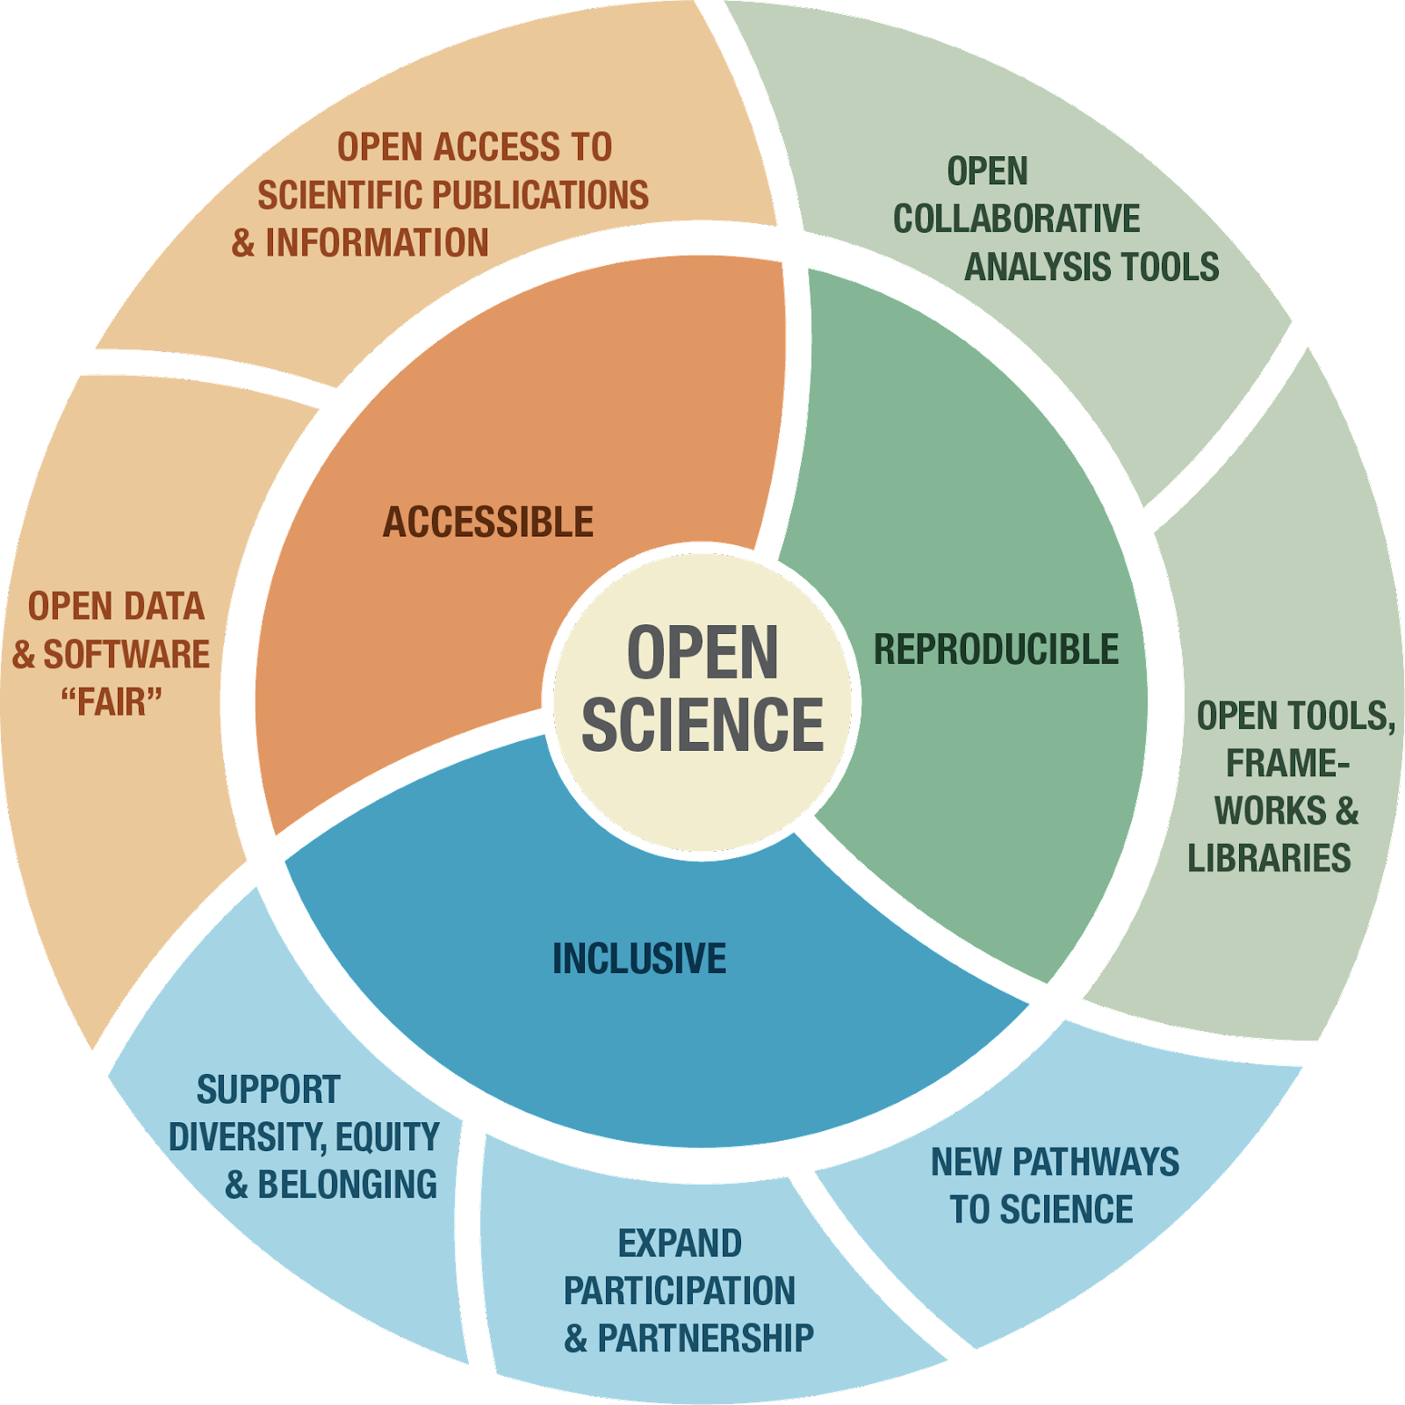
Open Science is Accessible, Reproducible & Inclusive
NASA OPEN-SOURCE SCIENCE INITIATIVE
Creates research that is:
Cited more
Has a bigger impact
Increases transparency
More inclusive
Inclusive science means more:
Collaborative projects
Access to ‘hidden knowledge’
Equitable Systems
Increased Participation
Notes:
A collaborative culture enabled by technology that empowers the open sharing of data, information, and knowledge within the scientific community and the wider public to accelerate scientific research and understanding.
Open Science means different things to different communities.
TOPS is encouraging a more nuanced, inclusive definition of Open Science
Open science is Science - data, software, results, publications.
Open science is inclusive science - it enable transparents & collaborative scientific practices, this works to opens up hidden knowledge, it is more equitable, and actively works to broaden participation in science.

Slide 10
Policy
Infrastructure
NASA’s
Open-Source
Science
Initiative
Incentives
Community
Notes:
SPD-41a aims to maximize openness while minimizing burden on SMD-funded missions and researchers.

Slide 11
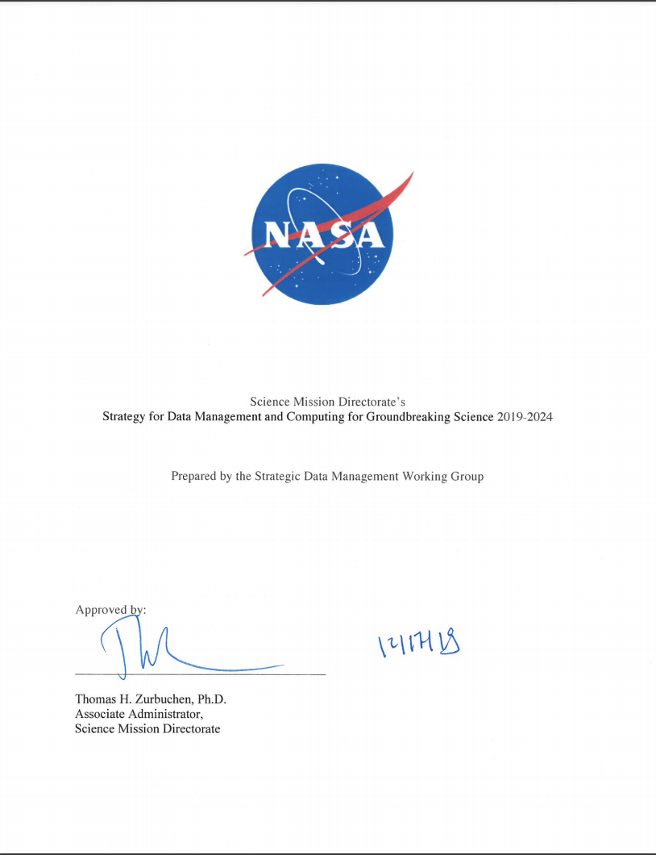
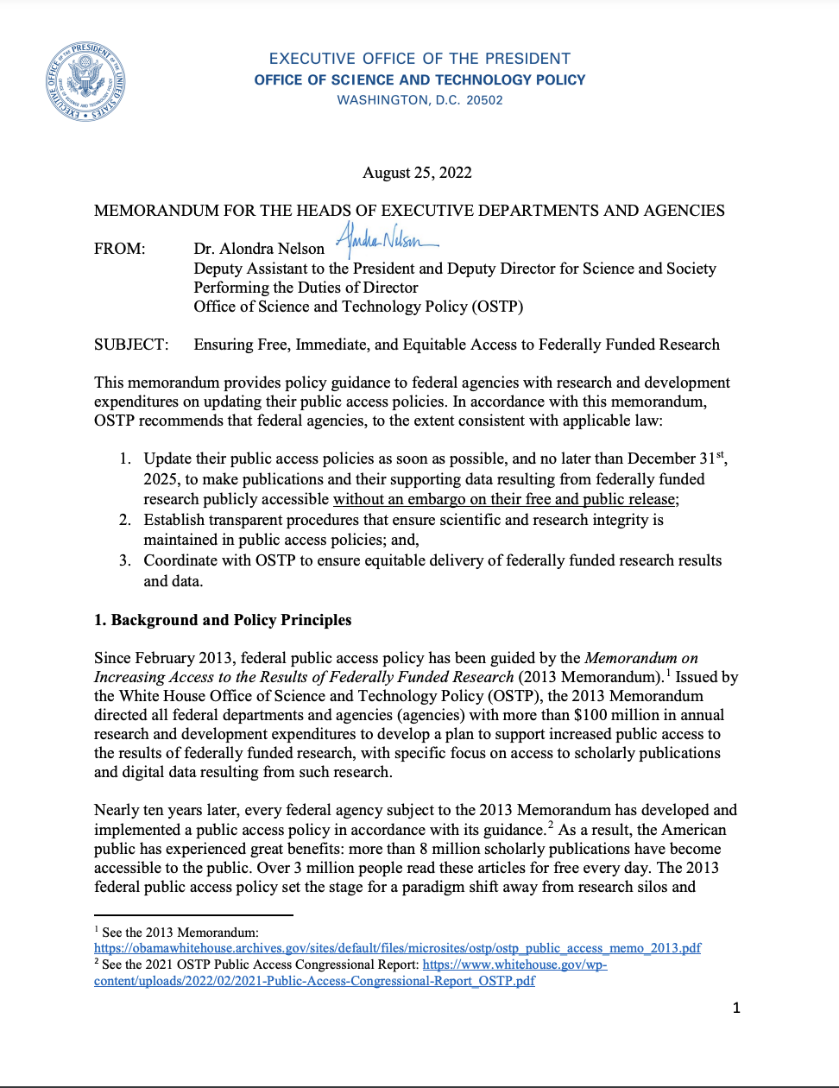
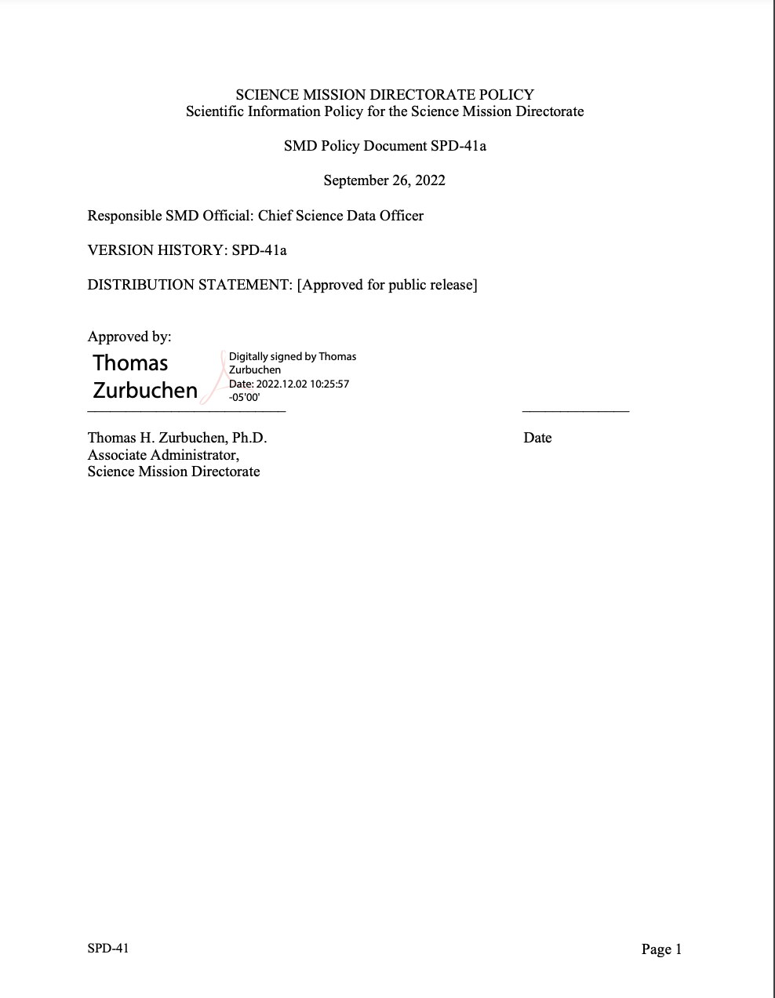
Background
[2019 - 2024]
SMD Strategy for Data Management and Computing for Groundbreaking Science
[August, 2022]
OSTP Memo: Ensuring Free, Immediate, and Equitable Access to Federally Funded Research
[September, 2022]
Scientific Information Policy for the Science Mission Directorate: SPD-41a

Slide 12
Office of the
Chief Science Data Officer
GOAL 1
Develop and Implement Capabilities to Enable Open Science
GOAL 2
Continuous Evolution of Data and Computing Systems
GOAL 3
Harness the Community and Strategic Partnerships for Innovation

Slide 13
Policy &
Governance

Slide 14
Don’t Panic
Many groups are already fully compliant with Open Science requirements and there are already many options for how to share your science.
The new requirements are on SMD and flow down to NEW projects.
Existing grants and missions are not required to adopt new guidance, but they are encouraged to do so if feasible with available resources.
You are already doing a great job of being Open!

Slide 15
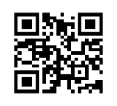
SPD-41a is SMD’s updated Scientific Information Policy.
SPD-41a updates the previously released SPD-41, which consolidated existing Federal and NASA policy on sharing scientific information.
Policy updates were developed with:
Science Mission Directorate (SMD) community input via workshops and RFIs
Input from our data repositories and missions
National Academies studies
White House OSTP Memo on Ensuring Free, Immediate, and Equitable Access to Federally Funded Research
One component of SMD’s Open-Source Science Initiative (OSSI)
Scientific Information Policy Website
Notes:
Links to share:
1) SPD-41a
2) Ensuring Free, Immediate, and Equitable Access to Federally Funded Research
3) Open-Source Science Initiative
4) Scientific Information Policy Website

Slide 16
NASA’s Open-Source Science Initiative
SPD-41a is SMD’s updated Scientific Information Policy
SPD-41a is forward looking and will apply to all future SMD-funded scientific activities
Major Policy Updates
Peer-reviewed publications are made openly available with no embargo period.
Research data and software are shared at the time of publication or the end of the funding award.
Mission data are released as soon as possible and unrestricted mission software is developed openly.
Science workshops and meetings are held openly to enable broad participation.

Slide 17
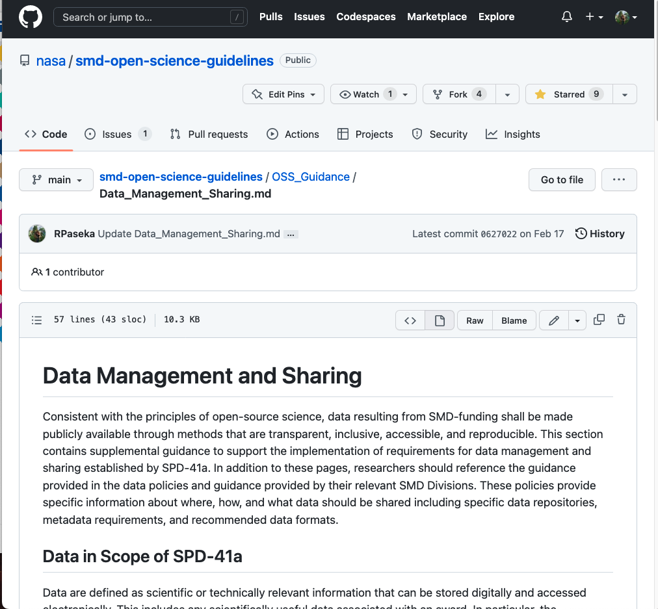
NASA’s Open-Source Science Initiative
Open-Source Science Guidance for Researchers
Narrative guidance on how to comply with SPD-41a
Broad guidance, for relevance across SMD Divisions
Includes:
Open Science and Data Management Plan
Sharing Publications
Data Management and Sharing
Software Management and Sharing
Sharing Materials for Science Events
Glossary of Open-Source Science Terms
To be development:
Open Source Science Guidances for Data Repositories
Open Source Science Guidance for Missions
https://github.com/nasa/smd-open-science-guidelines

Slide 18
Open Source Science Initiative
Updates to NPR 2210: NASA Software Release
NPR2210.2E released in June 2023, but it will still take some time to integrate into existing processes.
Highlights of updates related to SMD:
Software developed solely for scientific publications will be treated as other Science and Technical Information and NPR 2210 is not applicable.
Projects can go through the Software Release process at the start and then be fully developed in the open.
Additional licenses than NOSA can be used. Consult with OGC on appropriate licenses.
NASA personnel can contribute to work-related open source projects with approval from their manager.

Slide 19
Updates to NASA Plan for Access to Scientific Research
In response to the OSTP August 2022 memo on Ensuring Free, Immediate, and Equitable Access to Federally Funded Research, NASA has released their update to NASA Plan for Increasing Access to the Results of Scientific Research. The requirements are similar to those in SPD-41a on publications, data, and software.
Feedback from the recent RFI will be integrated into a revised version.
Lead: Louis Barbier (Office of the Chief Scientist)

Slide 20
Core Data and Computing Services

Slide 21
NASA’s Open-Source Science Initiative
Core Data and Computing Services Program
The Core Data and Computing Services Program will provide a layered architecture on which SMD science Divisions can seamlessly and efficiently integrate their discipline-specific services such as data archives.
Central to the development of Core Data and Computing Services will be the integration of new and existing data and computing capabilities, including existing Division capabilities, into a modular and secure architecture such that they are reusable by all SMD Divisions.
SMD Core Data and Computing Services will:
Develop SMD-wide data and computing infrastructure to support Open Science
Develop services to support the adoption of SPD-41a by SMD Divisions

Slide 22
Data and Computing Architecture Study
NASA’s Open-Source Science Initiative
There is a need for a coordinated cloud-High End Computing (HEC) infrastructure to better support SMD’s scientific data and computing needs and SMD’s transition to Open-Source Science.
Hybrid Cloud, HEC, Scientific Computing: Possible integration of existing on-premises high-end/scientific SMD-funded computing resources cloud capabilities
There is a need for a coordinated cloud-High End Computing (HEC) infrastructure to better support SMD scientific data and computing needs and SMD’s transition to Open-Source Science.
Hybrid Cloud, HEC, Scientific Computing: Possible integration of existing on-premises high-end/scientific SMD-funded computing resources cloud capabilities
Open-Source Science: Community- Developed Services
Divisions: Science Services
SMD: Core Services
Citizen Science
Open-Source library contributions
Value-added products and services
Archives (community-
specific tools, services and data management)
Data archiving and distribution
Mission data processing
Algorithm and model development
Mission operations
Layered Architecture
Hybrid Computing Environment
- Cybersecurity (high, moderate, low)
- Egress optimization, user self-registration, usage metrics, data transfer service, deep science data archive
- Account management, billing
Data and Computing Architecture Study Scope
Scientific information management
Deep science data archive
HECC & Scientific Computing Resources
Agency Cloud Contracts
AMES**
GSFC
Collaboration tools
Research data and software archive
** In coordination with Agency HECC needs.

Slide 23
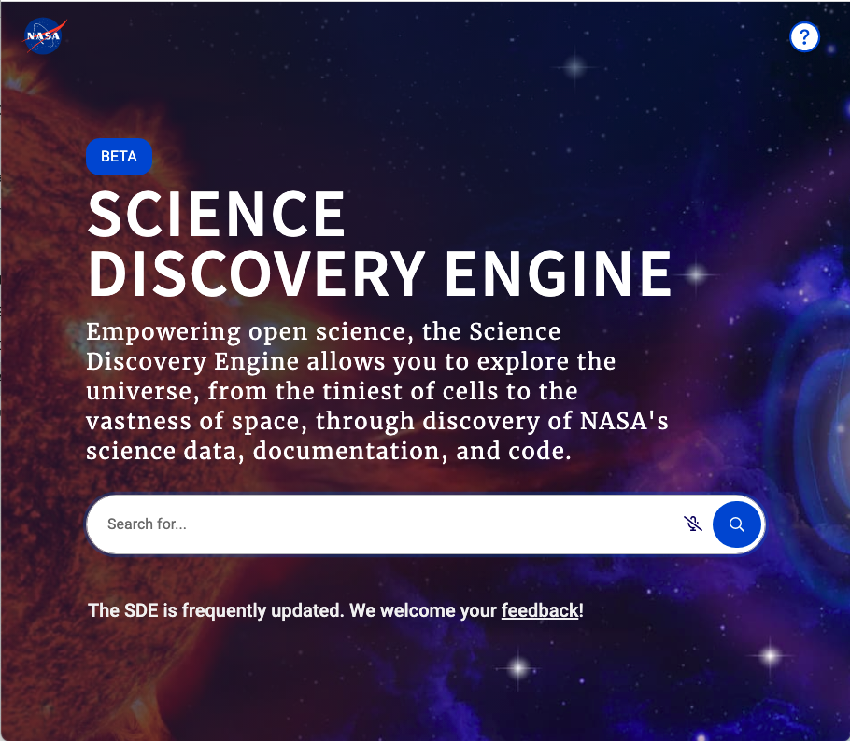
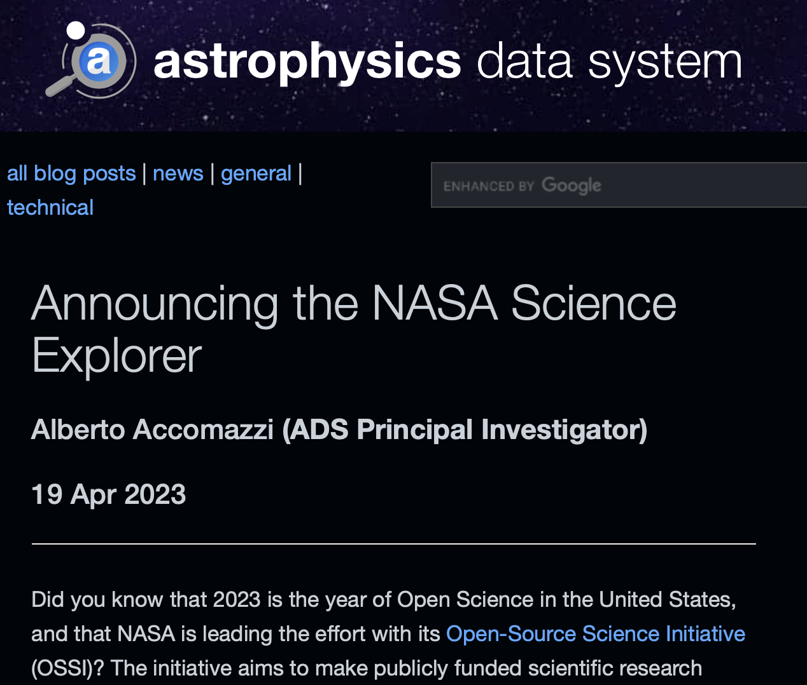
NASA’s Open-Source Science Initiative
Infrastructure: Core Services
Science Discovery Engine
SMD data catalog to support discovery and access to complex scientific data across Divisions
Science Explorer
Extend the primary digital library portal for researchers in astrophysics to support Earth and Biological and Physical Sciences
Notes:
Links to share:
Science Discovery Engine: https://sciencediscoveryengine.nasa.gov/app/nasa-sba-smd/#/home
Data and Computing Architecture Study: https://science.nasa.gov/open-science-overview/data-and-computing-architecture-study
RFI: https://nspires.nasaprs.com/external/solicitations/summary!init.do?solId={78AA81B6-A7B9-D934-20F8-7B3151DA59A2}&path=open

Slide 24
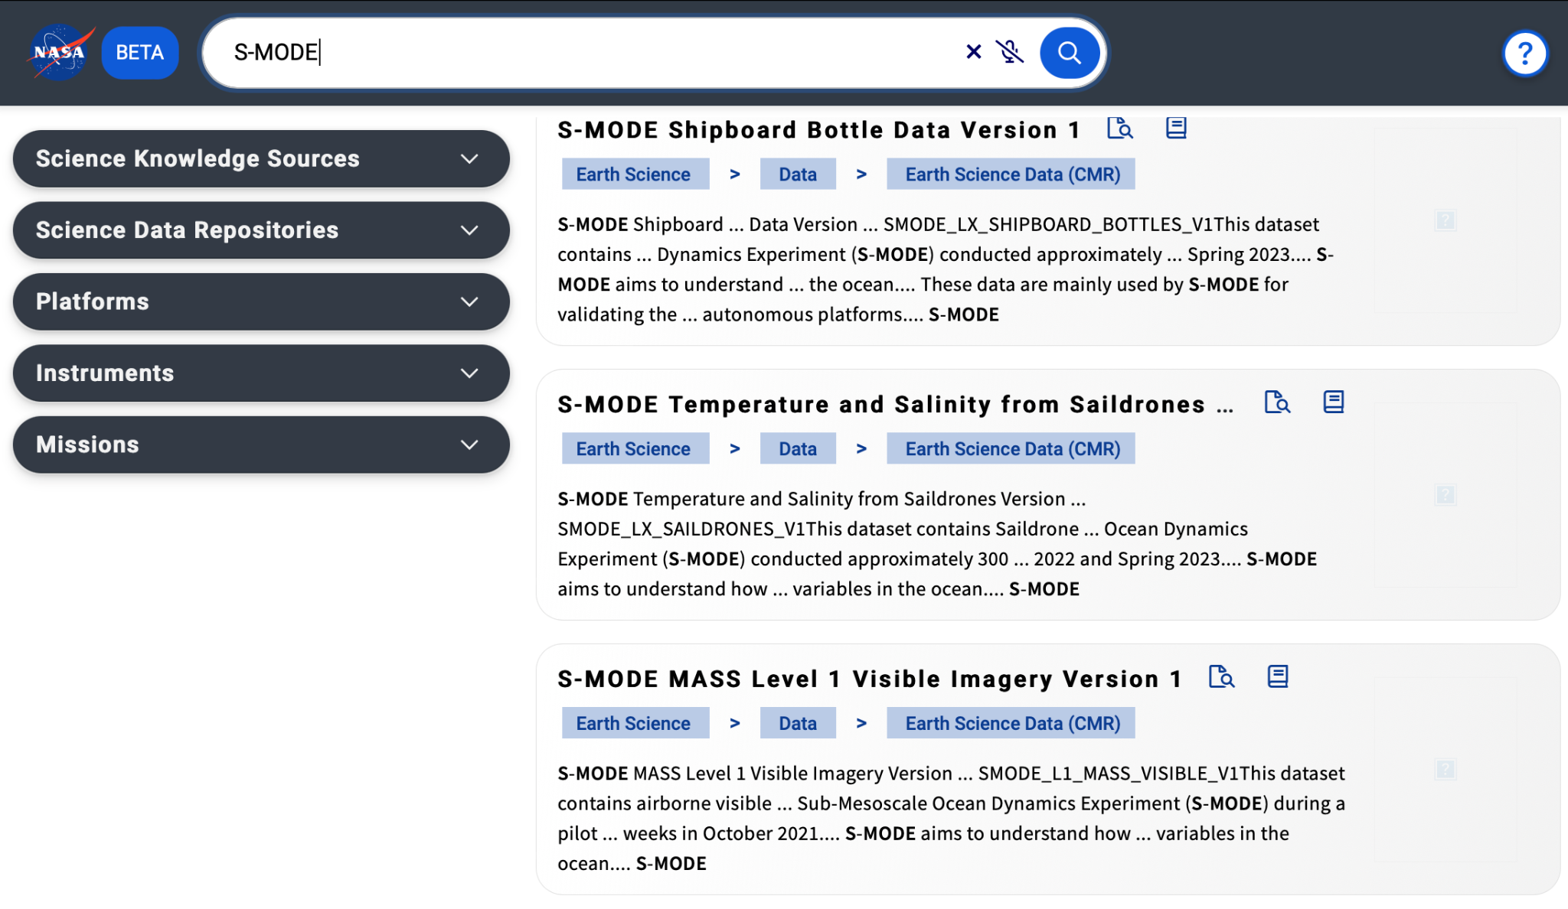
Open source Science Initiative

Slide 25
Open Science
Incentives

Slide 26
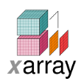
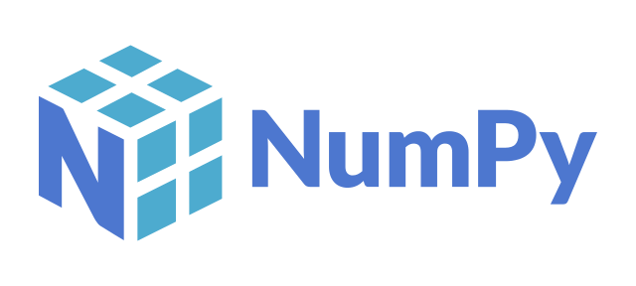
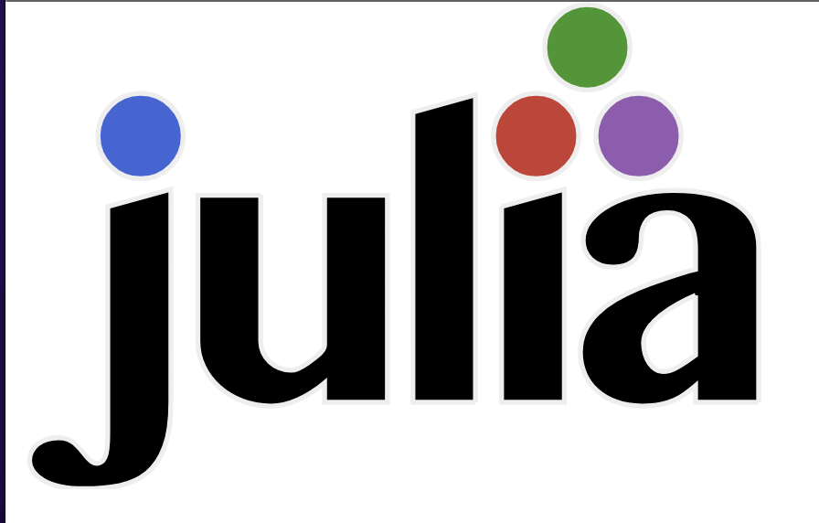
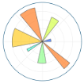
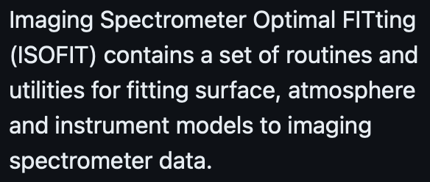
NASA’s Open-Source Science Initiative
Open Science Incentives
NASA provides funding for open science through a solicitations and opportunities. This includes supporting innovative open science projects and open source tools, frameworks, and libraries.

Slide 27
What Will NASA Fund?
NSPIRES https://nspires.nasaprs.com/
innovative, new ways to support Open Science
workshops,
conferences
Supplement for open science
open source
tools
machine learning tools to advance science
F.2 Topical Workshops, Symposia, and Conferences
platforms that support scientific analysis and processing
F.15 High Priority Open-Source Science (HPOSS)
F.8 Supplemental Open-Source Science Awards*
develop citizen science projects
F.7 Support for Open-Source Tools, Frameworks, and Libraries
F.16 Supplement for Scientific Software Platforms*
F.19 Multidomain Reusable Artificial Intelligence Tools
F.9 Citizen Science Seed Funding Program
* Requires an existing NASA grant or facility.

Slide 28
Community
Engagement

Slide 29
NASA’s Open-Source Science Initiative
NASA's Transform to Open Science (TOPS)
a 5-year mission to accelerate adoption of open science
Goals:
Increase understanding and adoption of open science principles and techniques
Broaden participation by historically excluded communities
Accelerate major scientific discoveries
Engagement
Capacity Sharing
Incentives
Coordination
https://nasa.github.io/Transform-to-Open-Science/

Slide 30
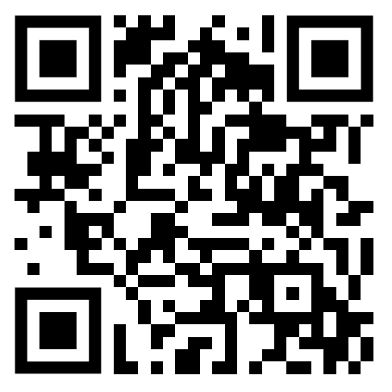
NASA’s Open-Source Science Initiative
TOPS Community Engagement
Community participation is the foundation of an open scientific process.
Listening, Learning, Collaborating, & Engaging
Online
Discussions
Open Science
Success Stories:
Monthly Community Forum
Monthly
Newsletter
Resources
Website
Events
Conferences
https://zenodo.org/record/6994587#.ZG0lUOzMJoZ
Community
Panel

Slide 31
TOPS Capacity Sharing: Open Science 101
NASA’s Open-Source Science Initiative
5 Modules designed to introduce Open Science
What is open science? Why should I do it? How should I do it?
How to use, make, & share software
Best practices for sharing all results and analysis, as well as peer reviewing
Tools
Data
Open
Open
ETHOS OF OPEN SCIENCE
OPEN TOOLS & RESOURCES
OPEN SOFTWARE
OPEN DATA
OPEN RESULTS
Science
How to use popular open science tools
Software
How to use, make, & share open data
Results
Open
Software
Open
Open
Open
Complete All 5 & earn NASA Open Science Badges & Certification

Slide 32
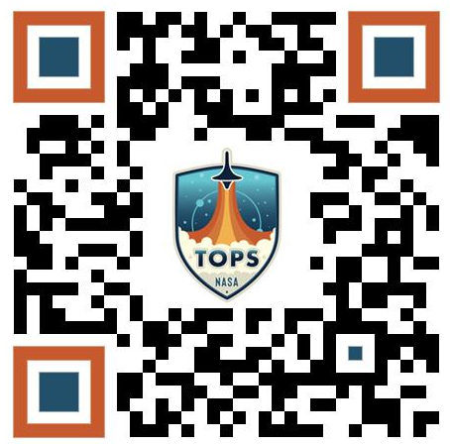
Why get a digital NASA Open Science Badge?
NASA’s Open-Source Science Initiative
Open Science 101: A community-developed introduction to open science with inclusivity, accessibility, and diversity at the forefront.
Designed to provide researchers with core open science skills, for example:
How to write data/software management plans
Know about open science tools and best practices (e.g. ORCID)
Grow connections across a community of open science practitioners
Enroll now!
https://bit.ly/EnrollOS101

Slide 33
Earth Science
Open Source Science
Cerese Albers, Ph.D.
Program Executive, Earth Science Data Systems
NASA Headquarters
Earth Science Division rep to OSSIC
Find additional information at earthdata.nasa.gov

Slide 34
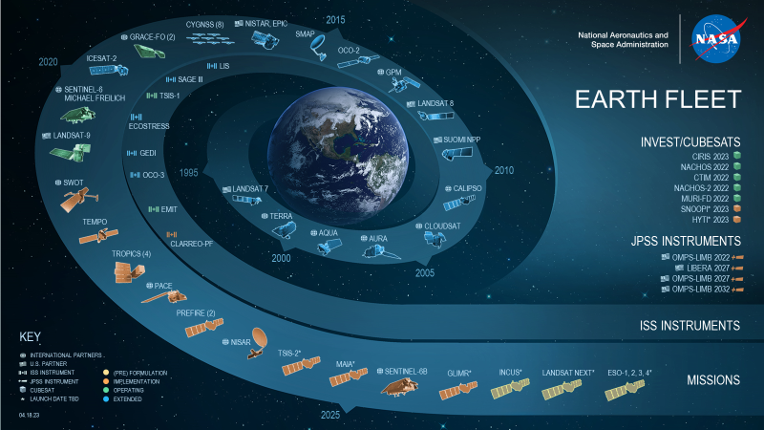

Slide 35
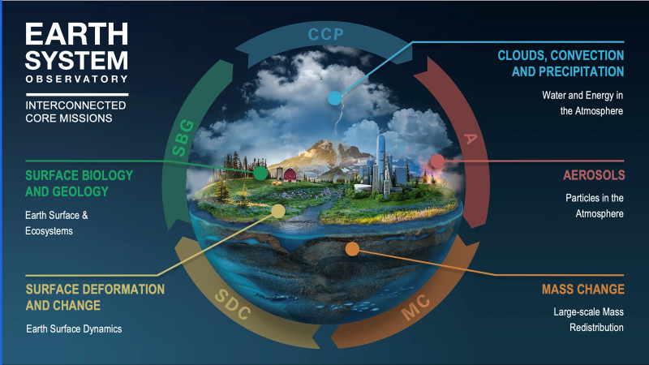
Find additional information at earthdata.nasa.gov

Slide 36
Find additional information at earthdata.nasa.gov

Slide 37
ESDS Program is Accelerating OSSI in ESD
Find additional information at earthdata.nasa.gov
•Changing policy: reflect NASA SMD policy SPD-41a and NASA Procedural Requirement 2210.1E
ESDS has updated its data and information policies, standards, templates and guidelines.
Updating PLRA template requirements for OSS in pre-KDP B for missions data, software, publications, and science events.
•Investigating potential new architectures that can meet upcoming mission science processing objectives.
•Studying new enterprise approaches to common services that enable increasing user-oriented focus.
•Prioritizing dataset cloud migration.
More than 4PB of data have already been migrated.
Already have some entire missions in the cloud from start-to-finish.
2 data repositories completely in the cloud, more on the way.
•Investing in cost-saving cloud technologies and strategies.
•Funding open science tools, community support, engagement and collaboration, and open software.
Funding Opportunities and Announcements
•Transforming our data systems to prepare for huge volumes of data and new ways of conducting science

Slide 38
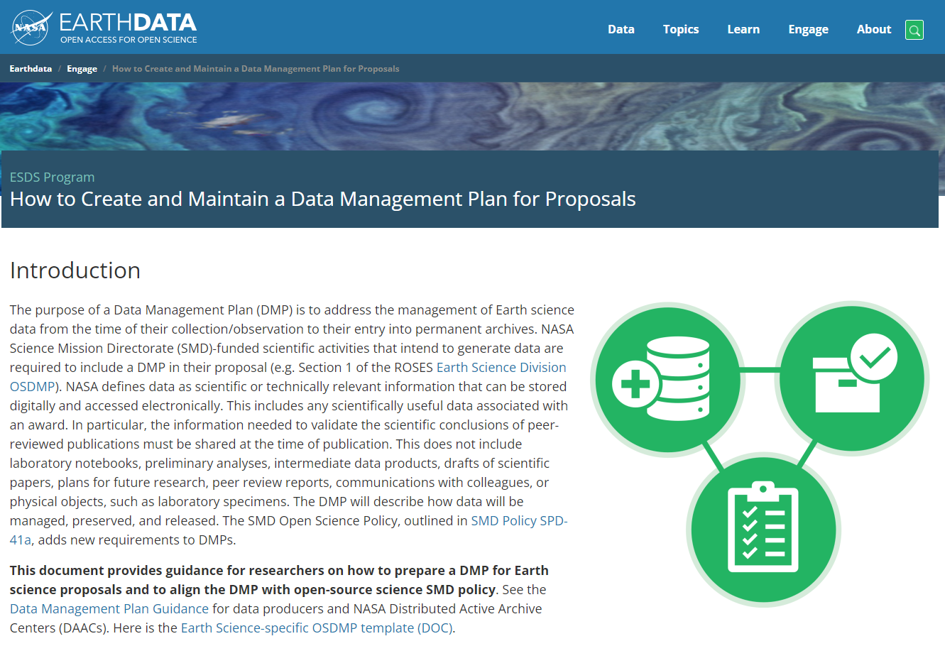
Policy compliance in ROSES 2023 and Beyond
Find additional information at http://earthdata.nasa.gov/engage/dmp-earth-science
The Open Science and Data Management Plan (OSDMP) is an enhancement of the past DMP.
OSDMP is required with proposals for new research in SMD starting with ROSES-23.
We have released an ESD-specific OSDMP for proposers.
And OSDMP template is development in coordination with the CSDO for future missions across SMD.

Slide 39
Find additional information at earthdata.nasa.gov

Slide 40
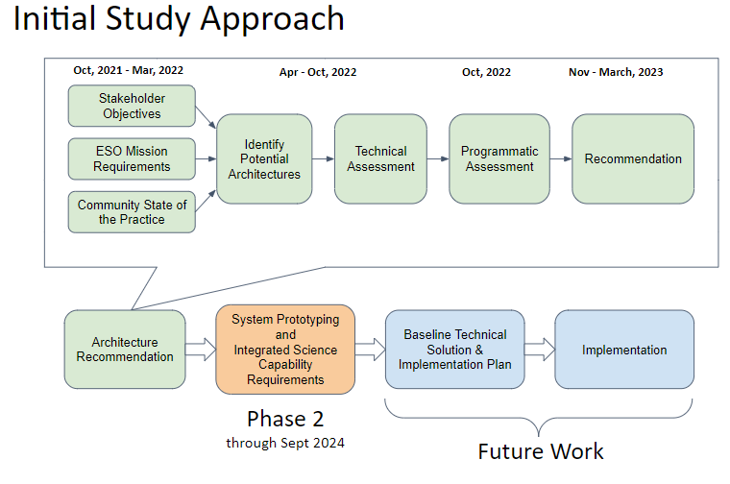
Find additional information at earthdata.nasa.gov

Slide 41
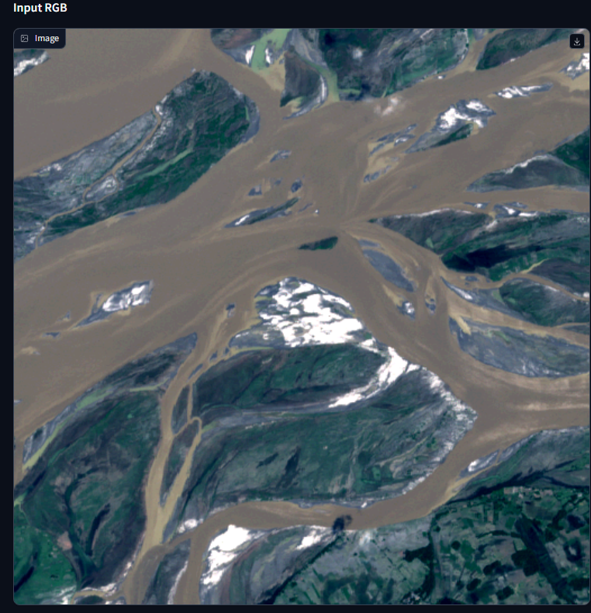
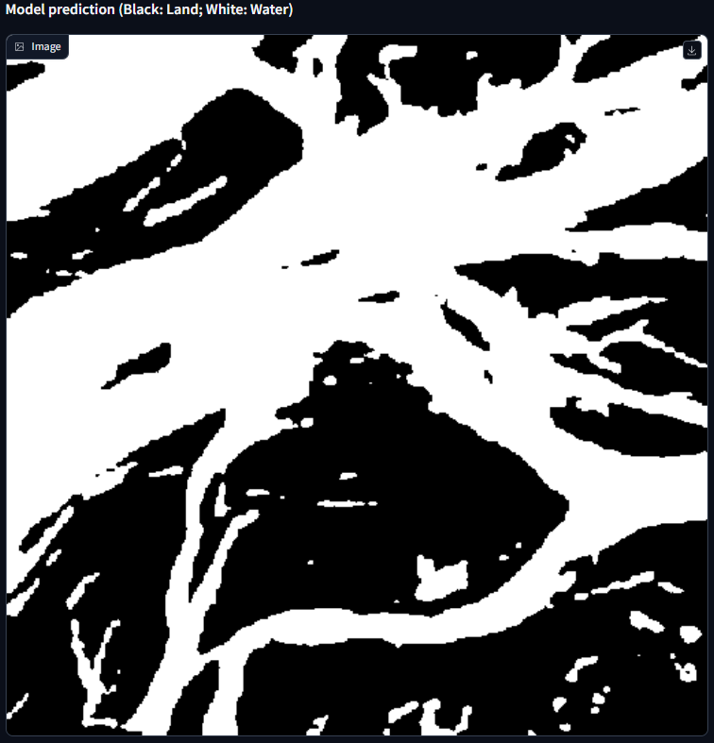
New Developments to Accelerate Open Science: Foundation Models
Find additional information at earthdata.nasa.gov
The pretrained Prithvi-100m model is finetuned to segment the extent of floods on Sentinel-2 images from the Sen1Floods11 dataset.
(Example over India)
Open Source Geospatial AI Foundation Model
Via a Space Act Agreement between NASA and IBM, IBM and NASA have developed and deployed an open-source geospatial AI foundation model on Hugging Face
Harmonized LandSat Sentinel-2 (HLS) Geospatial Foundation Model
Demo applications: crop detection, burn scars, flooding extent:
https://huggingface.co/ibm-nasa-geospatial

Slide 42
New Developments to Accelerate Open Science: Open Tools to Visualize Open Data such as VEDA
Find additional information at http://www.earthdata.nasa.gov/esds/veda

Slide 43
New Developments to Accelerate Open Science: Open Methods
Find additional information at http://www.earthdata.nasa.gov/esds/veda

Slide 44
Find additional information at earthdata.nasa.gov

Slide 45
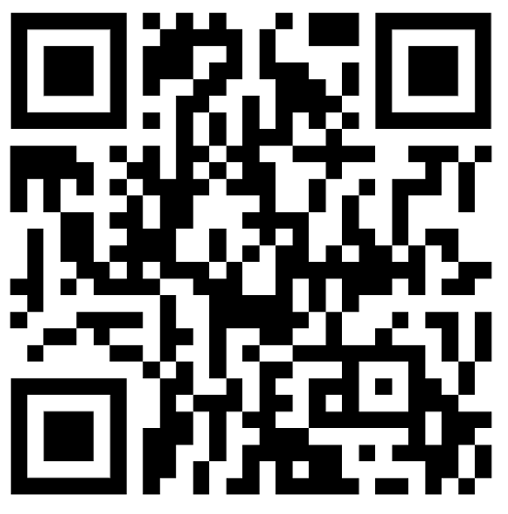
Thank You!
Learn more about the
Open-Source Science Initiative!
https://science.nasa.gov/open-science-overview

Slide 46
Backup

Slide 47
NASA’s
Open-Source Science Initiative
NASA’s approach for putting Open Science into practice.
https://science.nasa.gov/open-science-overview

Slide 48
Core Data and
Computing Services
Policy and Governance
Implement policies that advance open science, support SMD working groups and meetings, and develop standards and governance.
Develop SMD-wide data and computing infrastructure (Cloud and HEC), provide tools for discovery of NASA’s scientific information, reduce burden of SPD-41a, and support the adoption of advanced technologies (AI/ML).
NASA’s
Open-Source
Science Initiative
Open Science
Incentives
Community
Engagement
Grants, CANs, prizes and challenges to enable groundbreaking scientific discoveries using open science principles and tools.
Advance open science practices in the SMD community and build strategic partnerships for innovation in open science.

Slide 49
“
Unity is a strength…when there is teamwork and collaboration, wonderful things can be achieved.
”
Mattie Stepanek
OSSI Team:
Open-Source Science Initiative Council (OSSIC)
Membership includes representatives from each SMD Divisions
Science Management Council (SMaC)
OSSI briefs the SMaC quarterly
Community Feedback
RFIs, Studies, TIMs, Townhalls, Community Forums, Workshops, and other Listening Sessions

Slide 50
NASA’s Open-Source Science Initiative
SPD-41a is a forward-looking policy.
Updated policy requirements apply to all future SMD-funded scientific activities, including:
New grants, starting with ROSES-2023
New missions that have not yet reached Key Decision Point B by March 2023
Existing grants and missions are not required to adopt new guidance, but they are encouraged to do so if feasible with available resources.

Slide 51
NASA’s Open-Source Science Initiative
Policy Highlights: Publications
New in SPD-41a
All SMD-funded publications shall be made publicly accessible.
As-accepted, peer-reviewed manuscripts shall be deposited in a NASA-designated repository and made freely available with no embargo after the publication date.
SMD-funded publications describing Missions shall be made publicly accessible via a NASA-designated repository at the time of their publication.
Reasonable costs for open access publications are allowed budgetary expense and SMD encourages posting manuscripts as preprints.

Slide 52
NASA’s Open-Source Science Initiative
Policy Highlights: Data
New in SPD-41a
Scientific data underlying peer-reviewed manuscripts shall be made publicly available no later than the publication of the peer-reviewed article.
Scientifically useful data associated with a research award shall be made publicly available no later than the end of the award.
Scientific data should be findable, accessible, interoperable, and reusable (following FAIR principles), shall be made reusable with a clear, open, and accessible data license, and shall be citable with a persistent identifier.
Mission data shall be openly available with no period of exclusive access.
The period for data calibration and validation shall be as short as possible and shall not exceed six months.
All SMD-funded scientific activities shall include a data management plan.

Slide 53
NASA’s Open-Source Science Initiative
Policy Highlights: Software
New in SPD-41a
Research software:
shall be shared no later than the time of publication or the end of the funding award
should be assigned a permissive software license
shall be citable using a persistent identifier
Mission software shall be developed openly in a publicly accessible, version-controlled platform that allows for contributions and engagement from the community.
All SMD-funded scientific activities shall include a software management plan.

Slide 54
NASA’s Open-Source Science Initiative
Additional Policy Updates
New in SPD-41a
SMD-funded investigators shall have a persistent identifier (e.g., ORCID).
Publications produced for SMD-funded scientific events and presentations shall be made publicly accessible.
During SMD proposal reviews, peer reviewed data and software shall be recognized as having the commensurate value as peer reviewed manuscripts.
SMD shall provide a persistent identifier for all funding mechanisms and missions.
SMD should foster and encourage contributions and engagement with communities and organizations setting standards and best practices.

Slide 55
NASA’s Open-Source Science Initiative
Open Science and Data Management Plan (OSDMP)
New component for ROSES-2023 proposals, replaces requirement for Data Management Plan
Describes how proposed work will comply with SPD-41a, including the sharing of data, software, and publications
The costs for the activities described in the OSDMP should be included in the proposal budget. SMD will support reasonable costs associated with open science for future awards.

Slide 56
NASA’s Open-Source Science Initiative
SPD-41a Policies and Guidance by SMD Division
Astrophysics
Biological & Physical Sciences
Earth Science
Completed a Science Information Policy in February ‘23
Two fundamental principles:
Prioritize scientific efficacy and minimize compliance burden-
Early and continuous data usability
Completed a Science Data Management Policy in November ‘22
General guidelines:
Research data and software shall become available by investigation results publication
Full, open, and immediate sharing of BPS mission operation data
Long-standing Data and Information Policy is consistent with SPD-41a
New Data Management Guidance provides context on SPD-41a for earth science researchers
Updates to Open Source Software Policy
Heliophysics
Planetary Science
Released a Science Data Management Policy in February ‘23
Data Priorities:
Make high-quality data available as soon as practical
Encourage adherence to FAIR
Facilitate long-term data curation
Open HPD-funded software
Finalized an Information and Data Management Policy that aligns with SPD-41a and provides implementation guidance to the community
Planetary Data System

Slide 57
NASA’s Open-Source Science Initiative
NASA Funding
NASA Funding
F.2 Topical Workshops, Symposia, and Conferences
F.7 Support for Open Source Tools, Frameworks, and Libraries
F.8 Supplemental Open Source Science Awards
Events, Hackathons, un-conferences, and challenges that build open science skills, Training in open science.
Support and maintain open source tools, frameworks, and libraries that are significantly used by the SMD community. (ROSES-23 dates TBD)
Supplemental award to encourage the conversion of legacy software to open source. (Rolling deadline in ROSES-22; ROSES-23 dates TBD)
F.14 Transform to Open Science Training
F.15 High Priority Open-Source Science
F.16 Supplement for Software Platforms
Tutorials showcasing open science in action and NASA cloud data, summer schools, virtual cohorts. 16 programs selected in March 2023.
Supporting innovative open source tools, software, frameworks, data formats, and libraries. (Rolling deadlines in ROSES-22 & ROSES-23)
Supplemental support to existing awards for usage of scientific platforms. Budget TBD. (ROSES-23 dates TBD)

Slide 58
Core Data and Computing Services Program Engagement
NASA’s Open-Source Science Initiative
Community Engagement
RFI: “Scientific Data and Computing Architecture to Support Open Science” released January 5 2023, closed Feb 21 2023; 75 responses received (internal and external), final report in progress
Public Virtual Town Hall for RFI: Scientific Data and Computing Architecture (January 16, 2023)
17 Open Workshops (Fall 2022) that included talks from relevant internal and external organizations
2-day SMD User Needs Open Workshop (Oct 12-13 2022, hybrid at GSFC)
Division Engagement
4 Technical Interchange Meetings (TIMs) held with Division archives (BPS, HPD, APD, and PSD) to gather specialized Division needs
Bi-weekly Study Steering Committee meetings held with Division representatives (Fall 2022)
Regular briefings to OSSIC and SMaC on Study and Core Data and Computing Services development activities

Slide 59
TOPS Incentives
NASA’s Open-Source Science Initiative
It is important to recognize and incentivize the transition to Open Science
Prizes &
Challenges
Awards
Badges
Recognition
Create Open Science Awards
Recognize open science skills with digital badges
Science competition prizes and challenges that incorporate open science best practices
Open science activities recognized in evaluations

Slide 60
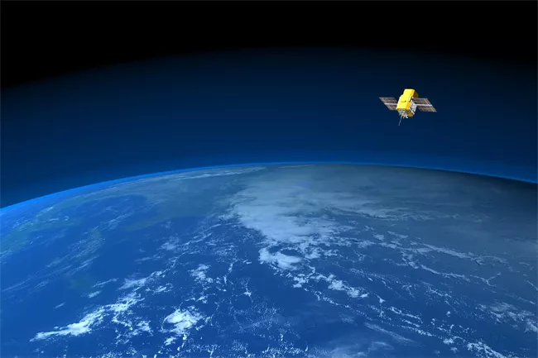
Can we rapidly iterate and resolve problems?
Global cooling in upper atmosphere reported
Analysis of satellite data showed cooling, therefore global warming is a farce
New version released
Closed code. Took 5 years & lots of funding to a different group to re-do analysis
1998
2022
1990
2003
Error in analysis discovered
Authors didn’t account for orbital decay and other effects - introduced an artificial cooling trend
New NASA Scientific Information Policy SPD-41a
Mission software must be open
https://digitalcommons.unl.edu/cgi/viewcontent.cgi?article=1318&context=usdeptcommercepub
Notes:
Can we rapidly iterate and resolve problems this is an older paper from 1990 that was highly cited said there's no atmospheric warming therefore we don't understand climate policy enough to change any policy the data was open but it was very difficult to access the software was closed in 1998 other scientists found that the original authors didn't account for the orbital Decay and other effects and this introduced an artificial cooling trained in the upper atmosphere it took until 2003 for them to reproduce the code and do a new analysis to fix the problems so five years later and a lot of money without 13 years from the original paper to show that there was an error to fix it open science as more people looking at the code and that improves the quality it makes it easier to revise Bill test hypotheses it shouldn't take 13 years to resolve an issue like this if you want to read either of these papers you can't because they're both behind paywalls. this isn't how we want science stuff. This isn't the speed that we need science to iterate and resolve problems. We need to do better.

Slide 61
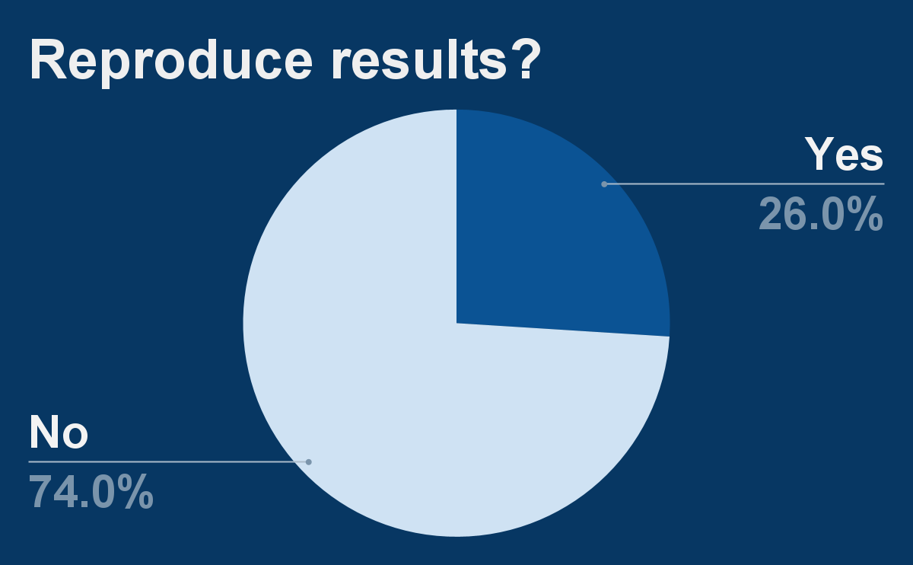
Can we build on and extend results?
NASA Transform to Open Science
Since 2011 AAAS Science Journal policy requires sharing data & software upon request
In 2018, tested 204 scientific papers for reproducibility
https://www.pnas.org/doi/full/10.1073/pnas.1708290115
Notes:
Can we build on and extend scientific results?
In 2011, the journal Science introduced a policy where data and software needed to be shared upon request.
Paper from 2018 by Stodden et al. where they tested 204 scientific papers that were published in Science after their updated policy on sharing data and code on request.
The paper also found that only 26% of the 204 papers were reproducible. The main reasons papers were not reproducible were due to not making data or code available and not sufficiently describing the methodology.
This is a fundamental flaw in how we're doing science if we can't reproduce and build upon previous results.

Slide 62
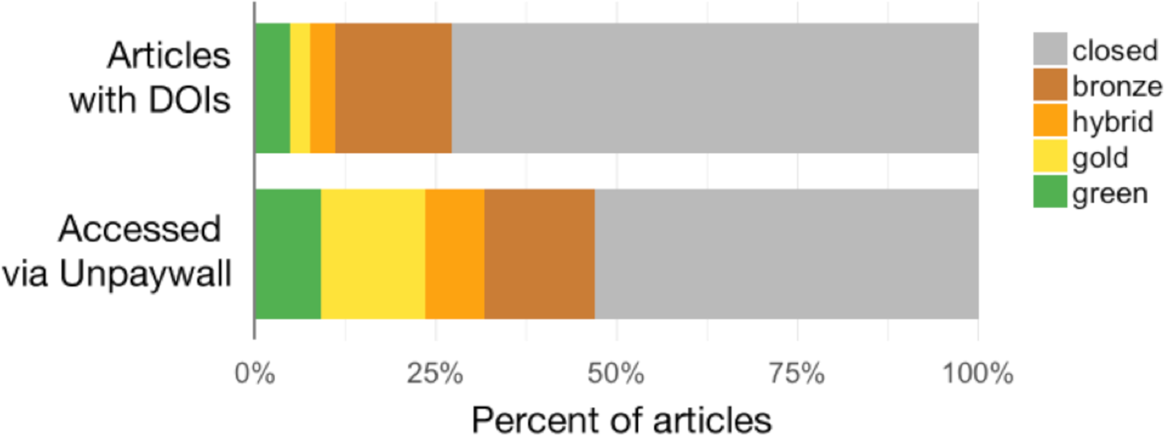
Open Access Articles, Articles with Open Data, Articles Accessed Online…All Lead to Higher Citations!
+18% more citations
25% higher citation impact
https://www.ncbi.nlm.nih.gov/pmc/articles/PMC5815332/
https://journals.plos.org/plosone/article?id=10.1371/journal.pone.0230416
Figure DOI: 10.7717/peerj.4375/fig-1
Notes:
You can get more citations! And we all know that publications and citations are our current currency in science.
One paper here finds that publishing open access increases citation count by 18%, and follows other literature with similar findings.
Another paper here shows that the citation impact is 25% higher in articles that make their data openly accessible via a link to a repository.
We discussed earlier the prohibitive costs that currently exist to publishing open-access, but remember that there are often other options (e.g. preprints) to share as much as you can.
Description of figure right: This figure is from the first “state of OA” paper that looked at three populations of each 100k articles.

Slide 63
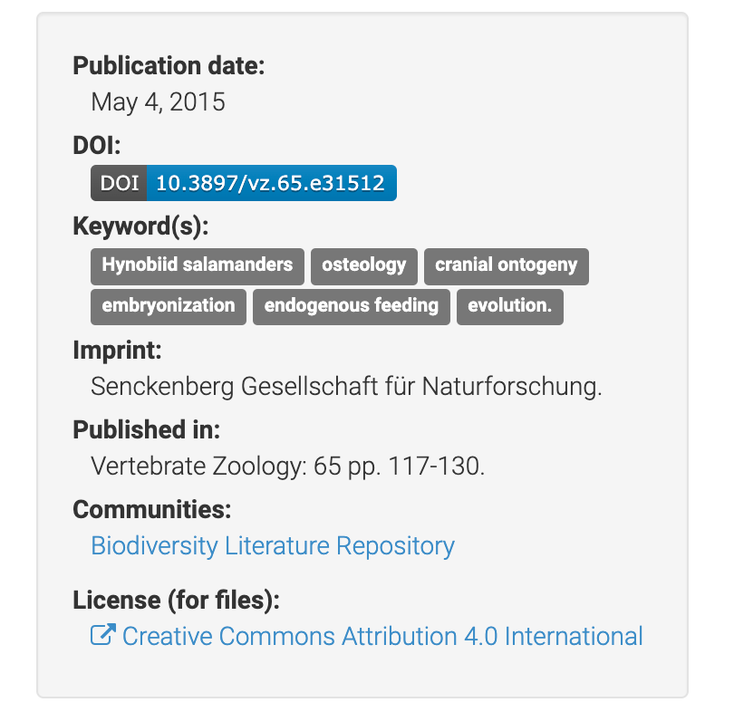
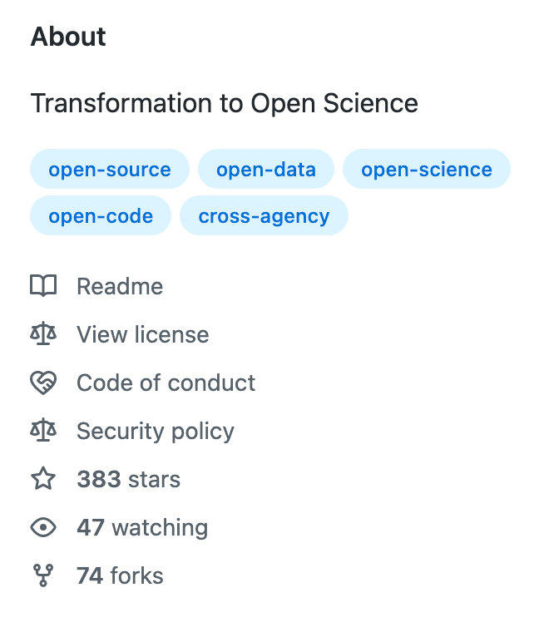
Get credit for more of the work that you do
Citable objects
Code
Data
Research talk slides
Lectures
And more!
All of these are tangible, scientific outputs! If shared, they can be used and cited!
Notes:
But you can get cited for more than just research papers! Open science is all about getting recognition for all of the diverse type of science work that you do.
A lot of our time as researchers is spent writing code, collecting data, putting together lectures and not *just* publications. By sharing materials publicly, they can be used by others and can also get cited!
For example, data repositories like Zenodo assign a digital identifier, or DOI (we will discuss this later in the course), which allows materials to be more easily cited.

Slide 64
Case Study: Public Drives New Research Methods
JunoCam: Just a Camera
A camera purposely manifested onboard Juno for citizen science. The Citizen Scientists started using the camera to map Jupiter, and now the camera is a core part of the science mission!
“Juno’s citizen scientists are part of a global united effort, which leads to both fresh perspectives and new insights” – Candy Hansen
Image: NASA/JPL-Caltech/SwRI/MSSS/Kevin M. Gill
https://www.nasa.gov/feature/jpl/citizen-scientists-enhance-new-europa-images-from-nasa-s-juno
Notes:
One of the groups that is emerging as a key player in the scientific research space, is citizen scientists!
Here we show a wonderful example of how citizen scientists used open data to dive into scientific research themselves, and how that positively impacted the scientific mission itself!
JunoCam is a camera/telescope on board the Juno spacecraft that is orbiting Jupiter. It was added to the Juno specifically designed for citizen scientists!
JunoCam lead Candy Hansen says “Juno’s citizen scientists are part of a global united effort, which leads to both fresh perspectives and new insights.” By making our science more accessible, we can expand the scope of who can do science, and enable more science to be done along the way.

