Slide 1
ESSP Program Forum
Scott Schwinger
Associate Director for Flight Programs (Acting)
August 22, 2023
Notes:
STILL

Slide 2
Earth System Science Pathfinder Program Overview
Mission: Understand and explore our home planet, improve lives, and safeguard our future.
ESSP
Earth Venture
Importance to ESD
Established in 1996 to stimulate new scientific understanding of the global Earth system to meet the challenges of climate change and other environmental events.
In 2009, NASA introduced the ESSP Earth Venture Class to create low-cost missions focused on developing innovative research and higher risk technologies to ultimately help communities respond to the changing environment.
Through development of orbital and suborbital remote-sensing instruments, ESSP projects produce data to address key Earth science research questions concerning the atmosphere, oceans, land surface, polar ice regions, and solid earth.
Notes:
The Earth System Science Pathfinder Program is an integral component of our ESD Flight portfolio.
It was founded in the late 1990's to fill a gap and address emerging areas of science that weren’t being addressed within our existing portfolio.
ESSP now serves the important purpose of stimulating new scientific understanding of the global Earth system, and helps us address some of the most pressing challenges associated with a changing climate including forest fires, heat waves, floods, storms, and other extreme weather events.
Each ESSP mission support’s the program’s overarching goals through the development and operation of remote-sensing instruments or suborbital missions that produce data that can utilized to address key Earth Science research questions.
In 2009, ESSP evolved as a result of a 2007 decadal survey recommendation to introduce lower cost, higher risk missions. The resulting ESSP Earth Venture Class includes missions focused on developing innovative research using higher risk technologies and producing key applications from their measurements.
In 2017 the program evolved again, this time from a 2017 Decadal Survey recommendation to include an Earth Venture Continuity component to provide opportunities for low-cost sustained observations.
Not only is ESSP of critical importance to the Division and the Directorate at large, but is urgently important for our communities. The program plays a vital role by funding relatively inexpensive science instruments and missions that seek to produce accurate and timely information to help our communities respond to a changing environment.

Slide 3
ESD Flight Programs
Associate Director Ɩ Katie Boggs
Deputy Associate Director Ɩ Scott Schwinger
Program Specialist (C) Ɩ Pat Thomas
Program Integration PE Ɩ Eric McVay
Program Integration Support (C) Ɩ Lacey McCarthy
Program Support (C) Ɩ Sophie Gossack
Flight Leadership Support (C) | Hannah Stewart
ESD Flight Programs
Acting Associate Director Ɩ Scott Schwinger
Program Specialist (C) Ɩ Pat Thomas
Program Integration PE Ɩ Eric McVay
Program Integration Support (C) Ɩ Lacey McCarthy
Program Support (C) Ɩ Sophie Gossack
Flight Leadership Support (C) | Hannah Stewart
Earth Systematic Missions Program (ESM)
Goddard Space Flight Center (GSFC) & Jet Propulsion Laboratory (JPL)
Earth System Science Pathfinder Program (ESSP)
Langley Research Center (LaRC)
Earth System Science Pathfinder Program (ESSP)
Langley Research Center (LaRC)
Airborne Science Program
Program Director Ɩ Bruce Tagg
SDC ESO
PE Ɩ Ben Kim
PS Ɩ Gerald Bawden
PAL Ɩ Emily Sylak-Glassman
Landsat Next
PE Ɩ Mike Egan
PS Ɩ Garik Gutman
PAL Ɩ Brad Doorn
NISAR ESO
PE Ɩ Mitra Dutta
PS Ɩ Gerald Bawden
PAL Ɩ David Green
PolSIR EVI-6
PE Ɩ Eric McVay
PS Ɩ TBD
PAL Ɩ
MAIA EVI-3
PE Ɩ Erica Alston
PS Ɩ Hal Maring
PAL Ɩ John Haynes
Airborne Mission Campaigns
Deputy Ɩ Melissa Martin
OMG EVS-2 📝
ACTIVATE EVS-3
DCOTSS EVS-3
DELTA-X EVS-3
IMPACTS EVS-3
S-MODE EVS-3
PolSIR EVI-6
PE Ɩ Eric McVay
PS Ɩ TBD
PAL Ɩ
MAIA EVI-3
PE Ɩ Erica Alston
PS Ɩ Hal Maring
PAL Ɩ John Haynes
Airborne Mission Campaigns
Deputy Ɩ Melissa Martin
OMG EVS-2 📝
ACTIVATE EVS-3
DCOTSS EVS-3
DELTA-X EVS-3
IMPACTS EVS-3
S-MODE EVS-3
Airborne Research Campaigns*
Deputy Ɩ Derek Rutovic
* Airborne Research Campaigns are managed through R&A
G
J
MC ESO
PE Ɩ Nicole Herrmann
PS Ɩ Lucia Tsaoussi
PAL Ɩ Brad Doorn
TSIS-2
PE Ɩ Erica Alston
PS Ɩ David Considine
PAL Ɩ
CLARREO─PF
PE Ɩ Nicole Herrmann
PS Ɩ Ken Jucks
PAL Ɩ
INCUS EVM-3
PE Ɩ Ben Kim
PS Ɩ Hal Maring
PAL Ɩ Shanna McClain
TEMPO EVI-1
PE Ɩ Marjorie Haskell
PS Ɩ Barry Lefer
PAL Ɩ John Haynes
INCUS EVM-3
PE Ɩ Ben Kim
PS Ɩ Hal Maring
PAL Ɩ Shanna McClain
TEMPO EVI-1
PE Ɩ Marjorie Haskell
PS Ɩ Barry Lefer
PAL Ɩ John Haynes
J
G
G
SBG ESO
PE Ɩ Mike Egan
PS Ɩ Woody Turner
PAL Ɩ Woody Turner
Sentinel-6B
PE Ɩ Jamie Wicks
PS Ɩ Nadya Vinogradova
PAL Ɩ
SWOT
PE Ɩ Tahani Amer
PS Ɩ Nadya Vinogradova
PAL Ɩ Brad Doorn
GLIMR EVI-5
PE Ɩ Marjorie Haskell
PS Ɩ Laura Lorenzoni
PAL Ɩ
PREFIRE EVI-4
PE Ɩ Amanda Whitehurst
PS Ɩ Hal Maring
PAL Ɩ
GLIMR EVI-5
PE Ɩ Marjorie Haskell
PS Ɩ Laura Lorenzoni
PAL Ɩ
PREFIRE EVI-4
PE Ɩ Amanda Whitehurst
PS Ɩ Hal Maring
PAL Ɩ
Reference
J
J
J
Pre-Formulation
Implementation
AOS ESO
PE Ɩ Carla Procaccino
PS Ɩ Hal Maring
PAL Ɩ John Haynes
PACE
PE Ɩ Marjorie Haskell
PS Ɩ Laura Lorenzoni
PAL Ɩ Woody Turner
CRISTAL
PE Ɩ Mitra Dutta
PS Ɩ Thorsten Markus
PAL Ɩ
Libera EVC-1
PE Ɩ Amanda Whitehurst
PS Ɩ David Considine
PAL Ɩ
TROPICS EVI-3
PE Ɩ Ben Kim
PS Ɩ Will McCarty
PAL Ɩ David Green
Libera EVC-1
PE Ɩ Amanda Whitehurst
PS Ɩ David Considine
PAL Ɩ
TROPICS EVI-3
PE Ɩ Ben Kim
PS Ɩ Will McCarty
PAL Ɩ David Green
Formulation
Operating
PE Program Executive
PS Program Scientist
PAL Project Applications Lead
D Detailee
C Contractor
G GSFC
J JPL
Program Executives
G
G
J
Erica Alston (D)
Tahani Amer
Mitra Dutta
Mike Egan
Marjorie Haskell
Nicole Herrmann
Marissa Herron
Ben Kim
Eric McVay
Carla Procaccino
Bruce Tagg
Amanda Whitehurst
Jamie Wicks
GeoCarb* EVM-2
PE Ɩ Tahani Amer
PS Ɩ Ken Jucks
PAL Ɩ Keith Gaddis
Operating Missions
PE Ɩ Jamie Wicks Support (C) Ɩ Warren Case
GeoCarb* EVM-2
PE Ɩ Tahani Amer
PS Ɩ Ken Jucks
PAL Ɩ Keith Gaddis
Aqua
Aura
GRACE-FO ⁵
ICESat-2
GPM
Sentinel-6 MF ⁶
SMAP
Terra
Landsat 7 ¹
Landsat 8 ¹
Landsat 9 ¹
Suomi NPP ^{2, 🔰}
DSCOVR ^{2,3, 🔰}
OSTM/Jason-2 ^{2, 📝} SORCE 📝
QuickSCAT 📝
ISS Instruments
LIS
SAGE-III
TSIS-1
* Terminated; close out in process
Operating Missions
Operating Missions
PE Ɩ Jamie Wicks Support (C) Ɩ Warren Case
🔰 NASA operates some instruments 📝 Data Analysis Phase F
Operating Missions
PE Ɩ Jamie Wicks Support (C) Ɩ Warren Case
NASA Developed Missions Operated by Other U.S. and International Agencies
CloudSat ³
CYGNSS EVM-1
OCO-2
CALIPSO ^{4, 🔰}
ISS Instruments
ECOSTRESS EVI-2
EMIT EVI-4
GEDI EVI-2
OCO-3
USGS
NOAA
USSF
CNES
GFZ
Eumetsat
CloudSat ³
CYGNSS EVM-1
OCO-2
CALIPSO ^{4, 🔰}
ISS Instruments
ECOSTRESS EVI-2
EMIT EVI-4
GEDI EVI-2
OCO-3
Updated: 5/24/2023
Notes:
This chart demonstrates the size and scale of ESSP within the larger ESD Flight Portfolio.
ESSP comprises a sizeable portion of our overall portfolio, supporting 22 active project including 8 in formulation/implementation, 8 operating missions, and a number of Airborne Missions.
These projects are competitively selected and PI-led to address NASA’s high priority Earth System Science outcomes.

Slide 4
ESD Flight HQ
Earth Systematic Missions (ESM) Program
NASA Directed
Earth System Explorers (ESE) Program
Competed
Earth System Science Pathfinder (ESSP) Program
Competed
GSFC
(ESMPO-G)
JPL
(ESMPO-J)
GSFC
LaRC
Landsat Next
AOS
TSIS-2
PACE
CPF
MC
SBG
Sentinel-6B
NISAR
SWOT
TBD
INCUS
GLIMR
Libera
GeoCarb
MAIA
PREFIRE
TROPICS
Higher Cost
CATEGORY
Lower Cost
Lower Risk
CLASS
Higher Risk
Notes:
This chart visualizes our ESSP missions on the spectrum of cost and risk. ESSP missions are lower cost and higher risk, encouraging us to embrace innovation and development of new technologies that allow us to explore new scientific avenues and gather valuable Earth data.

Slide 5
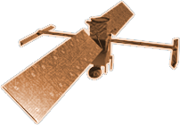
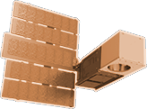
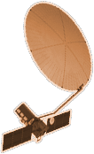
2020
SENTINEL-6
MICHAEL FREILICH
ICESAT-2
GRACE-FO (2)
CYGNSS (8)
LANDSAT-9
2015
LIS
NISTAR, EPIC
SWOT
SAGE III
SMAP
EARTH FLEET
TSIS-1
TEMPO
ECOSTRESS
OCO-2
INVEST/CUBESATS
TROPICS (4)
GEDI
GPM
NACHOS 2022
CTIM 2022
NACHOS-2 2022
MURI-FD 2023
SNOOPI* 2024
HYTI* 2024
ARGOS* 2024
OCO-3
LANDSAT 7
LANDSAT 8
PACE
TERRA
EMIT
AQUA
SUOMI NPP
PREFIRE (2)
AURA
2000
CLOUDSAT
CALIPSO
JPSS INSTRUMENTS
CLARREO-PF
NISAR
2010
OMPS-LIMB 2022
LIBERA 2027
OMPS-LIMB 2027
OMPS-LIMB 2032
TSIS-2
2005
MAIA
ISS INSTRUMENTS
2025
SENTINEL-6B
KEY
GLIMR*
INCUS*
MISSIONS
INTERNATIONAL PARTNERS
U.S. PARTNER
ISS INSTRUMENT
JPSS INSTRUMENT
CUBESAT
LAUNCH DATE TBD
CRISTAL*
POLSIR*
ESO: MASS CHANGE*
(PRE) FORMULATION
IMPLEMENTATION
OPERATING
EXTENDED
ESO: STORM*
ESO: SBG*
ESO: SKY*
LANDSAT NEXT*
07.06.23
2030

Slide 6
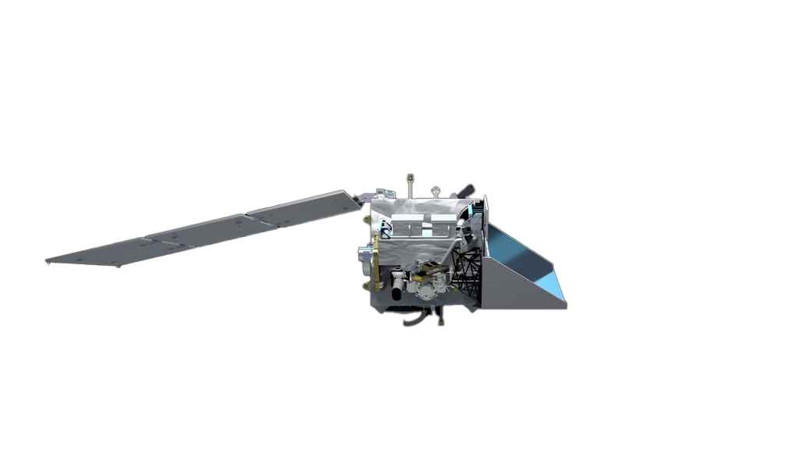
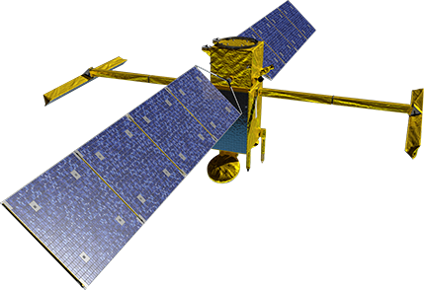
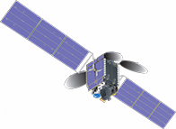
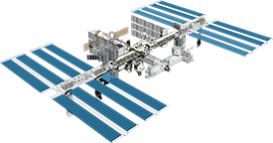
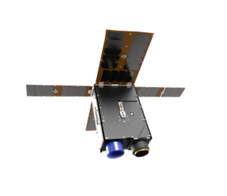
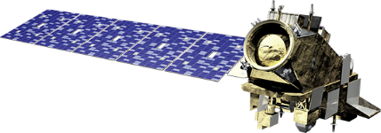
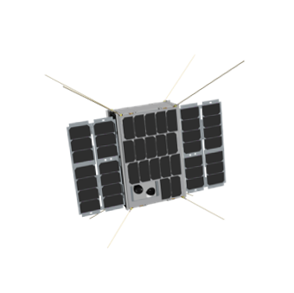
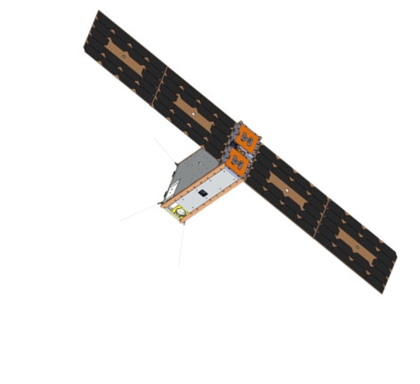
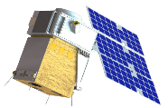
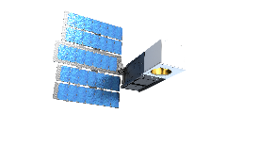
Recent and Upcoming Earth Science Launches
EMIT (ISS)
SWOT
PACE****
TEMPO*
OMPS-Limb (JPSS-2/NOAA)
HyTI*****
2022
2023
2024
July
November
December
January
April
May
February
May
June
TROPICS 2, 3**
CTIM-FD
MURI
SNOOPI***
*Agency LRD March 2023
**Agency LRD November 2023
***Launch Date NET February 2024
****Agency LRD May 2024
*****Launch Date NET June 2024
05.18.23

Slide 7
Earth Science Flight Opportunities (FY24)​
Open solicitation/In review | Completed solicitation
Mission | Mission Type | Release | Selection | Major Milestone
EVS-1 (EV-1) (AirMoss, ATTREX, CARVE, DISCOVER-AQ, HS3) | 5 Suborbital Airborne Campaigns | 2009 | 2010 | Completed KDP-F
EVM-1 (CYGNSS) | Class D SmallSat Constellation | 2011 | 2012 | Launched Dec. 2016
EVI-1 (TEMPO) | Class C Geostationary Hosted Instrument | 2012 | 2012 | Launched Apr. 2023
EVI-2 (ECOSTRESS & GEDI) | Class C & Class D ISS-hosted Instruments | 2013 | 2014 | Launched June & Dec. 2018
EVS-2 (ACT-America, ATOM, NAAMES, ORACLES, OMG, CORAL) | 6 Suborbital Airborne Campaigns | 2013 | 2014 | Completed KDP-F
EVI-3 (MAIA & TROPICS) | Class C LEO Hosted Instrument & Class D CubeSat Constellation | 2015 | 2016 | MAIA Delivery 2022; TROPICS Launch TBD
EVM-2 (GeoCarb) | Class D Geostationary Hosted Instrument | 2015 | 2016 | Launch TBD
EVI-4 (EMIT & PREFIRE) | Class C ISS-hosted Instrument & Class D Twin CubeSats | 2016 | 2018 | EMIT launched to ISS July 2022; PREFIRE delivery NLT 2023
EVS-3 (ACTIVATE, DCOTSS, IMPACTS, Delta-X, SMODE) | 5 Suborbital Airborne Campaigns | 2017 | 2018 | S-MODE in final deployment. 4 in post-deployment phase.
EVI-5 (GLIMR) | Class C Geostationary Hosted Instrument | 2018 | 2019 | Delivery NLT 2024
EVC-1 (Libera) | Class C JPSS-Hosted Radiation Budget Instrument | 2018 | 2020 | Delivery NLT 2025
EVM-3 (INCUS) | Full Orbital | 2020 | 2021 | Launch ~2026
EVI-6 | Instruments and SmallSats | 2022 | 2023 | Delivery NLT 2027
ESE | Explorer Mission | 2023 | 2025 | Launch ~2031 & ~2033
EVS-4 | Suborbital Airborne Campaigns | 2023 | 2024 | N/A
EVC-2 | Continuity Measurements | 2024 | 2025 | Delivery NLT 2029
EVI-7 | Instrument Only | 2025 | 2026 | Delivery NLT 2030
EVM-4 | Full Orbital | 2025 | 2026 | Launch ~2031
ESE | Explorer Mission | 2025 | 2027 | Launch ~2034 & 2036
EVC-3 | Continuity Measurements | 2027 | 2028 | Delivery NLT 2032
EVS-5 | Suborbital Airborne Campaigns | 2027 | 2028 | N/A
EVS
Sustained sub-orbital investigations
(~4 years)
EVM
Complete, self-contained, small missions
(~4 years)
EVI
Full function, facility-class instruments Missions of Opportunity (MoO)
(~3 years)
EVC
Complete missions or hosted instruments targeting “continuity” measurements
(~3 years)
ESE (NEW)
Medium-size instruments and missions
(~2 years)
04.19.23

Slide 8
Open-Source Science Initiative & Data Policy
NASA is making a long-term commitment to building an inclusive open science community over the next decade. Open-source science is a commitment to the open sharing of software, data, and knowledge as early as possible in the scientific process.
OPEN (TRANSPARENT) SCIENCE
Scientific process and results should be visible, accessible, and understandable
OPEN (ACCESSIBLE) SCIENCE
Data, tools, software, documentation, and publications should be accessible to all (FAIR)
OPEN (INCLUSIVE) SCIENCE
Process and participants should welcome participation by and collaboration with diverse people and organizations
OPEN (REPRODUCIBLE) SCIENCE
Scientific process and results should be open such that they are reproducible by members of the community
Notes:
Four Pillars:
Data (archive)
Software (new)
Meetings (public)
Publications

Slide 9
NASA PPBE PROCESS OVERVIEW
Planning
Programming
Budgeting
Execution
Strategic Plan
(every 4 years)
Strategic Planning Guidance (SPG)
OMB Submit
Operating Plan & Reprogramming
Agency Strategic Implementation Planning (A-SIP)
Program Resources Guidance (PRG)
Passback
Funds Distribution & Control
Performance Planning & Strategic Reviews
Program Analysis & Alignment (PAA)
President’s Budget Request
Performance Assessments & Reporting
Annual Performance Plan
Programmatic & Institutional Guidance (PalG)
Appropriation
Agency Financial Report (AFR)
Notes:
Blue represents roughly where we are in the PPBE process. (We’re finalizing PAIG this week, which should be done by Thursday. The next step is to submit to OMB)

Slide 10
Program Forum Preview
Earth Venture
Applications
Open Science Initiative
Communications
ESSP PROGRAM FORUM 2023
Science Lightning Talks
Class D
Leveraging Lessons Learned
777 Tour

