Slide 1
Earth Venture
Communications
Ellen Gray
ESSP Communications Liaison
Earth Science Division
NASA Science Mission Directorate
Notes:
STILL

Slide 2
If you remember one slide
about EV Comms activities
Messages about your Earth Venture
Core visual assets
Activities targeting media and broad audiences

Slide 3
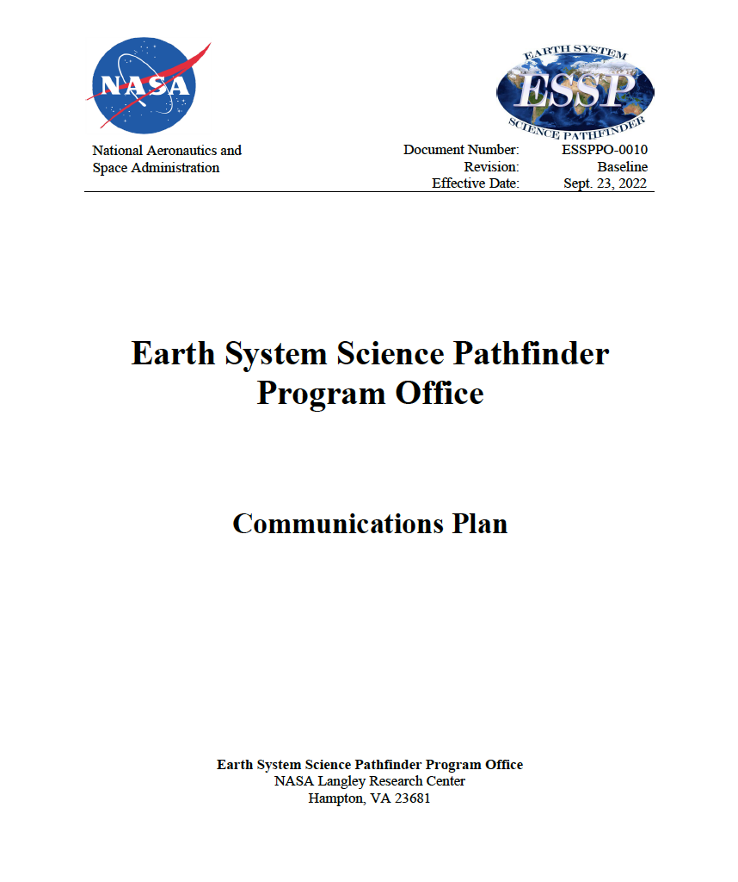
Jennifer Olson
Communications Lead
Earth System Science Pathfinder Program Office
Ellen Gray
ESSP Liaison and
Public Engagement Lead
Earth Science Division

Slide 4
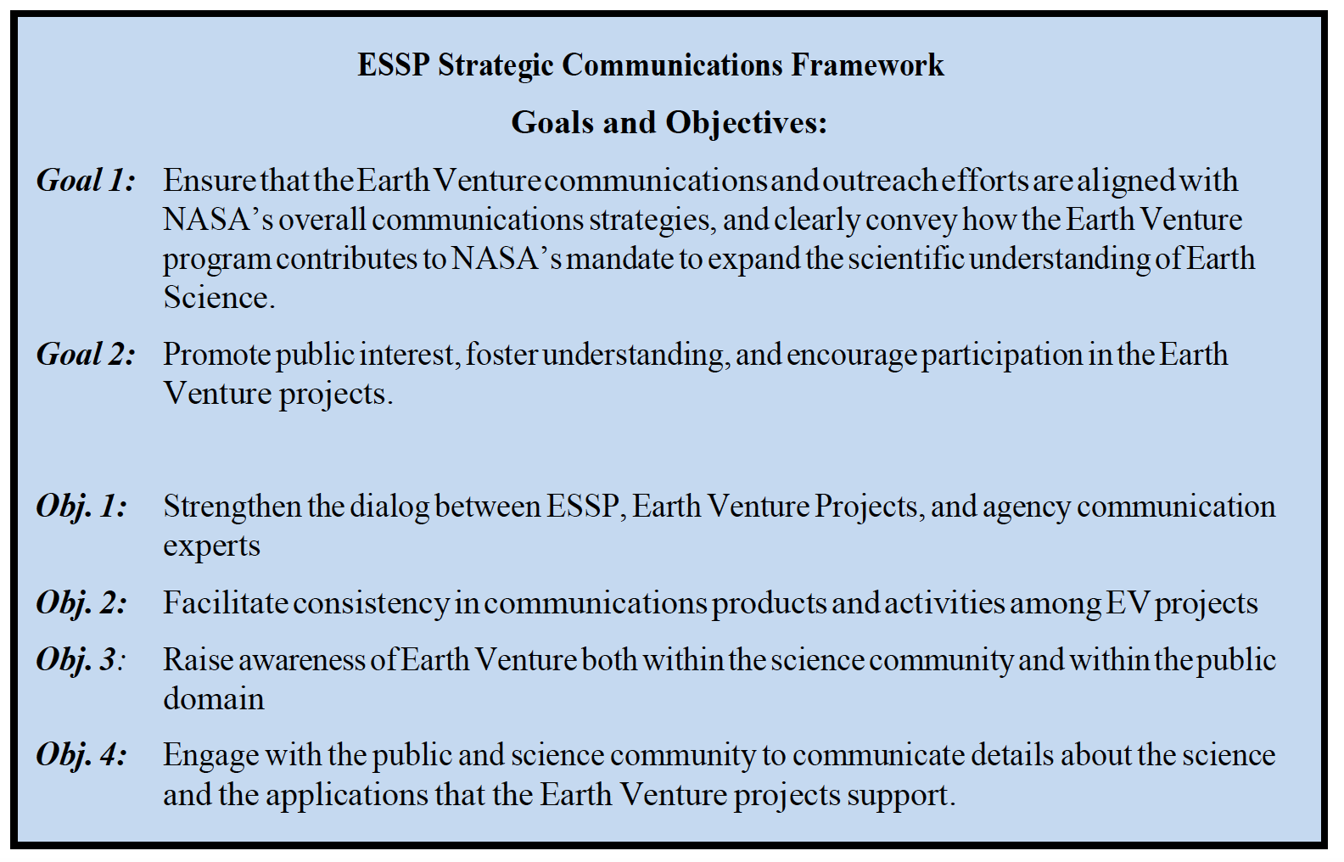

Slide 5
Agenda
01
Intro to NASA Comms
02
Intro to ESD Comms
03
Comms for Your Mission
Notes:
Science is the key to unlocking the secrets of the universe—unifying humanity with each discovery, expanding our knowledge and igniting our imagination. As we sail the sands of time and space, science gives context and meaning to measures great and small. Did you know there are as many stars in the universe as grains of sand on Earth? The new era of NASA Science discoveries is just beginning, and you are a part of it!
In 2022, we all watched in awe as the first images from the Webb Space Telescope were revealed. These stunning observations gave us a new view into the past and the deep universe and are only a glimpse of the discoveries to come. Artemis is preparing humanity to return to the Moon and explore beyond. On Mars, we have continued searching for signs of ancient life, both microscopic and macroscopic, as the Perseverance rover collects sands and rock samples to return to Earth in 2033. While here on Earth, we are developing new missions to provide novel insights into our system of systems that is our home planet. We are also preparing for the new Earth System Observatory missions which will improve our understanding of climate change and natural hazard mitigation, enabling tangible progress at local and national levels.
Our robotic investigators are not alone in unlocking new frontiers: NASA missions continued fueling new industries and technologies and the demand for a highly skilled and diverse workforce, one that brings to the table new ideas and approaches. And looking forward, our commitment to making discoveries more accessible to all includes starting a new Open-Source Science Initiative to share data worldwide.
The NASA Science team is excited to continue our voyage together with you through time and space, discovering the universe one grain of sand at a time. Come explore with us.

Slide 6
Intro to NASA Communications
Notes:
STILL

Slide 7
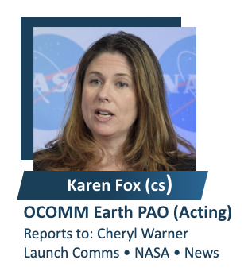
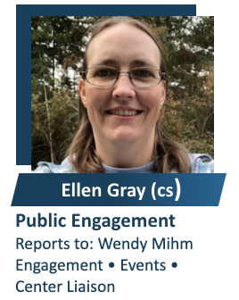
It can be confusing… but we all know each other
NASA Communications Strategy
Directorates
NASA Office of Communications
Sets agency policies
Supports EVS, EVI, EVM media events and launches
Runs @NASA social media accounts
Science
Earth
Earth Science Division Comms
Determines Division Messaging
Supports EVS, EVI, EVM media events and launches
Runs @NASAEarth social media accounts
Assigned Comms Team for Each EV Mission
JPL
Armstrong
Ames
Langley
Goddard

Slide 8
Why work within the NASA comms ecosystem?
Infrastructure
Experienced Staff
Existing Audiences

Slide 9
Goal 1
Ensure that the Earth Venture communications and outreach efforts are
aligned with NASA’s overall communications strategies, and
clearly convey how the Earth Venture program contributes to NASA’s mandate to expand the scientific understanding of Earth.

Slide 10
NASA’s Overall Comms Strategy
The mission is the message
NASA mission statement: NASA explores the unknown in air and space, innovates for the benefit of humanity, and inspires the world through discovery.
Inspire Value
Goal 1: Inspire humanity to realize the value of NASA.
Goal 2: Inspire contributors to add value to NASA.
Goal 3: Inspire deciders to understand and enable value to be created by NASA.

Slide 11
What this looks like in practice
IMPACTS is studying snowstorms to improve our understanding of how snow is distributed and our ability to model it.
IMPACTS will be the first field campaign to study East Coast snowstorms in 30 years and will do so with both ground-based and airborne instruments. This will be the most comprehensive study of North East snowstorms to date.
Snow clouds look broad but actually have narrow bands of intense snowfall called “snowbands.” IMPACTS is studying how these snowbands form and evolve through the life of the storm.
Currently, these snowbands are hard to predict with models.
Understanding the snow processes within clouds will help scientists understand how snow is distributed and ultimately where snow will fall heaviest on the ground
Snow is hard to measure from space.
When possible, IMPACTS will coordinate with the GPM satellite to collect data from space, the air, and ground simultaneously to improve satellite observations of snowfall.
Goal 1 – understand Earth
Exploring the unknown
Inspires Value – Why the average citizen should care
Part of bigger NASA picture to achieve larger benefit to humanity

Slide 12
Intro to ESD Communications
Notes:
STILL

Slide 13
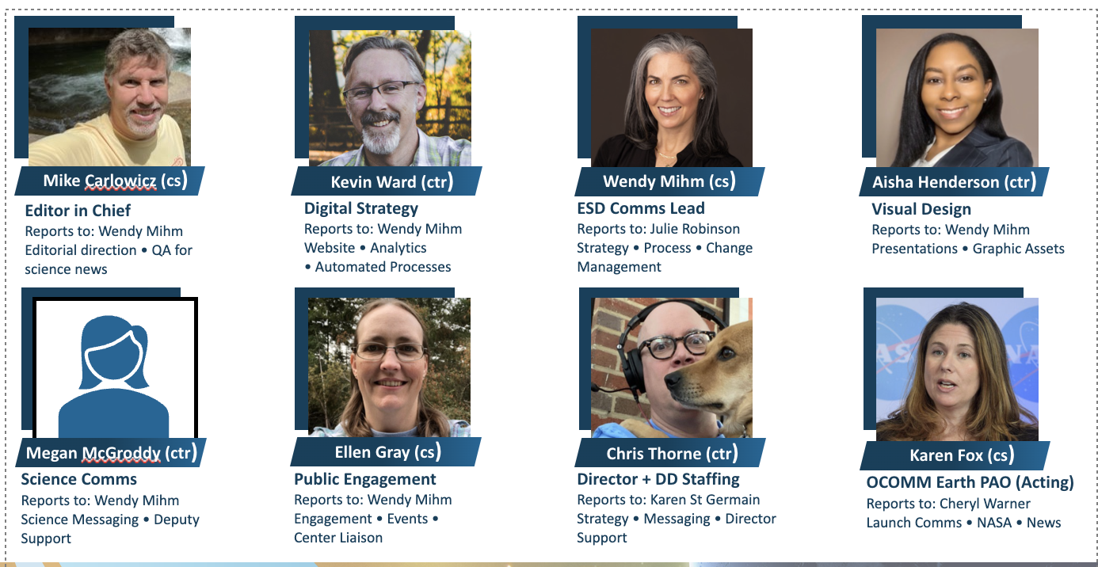
Earth Science Division Communications
HQ Earth Science Communications Team Members

Slide 14
Earth Science Division Communications
Earth Science Communications Team Leads at Centers
JPL
Armstrong
Ames
Langley
Goddard
Jane Lee
Andrew Wang
Anya Bifurno
Elena Aguirre
Rachel Hoover
Charlie Hatfield
Jenny Marder
Katie Jepson
Jake Richmond
Leverage existing resources from ESD and relevant Center Public Affairs offices – don’t reinvent the wheel

Slide 15
ESD Message Priorities
Earth System Observatory
– Missions acting as one observatory to study Earth as a system of systems from bedrock to the top of the atmosphere
Earth Science to Action
– Leverage NASA’s end-to-end capability as a space and science agency to quicken the pace of scientific discovery, broaden the impact of Earth science to benefit humanity, and better enable decisionmakers
Open Science
– NASA is committed transparency and reducing barriers to entry (particularly for excluded and marginalized communities) because doing so enables more diverse voices to accelerate scientific discovery and apply it to real-world programs that meet pressing human needs across the globe

Slide 16
Goal 2
For the Earth Venture projects:
Promote public interest,
Foster understanding, and
Encourage participation
Every day is Earth day

Slide 17
Earth Science Division Comms Strategy
Goals | Strategy | Tactics for EV
Promote Public Interest | Know our audiences and meet them where they are through a variety channels | Traditional Media Social Media Earth Information Center
Foster Understanding | Have clear standards and consistent high quality in our written and visual storytelling | Develop core comms messaging and assets Pitch process for stories Why NASA Why Now Why Care
Encourage Participation | Visibility at conferences and events, especially those targeted at students and underserved communities | Develop core outreach materials Pitch process for materials and activities

Slide 18
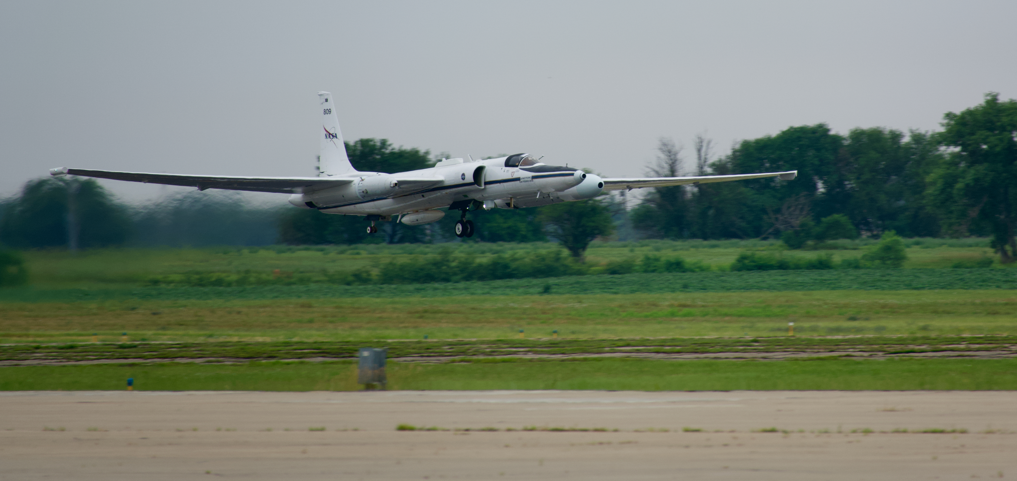
What this looks like in practice
Brings us to…

Slide 19
Comms for Your Mission
Notes:
STILL

Slide 20
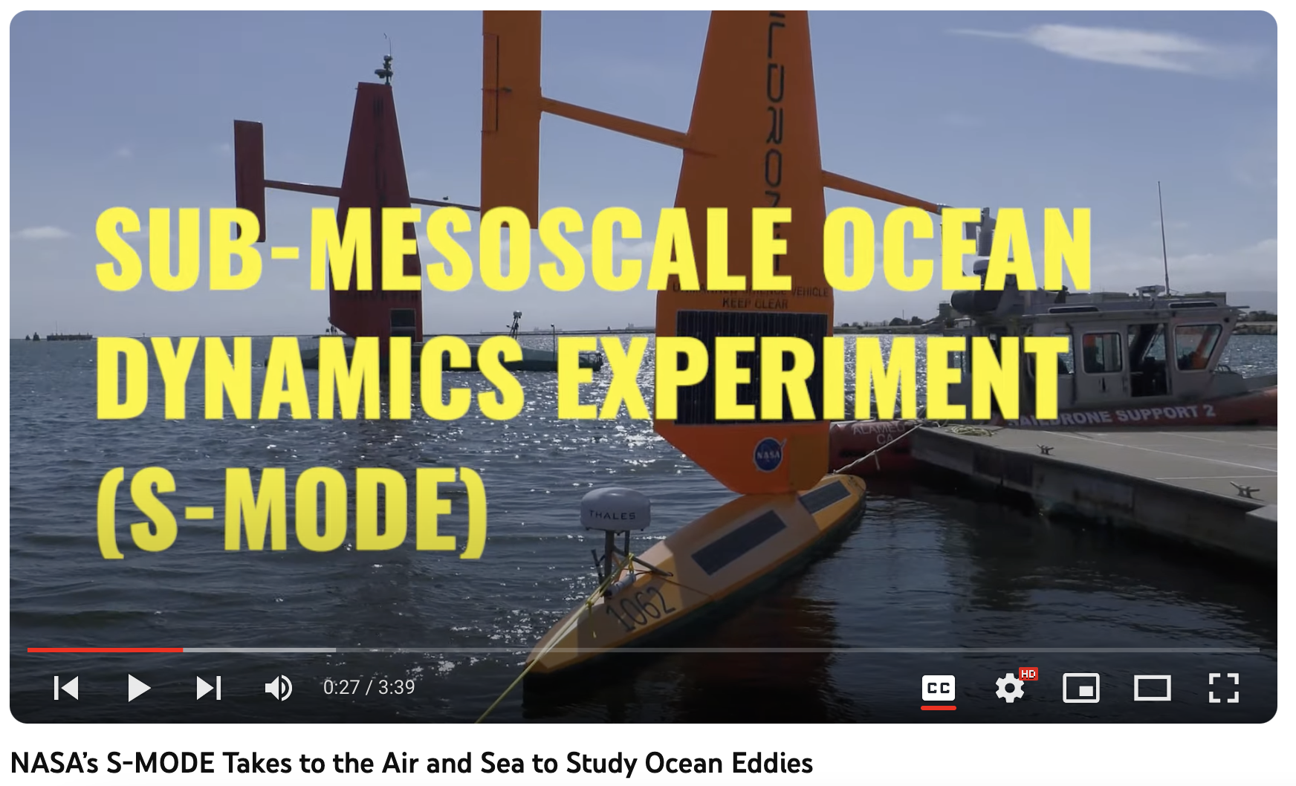
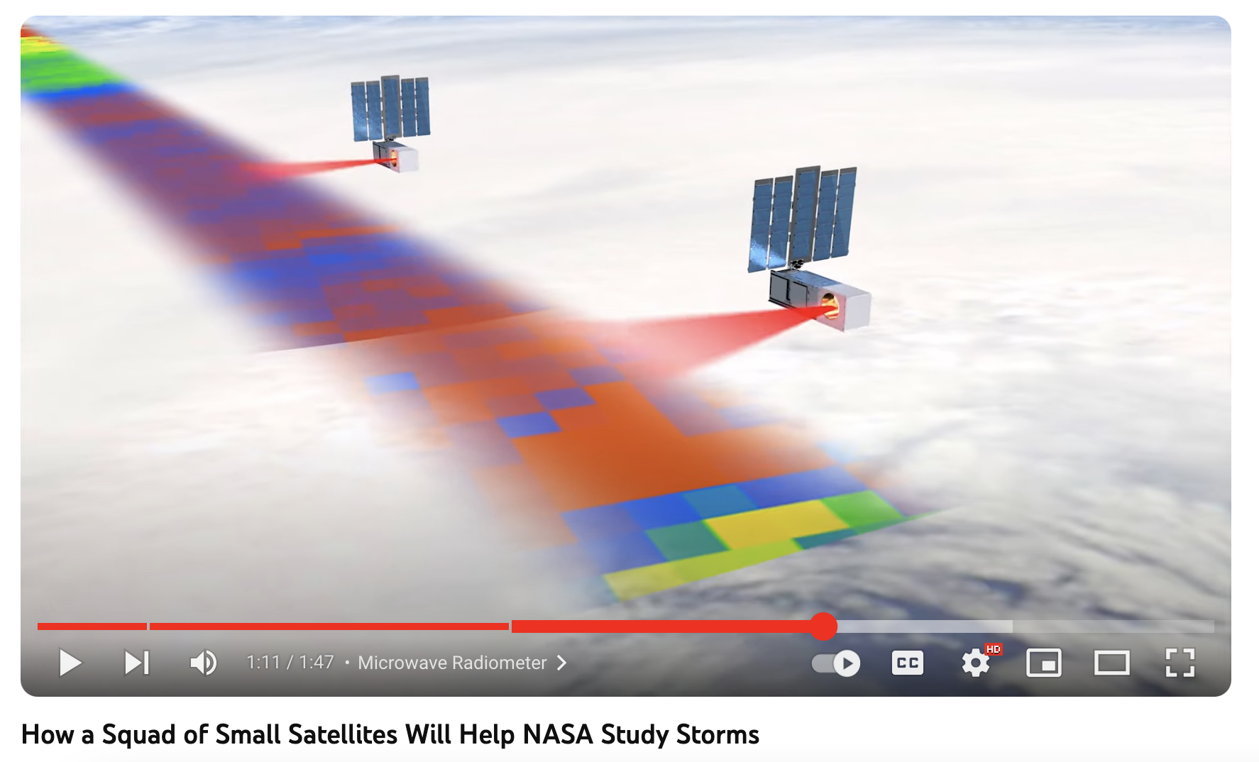
Comms for Earth Venture

Slide 21
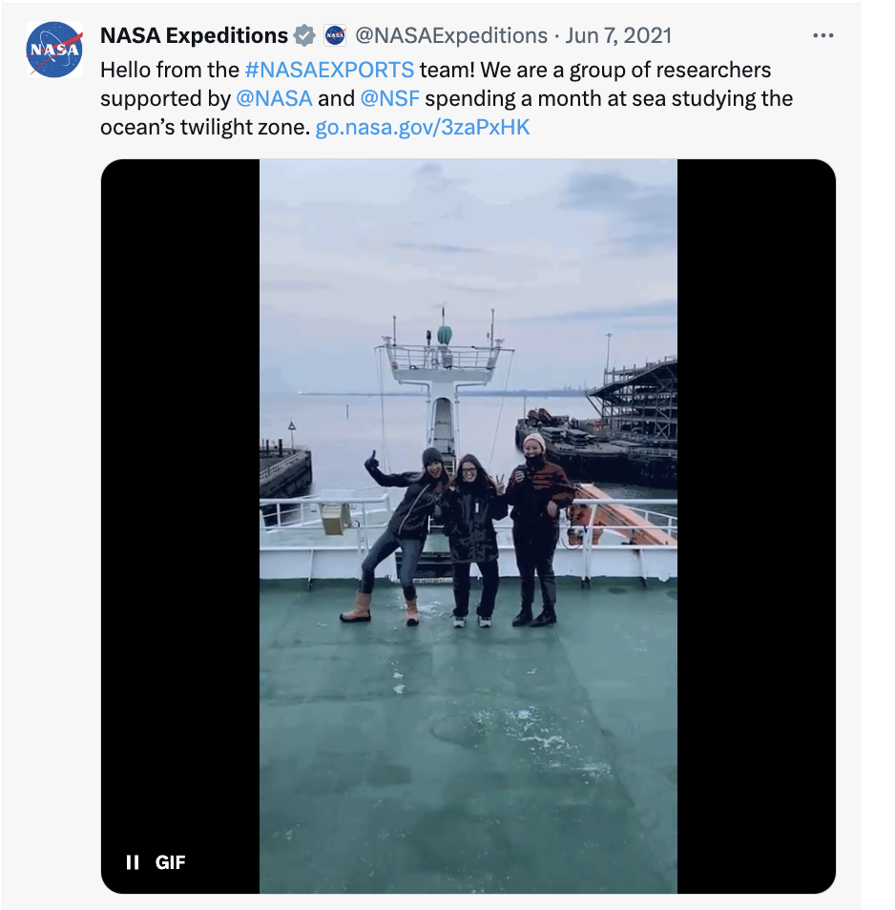
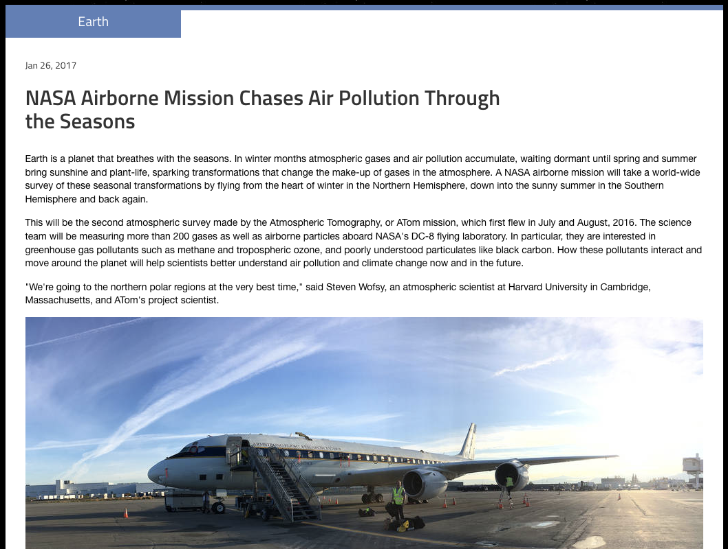
Comms for Earth Venture

Slide 22
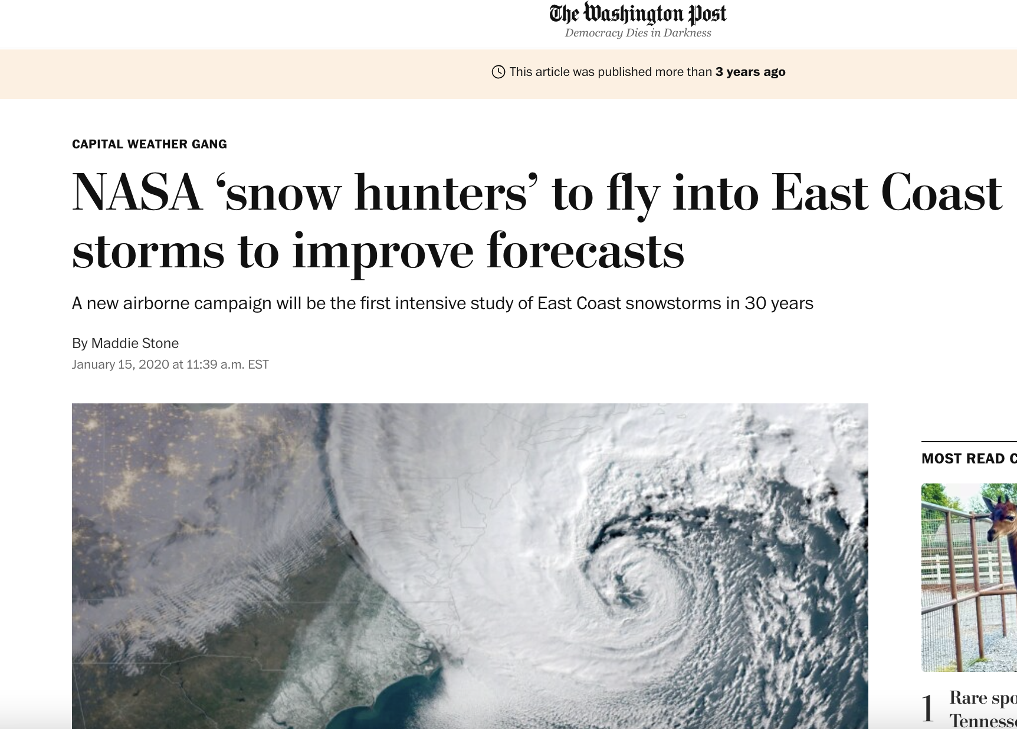
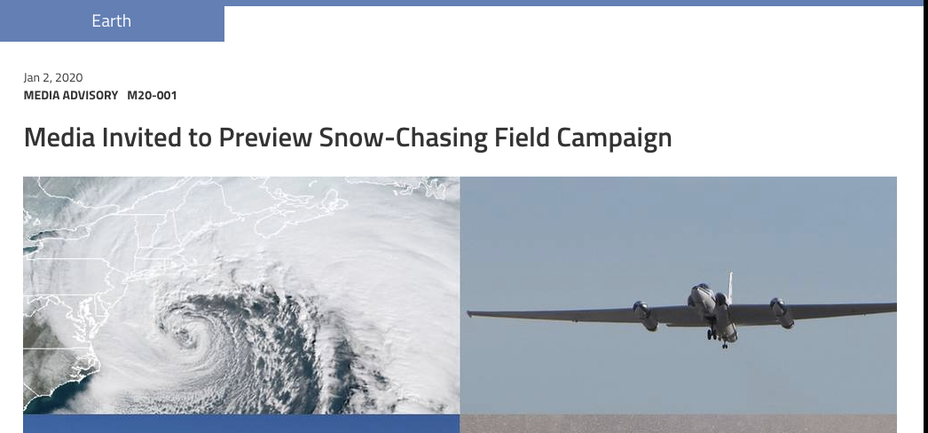
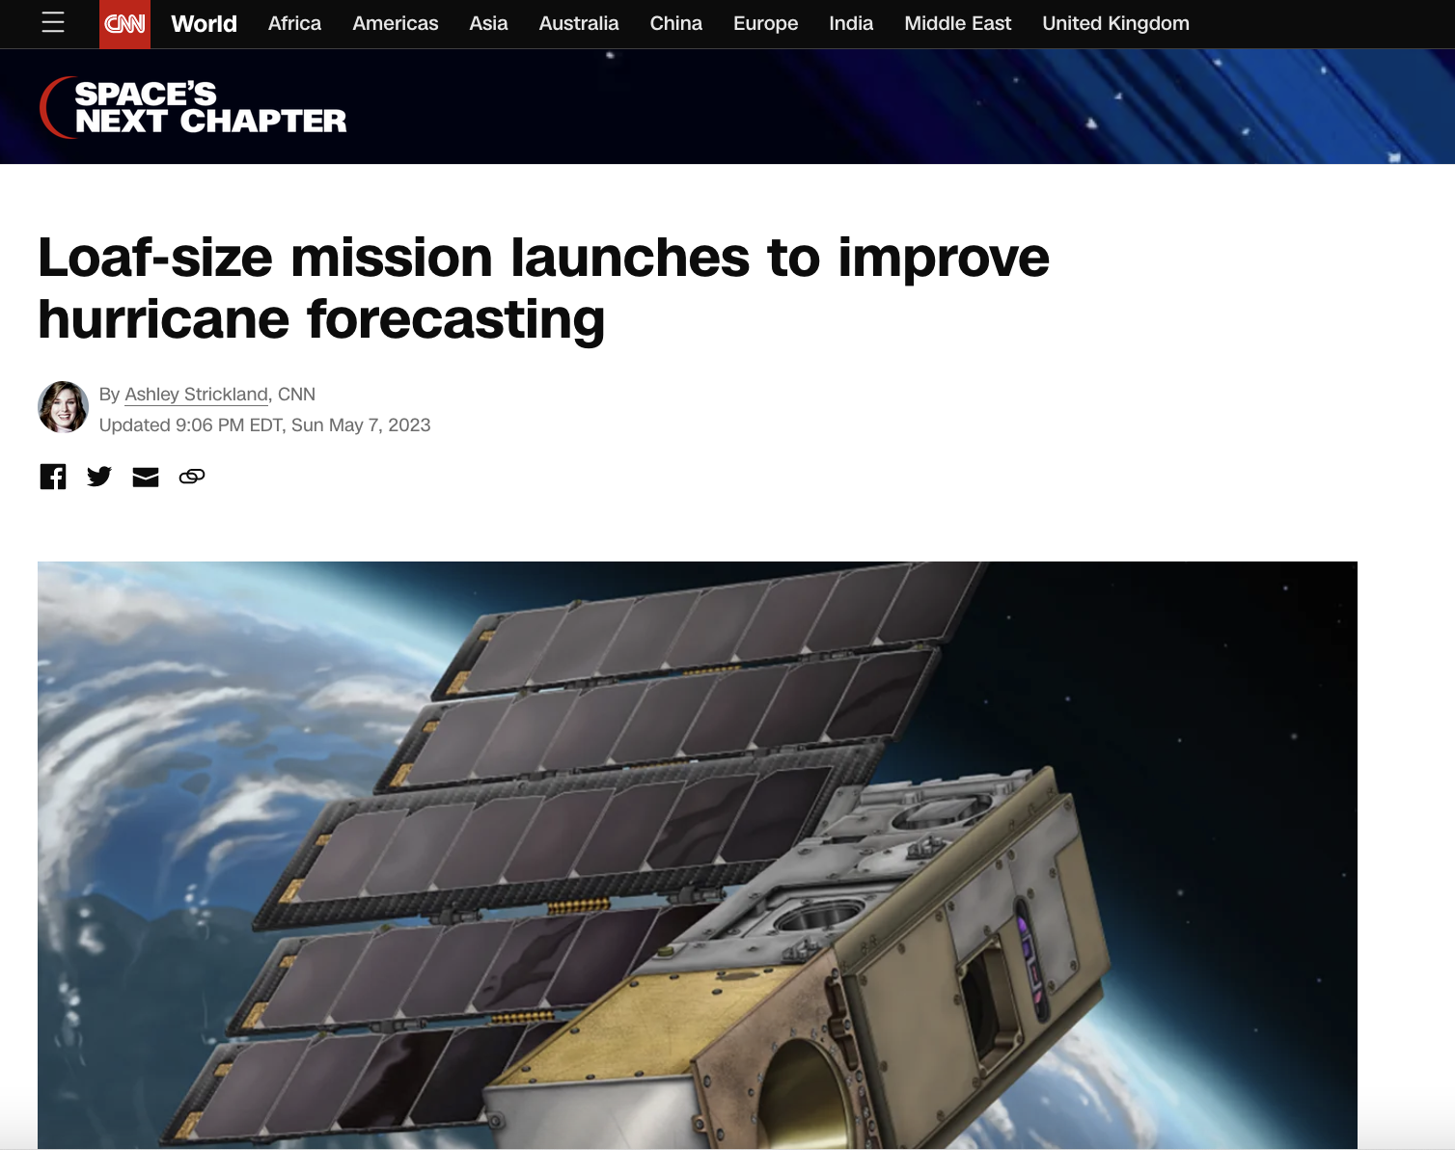
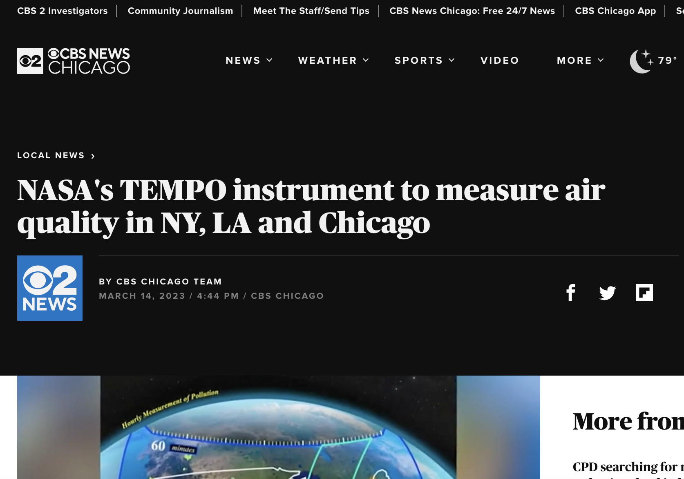
Comms for Earth Venture

Slide 23
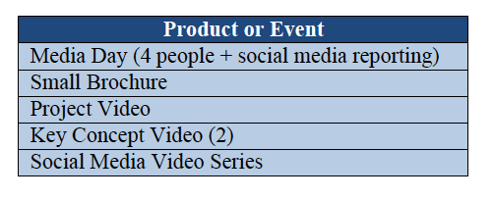
Comms for Earth Venture
Earth Venture Suborbital
EDS Comms funds staff (some exceptions) to provide right-sized coverage
Overview feature on nasa.gov
Social media and field blogs
Media pitching and representation at conferences and events
ESSP funds tangibles and travel

Slide 24
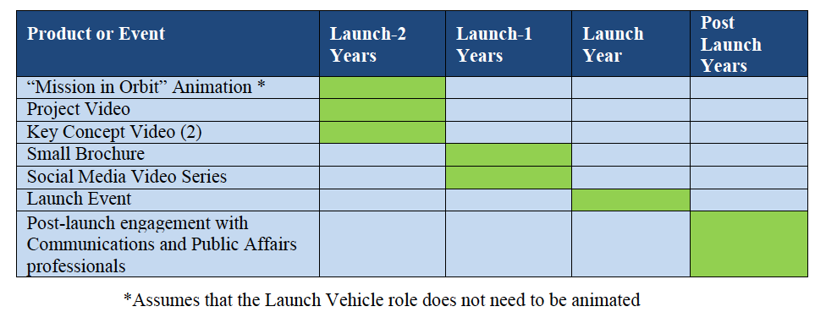
Comms for Earth Venture
Earth Venture Instrument
ESSP funds tangibles and travel for ESD staff to supplement Office of Communications launch activities
EDS Comms funds staff (some exceptions) to provide right-sized coverage
Office of Communications
-- worked through managing center
Communications Plan that defines Roles and Responsibilities
Series of pre-launch features/releases
Launch activities
L-2 briefing
Launch broadcast
Media relations

Slide 25
Comms for Earth Venture
Earth Venture Missions – scope may be larger than for EVI
ESSP funds tangibles and travel for ESD staff to supplement Office of Communications launch activites
EDS Comms funds staff (some exceptions) to provide right-sized coverage
Office of Communications
-- worked through managing center
Communications Plan that defines Roles and Responsibilities
Series of pre-launch features/releases
Launch activities
L-2 briefing
Launch broadcast
Media relations

Slide 26
We do not do new websites a mission page can be created within nasa.gov domain We do not do mission-specific social media accounts we leverage accounts that have existing audiences
NASA Policies
Congressional requirement to reduce web sprawl

Slide 27
To be aware of
Comms for Earth Venture
SMD/OComm is introducing new “packages” for comms launch support
Part of right-sizing comms efforts
Standard and consistent practices
Not fully rolled out – more details to come
ESD now requires all content going to a nasa website to be pitched and approved before work begins. This will be expanded to outreach materials in 2024.
Your ESD comms POC will manage this process
Ensures right comms product for the target audience
Raises quality and maintains message discipline
Managing resources
Our ESD and Ocomm staff are good but limited and working large portfolios.

Slide 28
THANK YOU!

