Slide 1
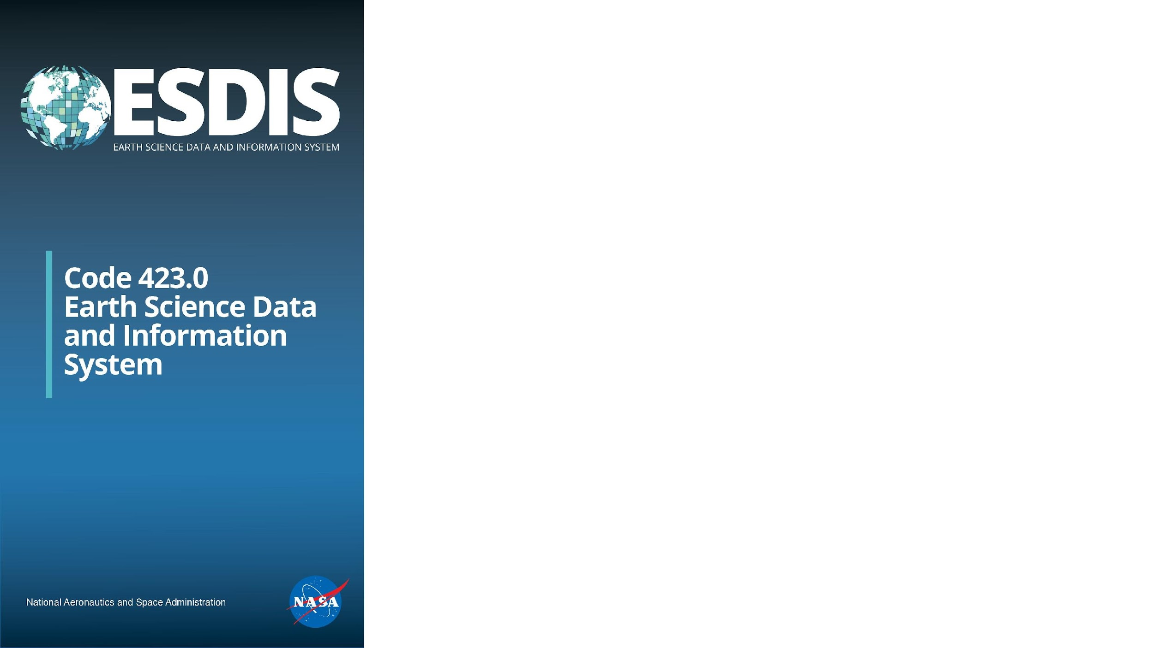
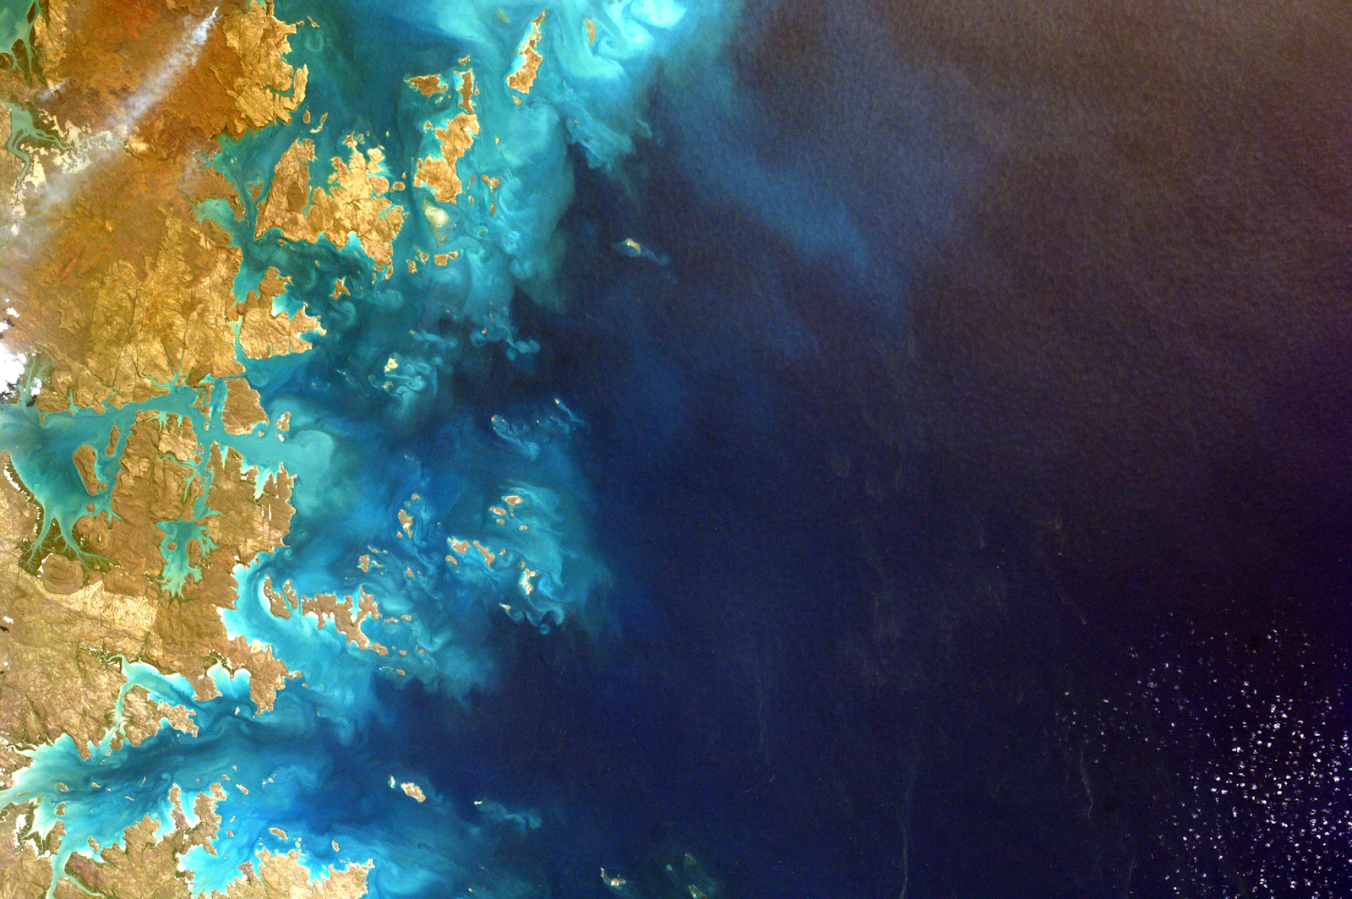
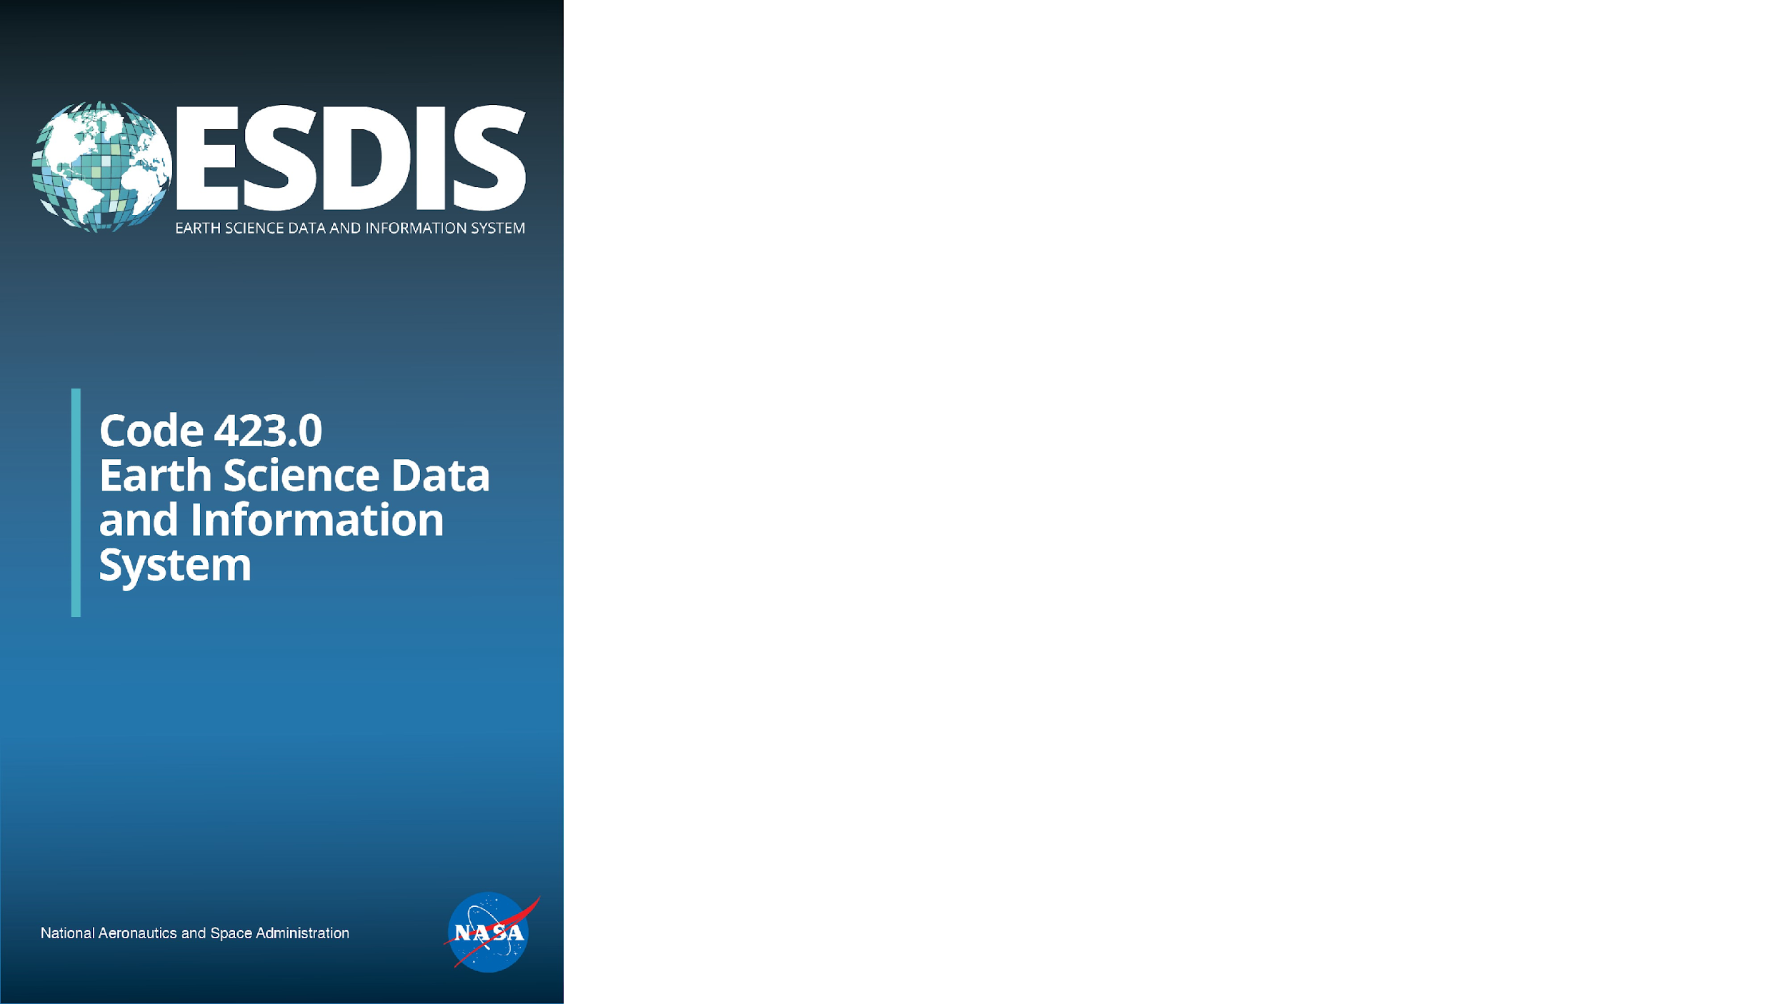


Working with ESDIS and the DAACs
Sara Lubkin
ESDIS Science Data Operations Manager
8/23/2023
Notes:
Earth Science Data Operations Manager

Slide 2



Acronym Soup
ESDS – Earth Science Data Systems is the name of the NASA Headquarters Program Office that funds the ESDIS Project.
ESDIS – The Earth Science Data and Information Systems manages the 12 NASA DAACS (Distributed Active Archive Centers) and the 12 SIPS (Science Investigator-led Processing System), which together form one of the world’s largest systems for processing, archiving and distributing Earth science data, information and services.
EOSDIS - the acronym name for the System that was developed to manage NASA’s Earth Observing System missions.
Notes:
ESDS – Cerese - Headquarters Program
ESDIS – Earth Science Data Systems Project one of several in the ESDS portfolio – Manage SIPS and DAACs which make up the worlds largest system for
Processing, archiving and distributing Earth Science data
And is responsible for ensuring the data is available for scientists to enable the study of the Earth, to policy and decision makers, and to the general public and promoting use of the data to a broad range of existing and potential user communities.
ESDS sets policy
ESDIS takes that policy and works with our DAACs to figure out how to implement it in a way that makes sense for our data providers and user communities
EOSDIS the system since 1990’s - updated

Slide 3
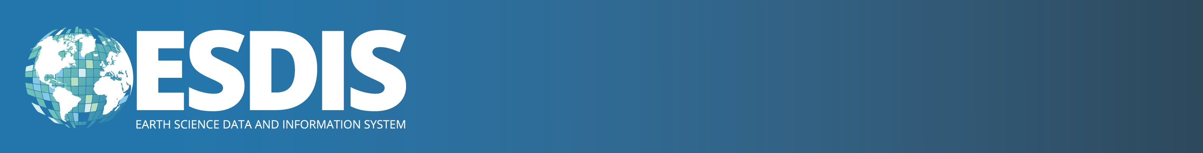
Science Investigator-led Processing Systems (SIPS)
Notes:
The SIPS perform forward processing of standard data products that are redistributed by the DAACs and reprocess data to incorporate algorithm improvements

Slide 4
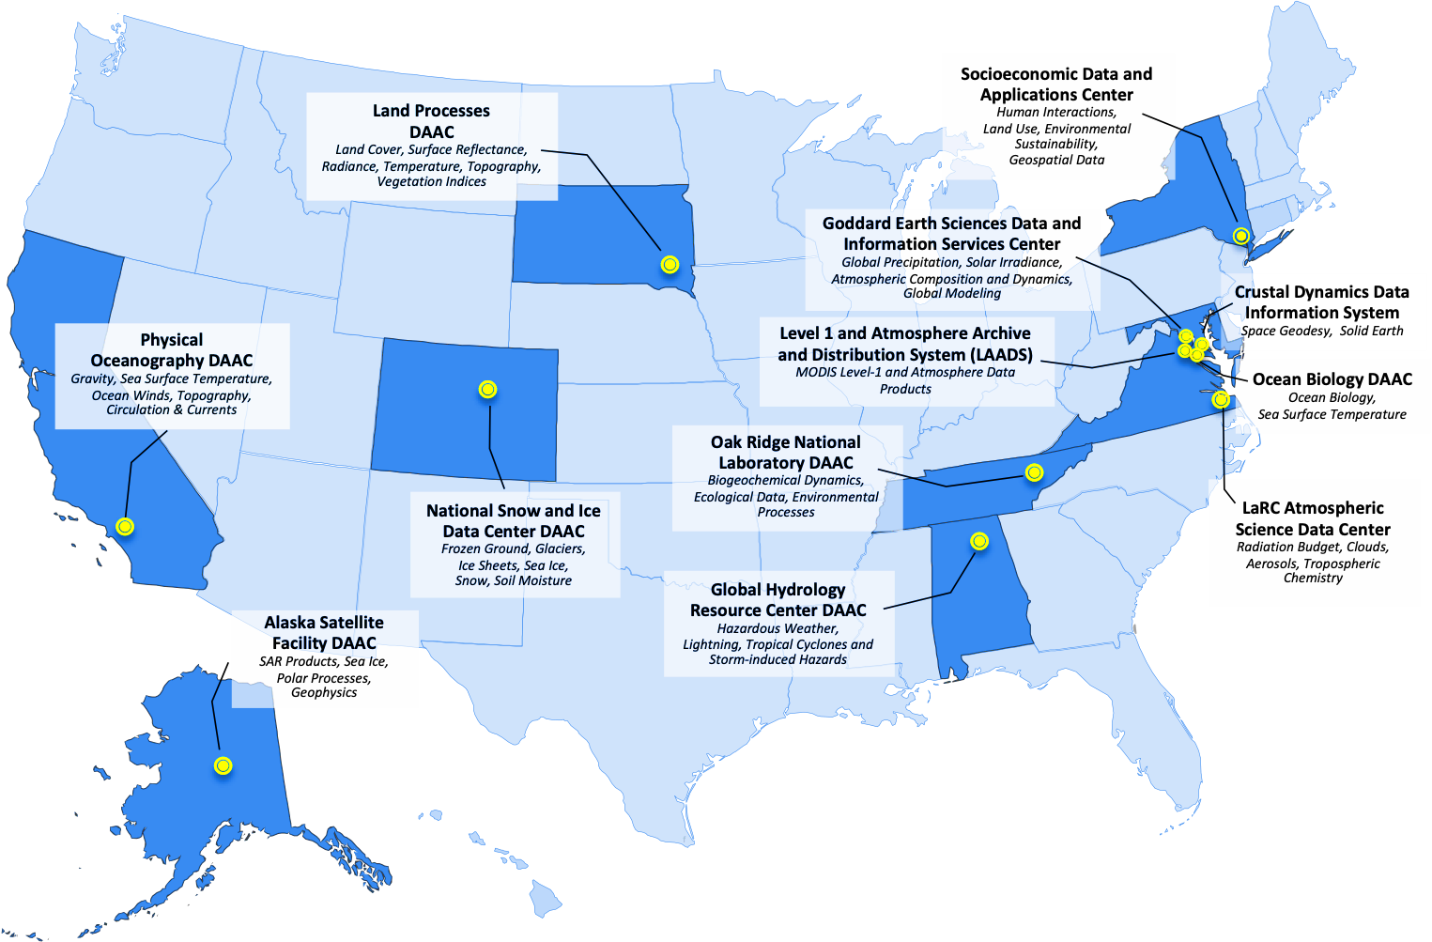
Distributed Active Archive Centers (DAACs)
Notes:
12 data archives
Distributed across the US – ASDC here, 4 at Goddard, PODAAC and ASF
DAACs – I’ll talk more specifically about wht they do in a minute, but they do the real work of ingesting, archiving and distributing Earth Science data
Each discipline orientation and thus have specialized tools, services, resources developed for their specific communities

Slide 5
Data Repository Assignment Process
The data archive selection for missions is initiated at NASA headquarters and occurs by KDP-B.
ESDIS makes a recommendation based on archive science alignment, synergies with current data holdings, available tools and services, technical experience, staffing, and cost.
The final decision is made by NASA headquarters, including representatives from ESDS, Research and Analysis, and Earth Applied Science.
Frequently, our data archives are choosing to collaborate.
Notes:
Discipline not the only factor in determining which DAAC works with a mission – especially since many are interdisciplinary (GEDI) and uses often extend beyond purpose of mission
How DAAC assignments made
PLRA – at very least need data products and anticipated volumes

Slide 6
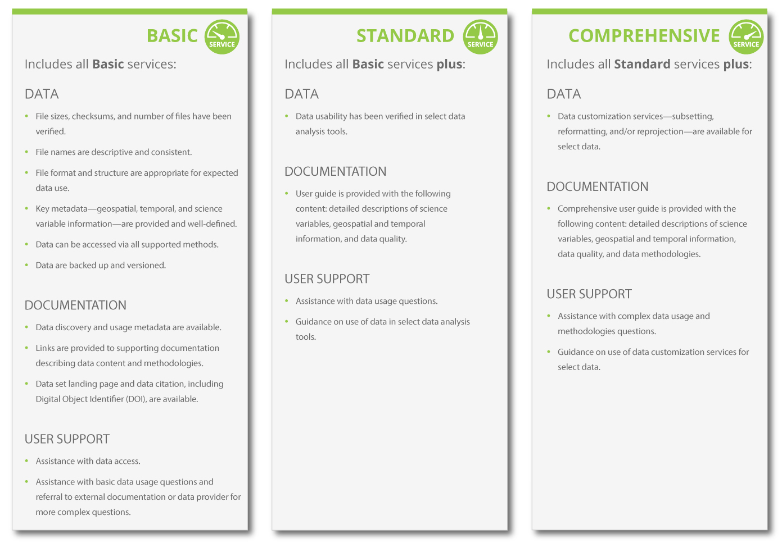

Data Product Levels of Service
To be cost efficient, not every dataset gets the same level of service.
6
6
Notes:
LOS – during DAAC assignment the LOS is also determined
3 levels of service –
Basic – accurate data and meta data meeting esdis standards, DOI, landing page, some documentation – nothing fancy
in general missions get a comprehensive LOS which may include the development of tools/services for that mission, user engagement, additional documentation etc.

Slide 7
What does a DAAC do?
Data and metadata stewardship
              Serve as primary point of contact for mission science teams
              Ensure quality and fitness for purpose of the organization's data and metadata assets
              Support identification/creation of simulated data product for early adopters
              Ingest science data products into cloud archive additional documents associated with the data (preservation content)
              Protects data from disaster and technology obsolescence
Information management
  Capture and catalog scientific information from publications into searchable databases linked to data resources
Open-source science and software support
  Meet many of the SPD 41-a requirements
  Support open-source software development projects
Cross-mission science and modeling
  Address cross-mission and division science and provide support for modeling communities to better integrate and fuse observational data into models
User support
                Answer scientific questions about data and information, evaluate and merge community contributions to open-source software, address technical questions, and develop unique software to serve science and applications communities.
                Support Early Adopter activities across a variety of communities
                Develop and operate tools, services, tutorials, hack weeks and other resources for specific science communities and applications users
Maintain connection between the data and the community And so much more…..
Notes:
How many worked with DAACS?
Interactive – talk about how DAACs help – could be doing anything better?

Slide 8
Supporting Science Teams
          ESDIS publicly distributes and provides user services for data archived at NASA’s DAACs for thousands of products and millions of science and applications users: data providers
  Works with science teams to ensure data provided are reliable, of high quality, and have the required metadata
  Defines and communicates requirements and standards to science teams
  Coordinates with the data producing missions or projects throughout their lifecycles, establishing Interface Agreements and Data Management Plans
  Ensures that the data active archive capabilities are available as long as there is interest in using the data, which is well beyond the lifetime of the missions
  Provide guidance for preservation content https://cdn.earthdata.nasa.gov/conduit/upload/10607/NASA_ESD_Preservation_Spec.pdf
Notes:
Work with the science teams – starting early in the mission life cycle – to ensure that the data and metadata are reliable and high quality – meet ESDIS standards

Slide 9
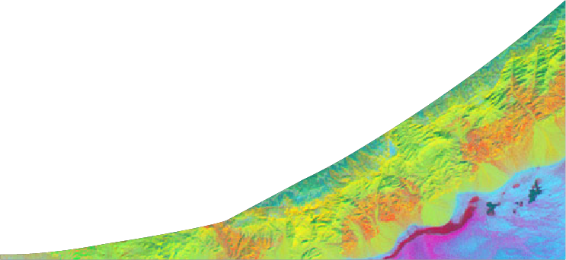

Earth Science Data Archive Growth Projection
600
12 new missions
to be added
400
Archive Volume (PB)
200
Current archive holdings continue to grow (~95 missions)
FY22: 72PB
*
0
2019 2020 2021 2022 2023 2024 2025 2026 2027 2028 2029
Fiscal Year
Notes:
Current growth rate = 4 library of congress
EOSDIS archives include more than 15,000 datasets which have a volume of more than 87 Pb in our archives and that includes at least 20 PB in the cloud. With SWOT, that rate is growing by 61 TB a day –all the current holdings of the library of Congress add up to about 15 TB, so we are growing at a rate of 4 Library of Congress a day.

Slide 10

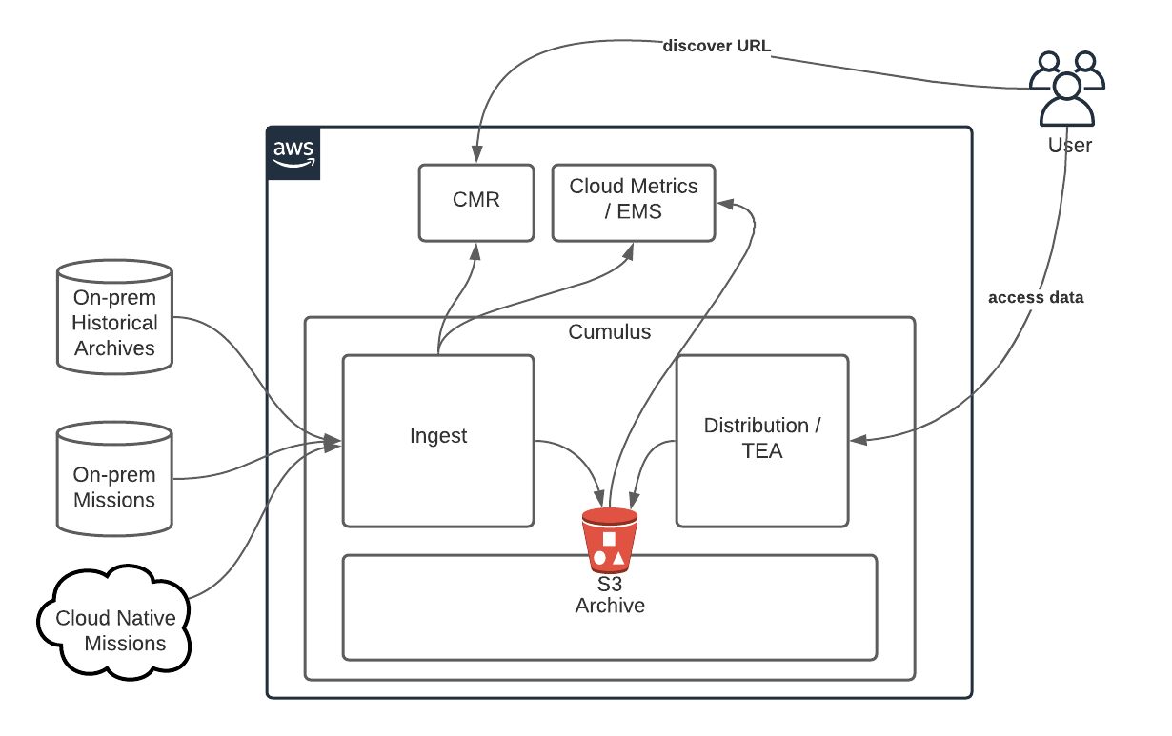
EDC is a “managed” commercial cloud for EOSDIS
It improves the efficiency of NASA’s data systems operations – maintaining the free/open data policy
Specifically architected for EOSDIS applications and mission data ingest, archive, distribution
EDC became operational July 2019, DAAC focused needs.
Currently EDC has routine systematic onboarding of mission data by DAACs
New missions go directly to Cloud
NASA Earthdata Cloud (EDC) – http://earthdata.nasa.gov
10
10
10
Notes:
Cloud – how are we supporting users? Diagram and fact sheet
Next question of course is how do we help our users work with data in cloud
but helping our data producers and data users move to the cloud has been a major focus for the DAACs – Openscapes – Cloud Playground (Earthdata Cloud Hub), webinars, tutorials, in person hack fests, cloud cookbook – PO.DAAC
Besides getting our users to the cloud, we are also looking at how we can work differently now that our data is in the cloud. Because of the move to the cloud the DAACs are also able to focus on working more collaboratively. Many of NASA’s upcoming missions are multidisciplinary – that means that there might not be one DAAC that is perfect for working with all the communities that can use the data. Putting data in the cloud means that the different DAACs and access the data and provide tools and tutorials for their discipline users and working together to create multidisciplinary resources.

Slide 11
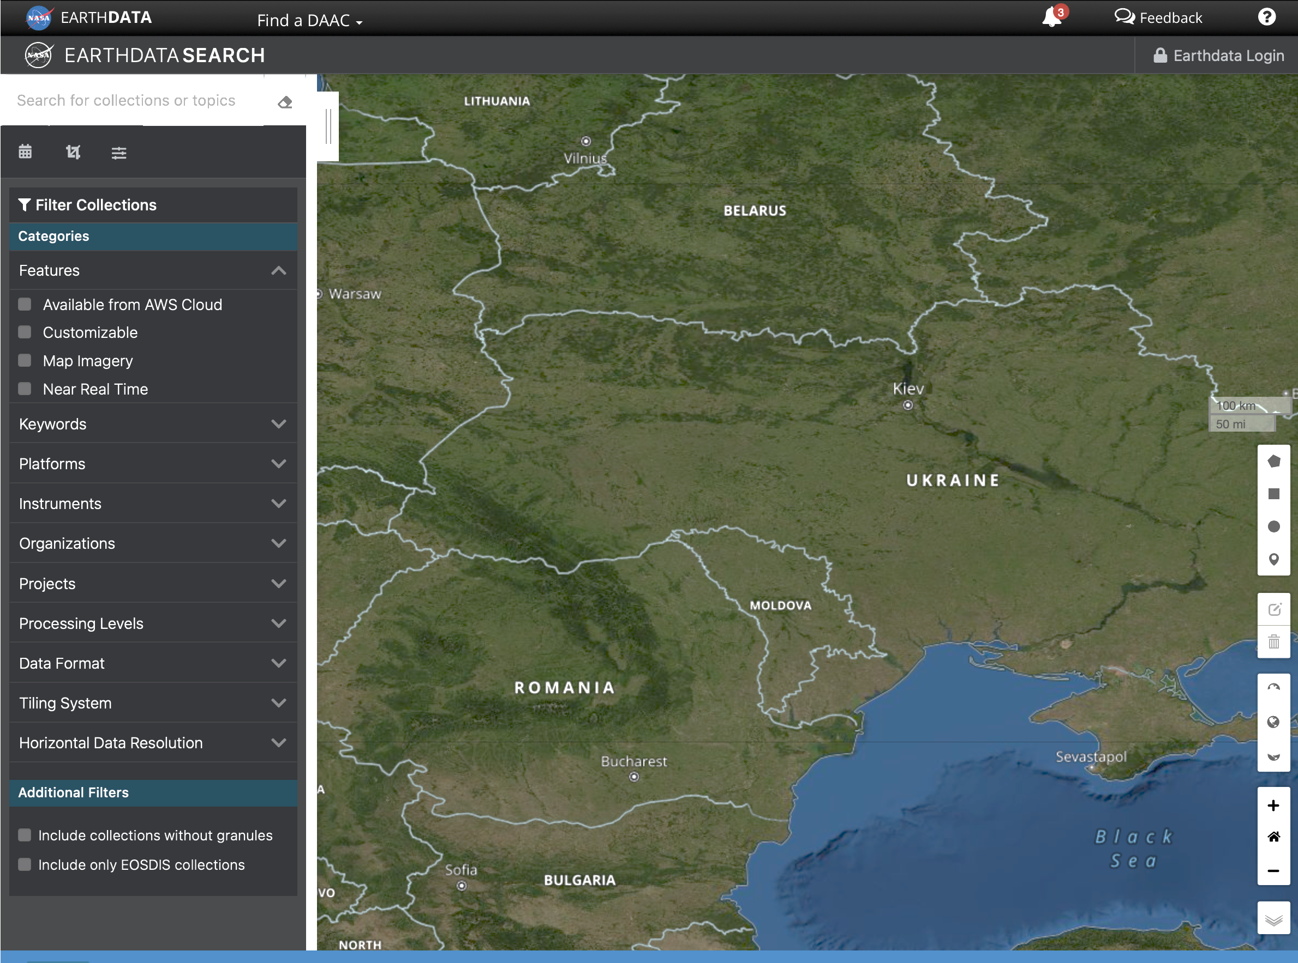
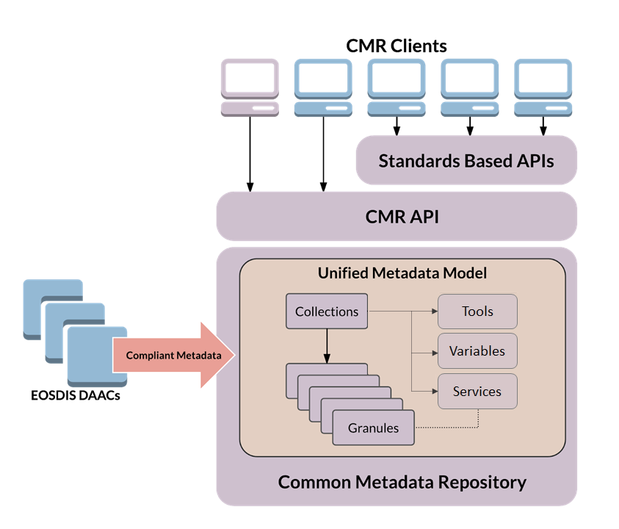
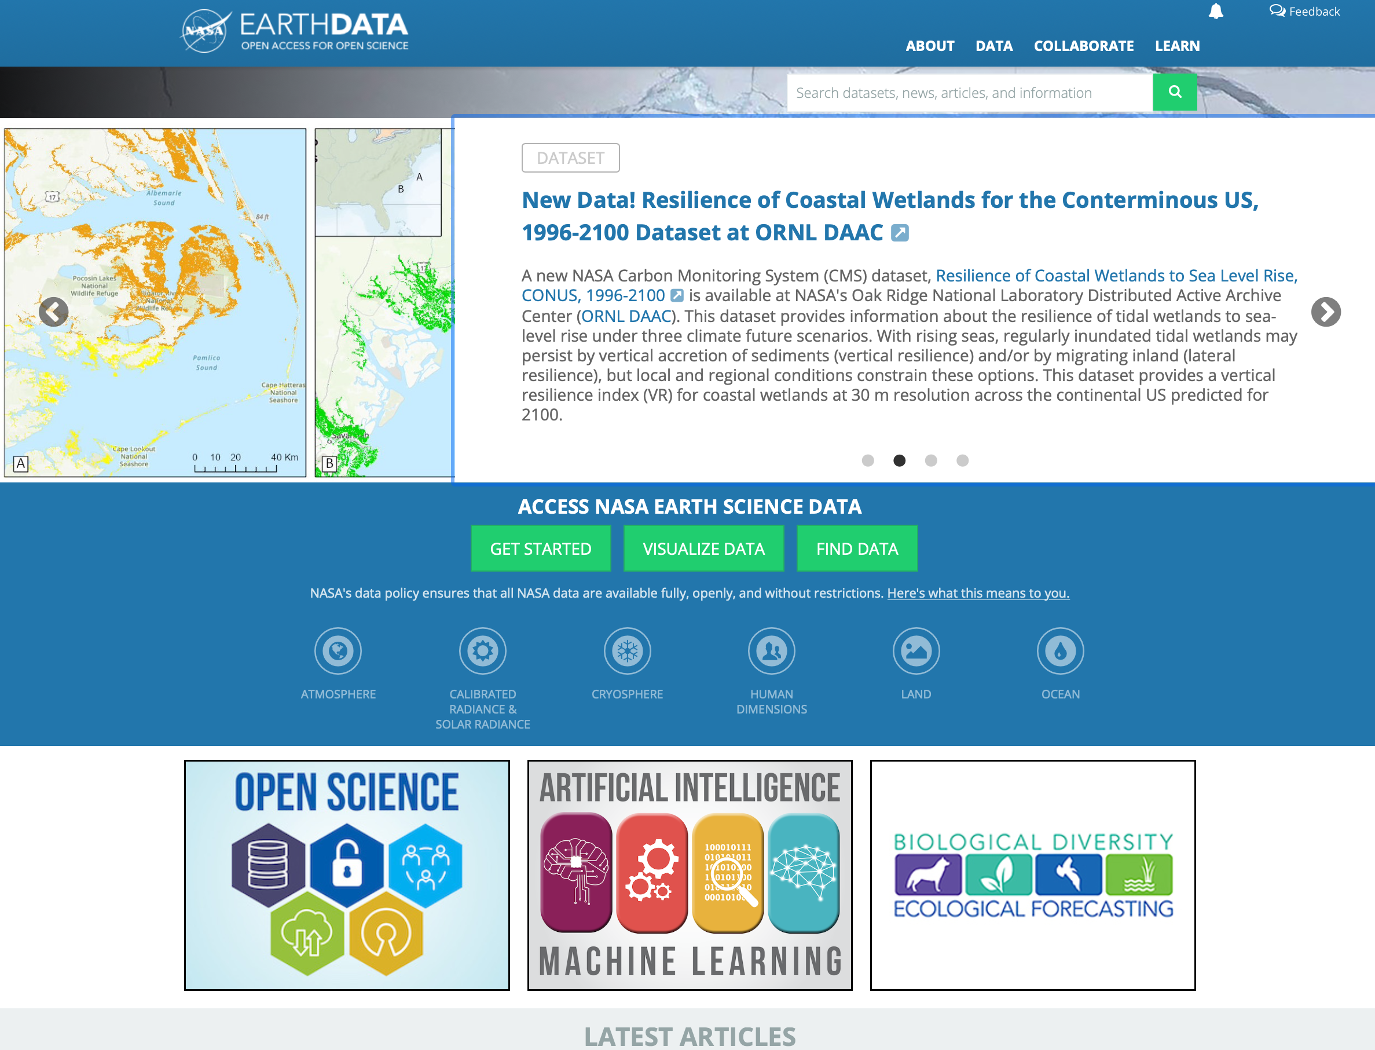

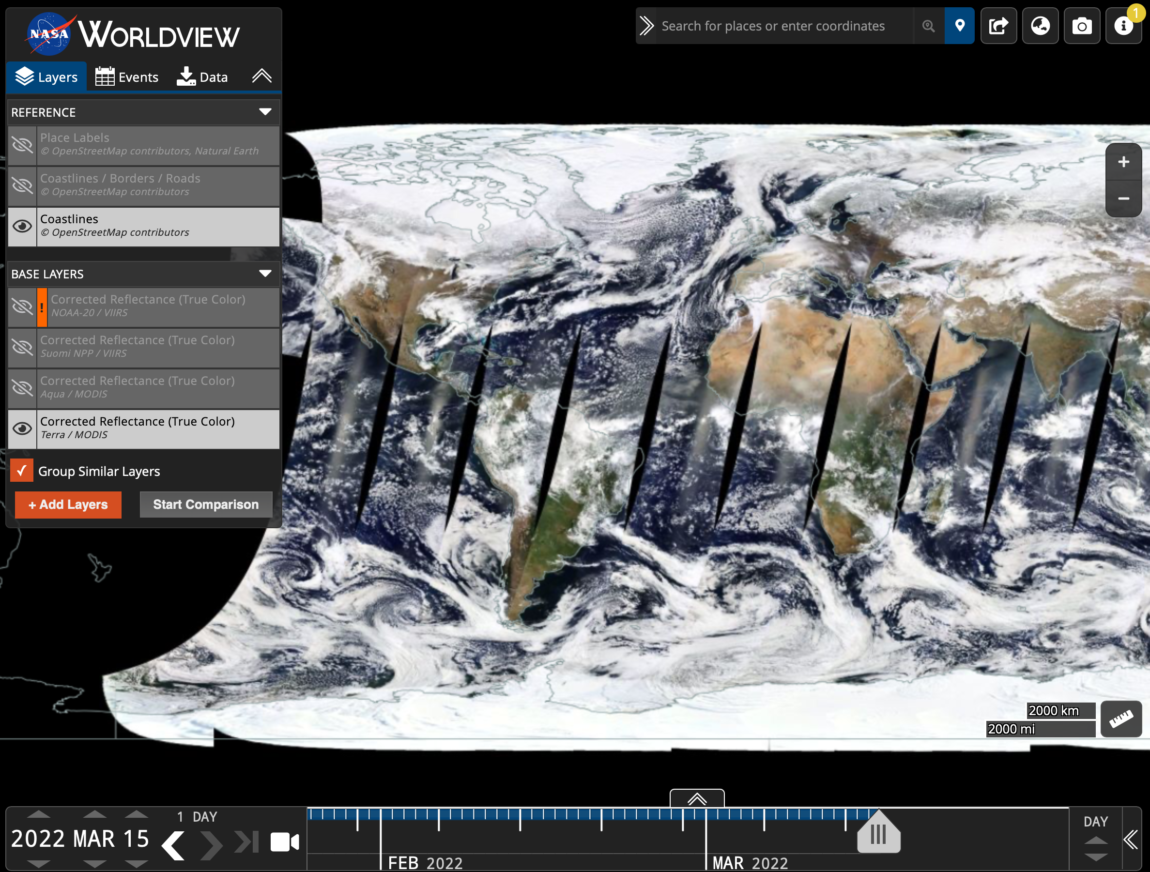
More than Data Enterprise Tools and Services
“Hello,
I’m a user”
Common Metadata Repository
Earthdata Search
Earthdata Website/DAACs
EGIS
Data Pathfinders & Tool Kits
Data Recipes
Webinars and Tutorials
Tools
And more…
11
11
Worldview Visualization/LANCE
Notes:
Earthdata is gateway to all the data --- Earthdata search, world view etc
and services and tools and tutorials and more

Slide 12
ESDIS and SPD 41-a
Open Accessibility: Since 1994, NASA Earth science data have been free and open to all users for any purpose as quickly as practical after instrument checkout and calibration. Data remains available as long as there is interest in use of the data, often well beyond the life of the mission.
Format: Data and metadata available for access, download, or export in non-proprietary, modifiable, open, and machine-readable formats consistent with common standards.
Inclusion of Metadata: ESDIS data includes standards compliant metadata that is indexed in NASA’s Common Metadata Repository, to enable discovery, reuse, and citation of SMD-funded data.
Clear Guidance on Use: NASA promotes the full and open sharing of all data with research and applications communities, private industry, academia, and the general public.
Persistent Identifiers: All data published in ESDIS archives are assigned a DOI.
Findability: CMR allows all data in ESDIS archives to be retrieved, downloaded, indexed and searched through Earthdata Search and other tools.

Slide 13




Open-Source Science
Open Science DAAC Representatives
Each DAAC has an Open Science representative. These experts meet monthly to discuss Open Science and how DAACs can support their users as they adapt to SPD-41a and NASA’s Open Science requirements.
TOPS
These POCs will complete the TOPS – Transform to Open Science – curriculum in order to better help science teams and data users understand NASA requirements.
Openscapes
NASA-funded initiative to support mentors from NASA Distributed Active Archive Centers (DAACs) helping science teams migrate workflows to the Earthdata Cloud
First Openscapes Champions Cohort in March/April 2022
Notes:
Each of our DAACs has an Open Science Representative – these representatives meet monthly to discuss how to help our users understand SPD-41a and NASA’s Open Science requirements.
The group will work together to create materials for our user communities.
They will also complete TOPS training
And work closely with our UN pocs to understand UN around OS
Openscapes – Working with science teams to help them get comfortable using the cloud

Slide 14
Supporting Data User Needs
EOSDIS data users have high satisfaction with data, products, and services:
  • Score of 79 out of 100 on the annual American Customer Satisfaction Index (ACSI) survey
  • Indication of consistent, high satisfaction
  • 19th year NASA has performed an independent review of user satisfaction with NASA Earth Science DAACs
  Increased connections with data users through the Earthdata Forum.
User Services/UN Working Group – DAAC User Services personnel work together to best service science communities User feedback – via Kayako and Personal interaction with users
DAAC User Working Groups – Provide assessments and recommendations based on unique DAAC mission requirements.
Webinars, tutorials, data recipes, How-Tos, FAQ’s documentation and more!
Notes:
Go back to User needs
High priority for us
Reflected in ACSI scores
Engage with users through Earthdata Forum
User services and User Needs working groups – which include a representative from each DAAC

Slide 15

Airborne and Field Data Working Group
ESDIS is partnering with the Airborne Data Management Group (ADMG) to improve airborne data and services:
    Airborne data has been a part of EOSDIS since its inception in the 1990’s. Currently EOSDIS archives data for- more than 120 missions, campaigns and investigations and from more than 25 facility and major airborne instrument (and growing!).
    While NASA airborne and field data are often collected to validate and ensure the quality of NASA’s satellite data products, they are also a valuable resource supporting a wide range of resources and applications.
    The Airborne and Field Data Working Group is a collaboration of the DAACs, ESDIS and ADMG. The goal is to work together to improve discovery, access, and reuse of NASA’s airborne and field data across EOSDIS.
    The group held a workshop in March 2022. As a result, the group is now designing an Airborne and Field Data Resource Center.
    A follow-on workshop is being planned for 2024.
Notes:
Airborne and field data have always been an important part of NASA’s Earth observations and have been archived in the DAACs for as log as there have been DAACs, but these data aren’t as well utilized as satellite data.
NASA’s Airborne Data Management Group (ADMG) was established by ESDS in 2018 to support NASA’s airborne science community. ESDIS and the DAACs work closely with ADMG – and together we established an Airborne and Field Data WG – which is really focused on how we can work together to improve discovery, access, and reuse of NASA’s airborne and field data across EOSDIS.
We had our first Airborne and Field Data Workshop last year (2022). It was virtual -and included data users and producers who discussed what NASA was doing right and where we could improve. We spent a year looking at that feedback and wrote a white paper. As a result we are building an Airborne and Field data Resource Center on Eatrhdata and all this was done very openly through collaborative sessions at conferences like AGU and ESIp.
We’re going to hold another workshop next year.

Slide 16
Thank You
Questions?
Contact me at sara.h.lubkin@nasa.gov

Slide 17
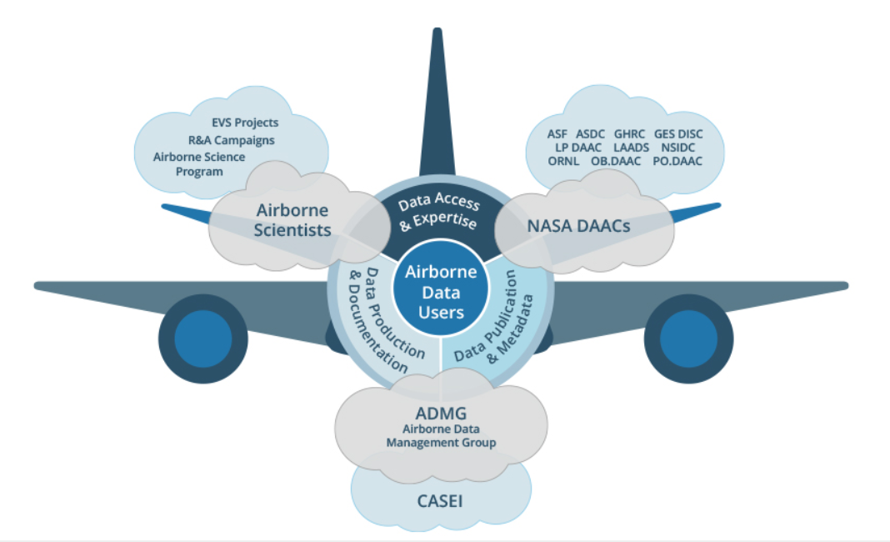

Airborne Data Management Group (ADMG)
The ADMG was established in 2018 to respond to the need for better stewardship of airborne and field data at NASA.
ADMG is part of the Interagency Implementation and Advanced Concepts Team (IMPACT) at NASA MSFC.
ADMG’s Primary Role is to support data producers and DAACs in making airborne data more discoverable and usable for the scientific community

Slide 18
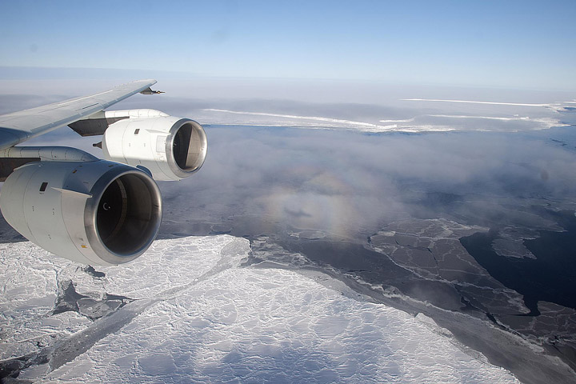
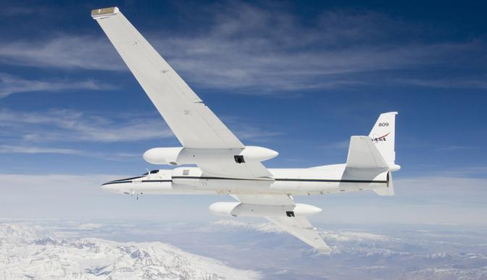
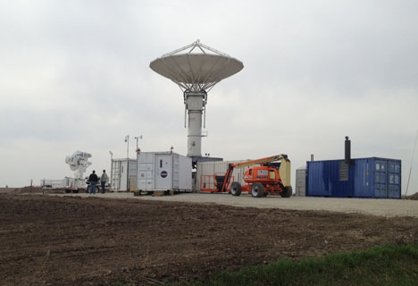
Airborne Data Management Group (ADMG)
ADMG Primary Tasks:
Take a full assessment of NASA Airborne and Field Earth Science data and provide a public, centralized, metadata-rich inventory
Develop and maintain a knowledge center containing important information and document access, and simplified access to airborne tools and use cases
Develop systematic approaches and best practices that bring consistency and expediency to airborne and field data stewardship
Improve communication between the DAACs, airborne campaign investigators, ADMG, and other stakeholders
Ensure users have open access to NASA airborne and field data

Slide 19
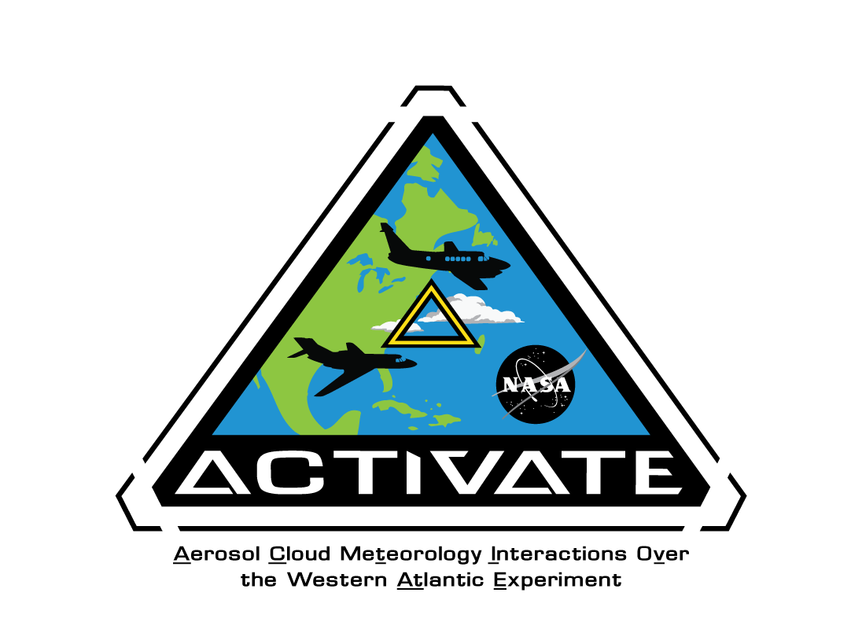
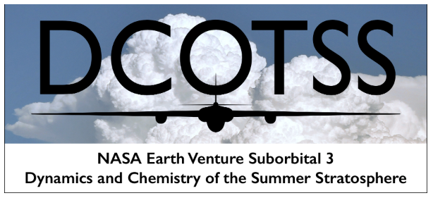
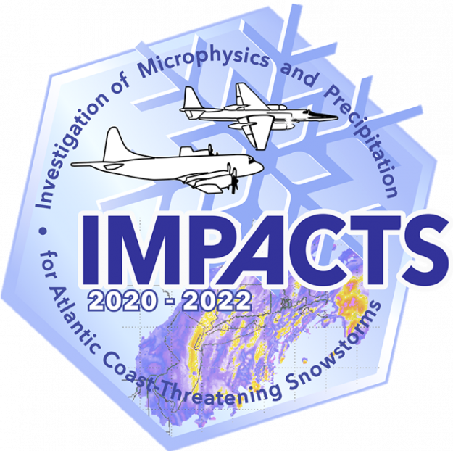
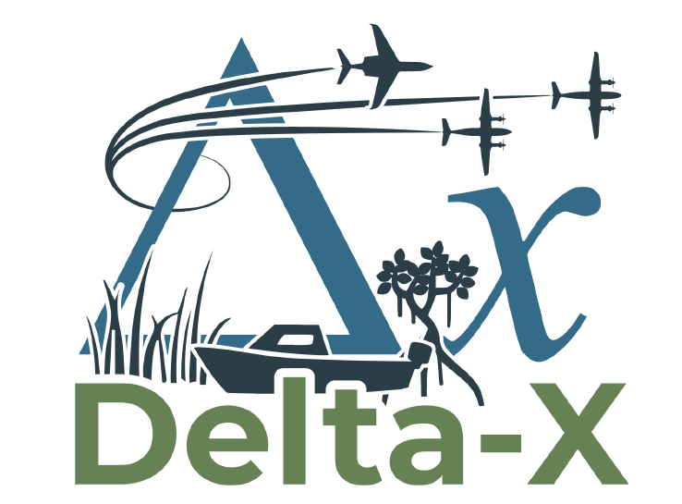
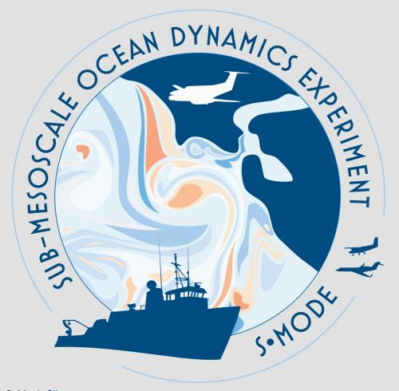
ADMG and Earth Venture Suborbital Investigations
Support the investigation team before DAAC is assigned and ensure a comprehensive data management plan is developed
Facilitate effective communication and understanding between the investigation team and the DAAC when needed
Improve guidance for inclusion of detailed campaign metadata in the ADMG inventory and DAACs so users can more easily find campaign information in the future
Work with DAACs to improve consistency with respect to terms, documentation, metdata and methods used in data handling
Help to find solutions to problems

Slide 20
ADMG Improvements to Needed Resources
Web pages
Earth Science Data Systems ADMG resources: https://www.earthdata.nasa.gov/esds/impact/admg
Definitions of Common Terms:
https://earthdata.nasa.gov/esds/impact/admg/admg-definitions
Airborne DMP Guide for the Data Management Plan Template
A guide describing how to interpret the new DMP Template for investigations
Data Product Development Guide for Data Producers
Worked with ESDIS team to update the DPDG and add guidance for producers of airborne and field data
Updated Preservation Documentation
Worked with an ESDIS team to update NASA ESDIS Preservation Requirements by adding airborne and field data requirements

Slide 21
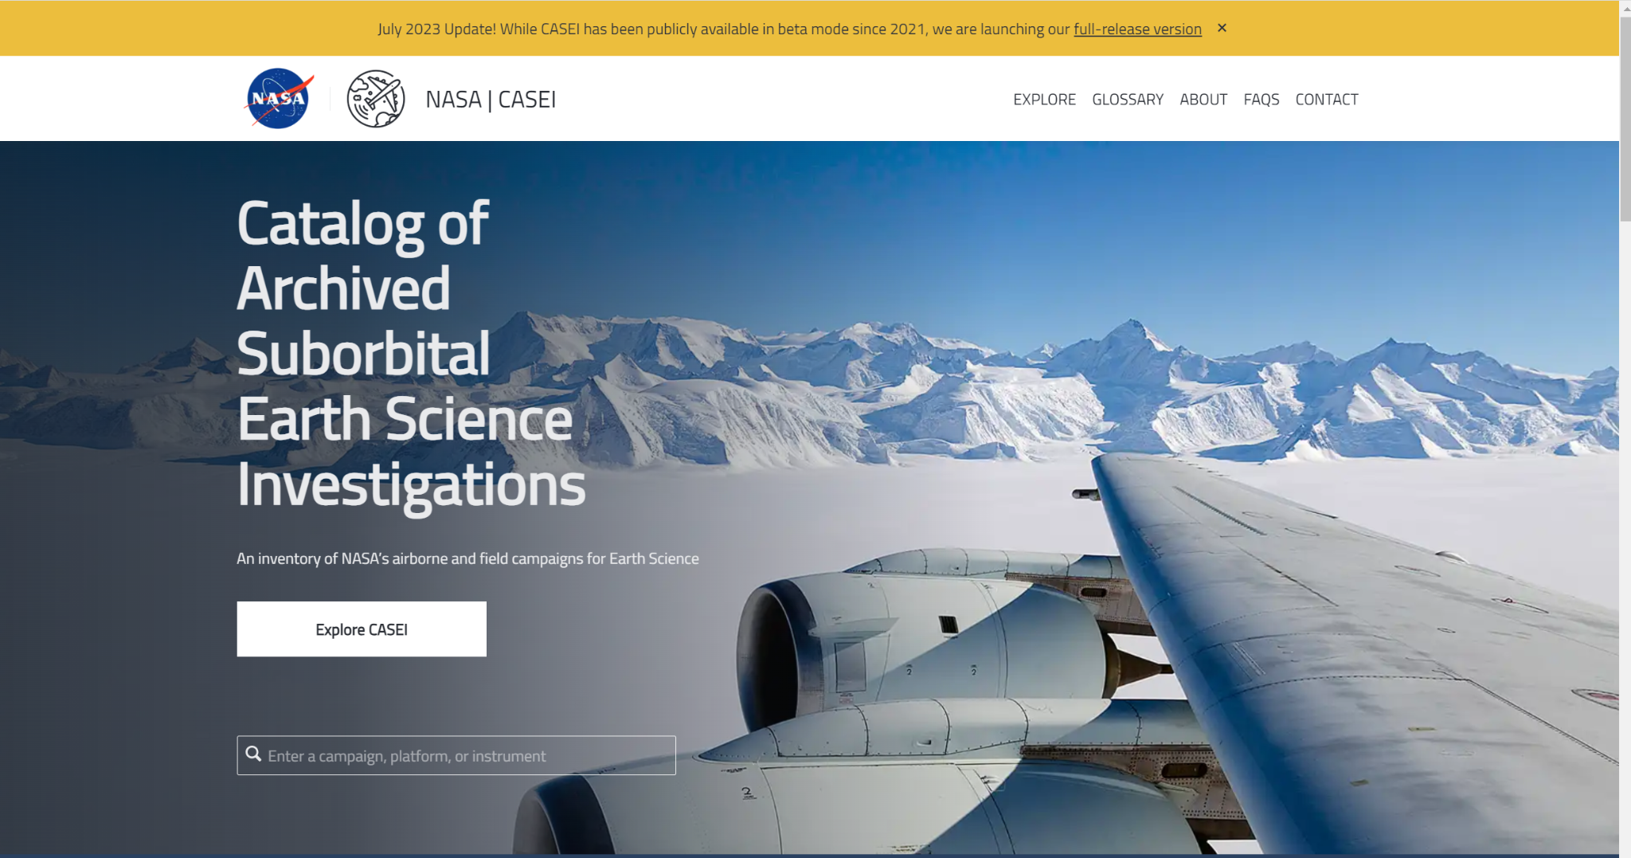
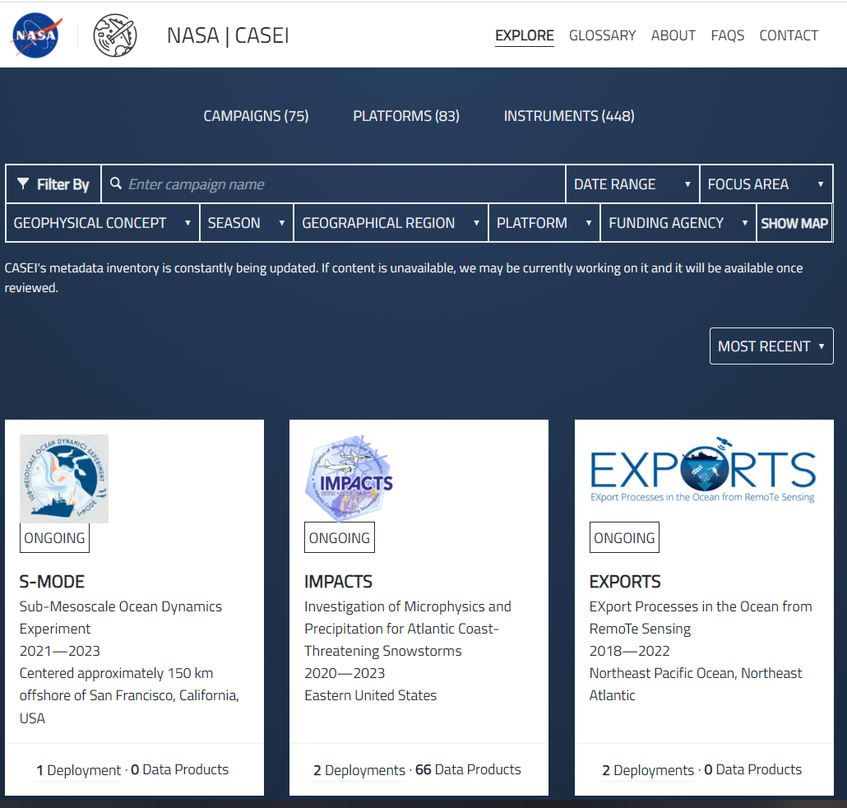
CASEI: The Catalog of Archived Suborbital Earth Science Investigations
https://impact.earthdata.nasa.gov/casei/

Slide 22
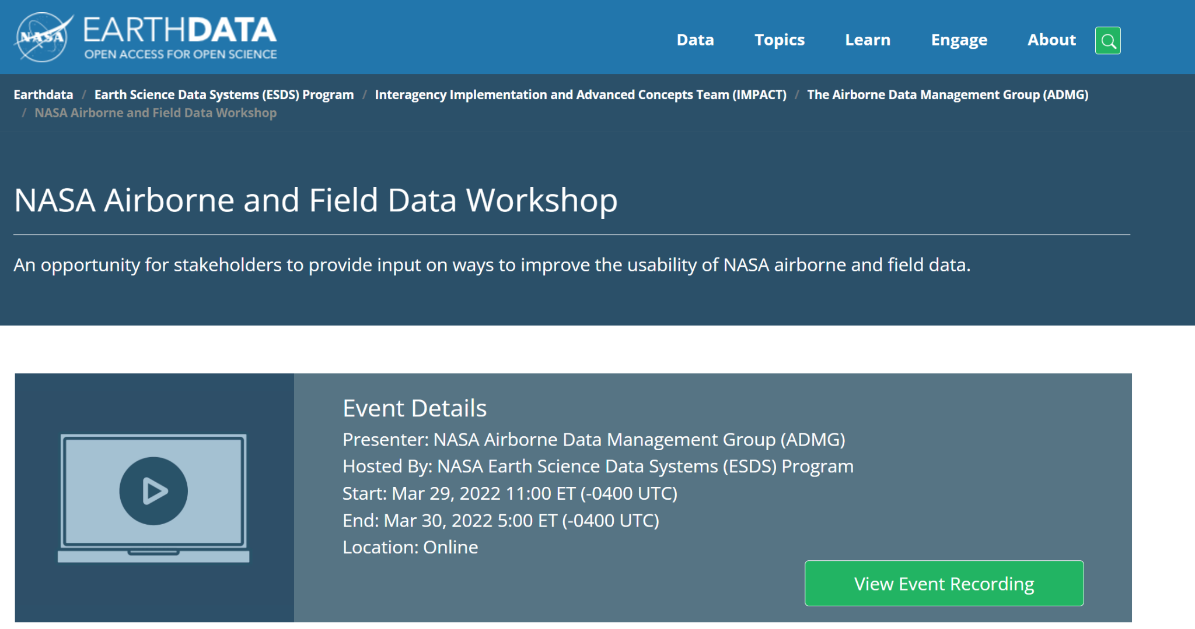
Airborne Data Workshop
Airborne data workshop (Mar 2022) which helped to bring data user and data producer issues to light (recordings)
Read the Final report

Slide 23

Workshop Purpose and Goals
Workshop Purpose: to gather valuable feedback from data users and data producers in order to improve the acquisition and use of NASA’s airborne and field data.
Workshop Goals:
Identify new ways to improve the discovery, access, and reuse of NASA’s airborne and field data
Intentionally include the airborne community in future planning to ensure the community needs are met
Understand how NASA can better help researchers realize the full value of airborne and field data
Enable Open Source Science and determine what this means for airborne and field data communities

Slide 24
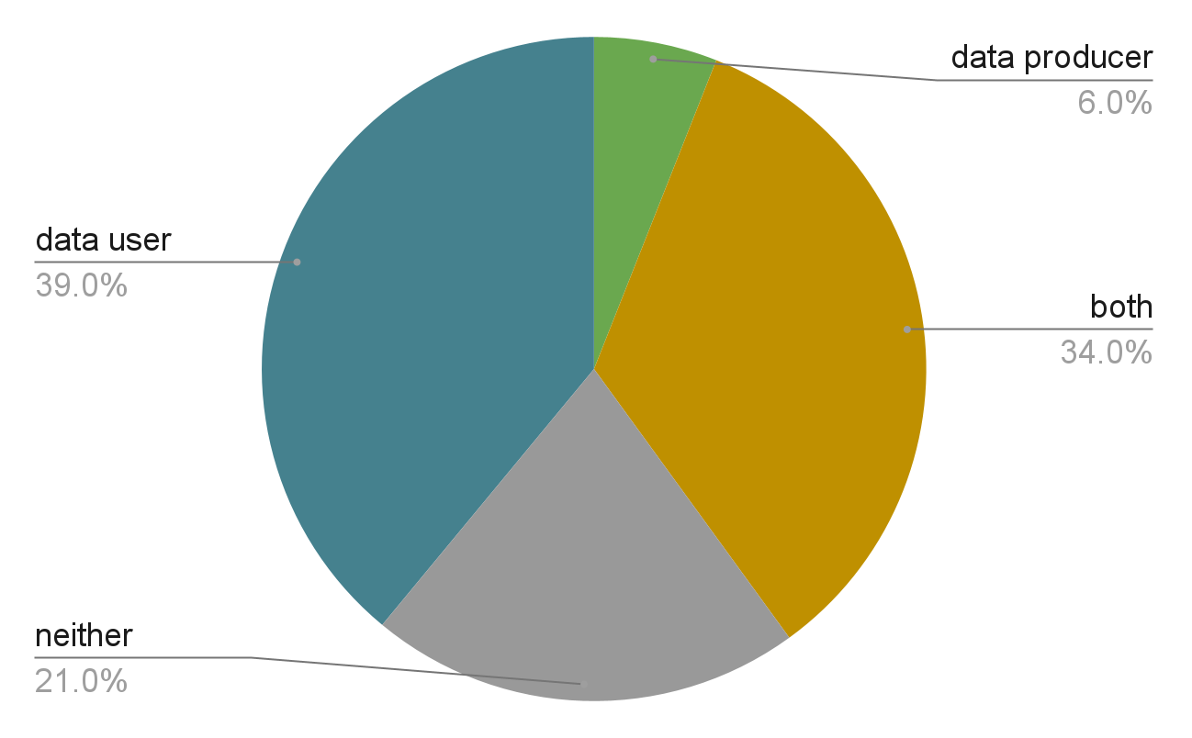
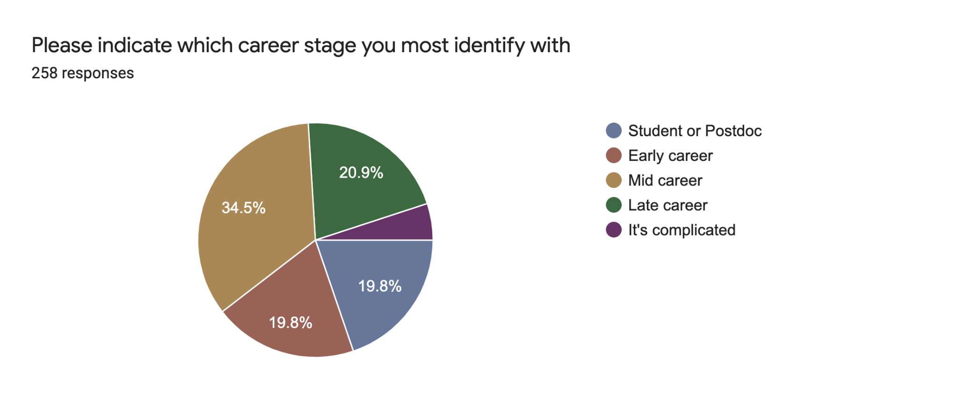

Workshop Attendees
272 people registered for the workshop
Between 50 and 100 attendees at any given time
Maximum attendance occurred on Day 1
Notes:
Over 70% are data users (when adding both)
We hit our target audience
Want producers to hear what users said
Pie chart showing role of workshop registrants. More than one-third of registrants considered themselves both data users and data producers. 2nd figure shows most registrants were students, early and mid career scientists

Slide 25

Immediate changes
(high return, high need, low cost)
Early DAAC assignment
Airborne and Field Resource Center on Earthdata
Improve DAAC Campaign or Instrument Information at DAACs
More consistency in units, file formats and variable names, terms used in communications
Recommendations
Notes:
Build a detailed resource center for data users on Earthdata that will direct users to appropriate resources based on needs. The Airborne and Field Working Group (the Monday meetings) is going to build the resource together.
Recommendations sorted into categories: high need, high return, low cost
3rd bullet: We need contextual information

Slide 26
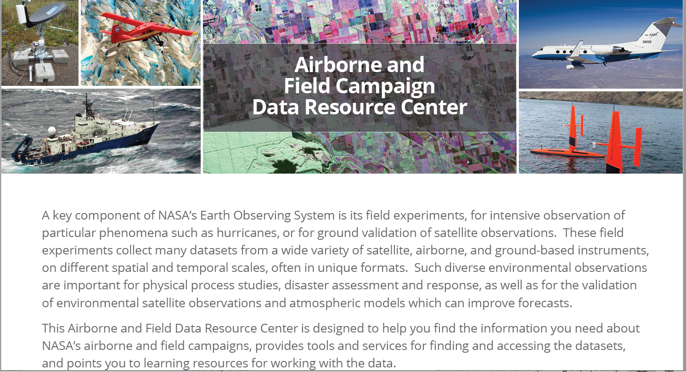

Slide 27
New Tools and Services
Ensure airborne and field data can be found via Earthdata Search
Provide ability to search for multiple variables
  In situ air samples (i.e targeted compounds)
  Air column (i.e. total column)
  Remote sensing of surface - (location, bands, altitude)
  Ocean surface or ocean subsurface
Utilize campaign catalog/flight catalogs across all DAACs and gather contextual information for campaigns
Provide ability to subset data based on location, date, altitude, instrument, platform, flight
Expand/improve existing tools such as Field Campaign Explorer (FCX)
Enable data subscriptions to update users when new data available
Recommendations
Notes:
Just highlight a coupe that I want to mention
Note that this is a long list as users have a lot of needs and they have various amount of effort and work

Slide 28
Program Changes
(high return, low cost, culture change)
Develop uniform and consistent practices across DAACs for documentation and user guides
Plan another workshop in 2 years to assess changes
Provide a means to share Science Team developed code
Recommendations
Notes:
Culture changes: High return, low cost

Slide 29

Explore CASEI: https://impact.earthdata.nasa.gov/casei/
For a CASEI demonstration…
If you have historical data needing a DAAC…
Or if you have any questions about ADMG…
contact deborah.smith@uah.edu
CASEI Webinar registration link: https://www.earthdata.nasa.gov/learn/webinars-and-tutorials/webinar-casei-2023-08-30
ADMG is supported by NASA Grant 80MSFC22M004 as part of the Interagency Implementation and Advanced Concepts Team (IMPACT).

Slide 30
A Quick Word on Leveraging
ESDS Mission and Sub-Orbital Support
ESSP Forum | August 23, 2023
Cerese Albers, Ph.D.
Program Executive, Earth Science Data Systems
NASA Headquarters

Slide 31
Highlighted Contributions from ESDIS and IMPACT Projects facilitating Mission Data for Users
LANCE: NRT portal
Large Data Transfer technologu
ML/ AI and Foundation Models
Visualization Tools
Cloud-based Infrastructure
Sub-orbital campaign explorer (CASEI)
Specific data transformation tools
Common Metadata Repository
Dedicated interfaces and collaborations with other agencies

Slide 32
DAACs are our User-Facing Stewards of Mission Data and Enabling Open Source Science
Create or access specialized tools developed for User communities.
  Some DAAC-developed, some ESDIS-developed, some ESDS-wide
  Cloud access, training, and advanced cloud capabilities for users
Advocates for use of Mission Data by new communities.
Advocates user viewpoints to program and division decision-making
  Advocate requests for addition of new datasets ancillary to original mission
Expert Level of Service applied to data and to curation, maintenance, and long-term preservation
Advocates of user-facing open-science

Slide 33
We want to hear from you!
This is a time for open discussion:
  What are some unique ways you have been helped working directly with a DAAC?
  What is something new you would like to see DAACs do or engage in?
  If there was just one improvement for ESDS Mission Support as-a-whole that you could recommend, what would it be?
  What is a sub-orbital support recommendation that you have for ADMG?

