Slide 1
Beyond the Capture of Lessons Learned
ESSP Program Forum
August 22, 2023
Richie Law
Bart Singer
Trade names and trademarks are used in this report for identification only. Their usage does not constitute an official endorsement, either expressed or implied, by the National Aeronautics and Space Administration.

Slide 2
Topics
Sources for Traditional Lessons Learned Capture and Retrieval
Less Traditional Lesson Learning
Beyond Capture and Searching
.
.
.
And I’d feel badly if I didn’t mention …

Slide 3
Traditional Sources for Lessons Learned Capture and Retrieval?
Slido Question: Where do you look for lessons related to your projects?

Slide 4
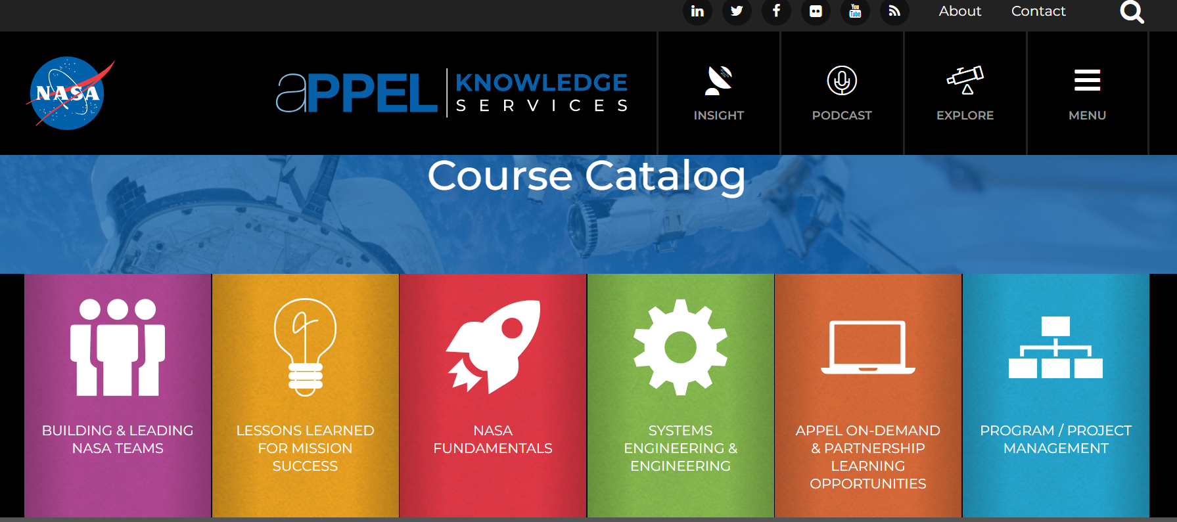
Agency Level Resources
NASA Lessons Learned Information System (LLIS):
https://nen.nasa.gov/web/ll/viewall (inside NASA);
https://llis.nasa.gov/ (outside NASA)
Search for specific lessons!
Academy for Program, Project, and Engineering Leadership (APPEL): https://appel.nasa.gov/
Videos and seminars, courses, knowledge sharing tools, lots of resources!
NASA Engineering Network Knowledge Services
https://nen.nasa.gov/web/km
Support, contact lists etc.
NASA Technical Reports Server (NTRS): https://ntrs.nasa.gov/

Slide 5
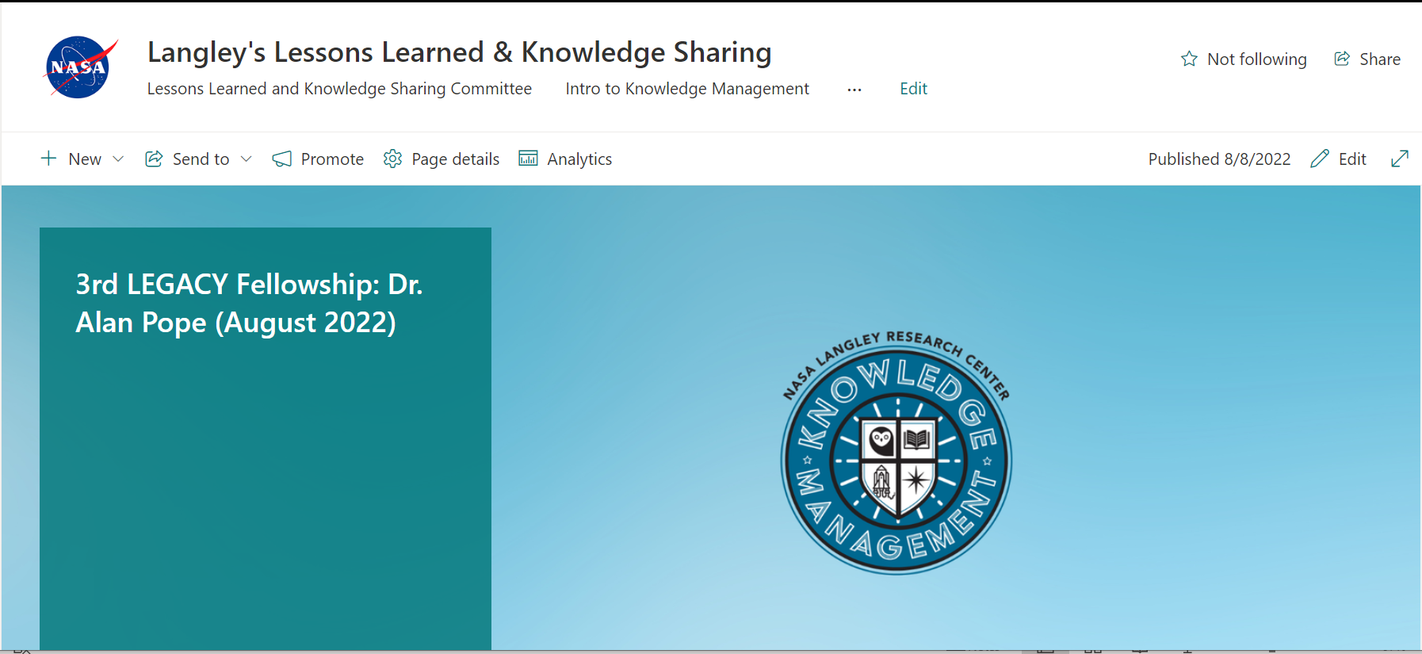
Langley Resources
Langley’s Lessons Learned & Knowledge Sharing: https://nasa.sharepoint.com/sites/larcllksc
Includes information on LEGACY Fellowship, Flight Risk Reduction Manual, and other tools (Continuity Book template + information, Little Things that Matter template, intro to Knowledge Management etc.)
Mentoring Employees to Realize Goals and Experiences (MERGE)
Foster helpful mentor-mentee relationships to transfer information
Langley Institutional Knowledge Management System (IKM): https://oneplace.larc.nasa.gov/ikm
Includes database of Lessons Learned and Best Practices articles – previous ones and ones you can create. Work in Progress for documents -- eventually will include sample documents and templates.

Slide 6
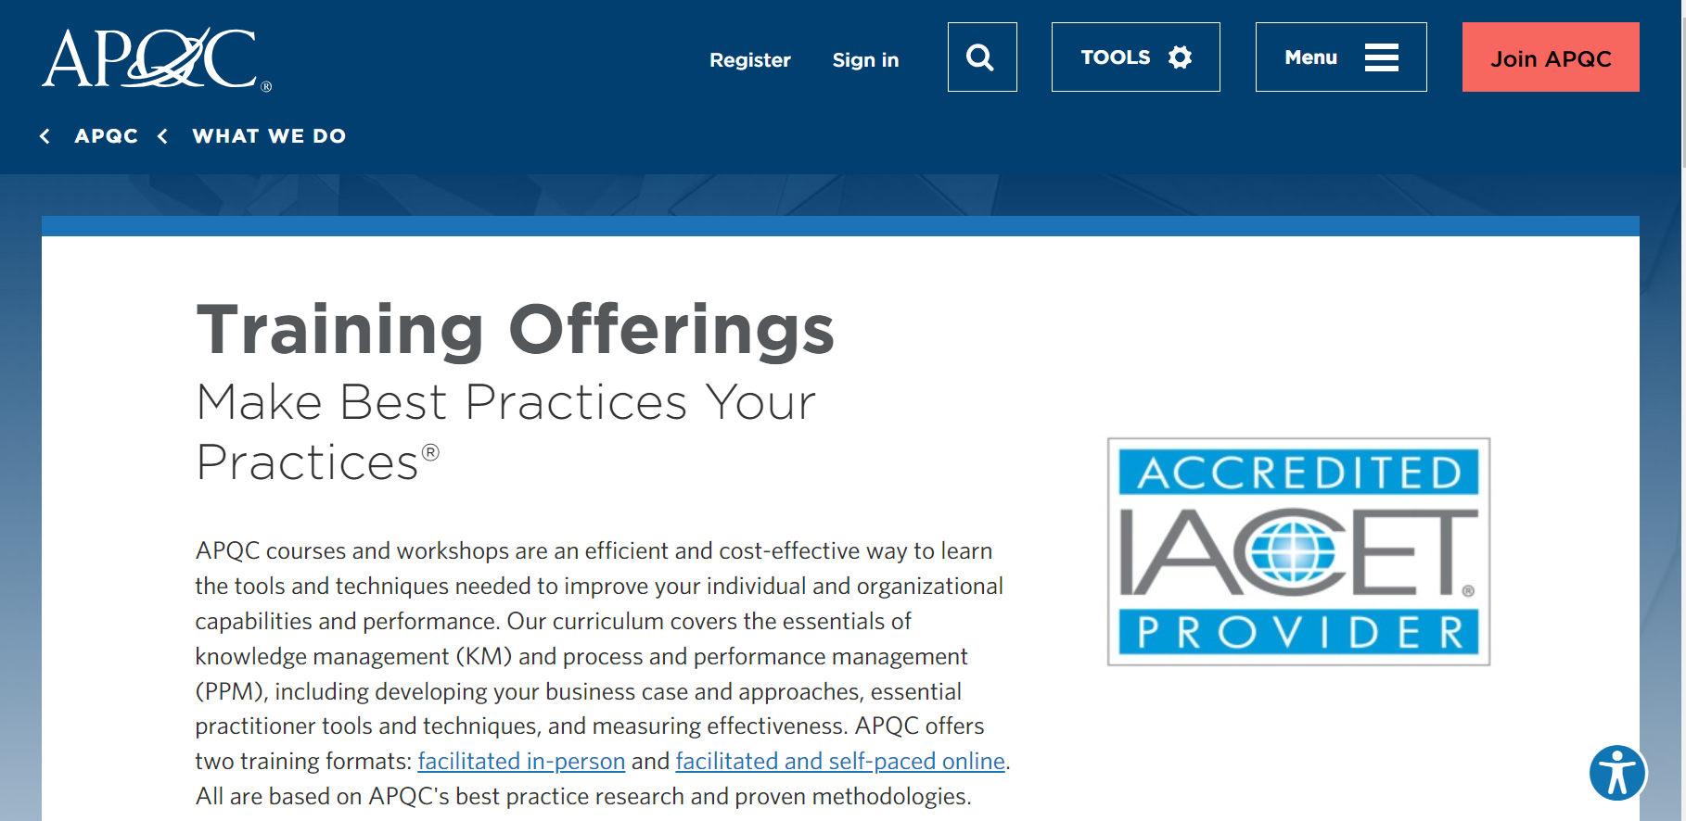
Outside of NASA
DISCLAIMER: No official endorsement of APQC is being made or implied.
American Productivity and Quality Center (APQC): https://www.apqc.org/
Resource Library - articles and infographics on varied topics
Training Practices
Free membership with NASA email address.
Graphic used with permission from APQC

Slide 7
Less Traditional Lesson Learning
Slido Question: Rank how do you prefer to learn?
a. Reading
b. Listening
c. Doing
d. a and b
e. a, b, and c

Slide 8
Aeronautics Research Directorate 12-step process for Flight Demonstration Risk Reduction Vision of modern version of a pop-up book

Slide 9
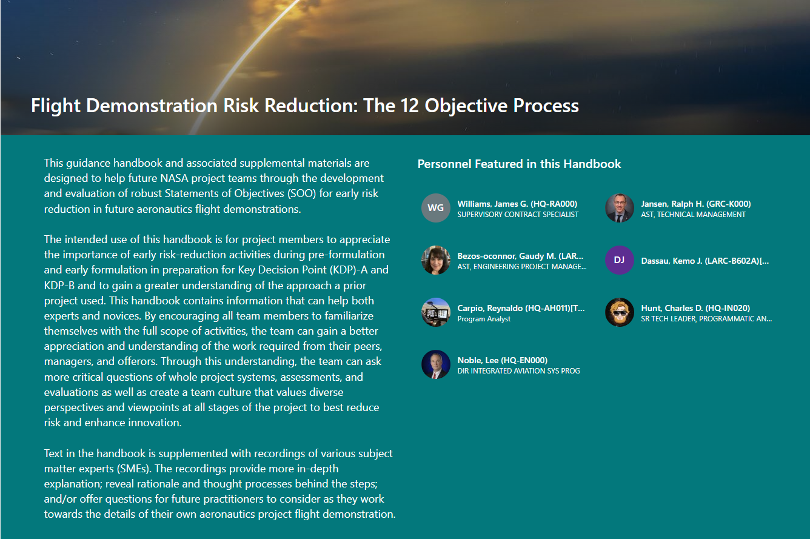
Flight Demonstration Risk Reduction: The 12 Objective Process (sharepoint.com)

Slide 10
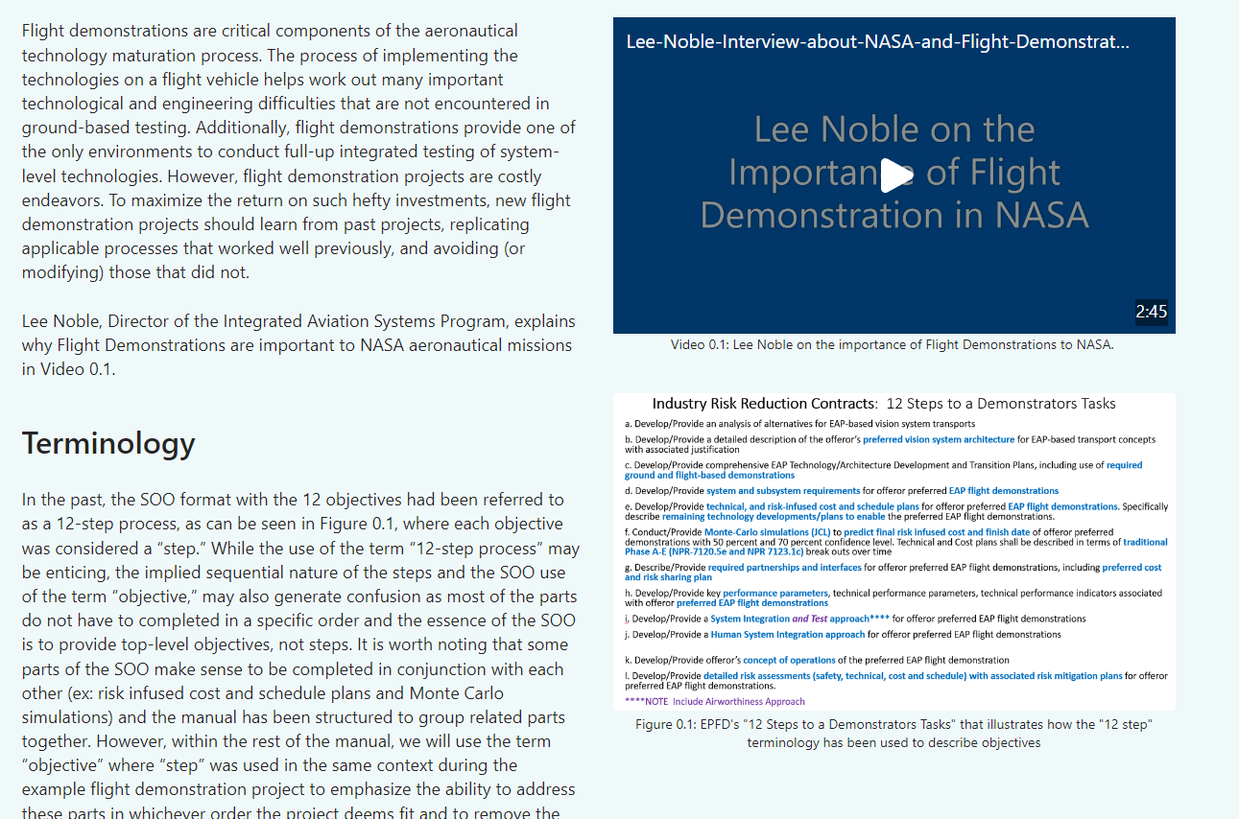

Slide 11
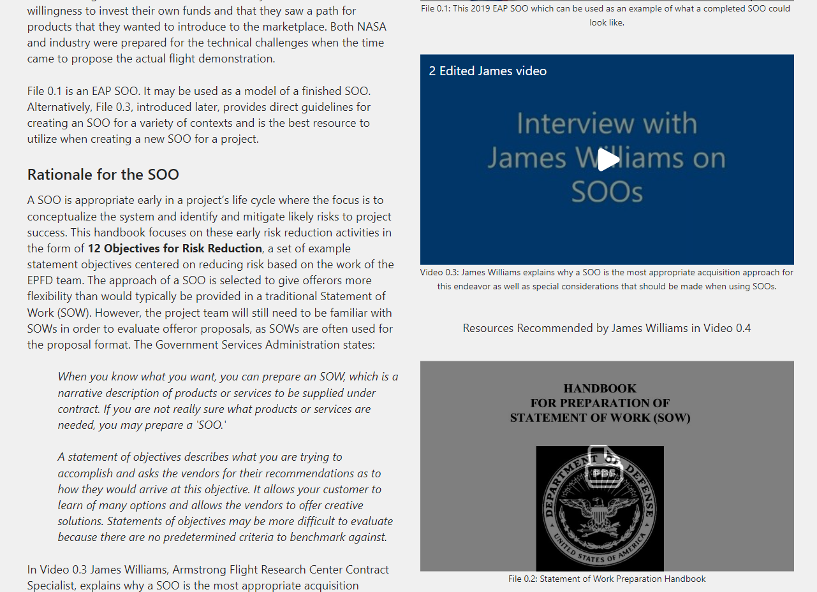

Slide 15
ARMD Chief Engineer’s initial comment: “This is extremely well done. Huge congratulations should go out to all involved in its development and production.”

Slide 16
Beyond Lesson Capture and Searching
Slido Question: Do you explicitly explore lessons learned related to project risks?

Slide 17
Risk Management and the Lessons Learned Bot

Slide 18
Lessons Learned Bot
What is the Lessons Learned Bot?
What is the relationship to Risk Management?
How do I get the Lessons Learned Bot?

Slide 19
What is the Lessons Learned Bot (LLBot)?
Microsoft Excel add-in application
Searches collection (corpus) of documents for those relevant to the contents of an Excel cell
Outputs a relevancy-ranked listing of documents (and abstracts, if provided)
Standard corpuses
NASA Lessons Learned Information System (LLIS)
Langley Institutional Knowledge Management (IKM) Lessons Learned
NTRS publication library

Slide 20
What is the Relationship to Risk Management?
Risk Managers typically use Excel spreadsheets to capture and track risks
The spreadsheets typically contain cells with good textual descriptions of the risks
Simply clicking on a cell with the risk description can provide a list of relevant lessons/documents that might be worth looking at

Slide 21
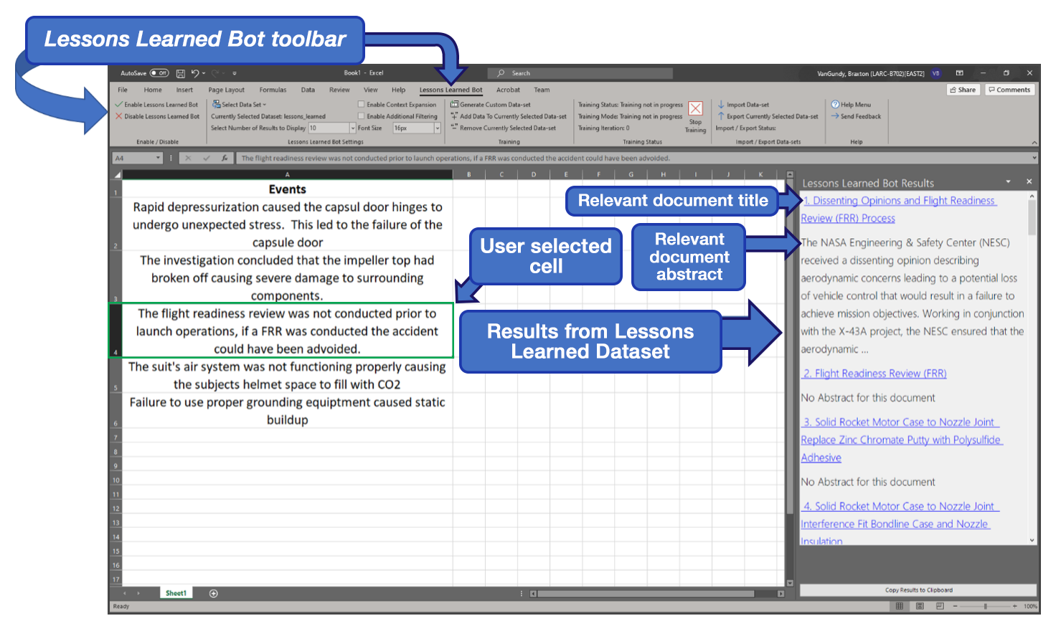

Slide 22
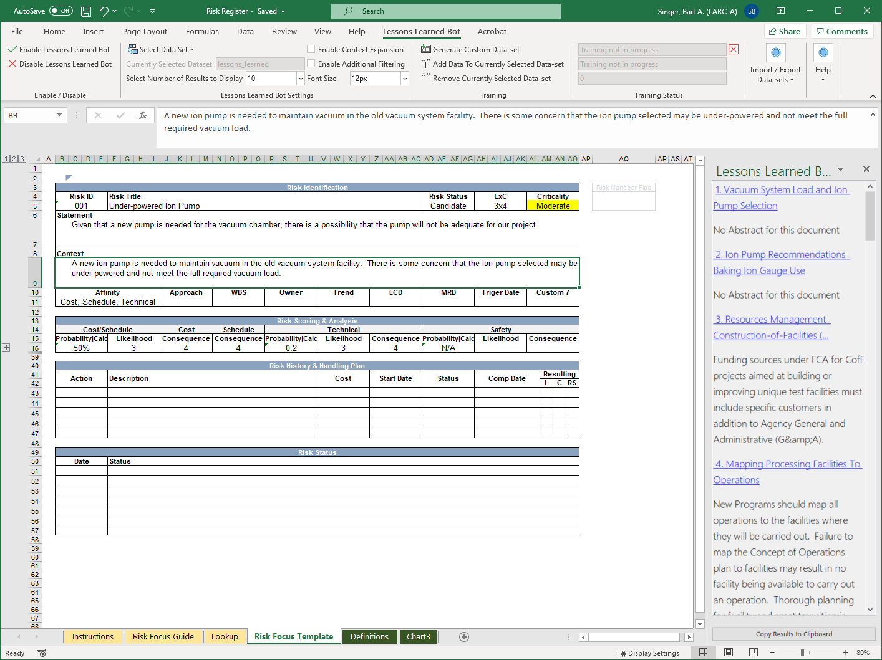

Slide 23
How do I Get the Lessons Learned Bot?
Lessons Learned Bot: https://appel.nasa.gov/lessons-learned/excel-llb/
The Lessons Learned Bot is available for download from the NASA Software Catalog: https://software.nasa.gov/software/LAR-19934-1
Scroll down to the bottom of the page and click the “Request Software” button.
You will need ELEVATED PRIVILEGES to install this application on your machine.

Slide 24
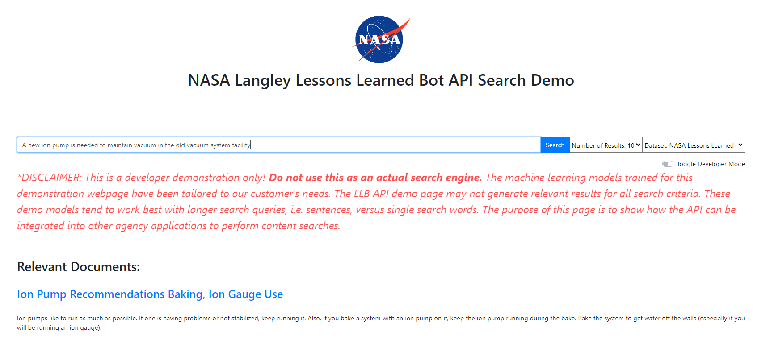
Lessons Learned Bot API
Want to try out the Lessons Learned Bot without going through the EP request process? Try our demo website at https://llbapi.ndc.nasa.gov/ . The demo website does not support CUI, SBU, ITAR, or other types of sensitive information!
We also provide an API to allow the integration of the LLB into other applications within the agency.

Slide 25
LLBot Questions?

Slide 26
Wrap Up
Sources for Traditional Lessons Learned Capture and Retrieval
LLIS
IKM
LL&KSC Sharepoint
Less Traditional Lesson Learning
Flight Demonstration Risk Reduction Handbook
Beyond Lessons Capture and Searching
Lessons Learned Bot
.
.
.
And I’d feel badly if I didn’t mention Langley Knowledge Management Videos

Slide 27
