Slide 1
Tropospheric Emissions:
Monitoring of Pollution
Tropospheric Emissions: Monitoring of Pollution (TEMPO)
Acting PI: Xiong Liu
PM: Kevin Daugherty
August 22, 2023

Slide 2
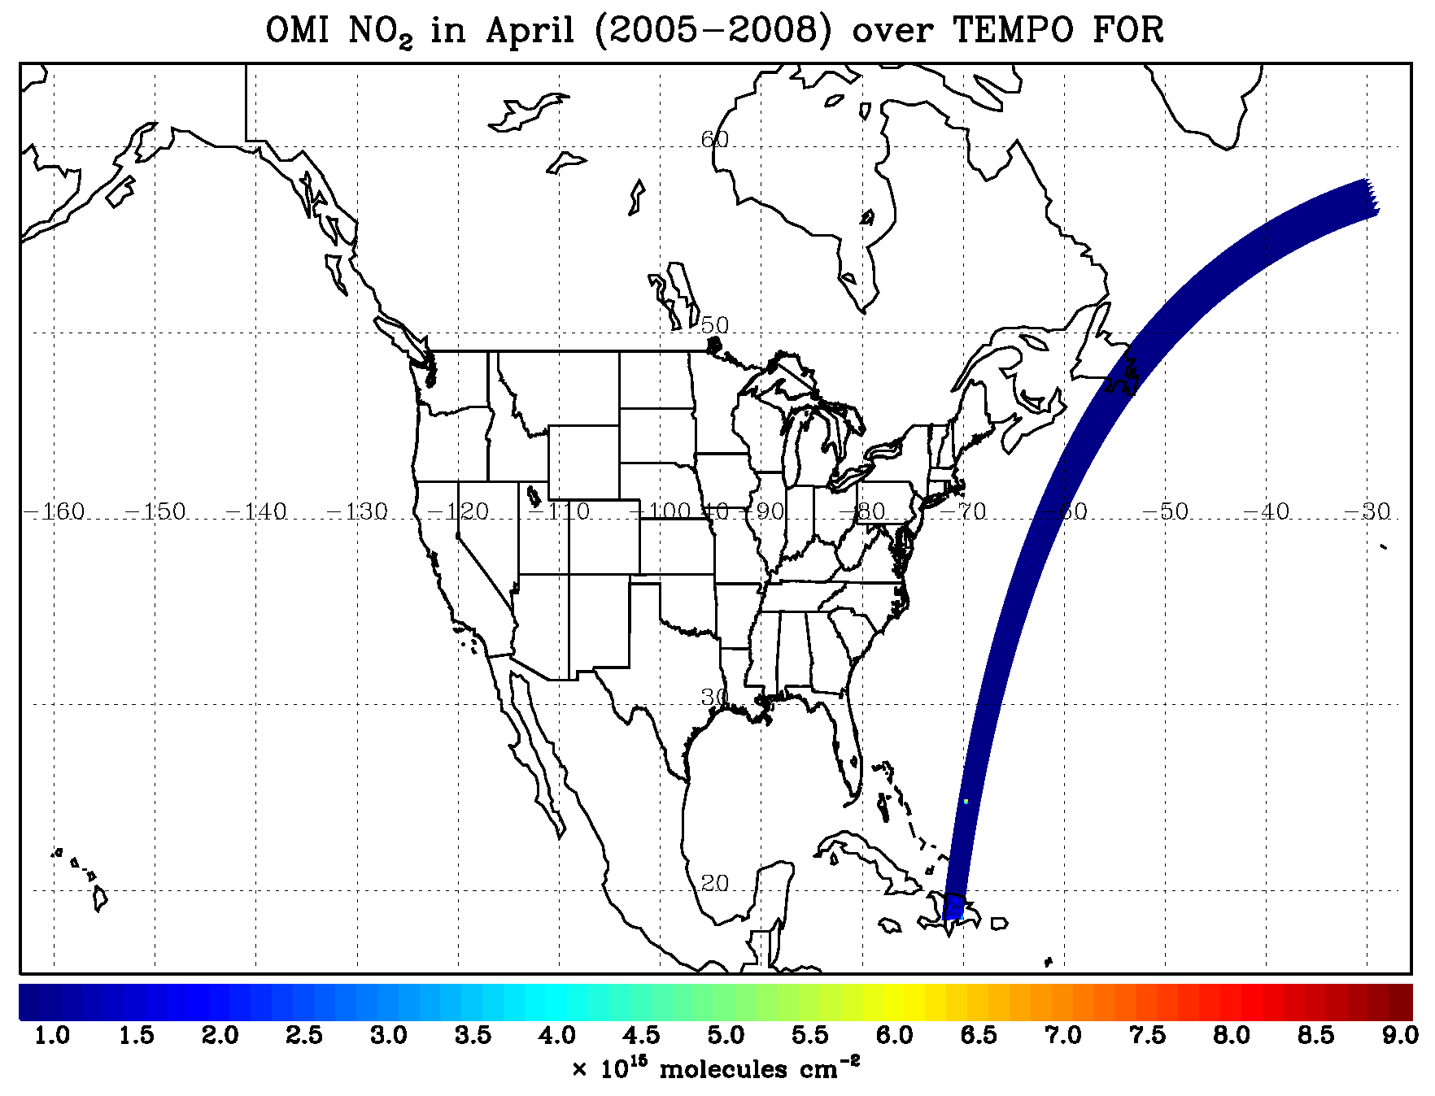
TEMPO At A Glance
TEMPO: Tropospheric Emissions: Monitoring of Pollution
Observing our air quality, hour by hour
Science Objectives:
Collect simultaneous high temporal and spatial resolution measurements of pollutants over Greater North America
Measure the key elements in tropospheric ozone chemistry and aerosol cycles
Observe aerosols and gases for quantifying and tracking evolution of pollution
Integrate observations from TEMPO and other platforms in models to improve representation of processes
Serve as the North American geostationary component of an international constellation for air quality monitoring
Project Approach: Two Class C Projects – one Mission
Instrument Project
Earth Venture Instrument-1; PI-led, cost-capped investigation
Ball Aerospace delivered the TEMPO Instrument, November 2018
UV/Vis grating spectrometer, wavelength: 290-490nm & 540-740nm
60 minute East to West scans of North America
Measurements built on heritage from 5 spectrometers flown in LEO
Mission Project
Directed project to procure commercial satellite hosting services
I&T with commercial satellite
Launch services to GEO
On-orbit and data transmission services
Contract awarded 2019 & Launched 2023

Slide 3
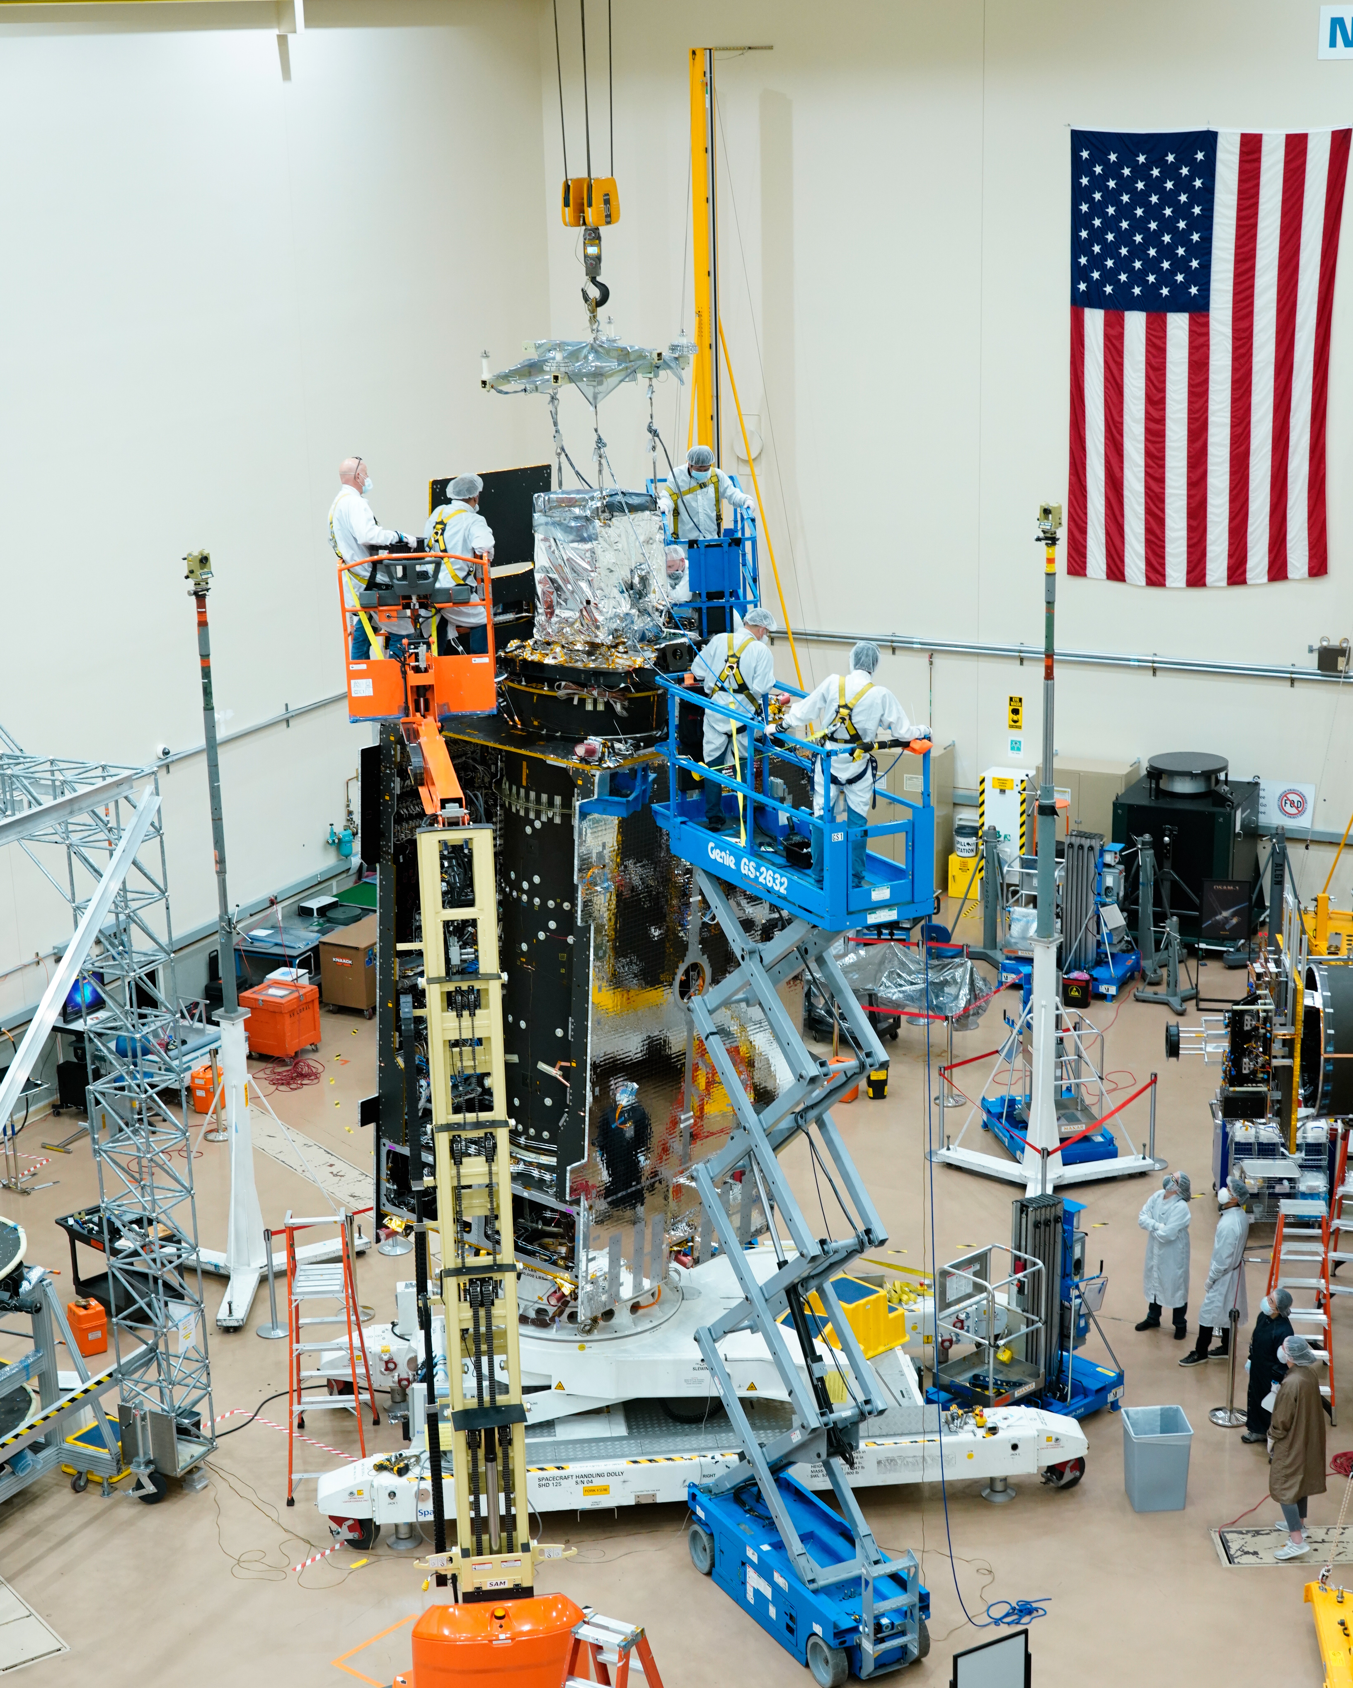
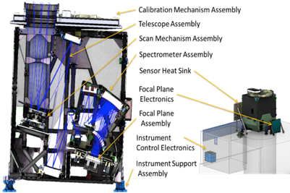
TEMPO Instrument & Hosting
The TEMPO Instrument uses a scan mechanism to focus on a vertical portion of the field of regard; moving from east to west over an hour
TEMPO can support “special observations” where the scan is more limited and revisit times are 10 min or lower
The TEMPO Science Team solicits ideas for special observations using a green paper format
Hosted on Intelsat’s IS-40e manufactured by Maxar, TEMPO view’s North America from a geostationary orbit at 91°W
TEMPO sits on the nadir deck of IS-40e and is flanked by dedicated radiators to provide thermal control
Intelsat provides continuous 24/7 commanding capability and telemetry streams

Slide 5
Tropospheric Emissions: Monitoring of Pollution (TEMPO)
Science Objectives:
Collect simultaneous high temporal and spatial resolution measurements of pollutants over Greater North America
Measure the key elements in tropospheric ozone chemistry and aerosol cycles
Observe aerosols and gases for quantifying and tracking evolution of pollution
Integrate observations from TEMPO and other platforms in models to improve representation of processes
Serve as the North American geostationary component of an international constellation for air quality monitoring
Project Approach: Two Class C Projects – one Mission
Instrument Project (Phase D)
Earth Venture Instrument-1; PI-led, cost-capped investigation
Ball Aerospace delivered the TEMPO Instrument, November 2018
UV/Vis grating spectrometer, wavelength: 290-490nm & 540-740nm
60 minute East to West scans of North America
Measurements built on heritage from 5 spectrometers flown in LEO and operational algorithms
Mission Project (Phase D)
Directed project to procure commercial satellite hosting services
I&T with commercial satellite
Launch services to GEO
On-orbit and data transmission services
Contract awarded 2019 & Launched 2023
Project Team
Smithsonian Astrophysical Observatory: Principal Investigator, Science Team, Science Data Processing, Instrument Ops Center (PI: Dr. Kelly Chance)
NASA Langley: Project Management, Systems Engineering, Safety/Mission Assurance, Spacecraft hosting services
Ball Aerospace: Instrument developer and spacecraft integration support
Maxar Technologies: Spacecraft hosting services [includes sub-contractors Intelsat (owner-operator) and SpaceX (launch services)]
USSF Space and Missile Systems Center (SMC): Hosted Payload Solutions (HoPS) Contract Administrator
Science Team and International Science Advisory:
NOAA, EPA, GSFC, NCAR, Harvard, St. Louis U, UC Berkley, U Alabama, U of Iowa, UMBC, Dalhousie U, Carr Astro, South Korea (GEMS) & Europe (Sentinel)
5

