Slide 1
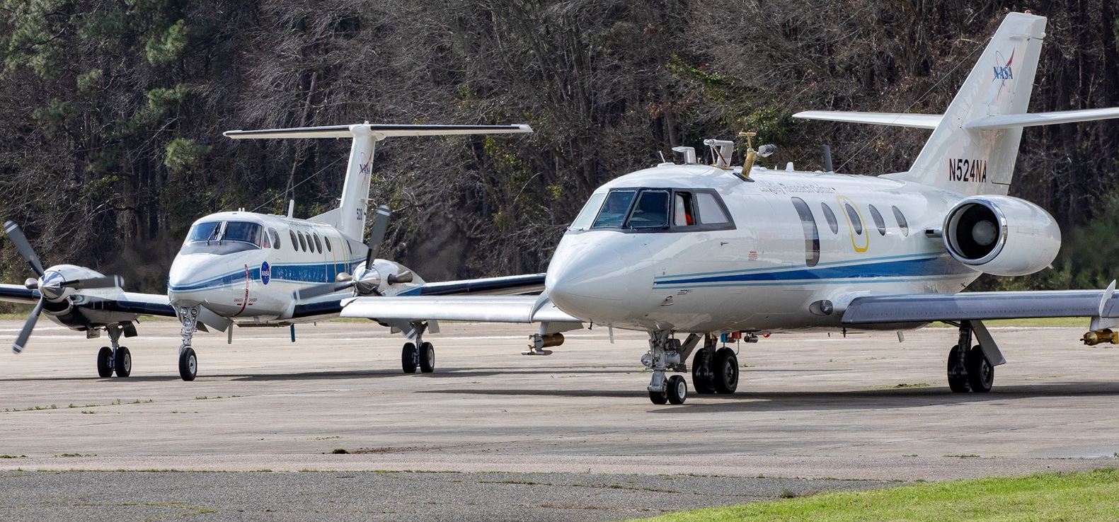
ACTIVATE: An EVS-3 Mission
Aerosol-Cloud Interactions: largest uncertainty in radiative forcing estimates
Armin Sorooshian (University of Arizona)
ACTIVATE science team
NASA ESSP Forum, 22-23 August 2023

Slide 2
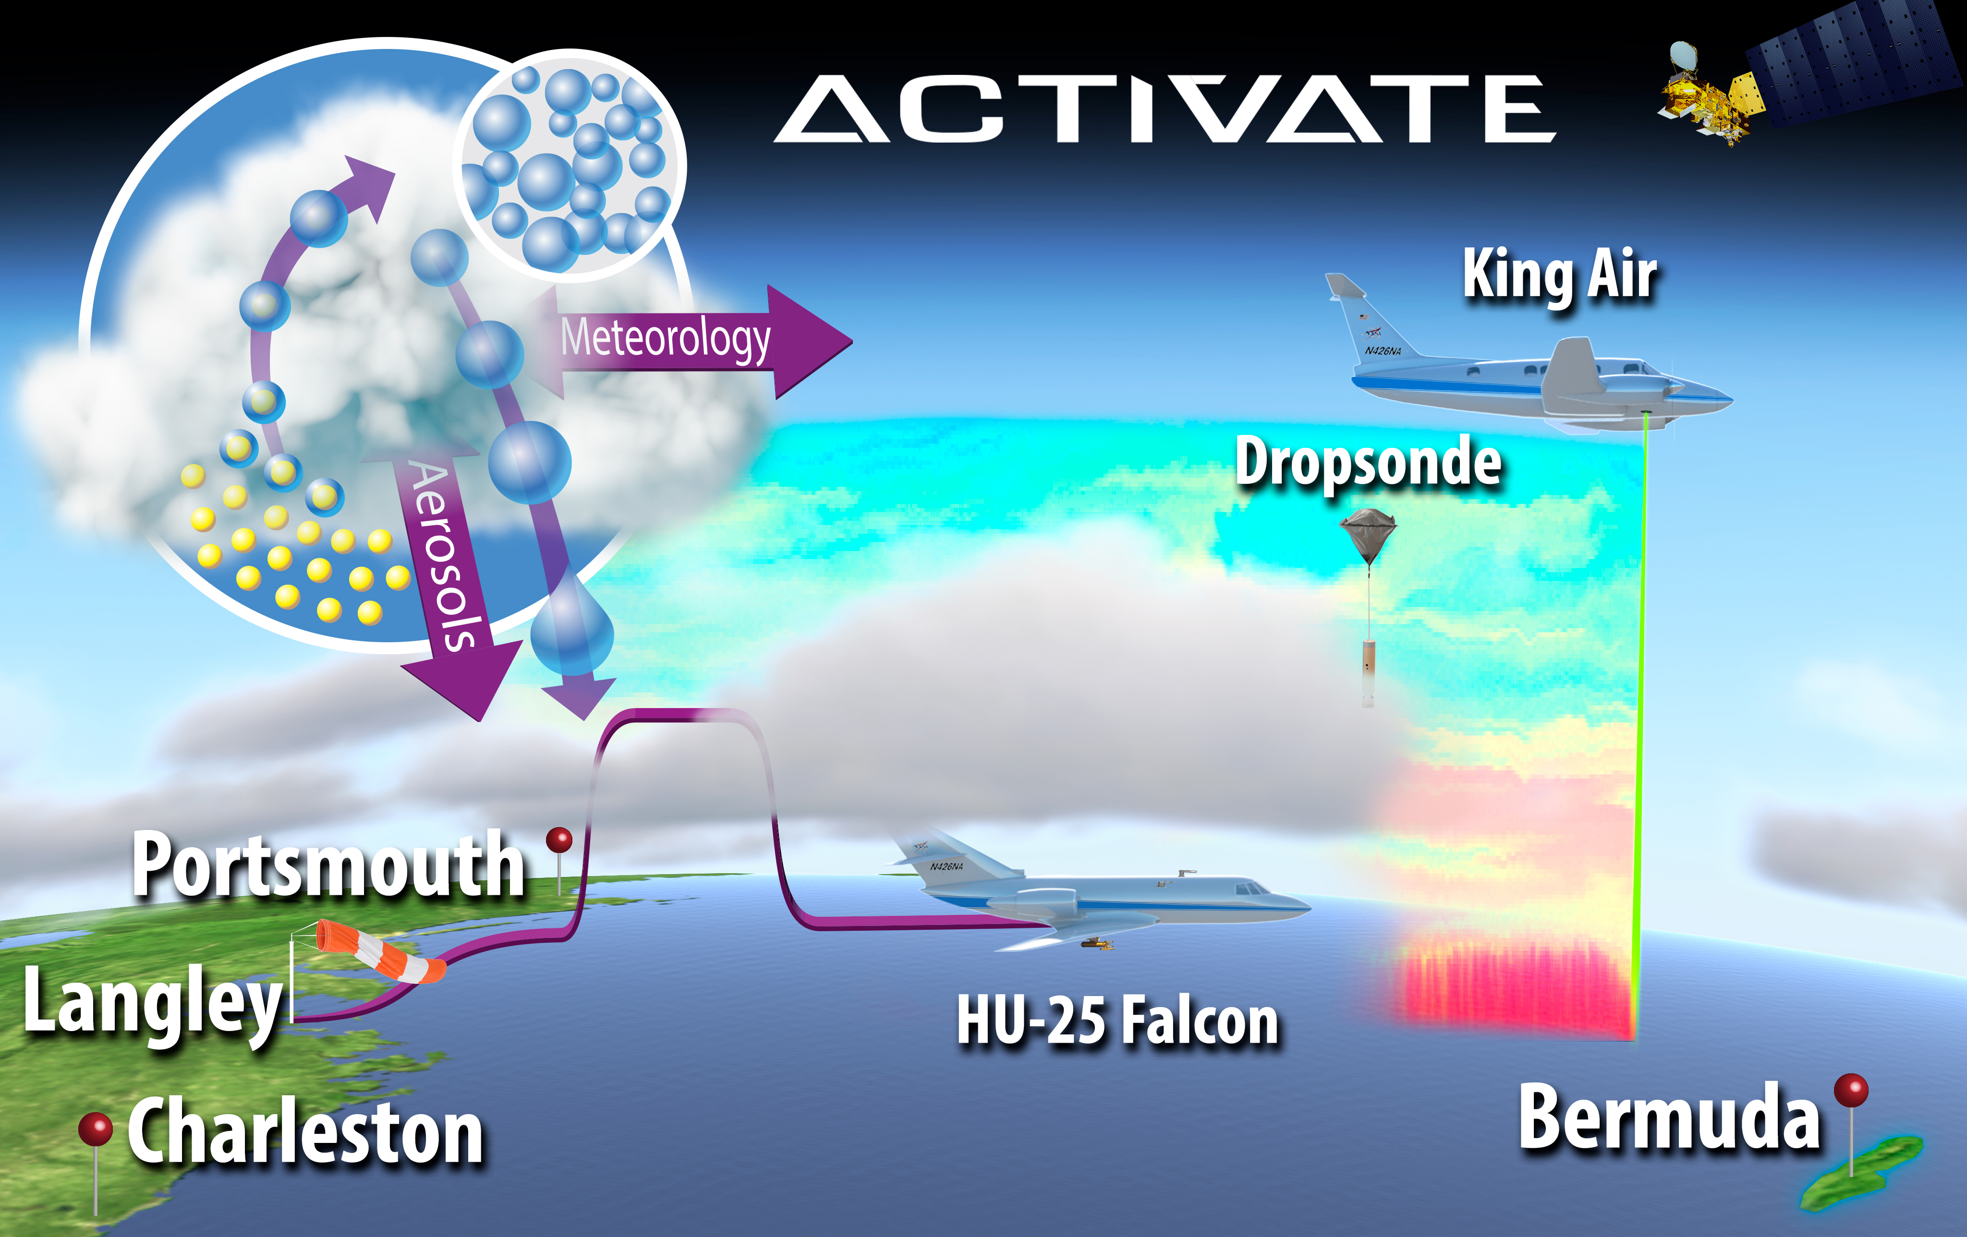
Aerosol Cloud meTeorology Interactions oVer the western ATlantic Experiment (ACTIVATE)
https://activate.larc.nasa.gov/
Science: Build an unprecedented dataset to better understand aerosol-cloud-meteorology interactions, improve physical parameterizations for Earth system and weather forecasting models, assess remote sensing retrieval algorithms, and guide plans for future satellite missions.
Airborne element:
  Platforms: HU-25 Falcon + King Air
  Initial goal: 150 joint airplane missions (~600 hrs per plane) over northwest Atlantic
  Based out of NASA LaRC, Hampton, VA
Approach:
  Measurements: In situ and remote sensing measurements of aerosol and cloud distributions and properties, atmospheric state
  Modeling: Particle dispersion, chemical transport, single-column, large-eddy simulation, cloud-resolving, weather forecasting and climate modeling
PI: Armin Sorooshian (U. Arizona)
Project Scientist: Johnathan Hair (LaRC)
Investigation Manager: Mary Kleb (LaRC)
Partnering Institutions: U. Arizona, NASA LaRC, NASA GISS, NCAR, SSAI, NIA, PNNL, BNL, U. Miami, DLR (Germany), NOAA, USC, U-Washington
Science Team > 130 people and growing
2

Slide 3
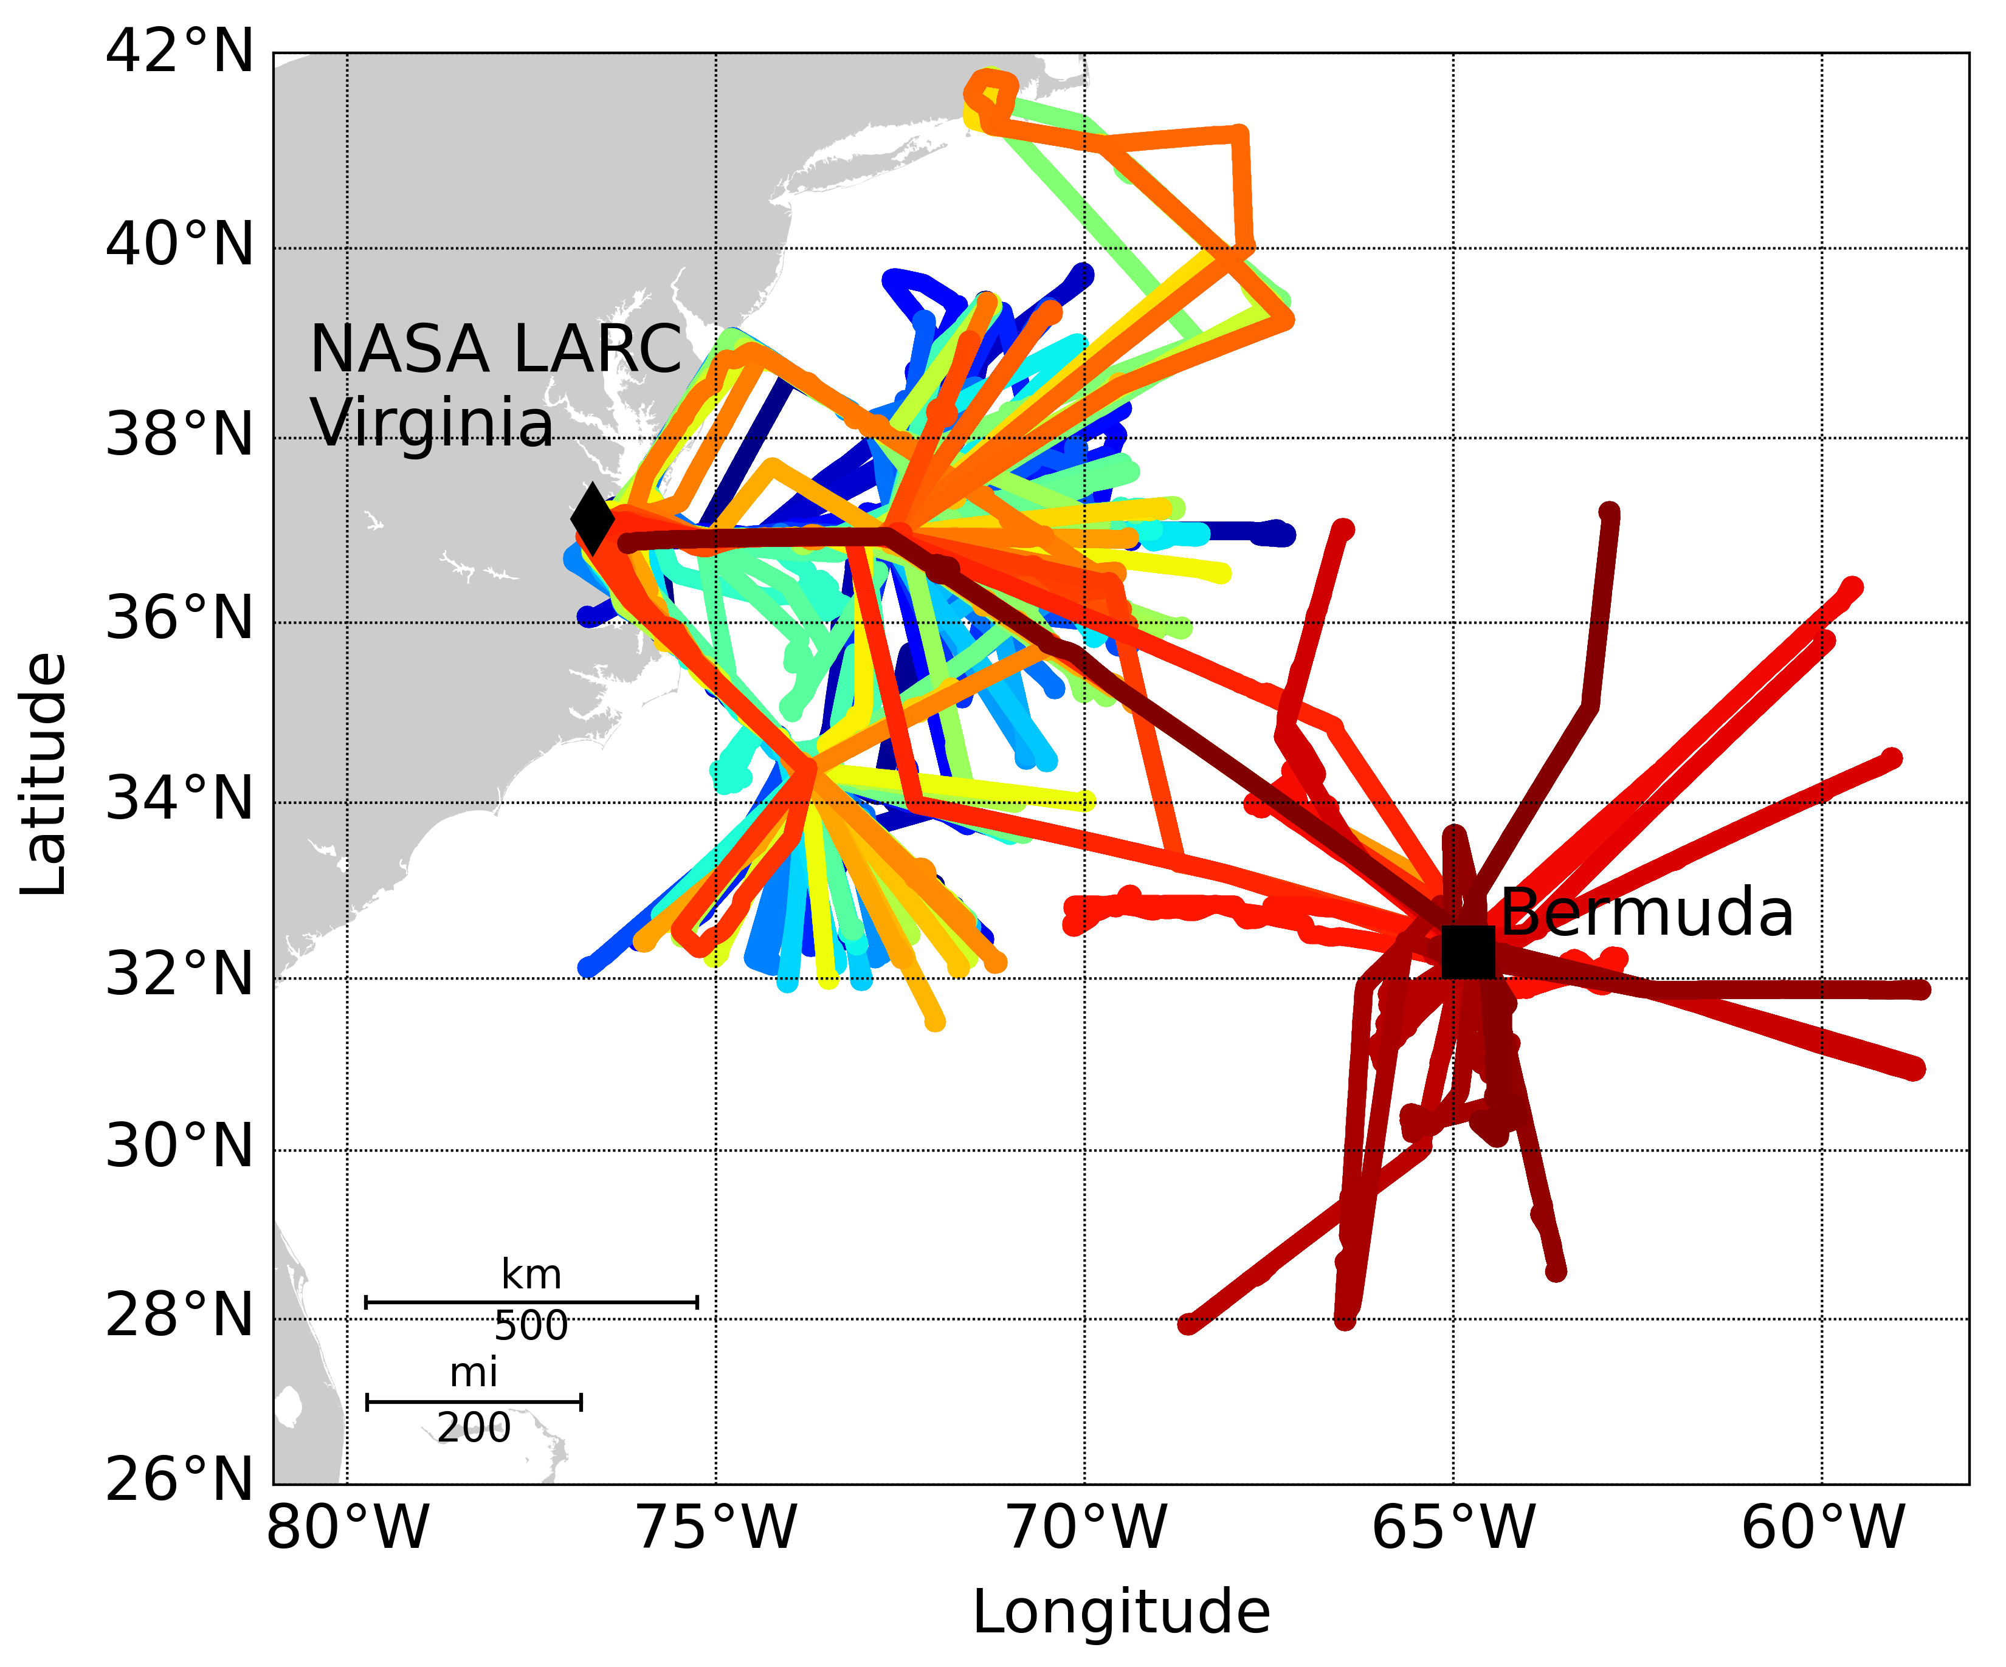
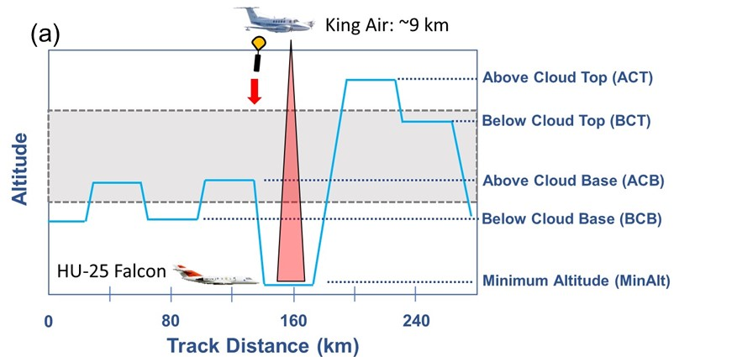
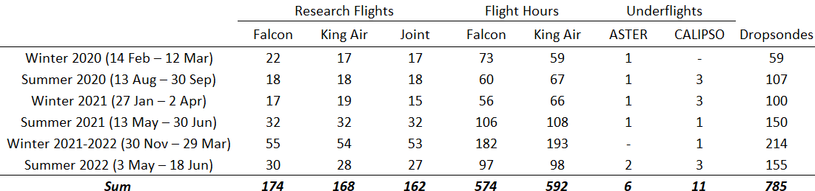
Flight Concept
Final Flight Metrics

Slide 4
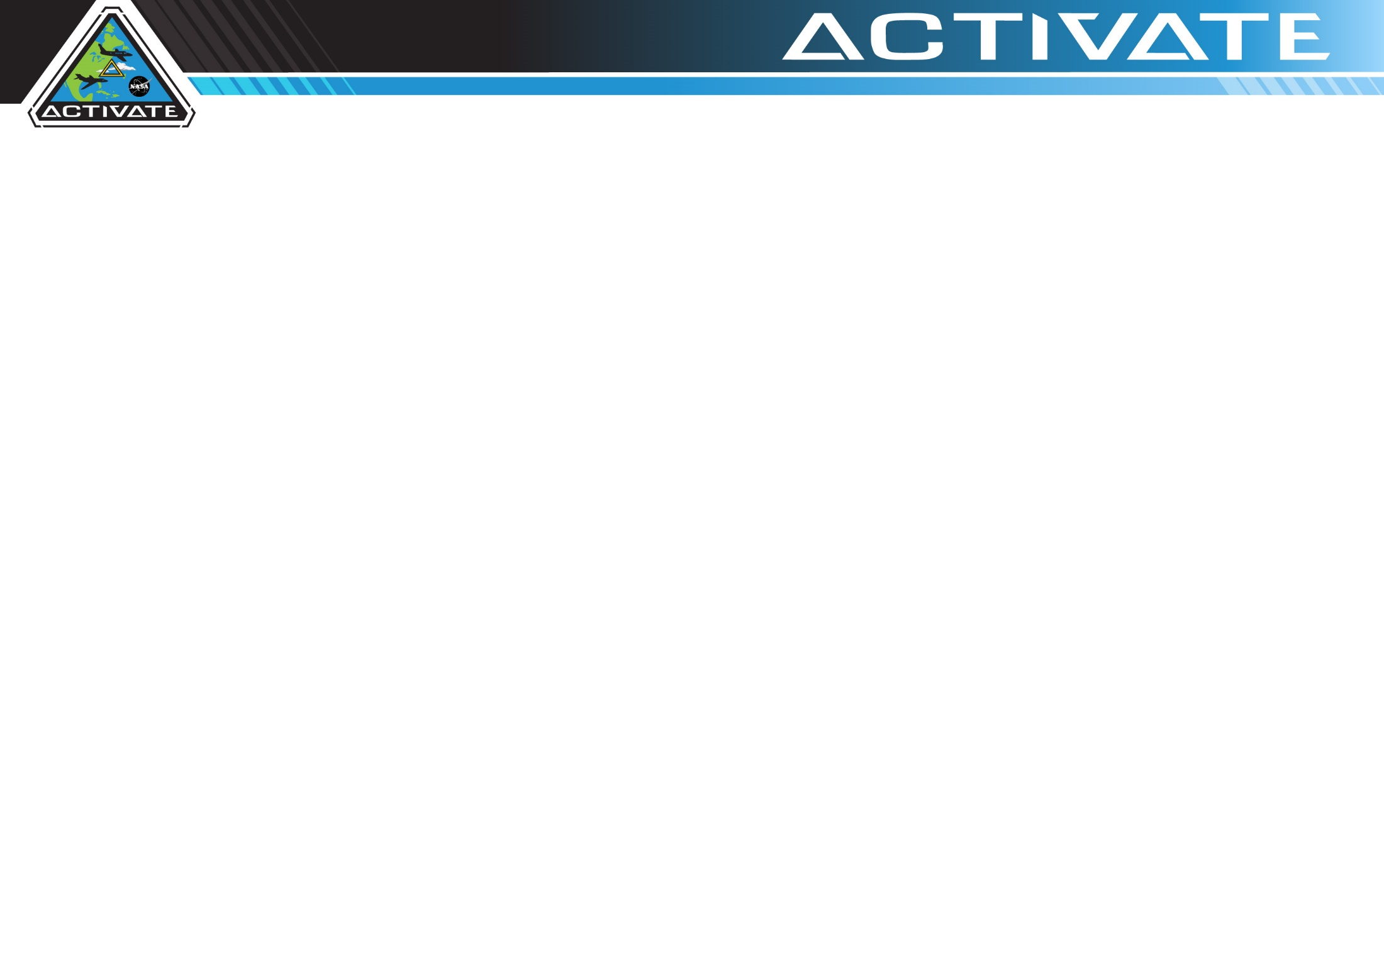
Objective 1: Quantify relationships between aerosols, cloud condensation nuclei (CCN), and cloud drops and reduce uncertainty in model parameterizations of cloud droplet activation.
Objective 2: Improve process-level understanding and model representation of factors governing cloud micro/macro-physical properties and how they couple with cloud effects on aerosol.
Objective 3: Assess advanced remote sensing capabilities for retrieving aerosol and cloud properties related to aerosol-cloud interactions.
Sorooshian et al. (2019), BAMS
4

Slide 5
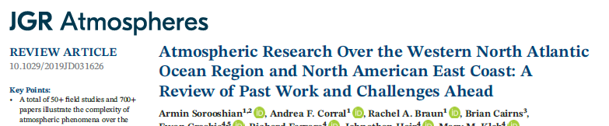
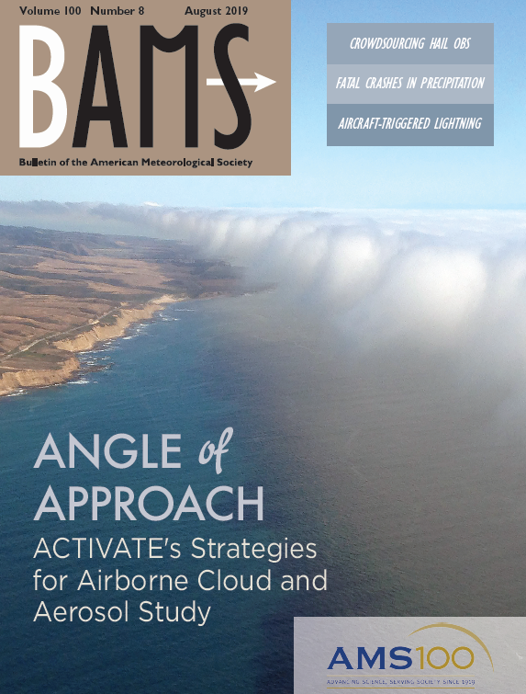
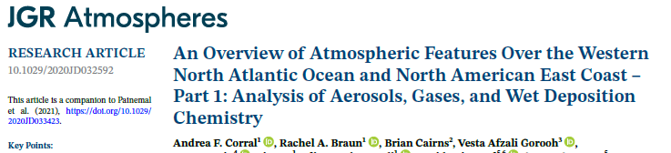
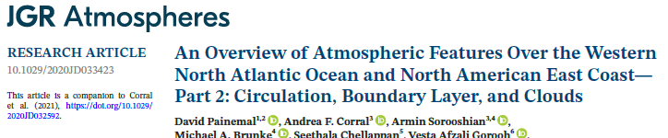
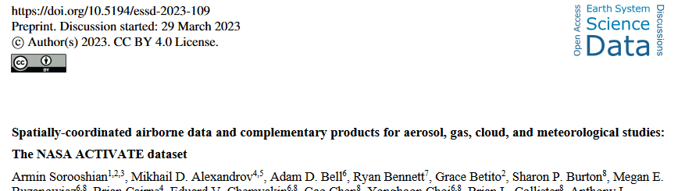
53 peer-reviewed publications: https://activate.larc.nasa.gov/publications/
Open data workshop materials: https://asdc.larc.nasa.gov/news/activate-data-webinar-materials
5

