Slide 1
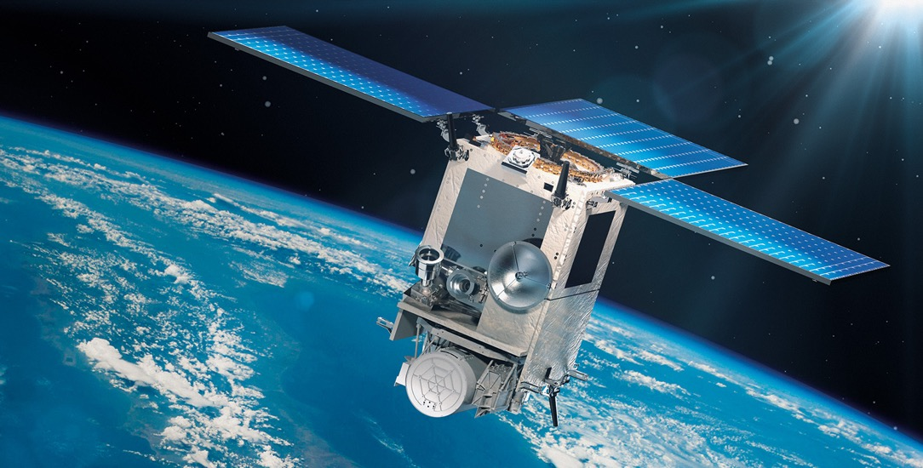


Associating airborne particulate matter and human health with the Multi-Angle Imager for Aerosols (MAIA)
David Diner
Stacey Boland
Kevin Burke
Sina Hasheminassab
Saagar Patel
Jet Propulsion Laboratory,
California Institute of Technology
© 2023 California Institute of Technology.
Government sponsorship acknowledged.
ESSP Forum
22-23 August 2023

Slide 2
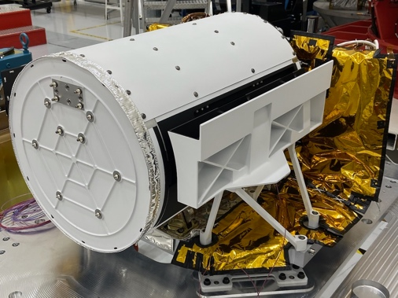
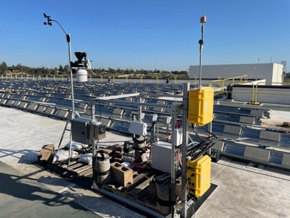
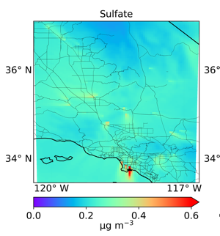


MAIA (EVI-3) background
1
MAIA will link exposure to different PM types (mixtures of particles having different sizes, shapes, and compositions) with human health.
NASA/JPL multi-angle imaging spectropolarimeter aboard Italy’s PLATiNO-2 spacecraft (2025 launch) | Surface monitors (operations currently underway) | Chemical transport model (WRF-Chem) | Birth, death, hospitalization records (privacy protected)
MAIA is a partnership between NASA and Agenzia Spaziale Italiana (ASI)
24-hr averaged concentrations of PM₁₀, PM_{2.5}, speciated PM_{2.5} at 1-km spatial resolution over selected major metropolitan centers
Epidemiological studies

Slide 3
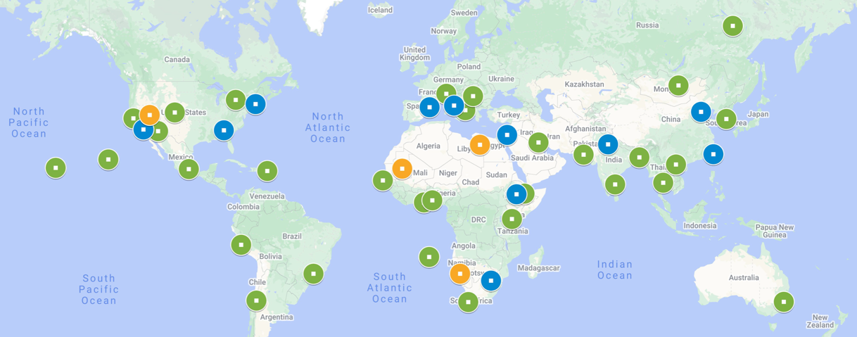
MAIA observation sites consist of a
globally distributed set of target areas
2
Epidemiological studies in the PTAs
Exposure timescale Health outcomes
Acute (days to weeks) Emergency room visits, premature deaths
Subchronic (months) Adverse birth outcomes, pregnancy complications
Chronic (years) Cardiovascular and respiratory diseases
Primary Target Areas (PTAs): Surface monitor data collections, epidemiological studies
  3 - 4 satellite observations/week
Secondary Target Areas (STAs): Air quality and climate studies
  Typically 1 - 3 satellite observations/week
Calibration/Validation Target Areas (CVTAs)
  Instrument and algorithm performance maintenance

Slide 4
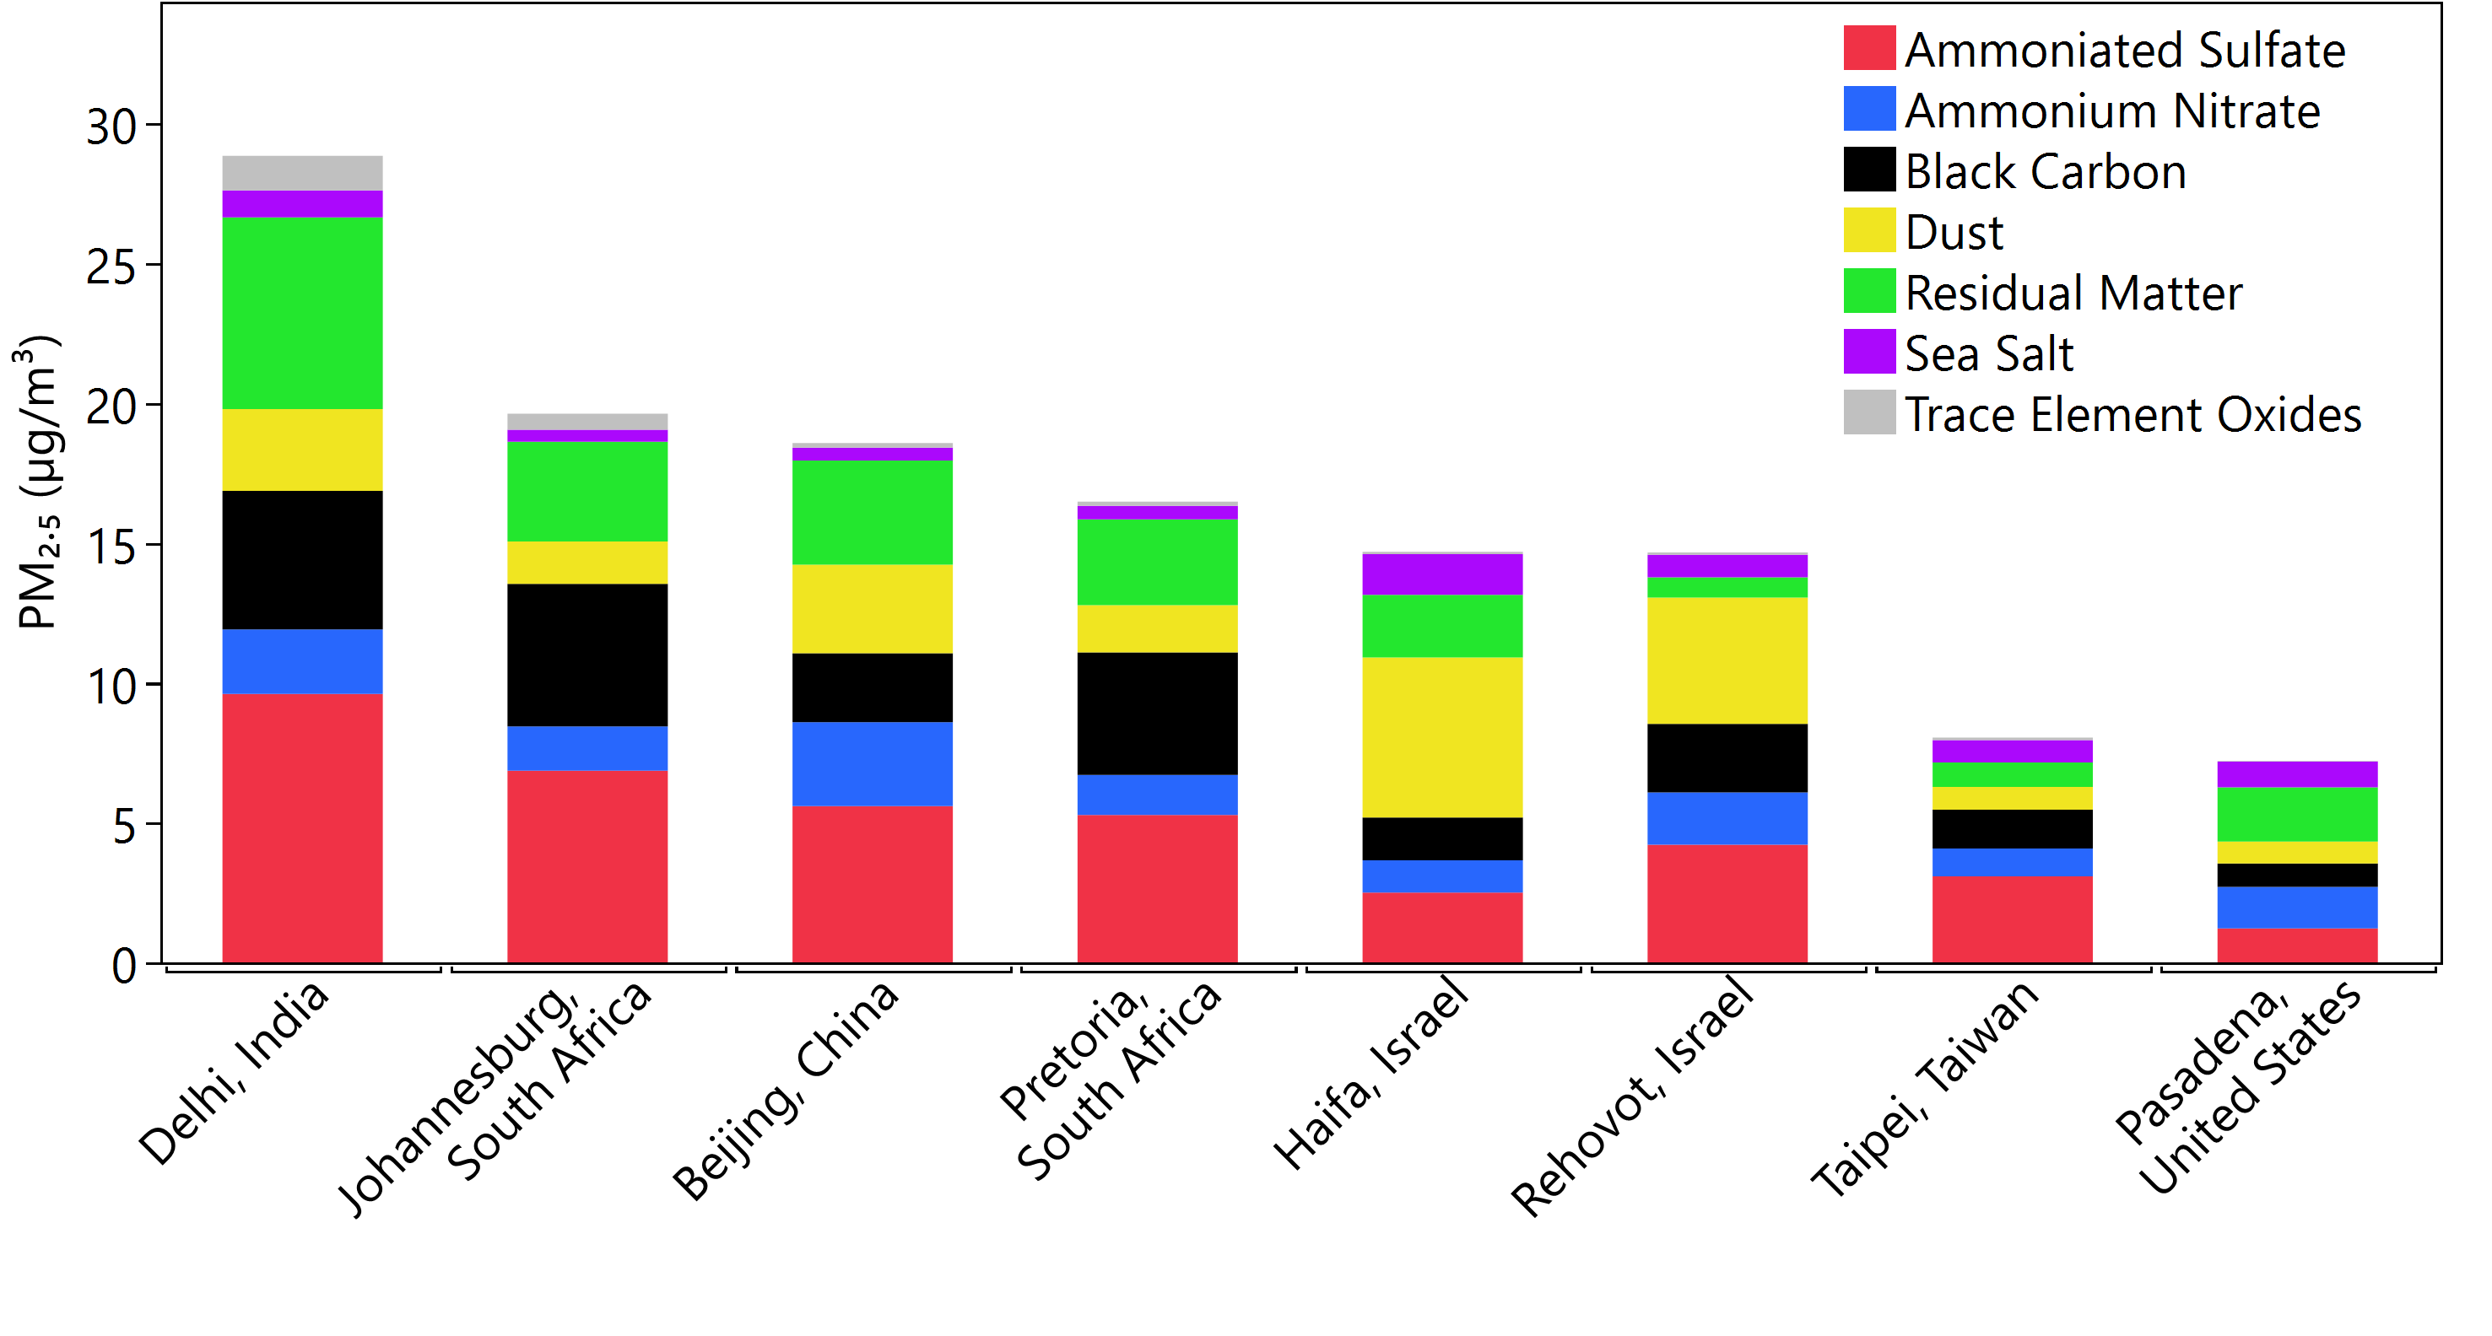
Pre-launch surface monitor-based speciated PM_{2.5} concentrations are being collected in the PTAs
3
Addis Ababa, Ethiopia
(US Embassy, Jacros)
Data from filter-based samplers in the Surface Particulate Matter Network (SPARTAN)
Time-resolved total PM_{2.5} and aethalometer black carbon data
7/2022 - 7/2022 | 4/2022 - 5/2022 | 3/2020 - 6/2022 | 10/2020 - 4/2022 | 2/2022 - 6/2022 | 1/2020 - 6/2022 | 1/2022 - 7/2022 | 11/2021 - 7/2022
3/2022-11/2022

