Slide 1
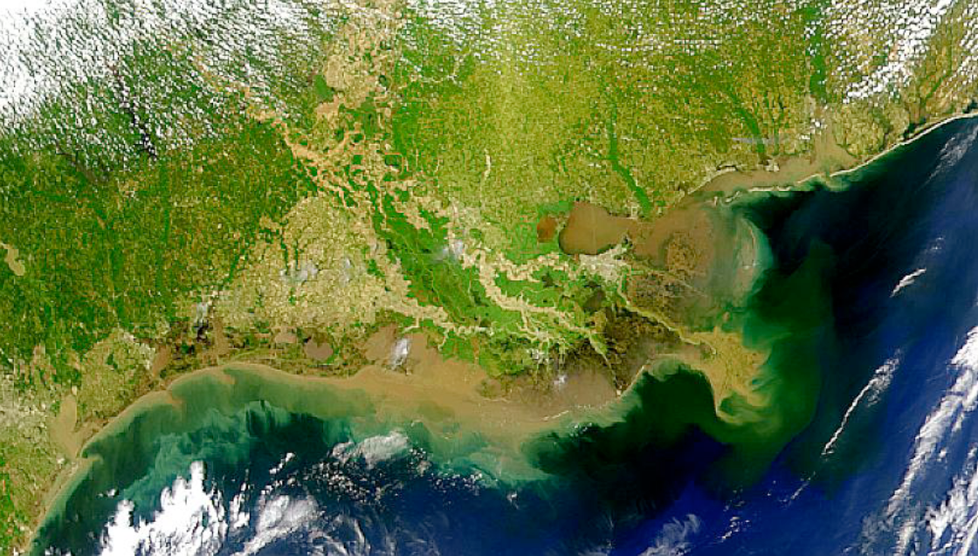
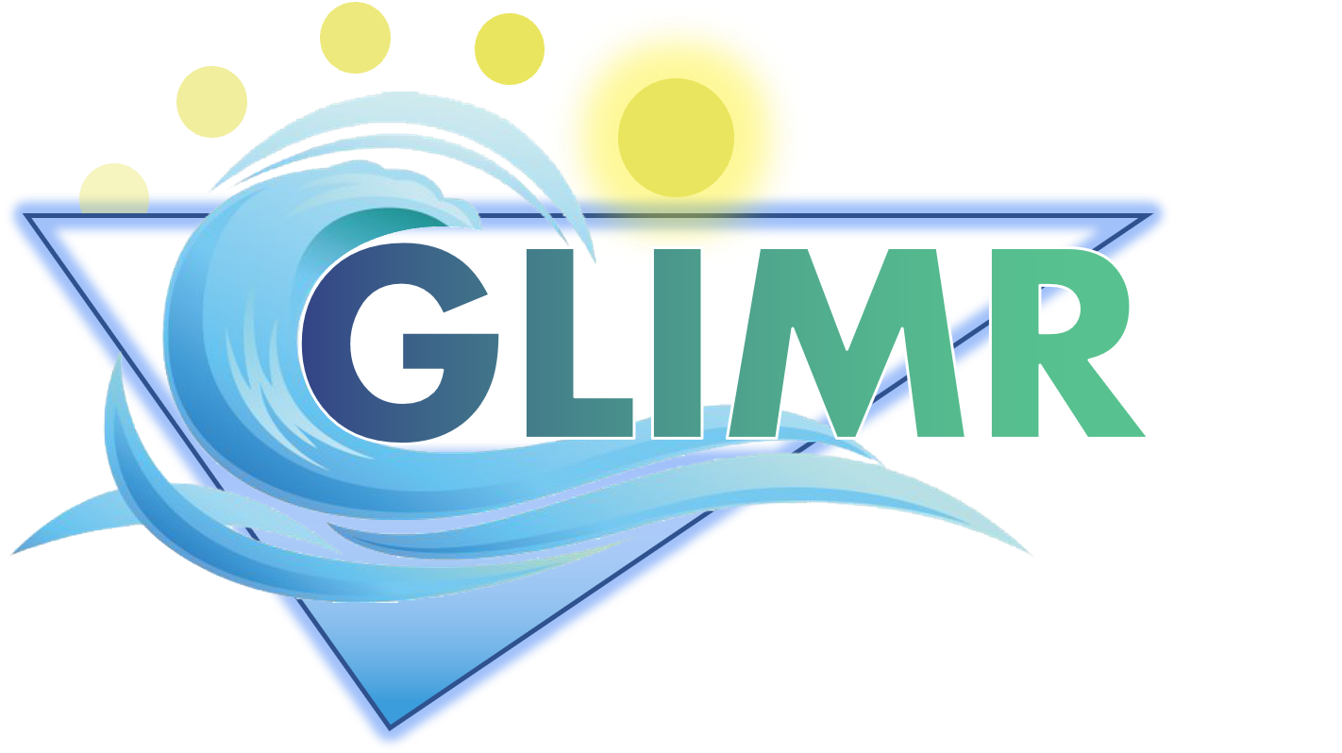




Geostationary Littoral Imaging and Monitoring Radiometer (GLIMR):
J. Salisbury (UNH), A. Mannino (NASA GSFC Ocean Ecology Laboratory), Jenn Epstein (UNH)

Slide 2
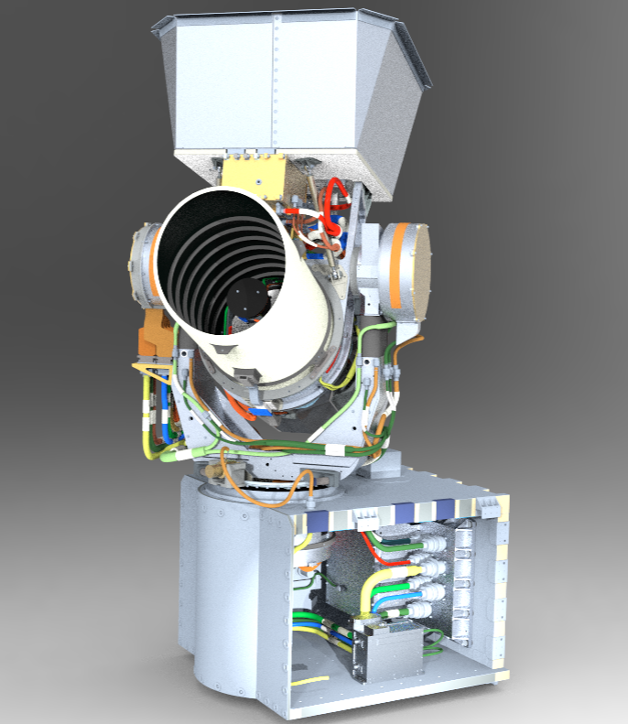
What is GLIMR?
It’s NASA’s newest Ocean Color instrument:
A hyperspectral spectrometer in Geostationary orbit
Hyperspectral
340-1040 nm
<10 nm resolution UV-Vis
<5 nm sampling UV-Vis
High Temporal
~hourly scans of Gulf of Mexico (6x/day)
2x/day other regions
3x/day HAB target sites
High Spatial
300 m GSD nadir
~328 m Gulf of Mexico
<500 m over coastal CONUS
High SNR
Requirements at Ocean Ltyp
> 420, UV
> 1000, 400-580 nm
> 750, 580-650 nm
> 580, 650-712 nm
> 500, 713-880
Geostationary Littoral Imaging and Monitoring Radiometer (GLIMR):
GLIMR’s unprecedented measurement capabilities (in toto)
Notes:
Not as good as a hyperspectral SBG for spatial resolution, Not as good as PACE in spectral range (and ability for atm correction), but it’s very good

Slide 3
Phytoplankton Growth and Physiology
Understanding processes contributing to rapid changes in phytoplankton growth rate and community composition.
Short Term Coastal Processes
Investigate how high frequency fluxes of sediments, organic matter, and other materials between and within coastal ecosystems regulate the productivity and health of coastal ecosystems.
GLIMR Science Overview

Slide 4
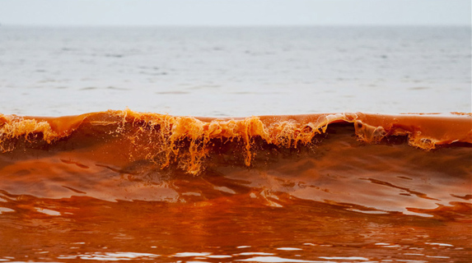

GLIMR Applications Efforts
Targeting the formation, magnitude, and trajectory of harmful algal blooms and oil spills.
human health
ecosystem health
fisheries
oil leaks
shipping
tourism
recreation
water quality
pathogens
HABs
disasters
food security
resource management
ecological forecasting
Integrated Ecosystem Assessment
Early response
Containment
Timely Public Advisories
GLIMR provides federal, state, and local agencies with vital information on coastal hazards (oil spills, harmful algal blooms, post-storm assessment, water quality)

Slide 5
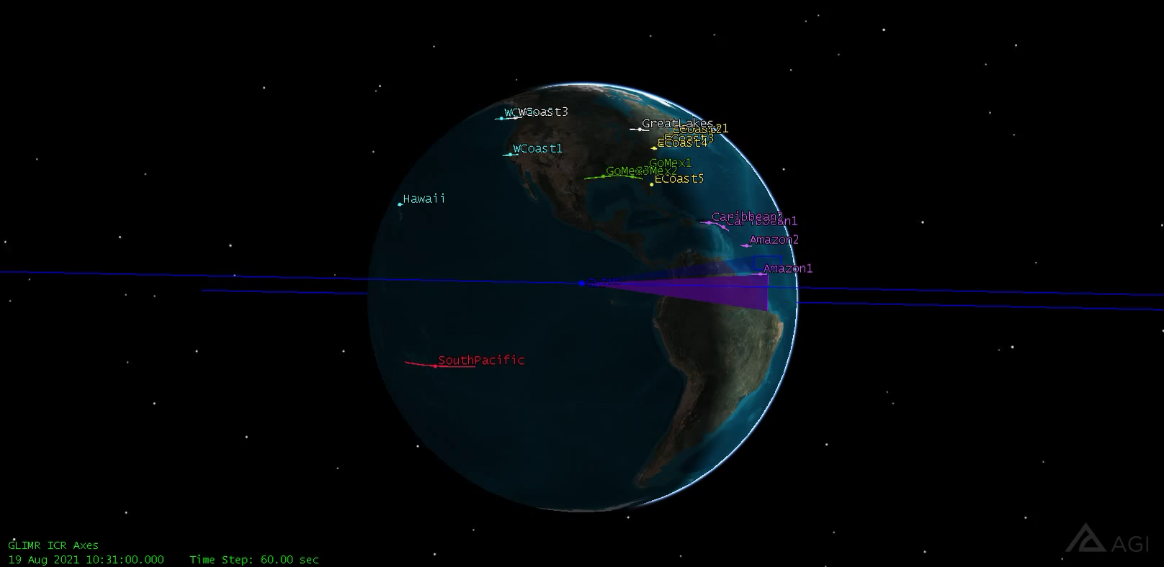
A day in the life of GLIMR from 95W
Courtesy of Dustin Berkovitch (RTX)

