Slide 1
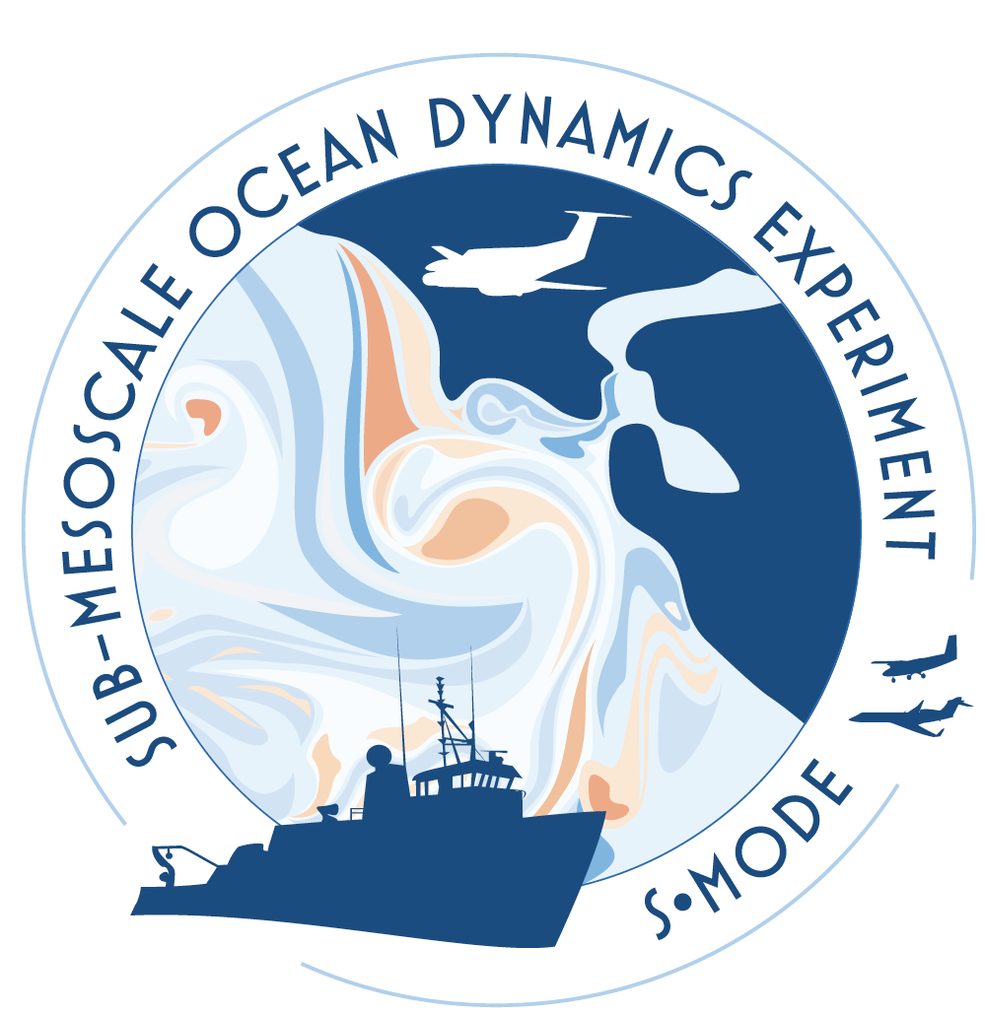
S-MODE: the Sub-Mesoscale Ocean Dynamics Experiment (EVS-3)
August 2023
Principal Investigator: J. Thomas Farrar (Woods Hole Oceanographic Institution)
Investigation Managers: Erin Czech (NASA Ames)
Deputy Principal Investigators: Ernesto Rodriguez (NASA JPL), Eric D'Asaro and Andrey Shcherbina (Univ. Washington)
NASA HQ Program Scientist: Nadya Vinogradova-Shiffer (NASA HQ)
NASA Mission Manager: Melissa Martin (NASA Langley)
Science team members from:
Woods Hole Oceanographic Institution, Univ. Washington, Scripps Institution of Oceanography, Univ. Maryland, UCLA, Cal Tech, JPL, Naval Research Laboratory, UNC, URI, Oregon State Univ., U. Conn, NASA Ames, NASA Armstrong, NASA Langley

Slide 2
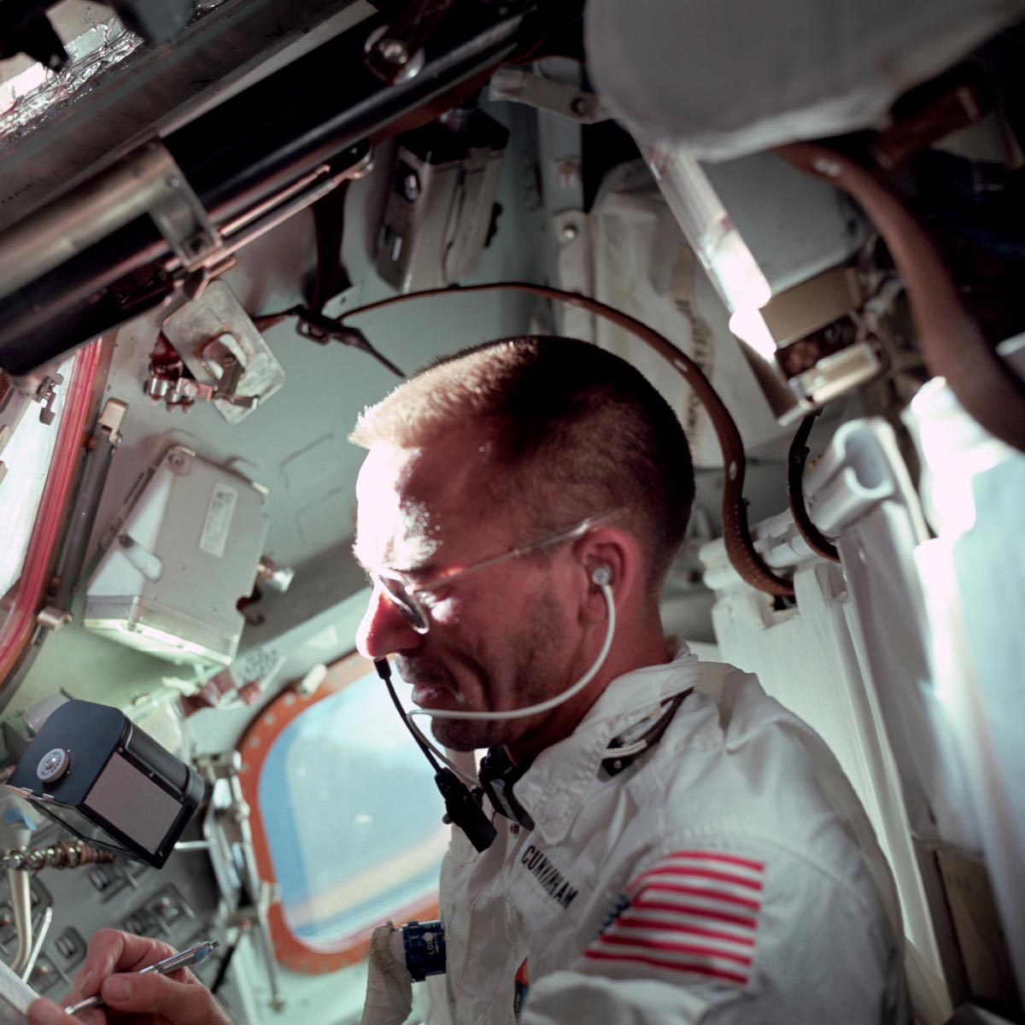
Image from Apollo 7 (1968 near Baja Peninsula)
10 km
Astronaut Walter Cunningham, Apollo 7 lunar module pilot (photo AS07-04-1586)
Swirling, spiral eddies <10 km in size are ubiquitous in the oceans
Photo credits: NASA/JSC/ASU/Apollospace, photo AS07-05-1632

Slide 3
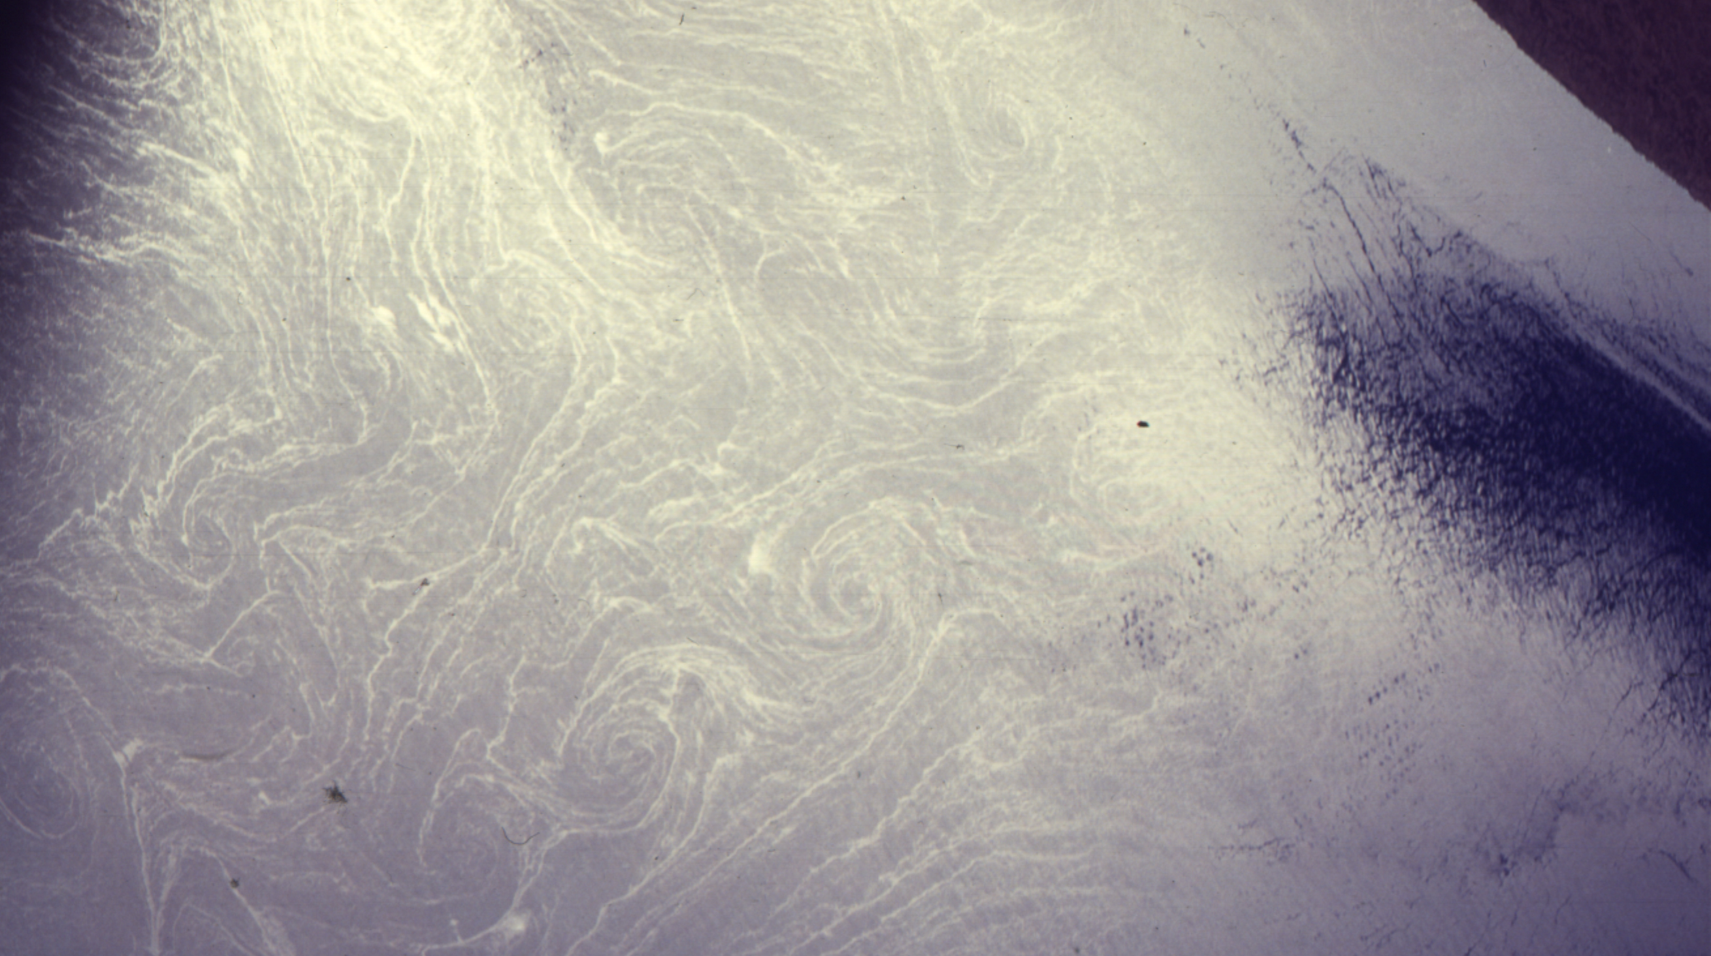
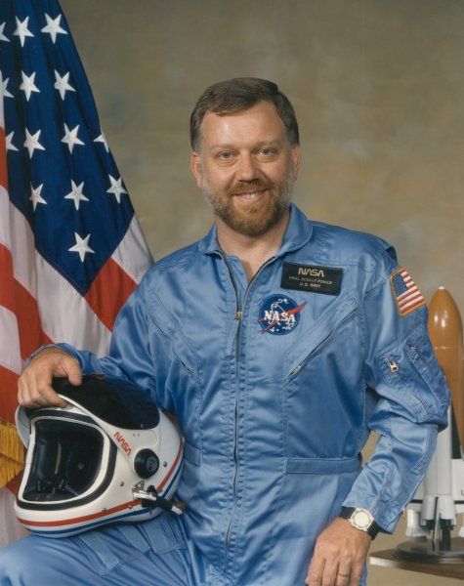
“Maybe the whole ocean is like this. I don’t know.” Paul Scully-Power, astronaut/oceanographer on Challenger Mission STS41G (1984)
“…once again you continue to see these spiral structures… maybe the whole ocean is like this. I don’t know.”
8 km
Photo of Mediterranean Sea from Space Shuttle Challenger, Oct 1984 (photo STS41G-35-94)

Slide 4
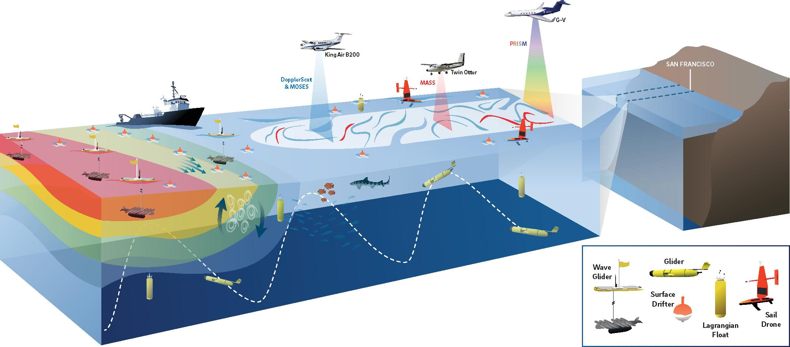
S-MODE Earth Venture Suboribital Investigation (EVS-3)
Science: Test the hypothesis that kilometer-scale (“submesoscale”) ocean eddies make important contributions to vertical exchange of climate and biological variables in the upper ocean.

Slide 5
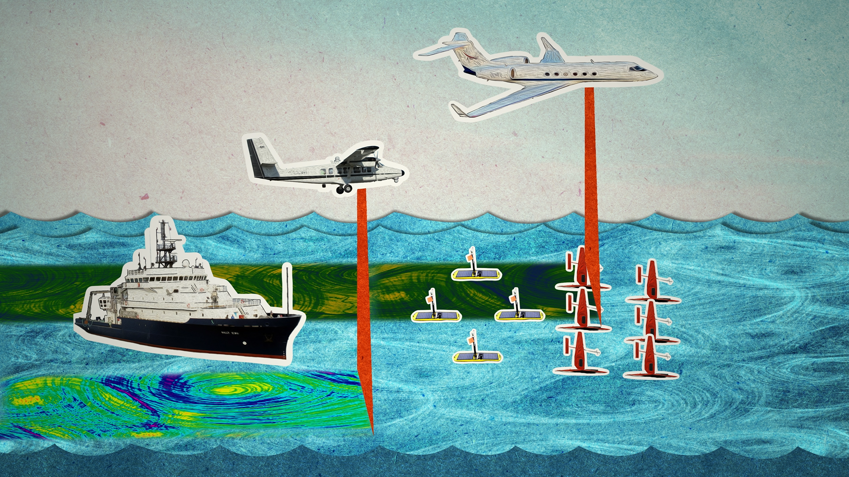
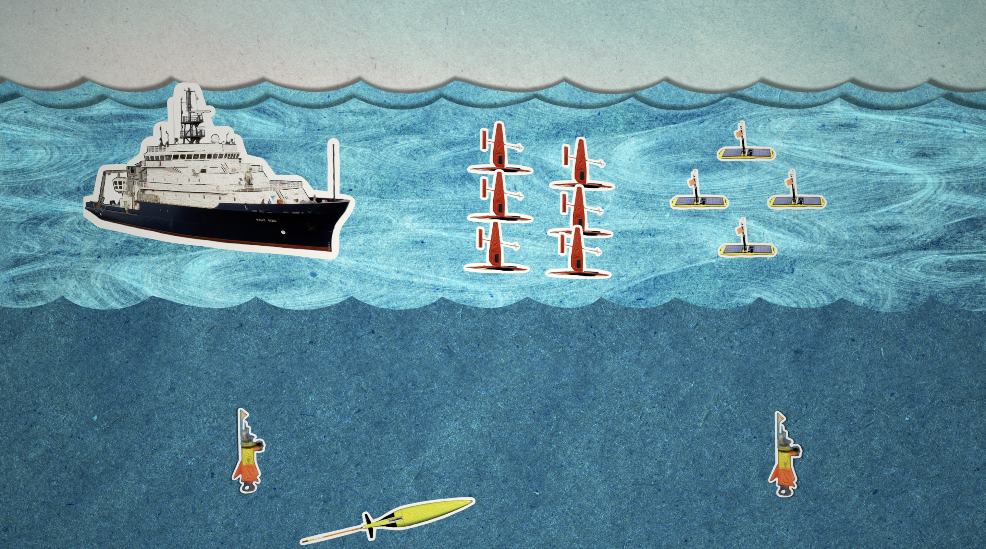
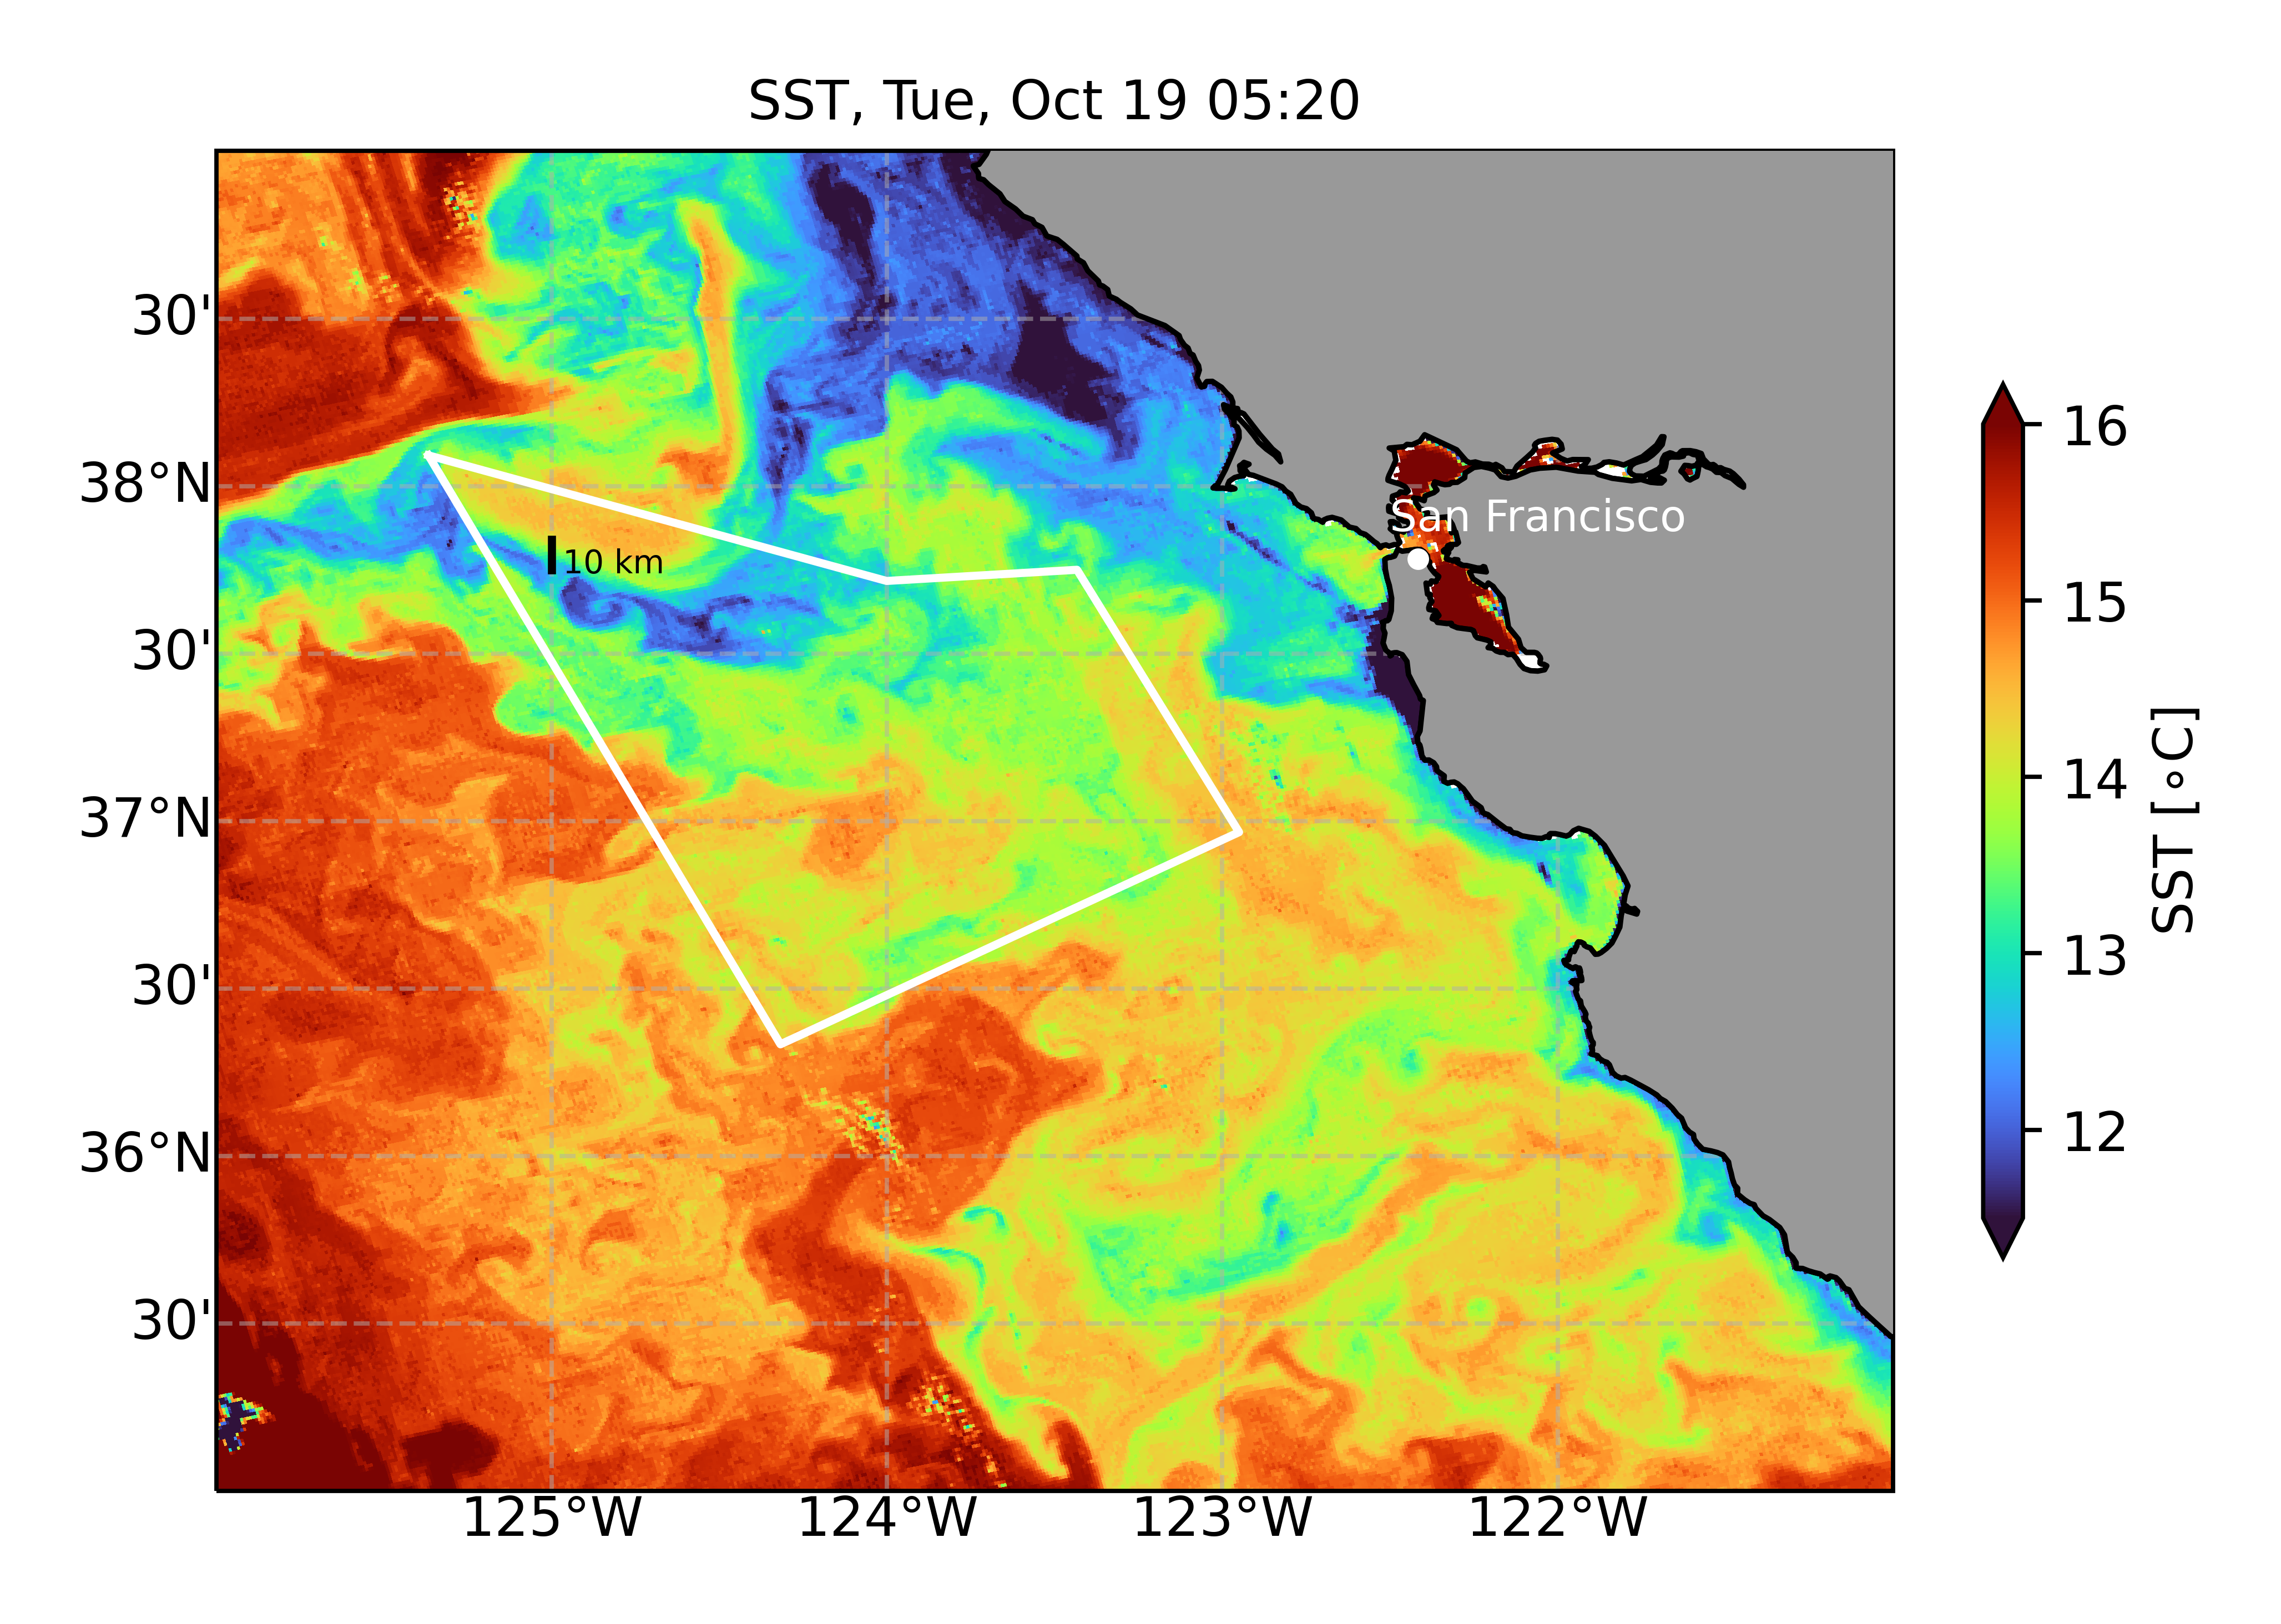
S-MODE campaigns west of San Francisco
Satellite Sea Surface Temperature, Oct 19, 2021
Three aircraft and a fleet of robotic vehicles to investigate the role of submesoscale eddies in ocean heat and nutrient transport

