Slide 1
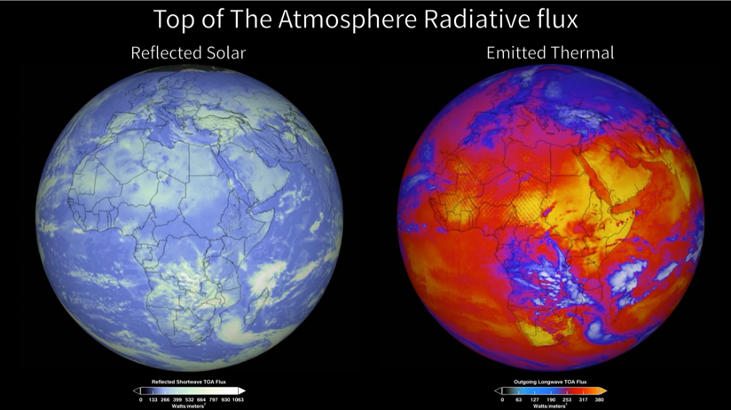
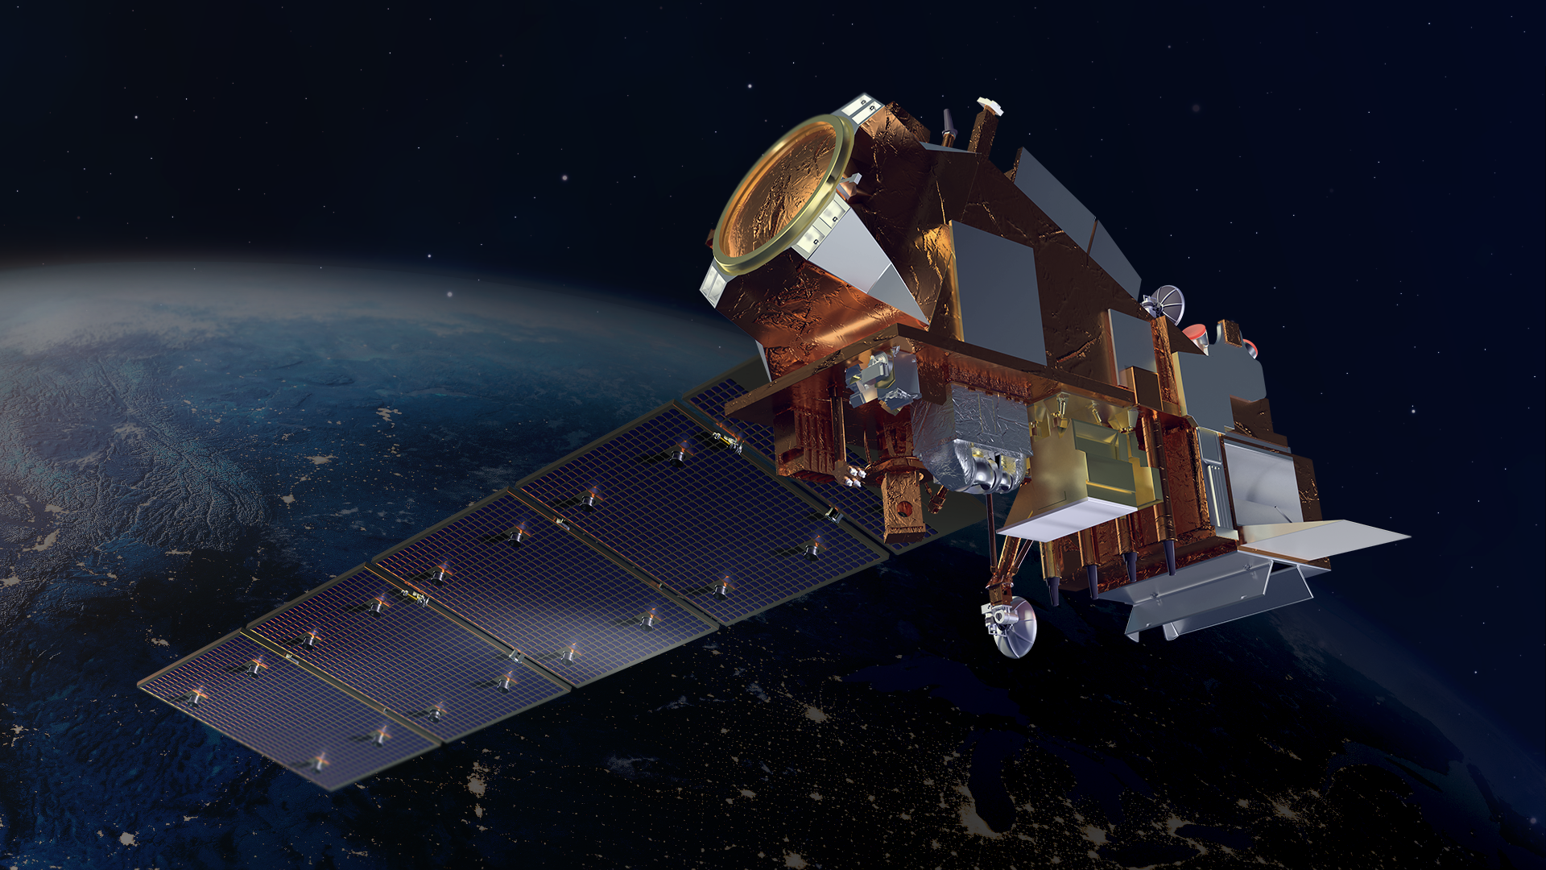
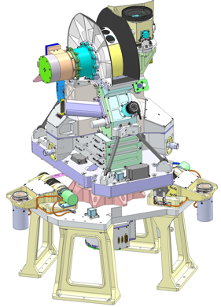
Libera, Earth Venture Continuity-1 Mission
’Li-be-ra, named for the daughter of Ceres in Roman mythology
Outgoing Earth Radiation
Libera continues the 23-year CERES Climate Data Record for the Earth Radiation Budget (ERB).
  Measures reflected solar and emitted terrestrial radiation from Earth
  Provides fundamental climate information about the balance between incoming (from TSIS) and outgoing energy from Earth
  Continuity of this climate record over time reveals the signals of climate change – connects temperature trends to energy flow
  Libera is Innovative:
  Uses state-of-the-art detectors with carbon nanotube technology, the blackest substance on Earth
  Adds a split-shortwave measurement to isolate where energy from the Sun is deposited in the Earth system
  Adds a wide-field-of-view camera to support split
  shortwave science
Partners:
  LASP, Ball Aerospace, NIST Boulder, Space Dynamics Lab
  Science Team: CU, JPL, CSU, UA, UM, LBL
  Flight:
    JPSS-4, 2027 launch; 5-year mission
Joint Polar Satellite System-4

Slide 2
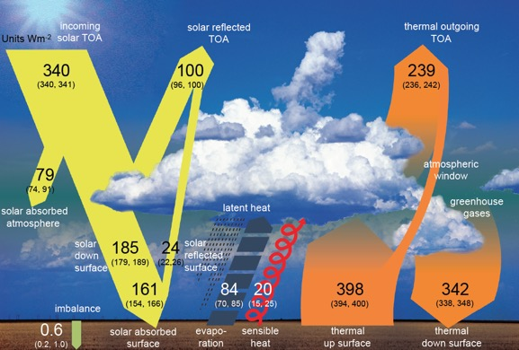
Libera Science Goals & Objectives
Provide seamless continuity of the ERB CDR with characteristics identical to CERES
  Prevents gap in ERB climate date record.
  Science objective 1: Identify and quantify processes responsible for variability of ERB
Develop a self-contained, innovative, affordable observing system
  Novel detectors improve accuracy & stability – pave way toward future missions.
  Science objective 2: demonstrate wide field-of-view camera capabilities to provide scene & angular context
Provide new and enhanced capabilities to extend ERB science
  Split-Shortwave measurement to quantify SW energy disposition
  Science objective 3: Revolutionize understanding of spatio-temporal variations in SW, VIS & NIR irradiance
Global Net Shortwave Anomaly

Slide 3
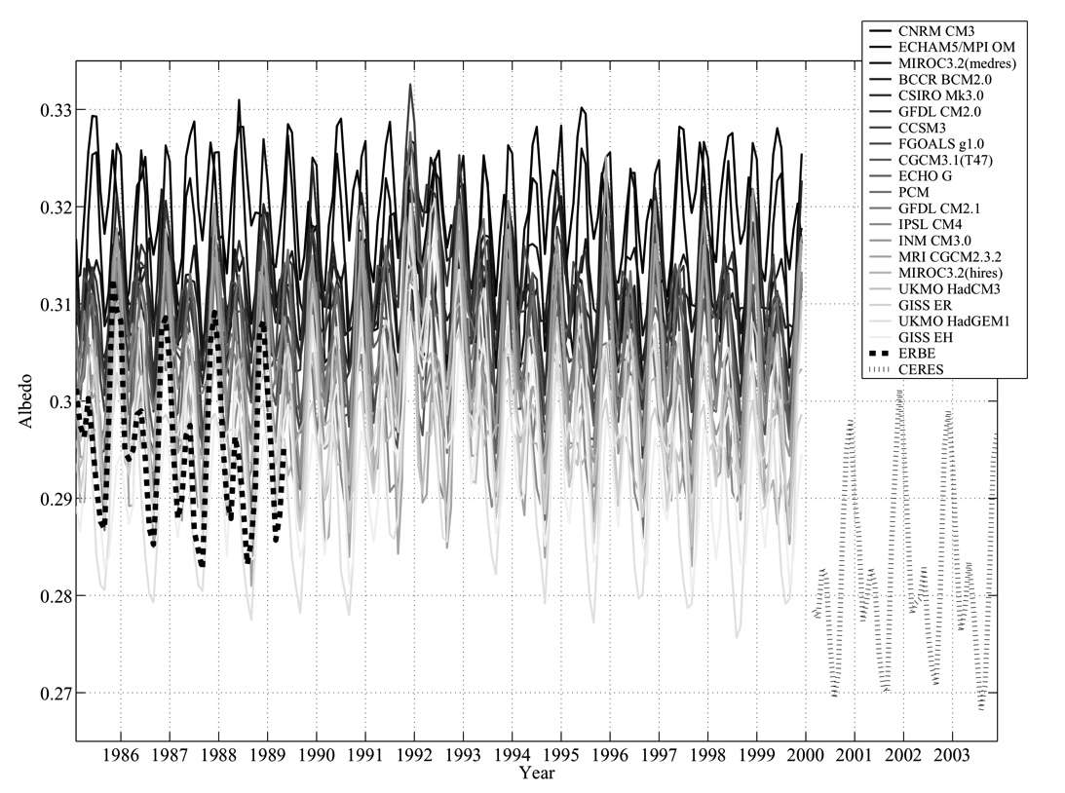
CERES vs. ERBE Albedo: Real Trend or Offset?
∆α ≈ 0.01 ≈ 3.0 W m⁻²
Bender et al. 2006

Slide 4
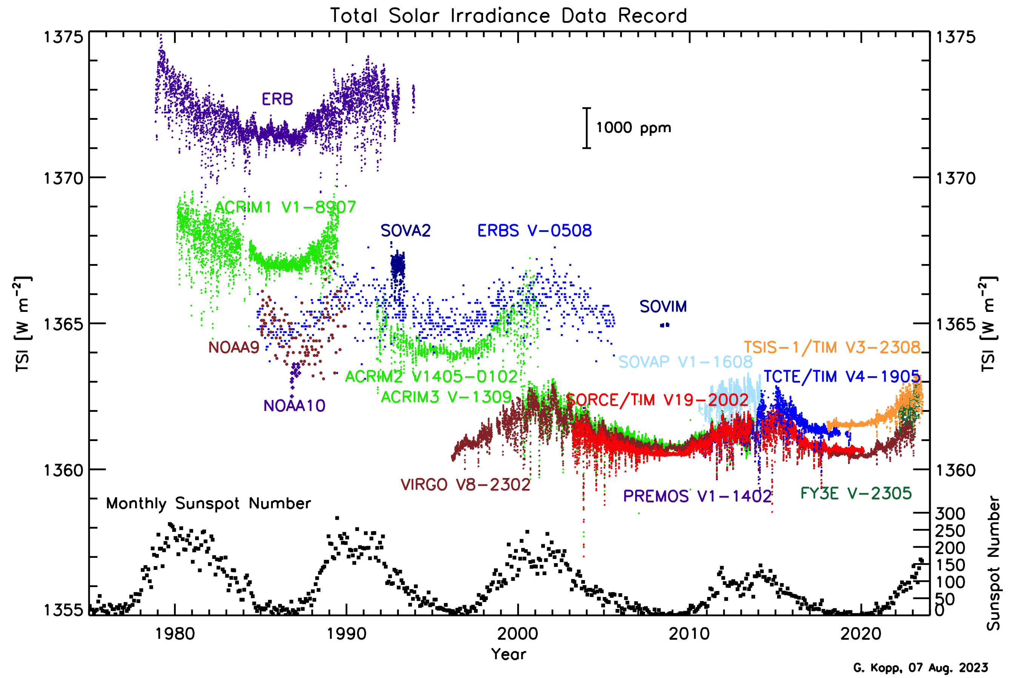
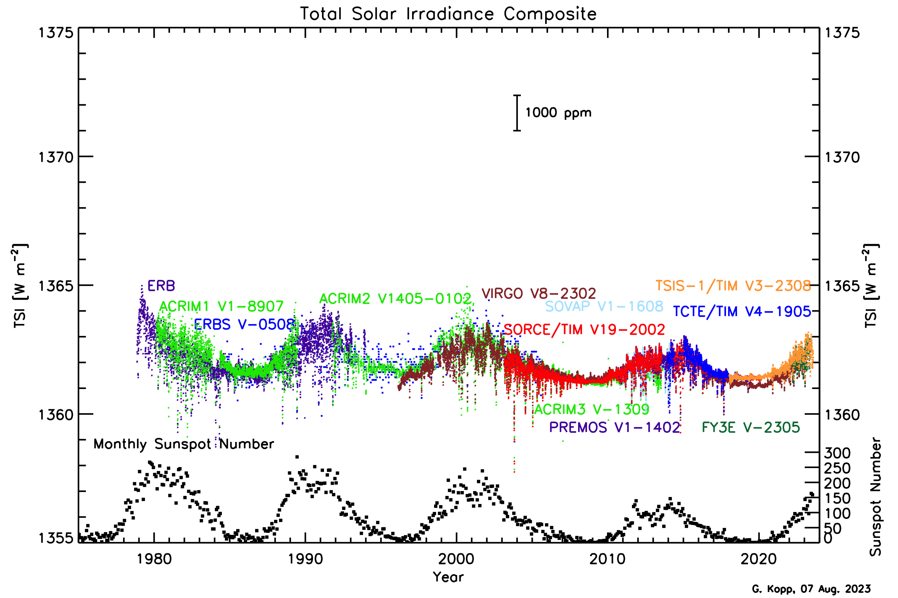
Total Solar Irradiance Data Record

Slide 5
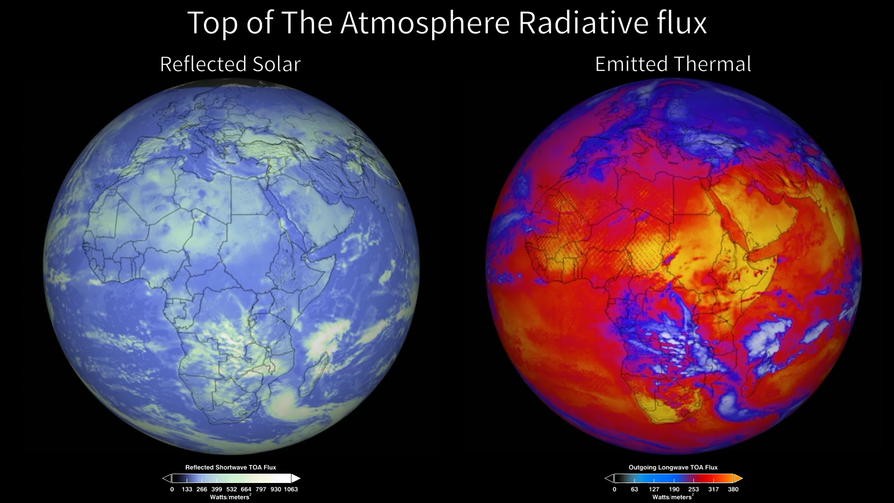
Outgoing Earth Radiation

