Slide 1
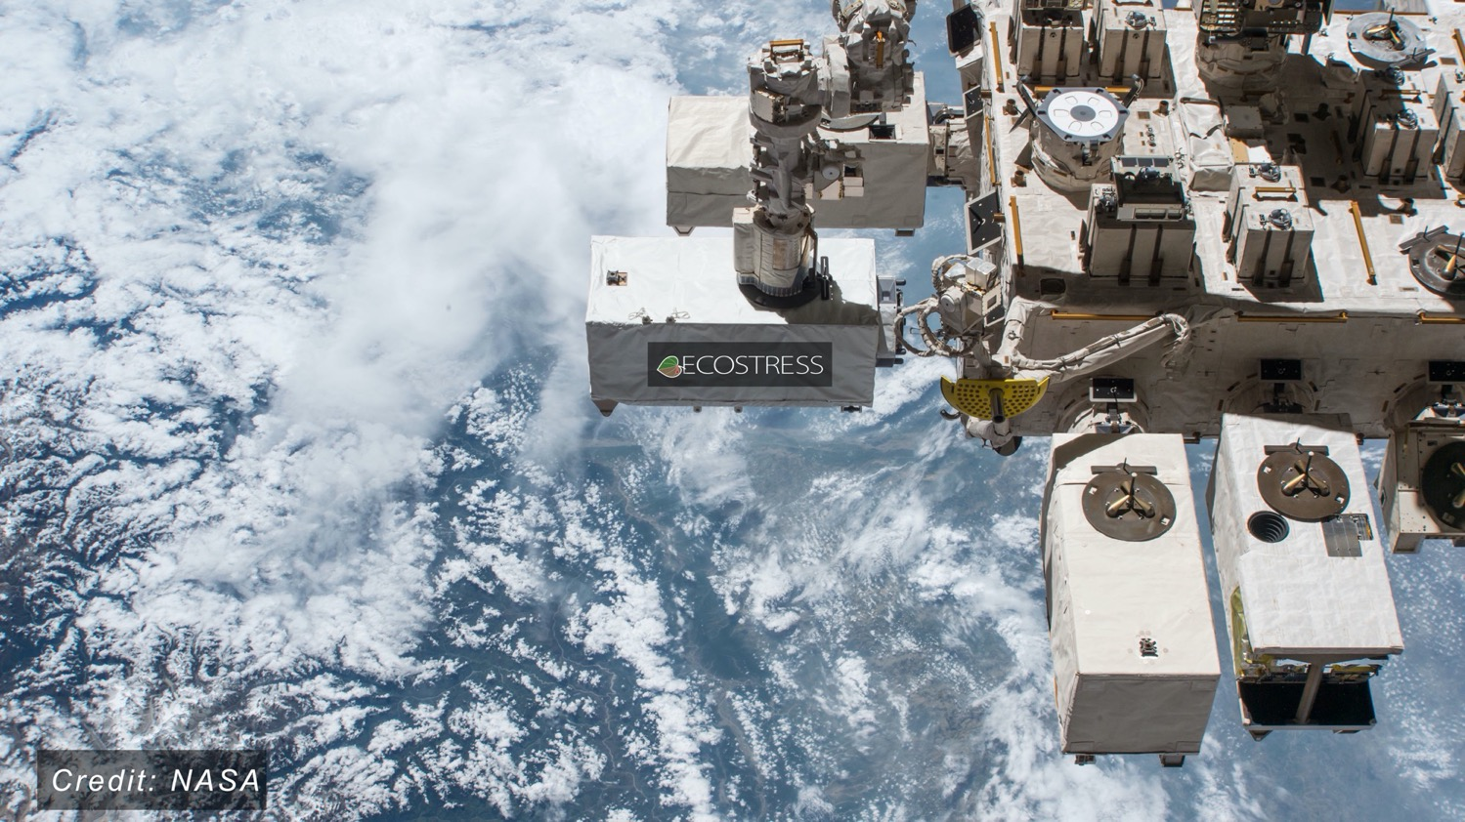
ECOSTRESS: Science Summary
Simon Hook, Kerry Cawse-Nicholson, Glynn Hulley, Christine Lee, Gregory Halverson, Madeleine Pascolini-Campbell, Dana Freeborn, Gerardo Rivera, and the ECOSTRESS Team
Jet Propulsion Laboratory, California Institute of Technology

Slide 2
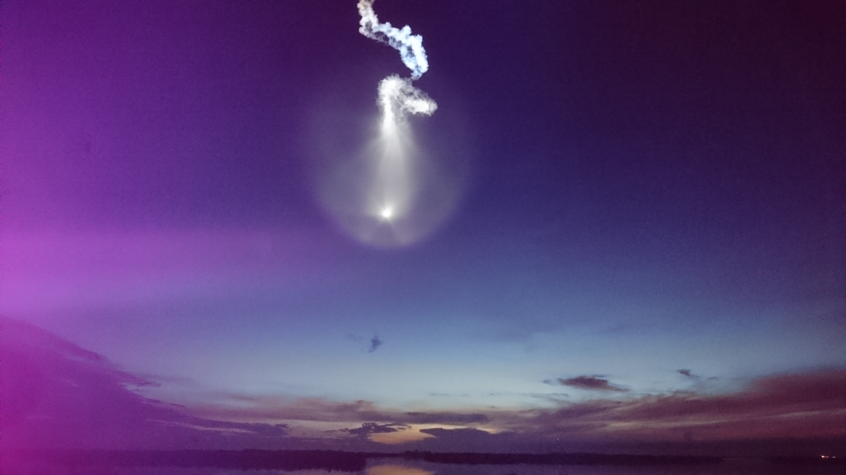

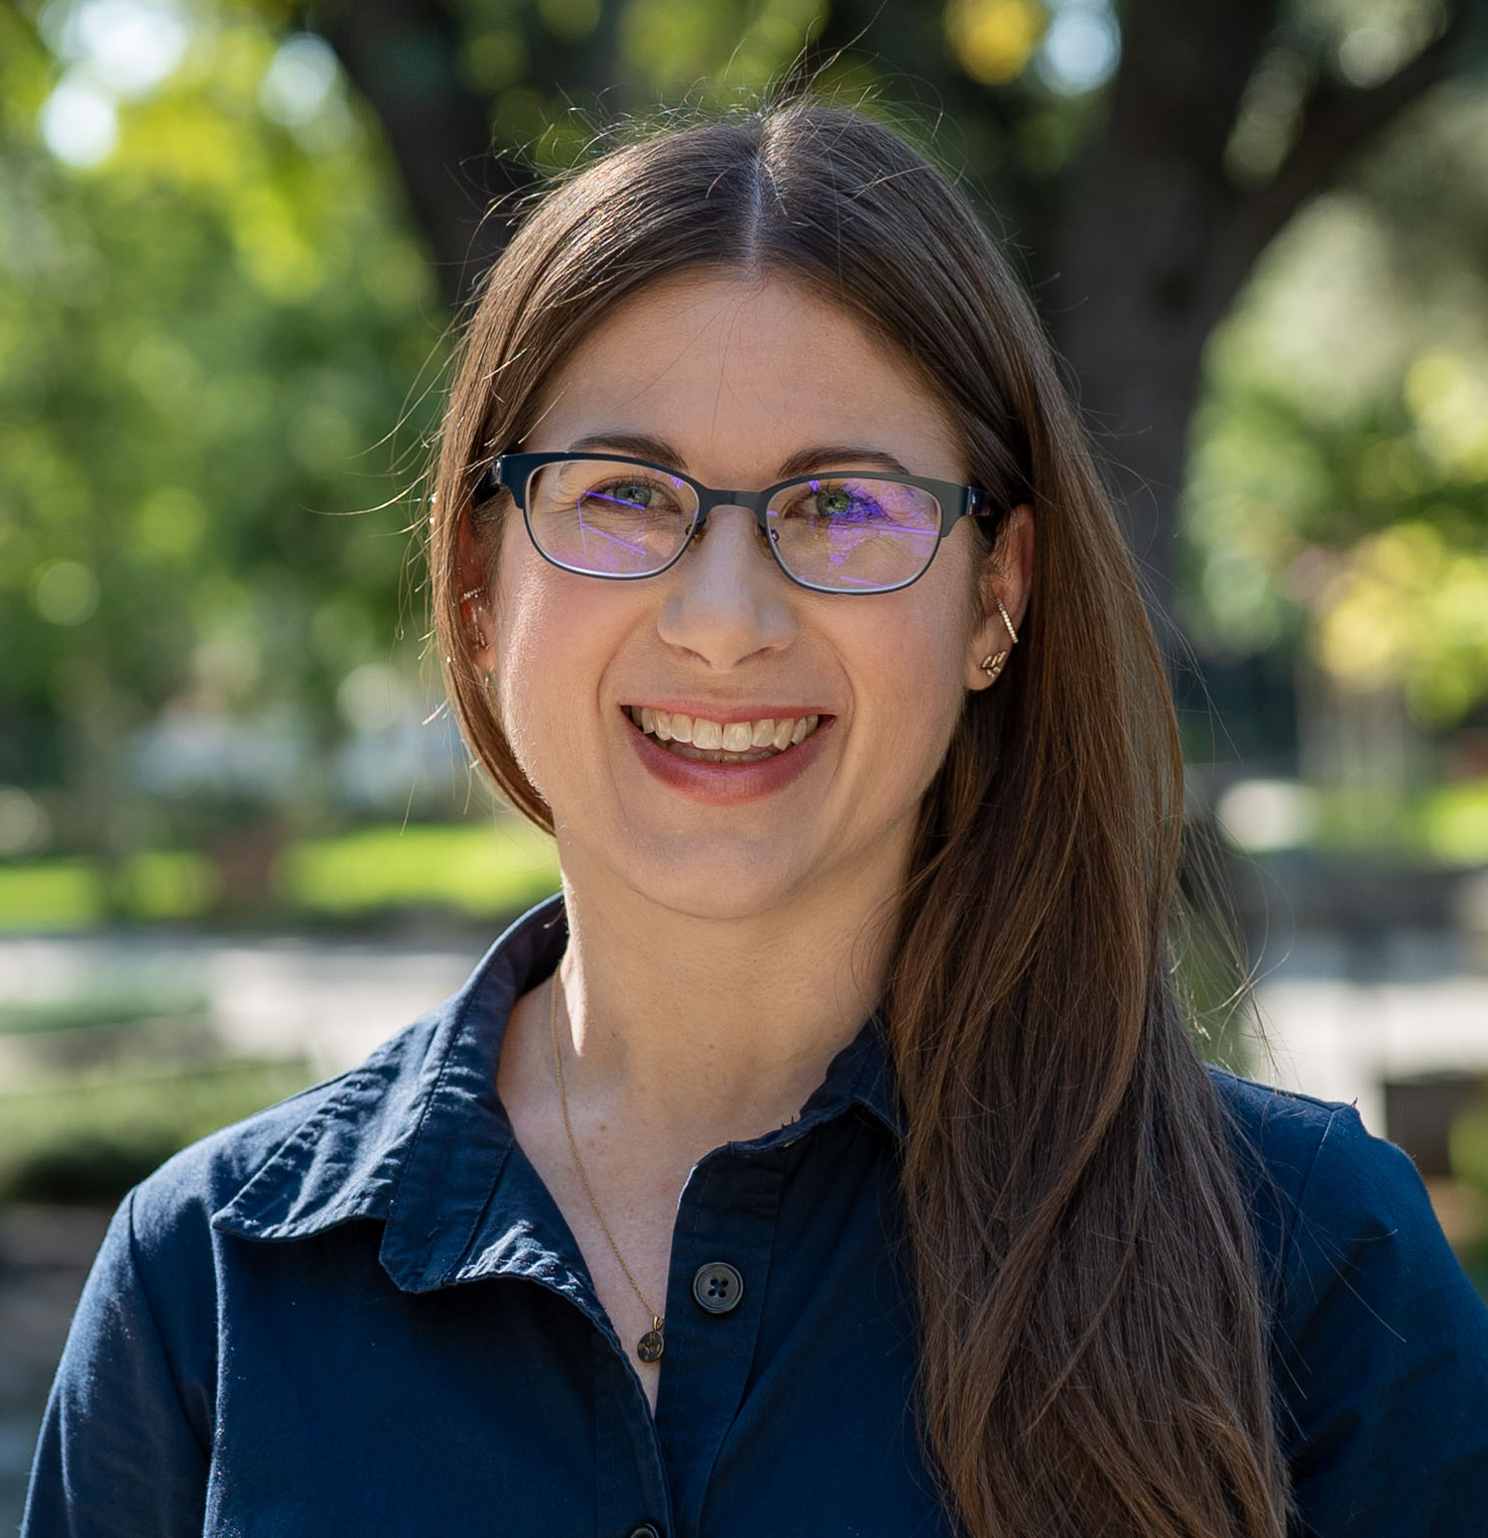

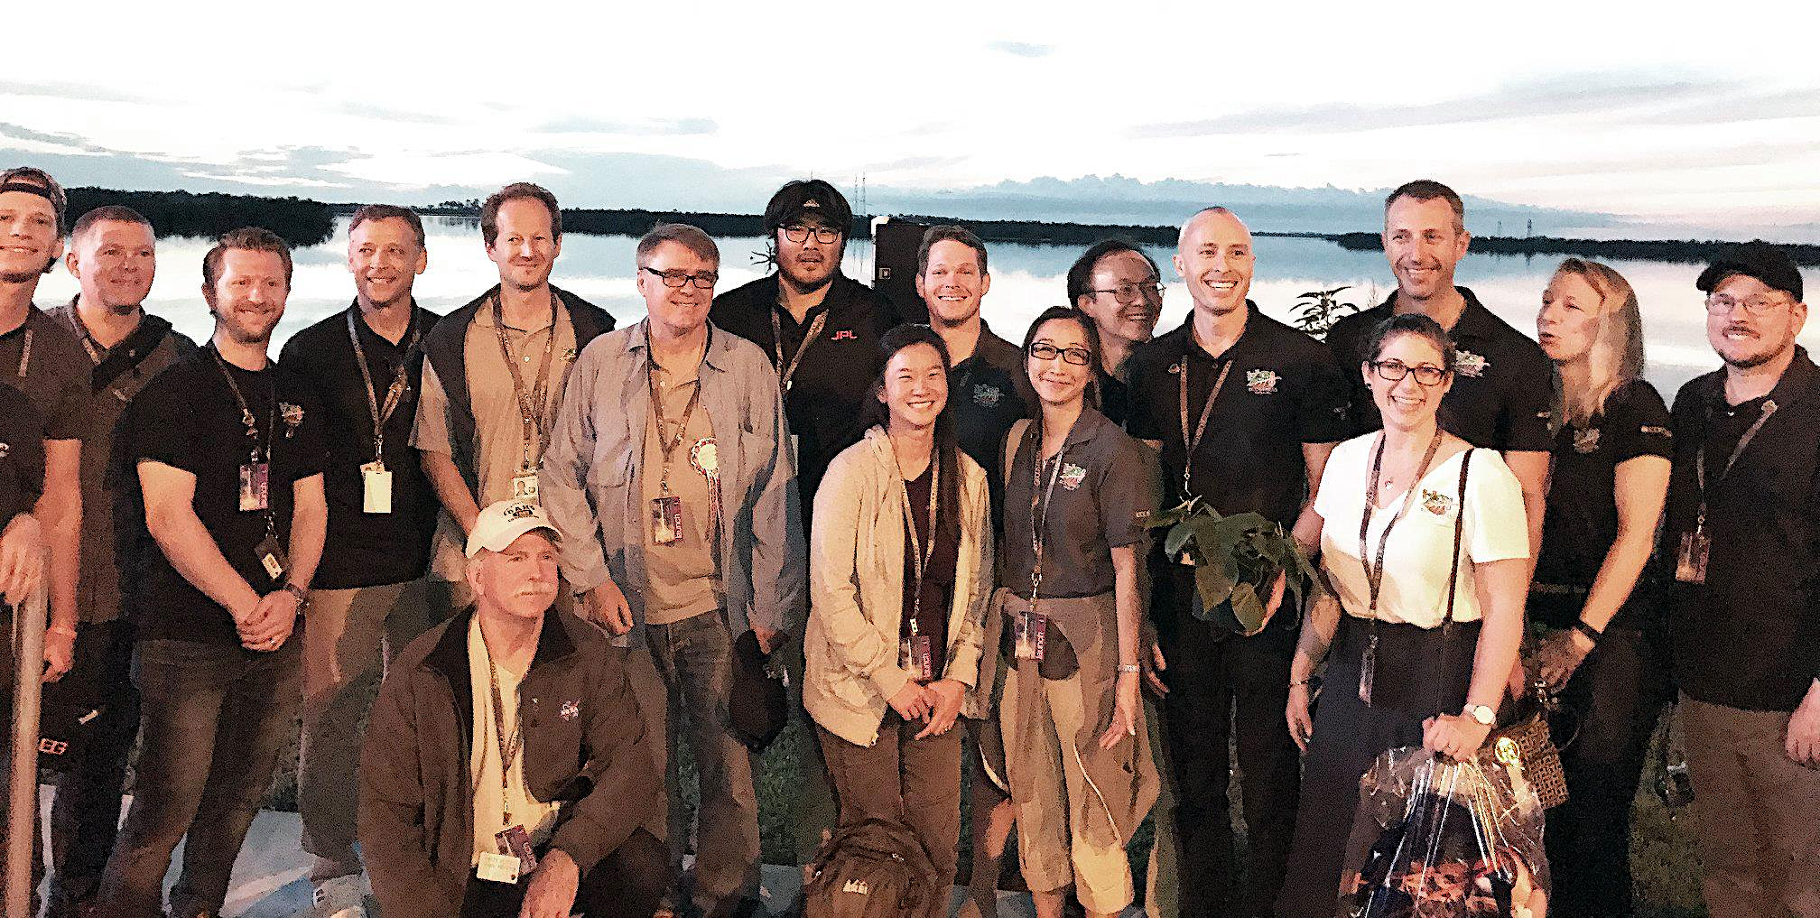
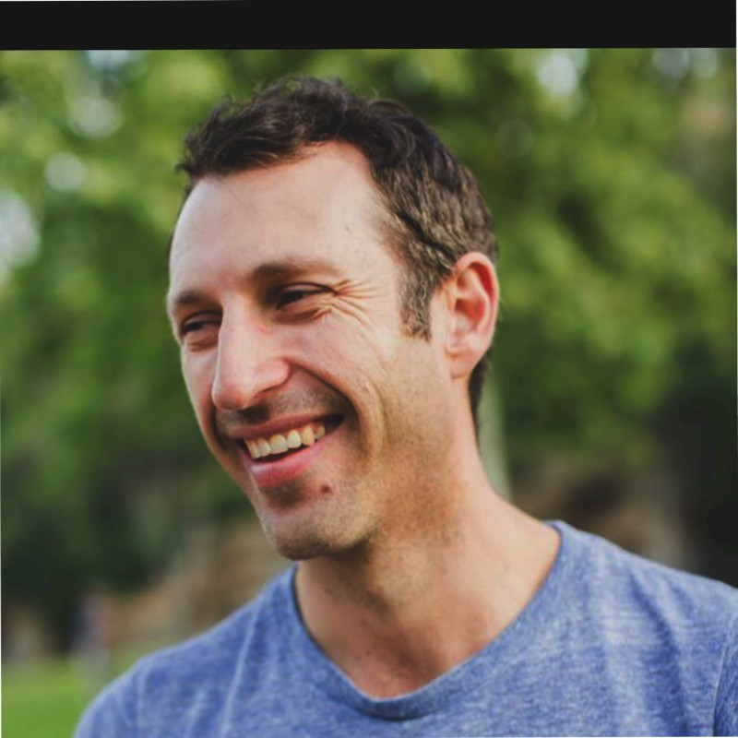
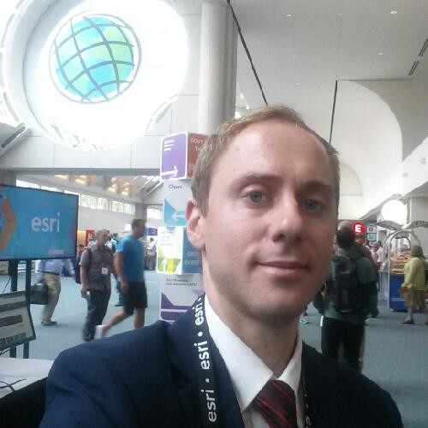
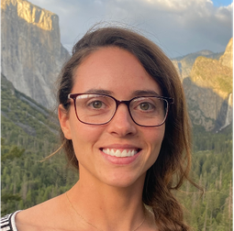
Project science team
Simon Hook
Principal Investigator
Kerry Cawse-Nicholson
Science Lead
Christine Lee
Applications Lead
Glynn Hulley
Gregory Halverson
Madeleine
Pascolini-Campbell

Slide 3
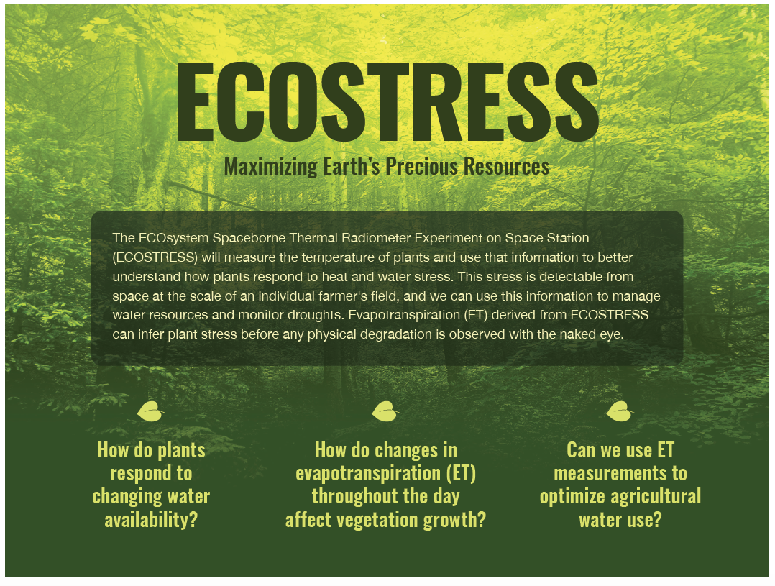
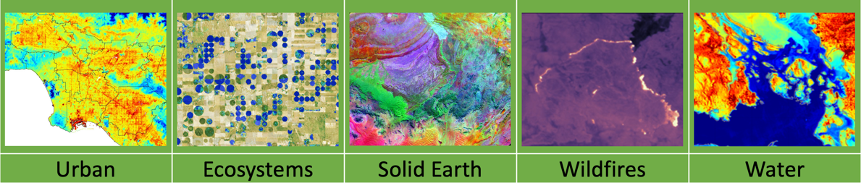
Science Goals

Slide 4
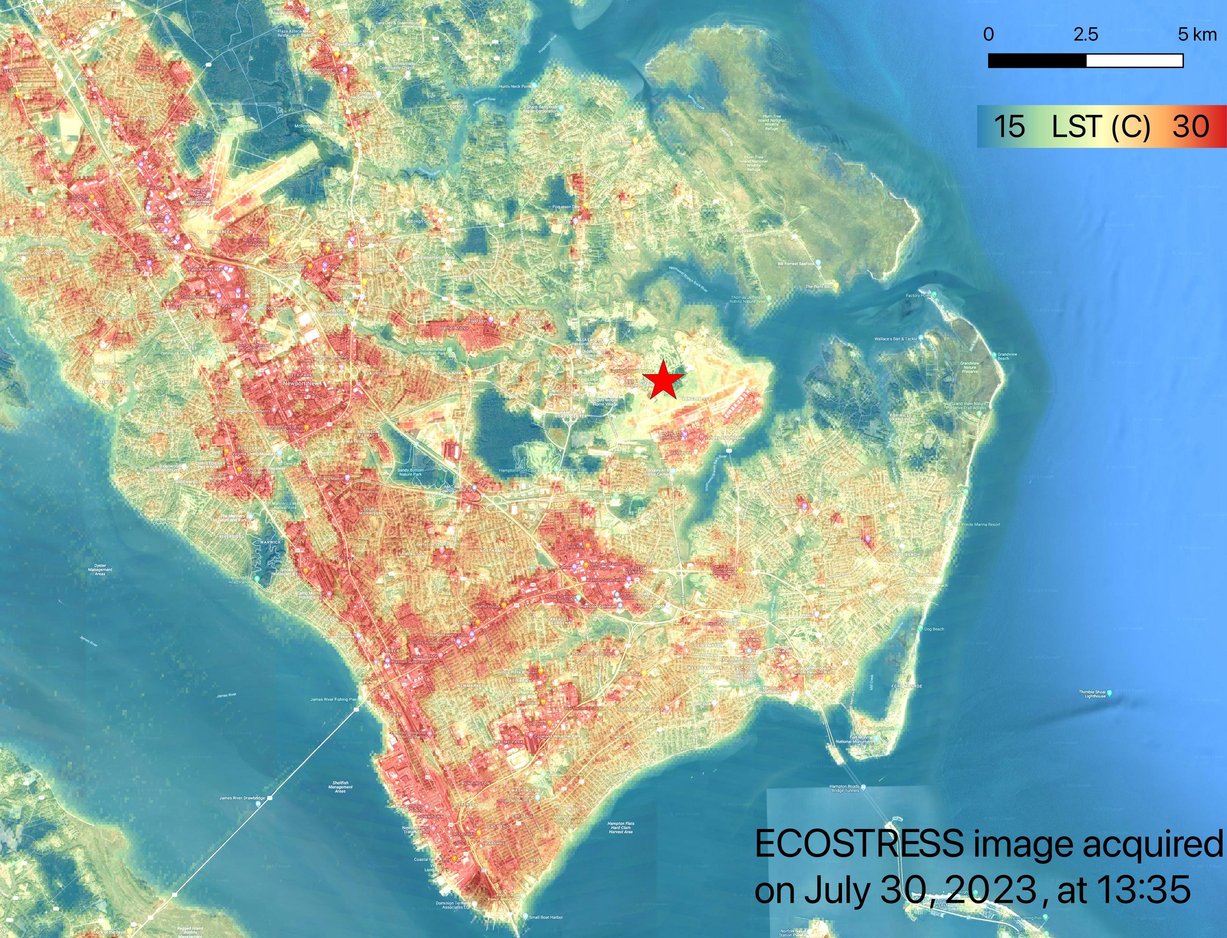
Applications
ECOSTRESS produces estimates of Land Surface Temperature, which are vital for monitoring urban heat. Within the city, the hottest surfaces are the streets, and vegetated areas are cooler. This heat has significant health impacts.

Slide 5
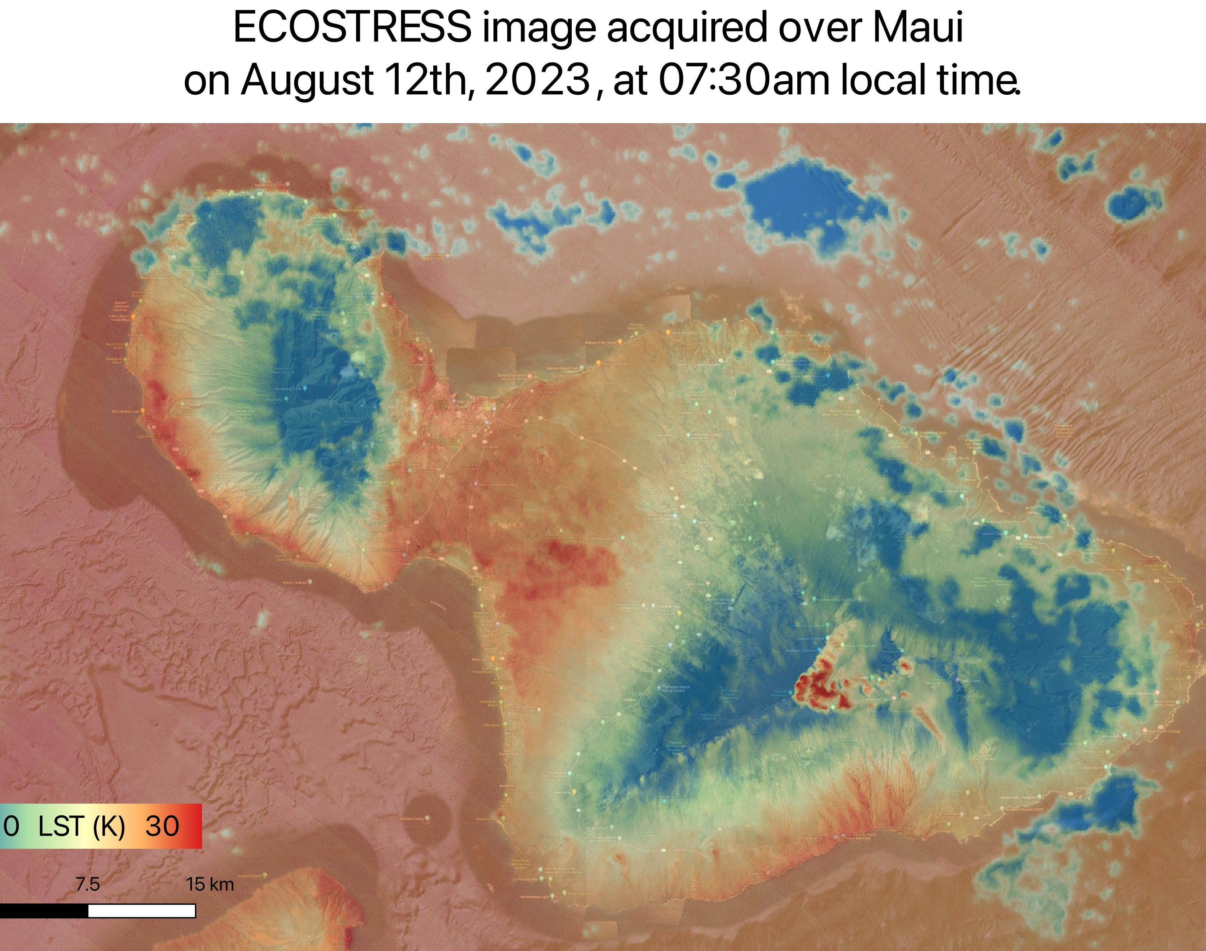
Applications
ECOSTRESS produces estimates of Land Surface Temperature that can be used to monitor pre-fire conditions, track active fires, and study recovery.

Slide 6
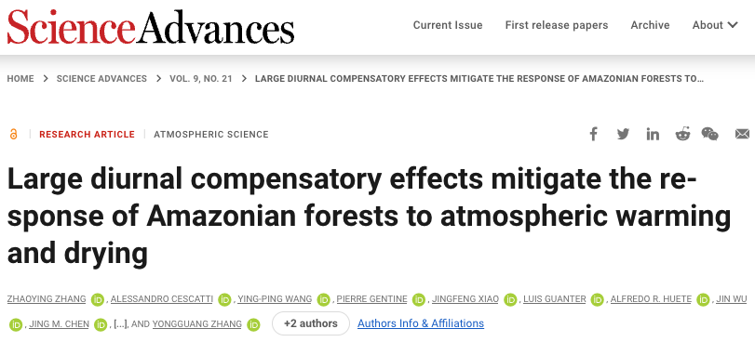
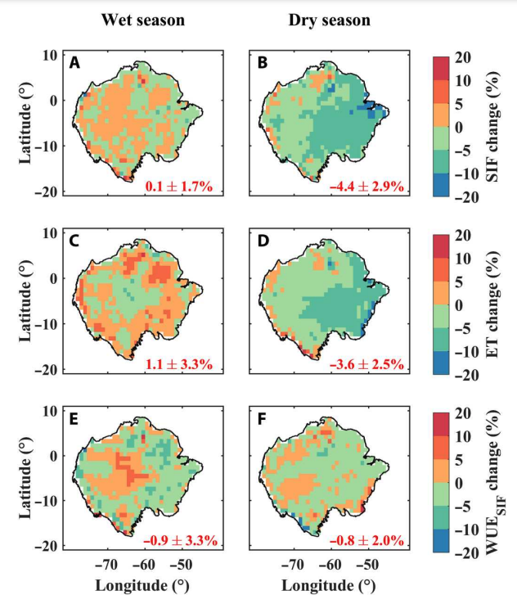
New diurnal water-carbon relationships in the Amazon
Photosynthesis and evapotranspiration in Amazonian forests are major contributors to the global carbon and water cycles
This study used OCO-3 and ECOSTRESS to reveal a strong depression of dry season afternoon photosynthesis and evapotranspiration
Furthermore, the study projected that the regionally depressed afternoon photosynthesis will be compensated by their increases in the morning in future dry seasons

Slide 7
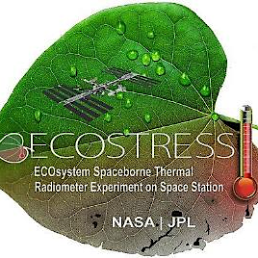
What’s next?
On ISS manifest until 2029
Precursor for SBG
ECOSTRESS Collection 2
ECOSTRESS science team meeting – Ventura, October 17-19

