Slide 1
Polar Radiant Energy in the Far InfraRed Experiment
Brian Drouin
Xianglei Huang
Brian Kahn
Jen Kay
Jonah Shaw
Aronne Merelli
Nathaniel Miller
Colten Petersen
Cassidy Johnson
Hamish Prince
Nicole-Jeanne Schlegel
Yan Xie
Mary White
Sharmila Padmanabhan
Boon Lim
Karen Dragon
Meredith Grames
Cameron Bertossa
Natasha Vos
Marian Mateling
Tristan L’Ecuyer
http://prefire.ssec.wisc.edu

Slide 2
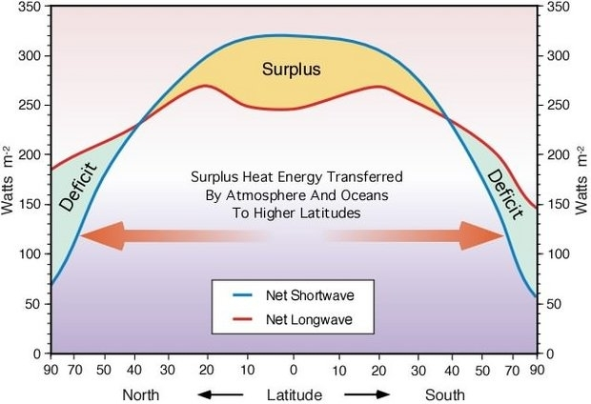
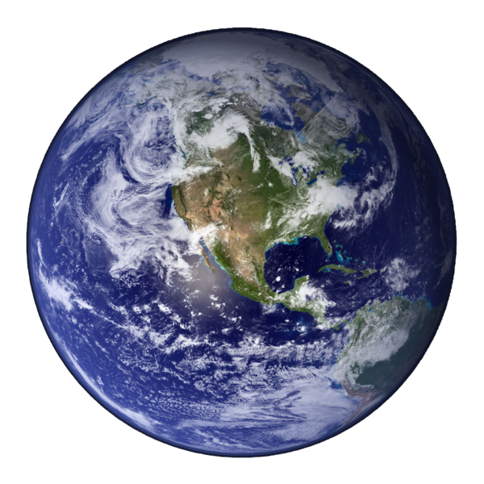
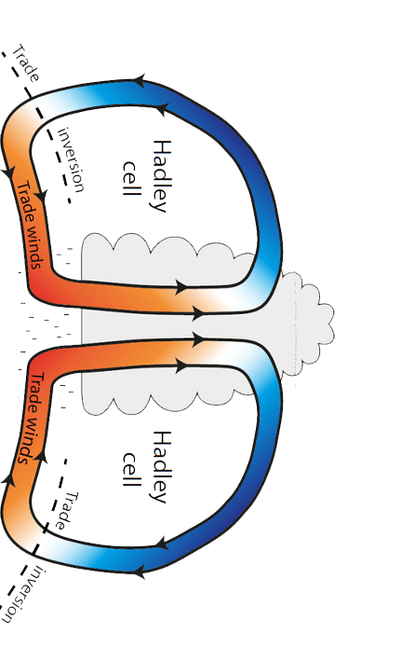
Radiation, Climate, and Weather
Arctic Deficit = 1.15x10¹⁵ W
Solar (IN)
Thermal (OUT)
$$F_{⨀}×\left(1−α\right)=σT_{p}^{4}$$
10¹⁵ W = 1 PetaWatt
The annual energy use in the United States is 430 GW or 0.00043 PW
Antarctic Deficit = 1.26x10¹⁵ W
Earth’s climate is determined by the balance between incoming solar and emitted thermal radiation.
The poles emit more than twice as much energy as they recieve from the sun.
Heat must be transported from lower latitudes via weather systems to offset these deficits.

Slide 3
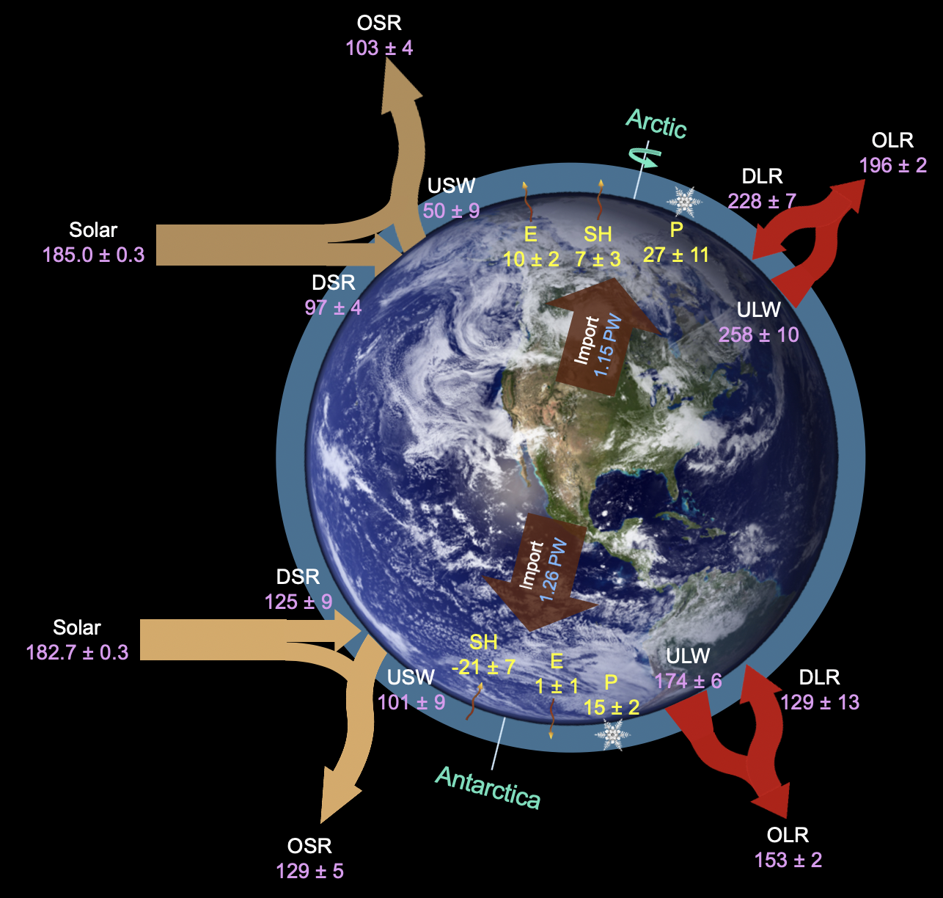
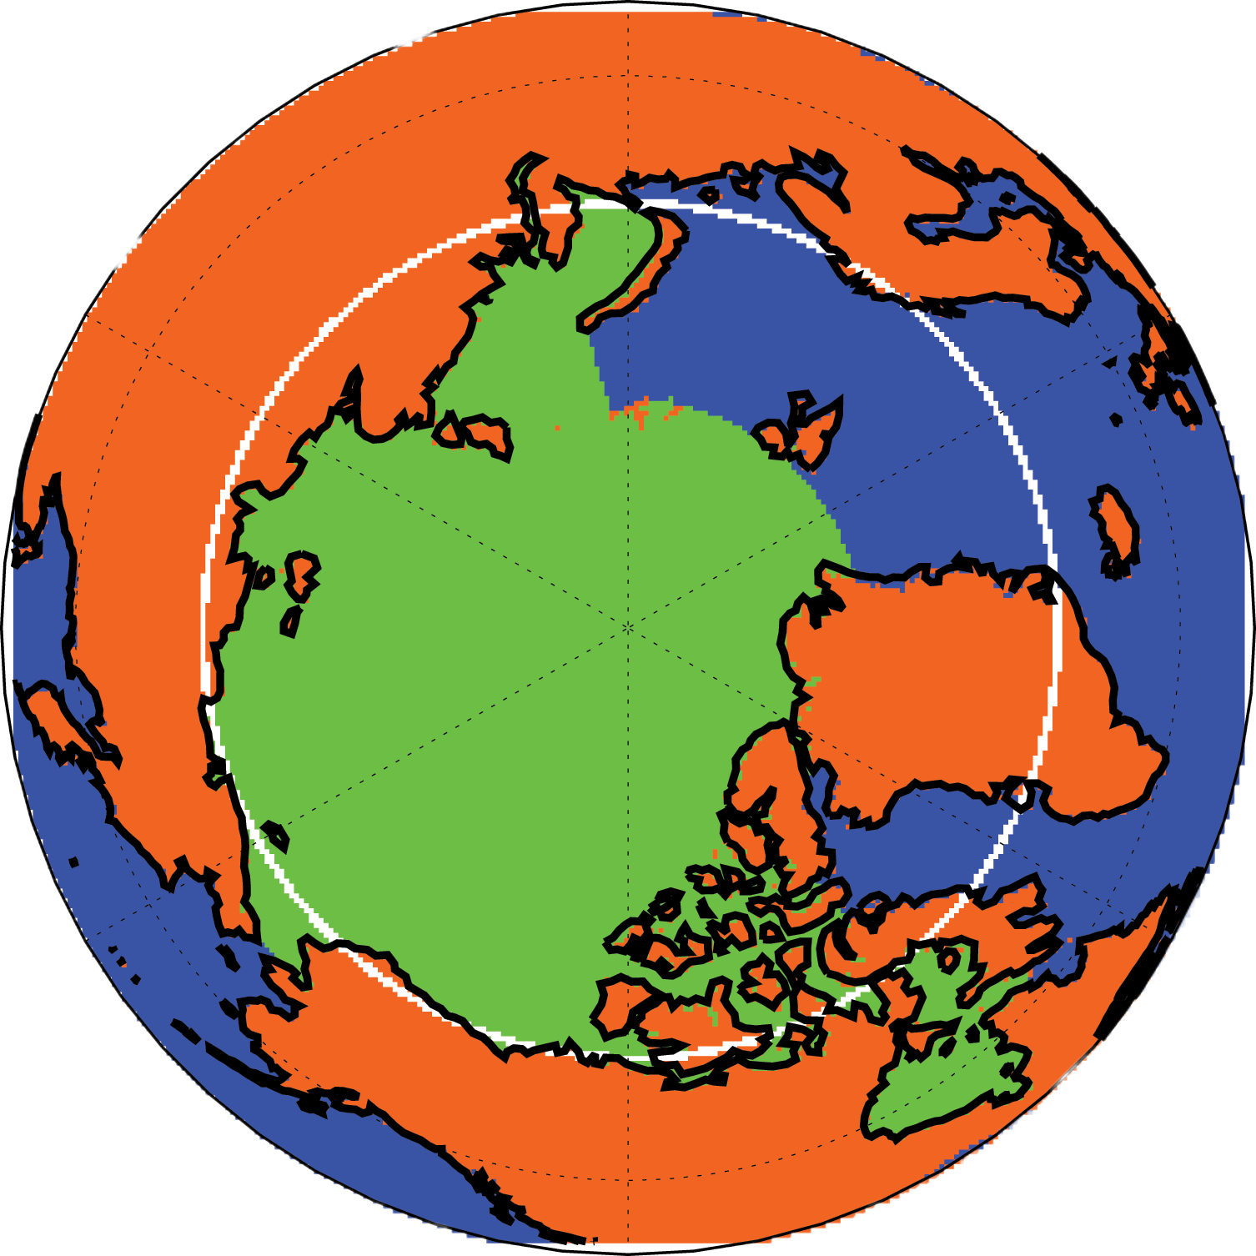
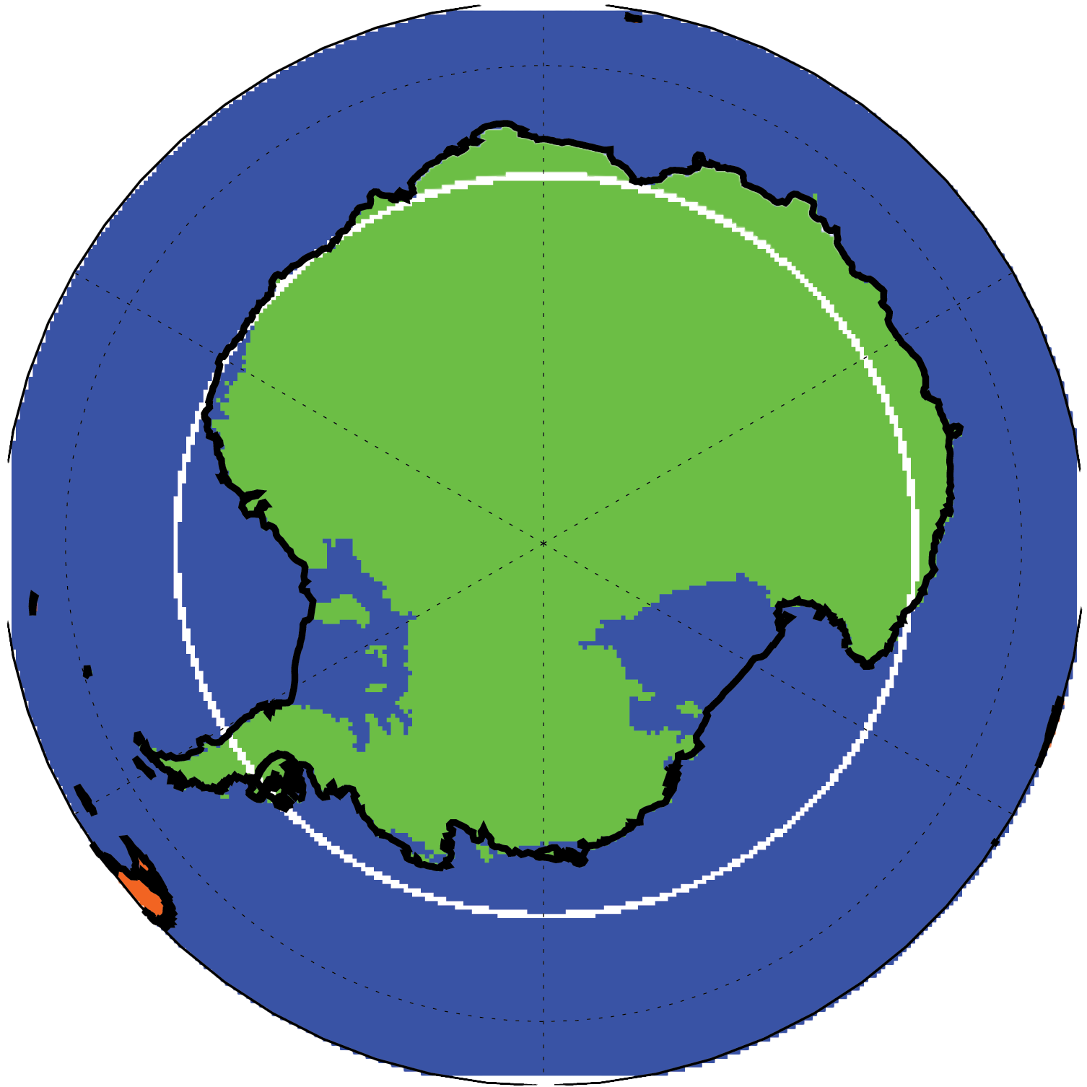
Goal: Reduce Uncertainty in Polar Climate Predictions by Constraining Earth’s Emission Spectrum
Wx Models: 214 – 236
Climate Models: 208 – 240
Wx Models: 258 – 278
Climate Models: 242 – 272
PREFIRE seeks to reduce uncertainty in polar energy fluxes, the processes that influence them, and, with improved modeling, the societal implications of polar climate change.
The Arctic
Antarctica
L’Ecuyer and Mateling, in preparation

Slide 4
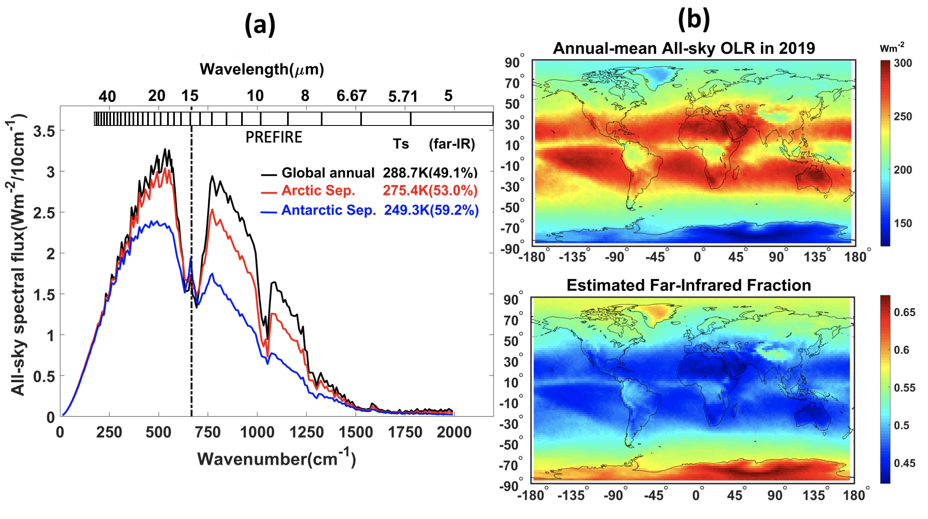
The Far-Infrared Observing Gap
Current Spectral Measurements
L’Ecuyer et al, BAMS (2021)

Slide 5
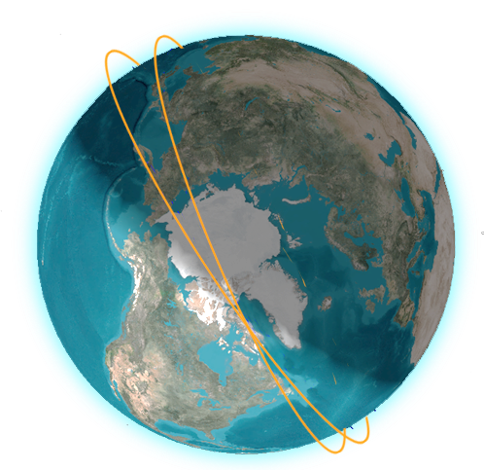
Polar Radiant Energy in the Far InfraRed Experiment
PREFIRE fills the far-infrared observing gap by documenting variability in spectral fluxes from 5 - 53 μm on hourly to seasonal timescales.
Greenland Emission Spectrum
CubeSat 1 (t₀)
CubeSat 2 (t₀ + ∆t)
TIRS Channels
PREFIRE maps polar far infrared emission spectra with two CubeSats flying in distinct 510 - 540 km altitude, near-polar (82°-98° inclination) orbits each carrying a miniaturized infrared spectrometer, covering 5-53 µm with 0.84 µm spectral sampling, operating for a complete seasonal cycle (10 months).
CrIS
IASI
AIRS
MODIS
CERES
PREFIRE

Slide 6
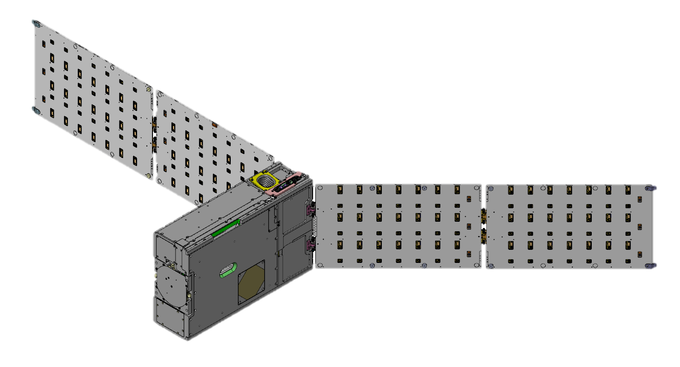
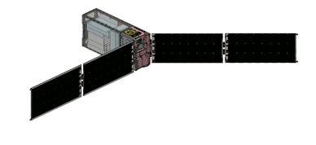
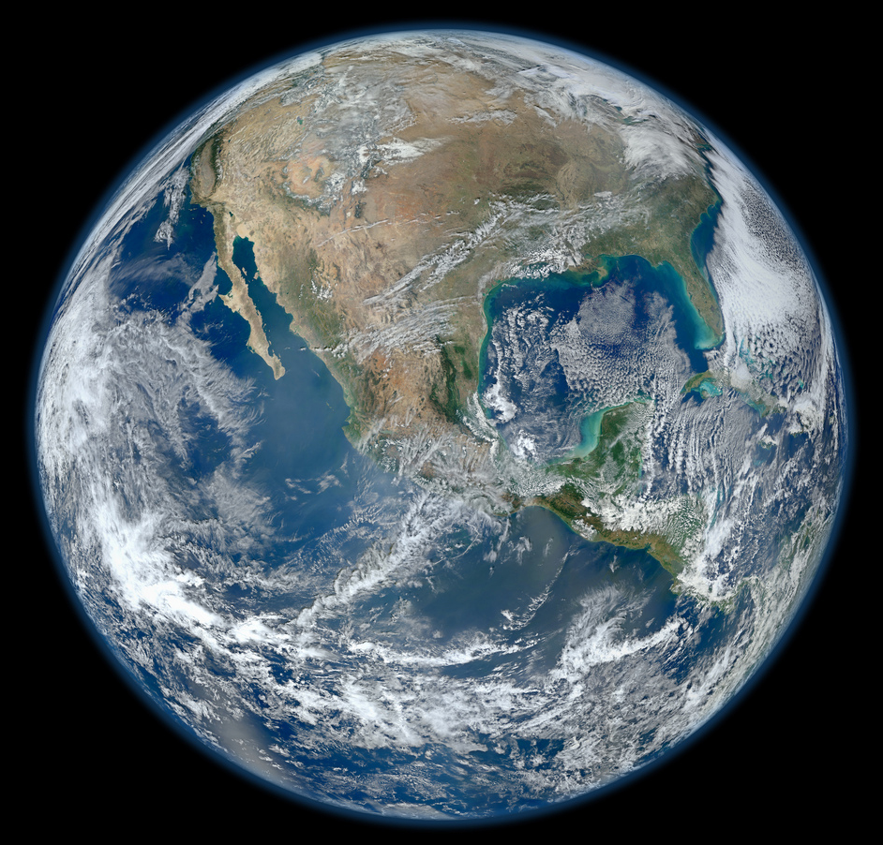
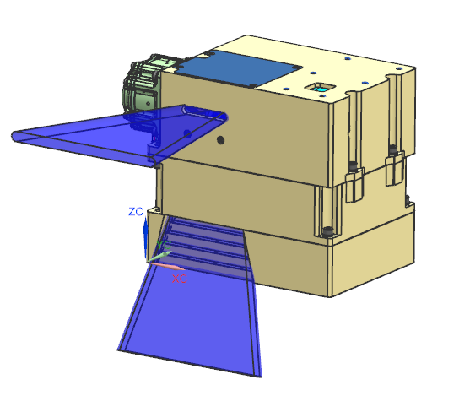
Polar Radiant Energy in the Far-InfraRed Experiment
May 2024
Up to 90 days
10 months
Nominal Operations
Continuous data collection
Downlink up to 4x to KSAT Lite Stations
Deliver to Rocket Lab
Launch to Polar Orbit
D = 0
Solar Array Deployment
D = +30 minutes
Detumble and Sun Acquisition
Checkout
BUS commissioning
TIRS commissioning
Nominally 30 days
Thermal InfraRed Spectrometer (TIRS)
5 to 53 μm spectral range
0.84 μm sampling
8x64 spatial x spectral channels
Size: 4U Mass: 3 kg Power: 4.5 W
Arctic
Science
Sun Avoidance
Spacecraft will Yaw 180º as necessary
To prevent Sun intrusion
on the apertures
Overlapping Measurements
Co-located ground scenes
separated by 1-12 hours
Earth View
(FIR spectra)
Space View
(calibration)
S-Band
Telecom
4x/Orbit
Calibration Sequences
Internal/Space View Switching
~10 seconds each
Nominally 8x per orbit
PREFIRE Science
PREFIRE connects observations, analyses, and models to improve polar climate prediction including rates of Arctic warming, sea ice decline, and ice sheet melt
10 month prime mission
Antarctic
Science
Altitude | 510-540 km
Inclination | 82-98º
Duration | 10 months
Two 6U CubeSats in asynchronous orbits reveal the fingerprints of Arctic processes
https://prefire.ssec.wisc.edu

Slide 7
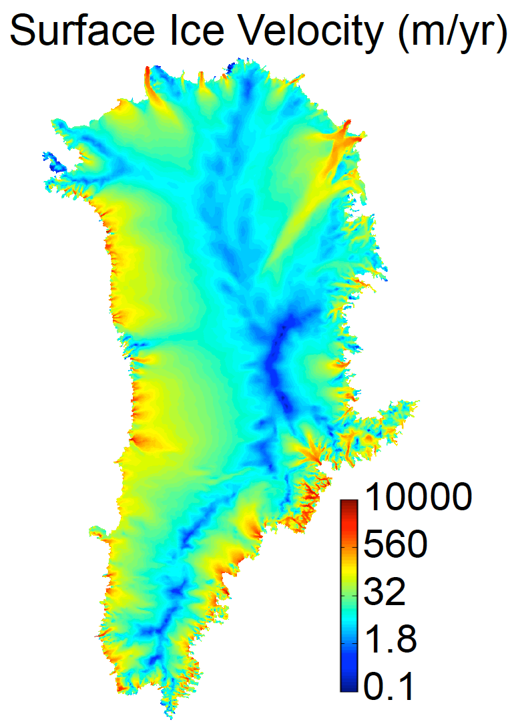
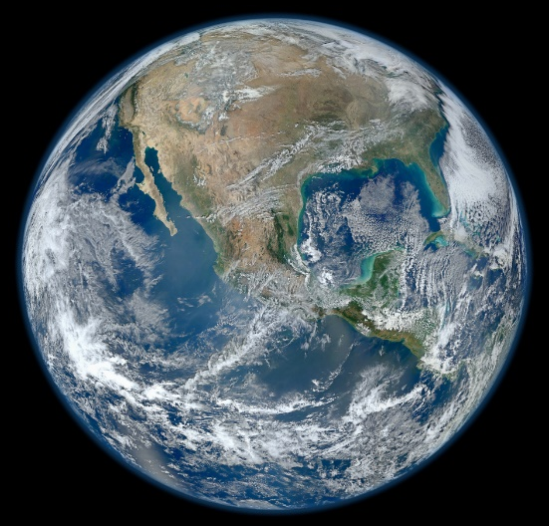
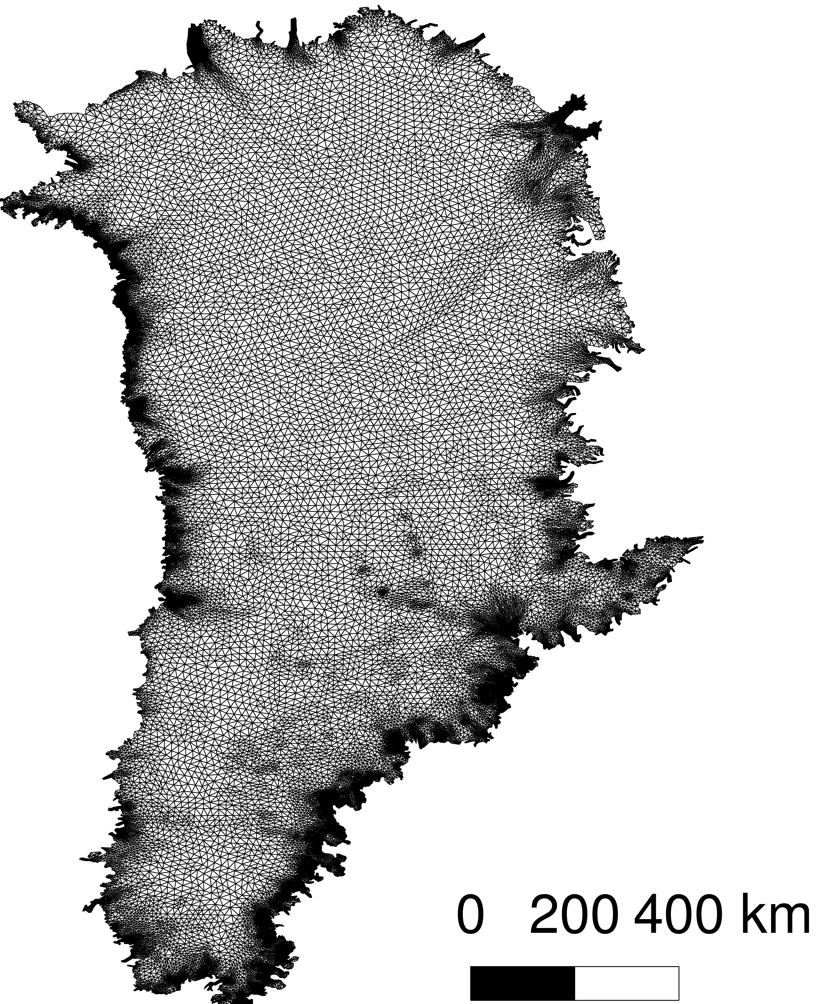
Connecting Observations to Predictions
PREFIRE Tests Two Hypotheses By Coupling Observations to Models
Time-varying errors in far infrared emissivities and atmospheric greenhouse effects (GHE) bias estimates of energy exchanges between the surface and the atmosphere in the Arctic.
These errors are responsible for a large fraction of the spread in projected rates of Arctic warming, sea ice loss, ice sheet melt, and sea level rise.
Observe FIR Spectra at the Poles
Establish Climatologies and Process Signatures
Evaluate and Improve Process and Climate Models
Perform New Process and Climate Model Simulations
Aggregate data using contextual data
Time-difference TIRS 1 & 2 spectra
Add new graphic of GCM here…
Emissions Pathways
Unforced Climate
Calibrate; geolocate; apply L2 algorithms
Analyze L3 Products
Integrate and Test Emissivity Modules
Hypothesis 1 is addressed by comparing observed spectral fluxes with those simulated from model output.
Hypothesis 2 is addressed by modifying emissivity models and examining impacts on ice sheet dynamic processes, ice sheet melt, Arctic warming, sea ice loss, and sea level rise.

