Slide 1
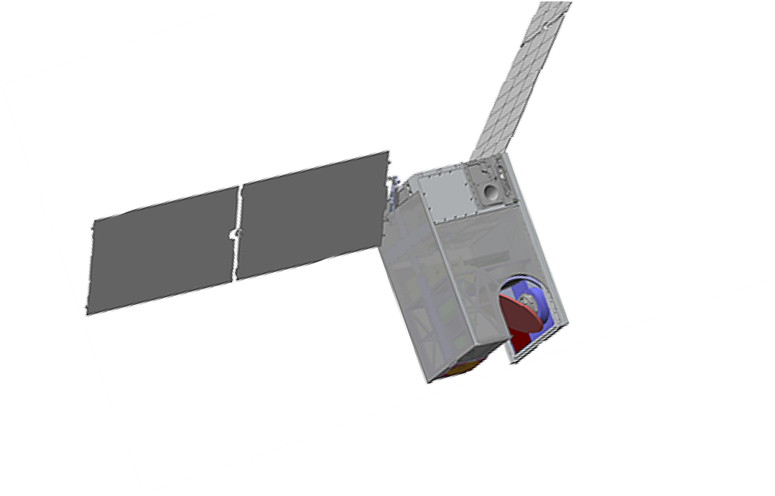
Polarized Submillimeter Ice-cloud Radiometer
The Polarized Submillimeter Ice-cloud Imager (POLSIR)
Principle Investigator: Ralf Bennartz, Vanderbilt University • Deputy PI: Dong Wu, NASA’s Goddard Space Flight Center
Why PolSIR? PolSIR characterizes the diurnal variability of ice clouds to improve climate models and predictions in the crucial 10-40-year range
The representation of ice clouds in Global Climate Models (GCMs) remains a major source of uncertainty in climate predictions.
PolSIR will ultimately help society adapt to climate change by providing key observational constraints on ice properties enabling climate modelers to develop more accurate cloud parameterizations.
PolSIR addresses NASA objectives and contributes to critical international climate priorities:
NASA DECADAL SURVEY OBJECTIVE
“Objective C-2a. Reduce uncertainty in low and high cloud feedback by a factor of 2 (Most Important).”
IPCC AR6 WG 1 REPORT (2021)
“At present, cloud feedbacks remain the largest source of uncertainty in climate sensitivity estimates”

Slide 2
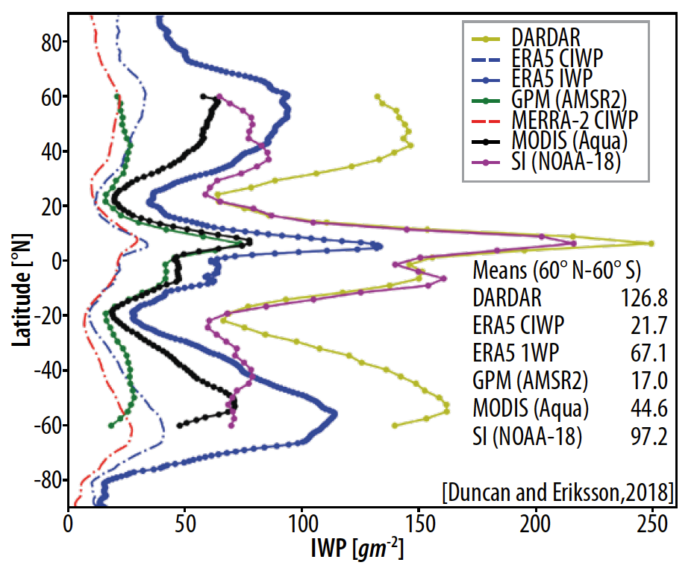
Polarized Submillimeter Ice-cloud Radiometer
Science and Application Objectives and Science Team
Ice clouds are poorly constrained in models and observations, with cloud ice estimates varying by a factor of 10. PolSIR will reduce this to a factor of 2
Science Team
Bennartz | Ralf | Vanderbilt
Wu | Dong | NASA-GSFC
Adams | Ian | NASA-GSFC
Barahona | Donifan | NASA-GSFC
Berndt | Emily | NASA-MSFC
Brogniez | Helene | U Paris Saclay
Ehsan | Negar | NASA-GSFC
Elsaesser | Greg | GISS/Columbia U
Gong | Jie | NASA-GSFC
Johnson | Ben | UCAR
Karpowicz | Bryan | NASA GMAO
Kroodsma | Rachael | NASA-GSFC
Merrelli | Aronne | U-Michigan
Pettersen | Claire | U-Michigan
Racette | Paul | NASA-GSFC
Rapp | Anita D. | Texas A&M
O1: Constrain the seasonally influenced diurnal cycle amplitude, form, and timing of the ice water path (IWP) and particle diameter in tropical and sub-tropical ice clouds
O2: Determine the diurnal variability of ice clouds in the convective outflow areas and understand relation to deep convection
O3: Determine the relationship between shortwave and longwave radiative fluxes and the diurnal variability of ice clouds
A1: Enable improvement of climate models by providing novel observations of the diurnal cycle of ice clouds

Slide 3
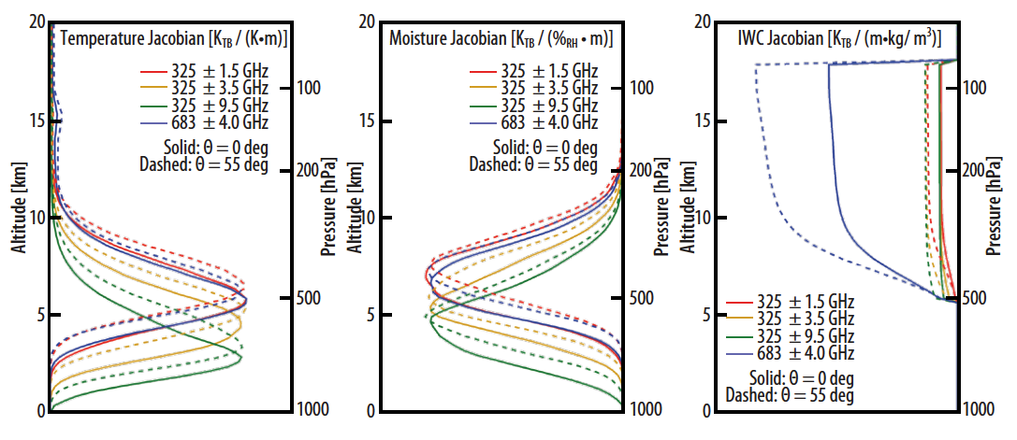
Polarized Submillimeter Ice-cloud Radiometer
Investigation overview: Two identical 12U Cubesats are separated in equator crossing time to allow for full diurnal sampling over the course of a month
PolSIR observes ice clouds at timescales necessary to improve climate modeling. Ground tracks for PolSIR-1 (red) and PolSIR-2 (blue) for one full day. The blue and red semi-transparent areas show the swath coverage for three consecutive orbits. The two spacecraft are separated 90 degrees in RAAN.
PolSIR provides launch and orbit flexibility: PolSIR can be launched to any orbit between 35° and 55° inclination and between 450 and 510 km orbit.
PolSIR observes the Earth in six channels: four around the 325.15 GHz water vapor absorption line and two at 683 GHz. These channels are highly sensitive to tropical ice clouds but ‘surface-blind,’ and thus not adversely affected by surface emissivity variations. The channels at 683 GHz and 325.15 ± 9.5 GHz are polarized and provide critical information about ice particle size and habit
PolSIR is currently scheduled for launch in late 2027

