Slide 1
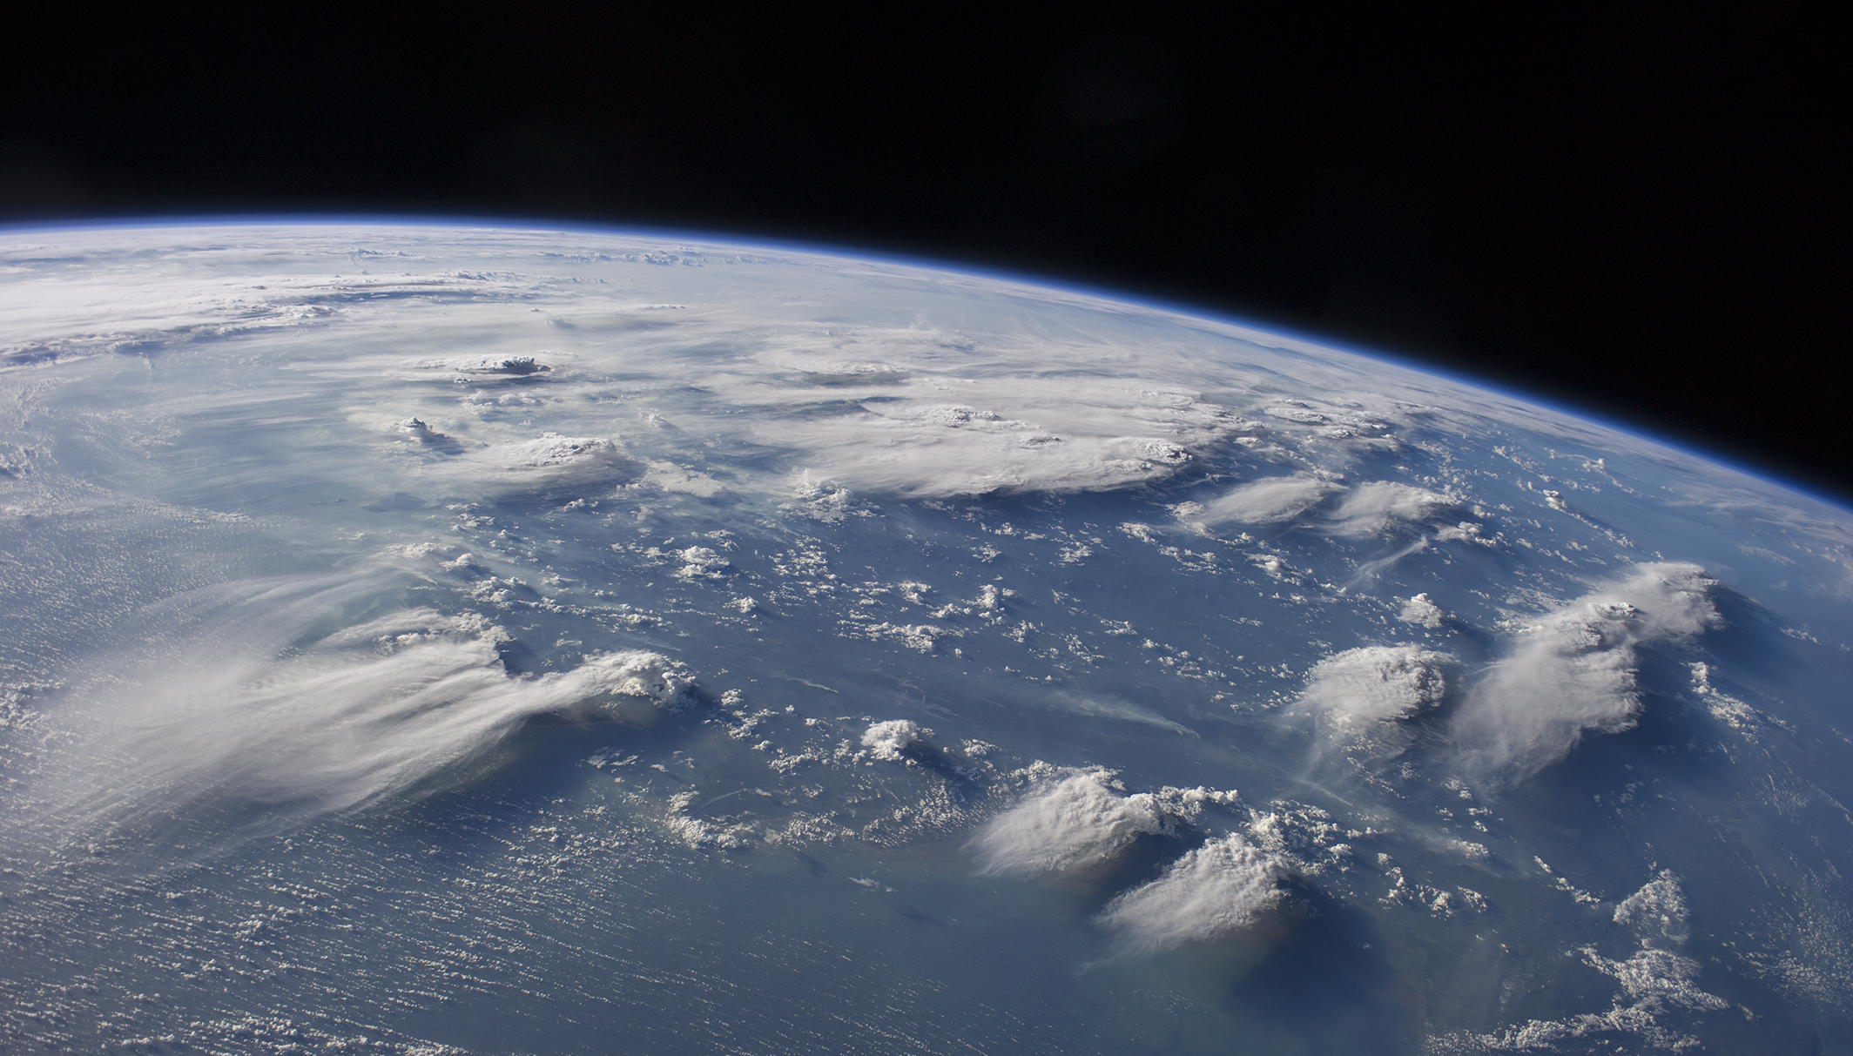
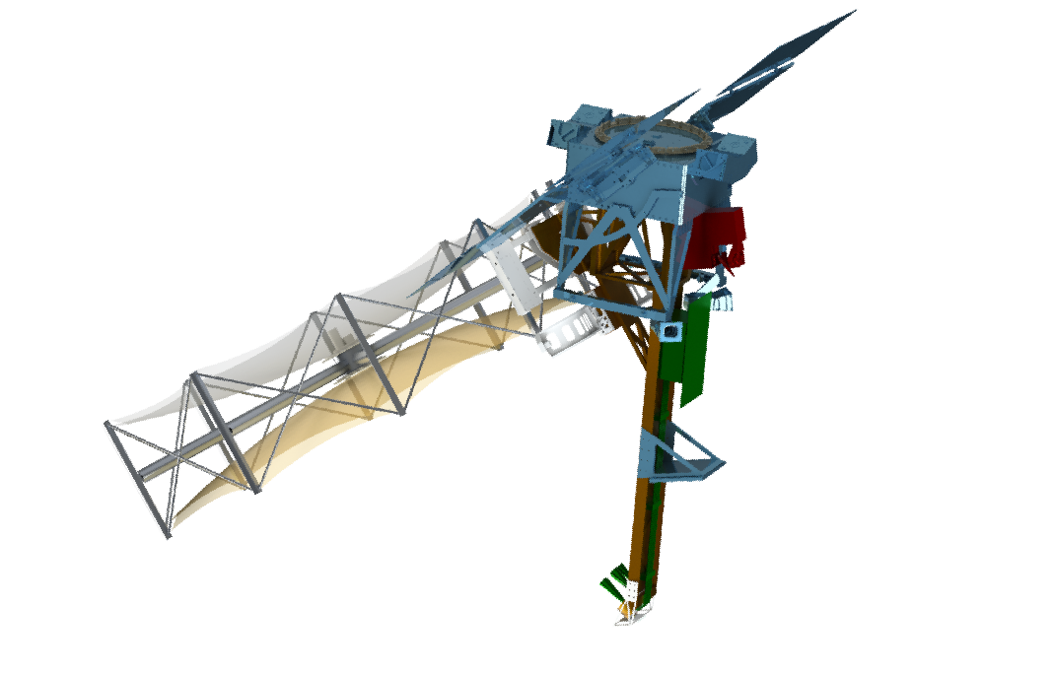


The NASA Investigation of Convective
Updrafts (INCUS) Mission
Susan C. van den Heever¹, Ziad Haddad², Simone Tanelli², Graeme Stephens², Derek Posselt², Yunjin Kim², Kristen L. Rasmussen¹, Jennie Bukowski¹, Randy Chase¹, Brenda Dolan¹, Sean Freeman³, Leah Grant¹, Pavlos Kollias⁴, Gabrielle Leung¹, Johnny Luo⁵, Peter Marinescu¹, Mary Morris², Sai Prasanth¹, Rick Schulte¹, Itinderjot Singh¹, Rachel Storer⁶, Ousmane Sy², Hanii Takahashi², and Zhuocan Xu⁴
¹ Colorado State University, Ft Collins CO; ² Jet Propulsion Laboratory, California Institute of Technology, Pasadena CA; ³ University of Alabama, Huntsville; ⁴ State University of New York at Stony Brook, Stony Brook, NY; ⁵ City College of New York, New York, NY; ⁶ UCLA
This work is supported by INCUS, a NASA Earth Venture Mission, funded by NASA’s Science Mission Directorate and managed through the Earth System Science Pathfinder Program Office under contract number 80LARC22DA011.
Image: NASA Earth Observatory (https://www.flickr.com/photos/nasa2explore/14991571998/)

Slide 2

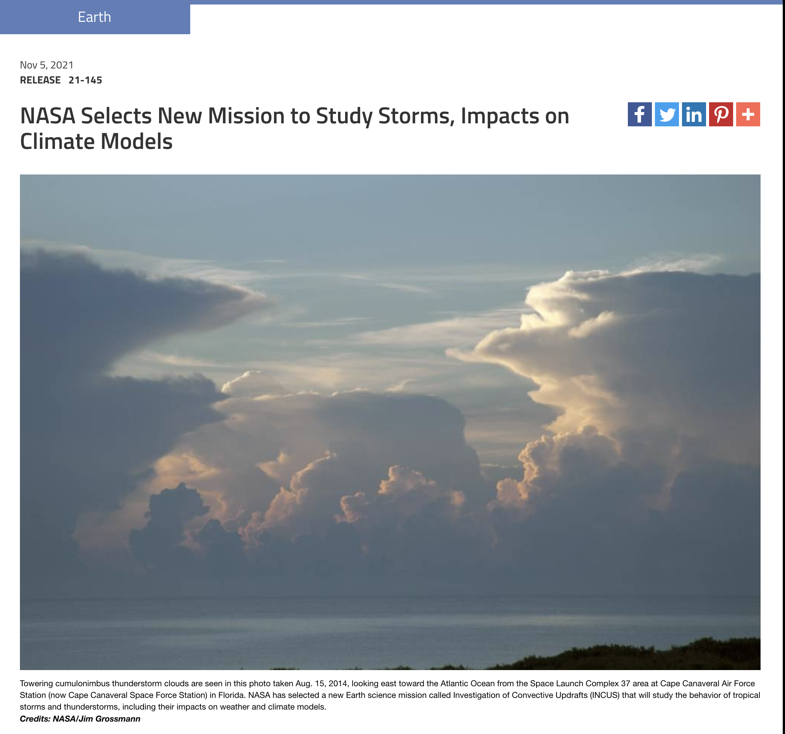
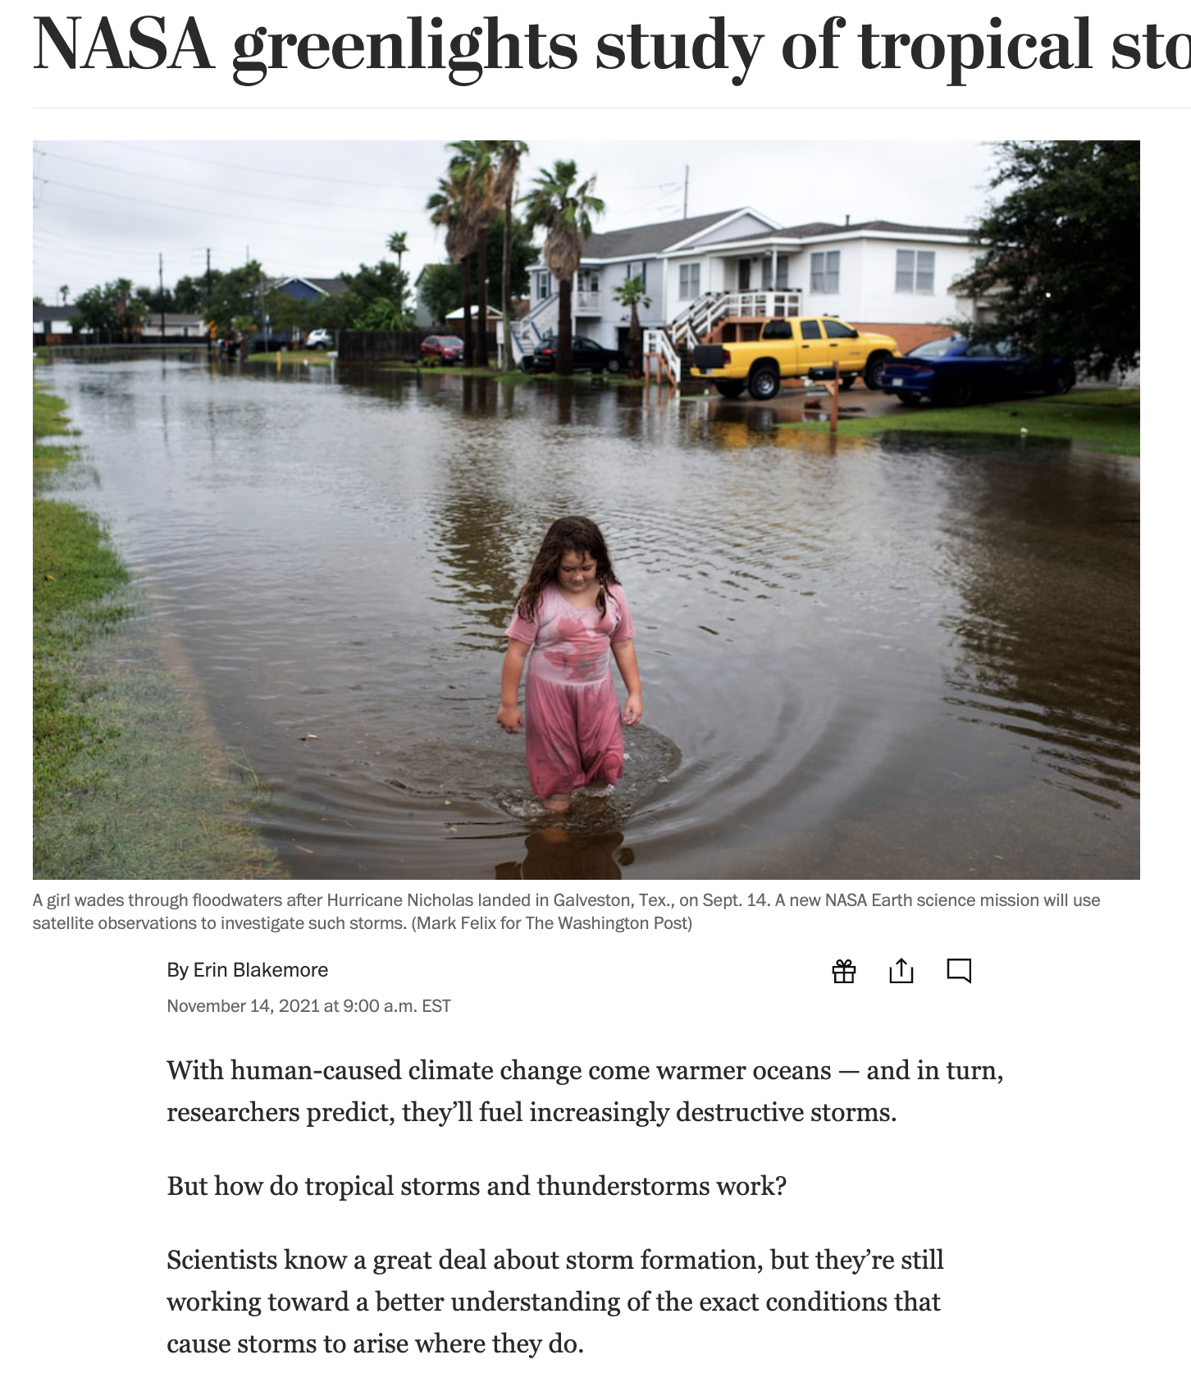
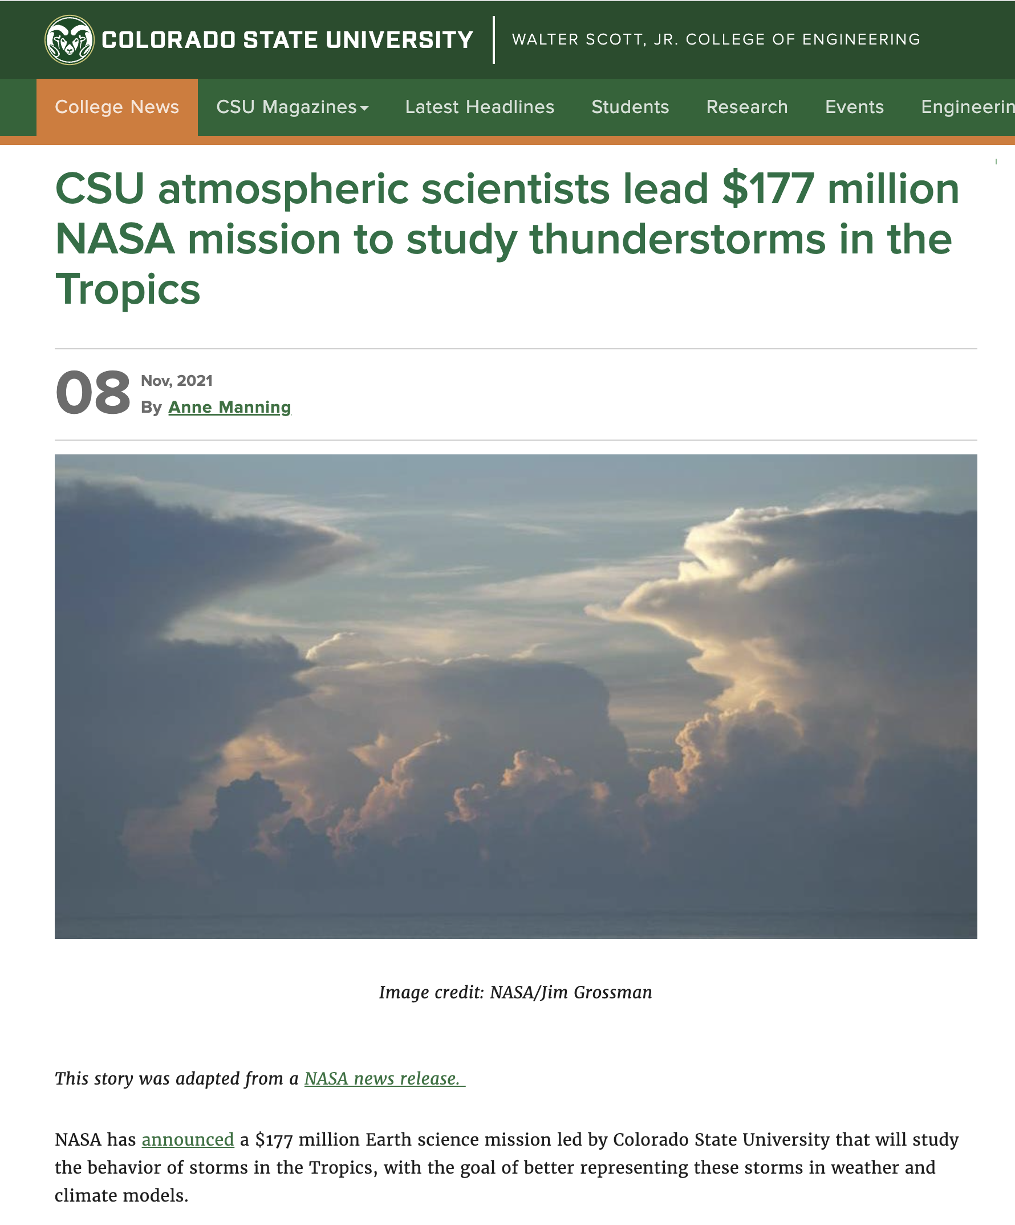
INCUS Selected as Earth Ventures Mission - 3
INCUS competitively selected in November 2021
“a series of new science-driven, competitively selected, low cost missions that will provide opportunity for investment in innovative Earth science”

Slide 3
Global Focus on Extreme Weather
World Economic Forum (2020)

Slide 4
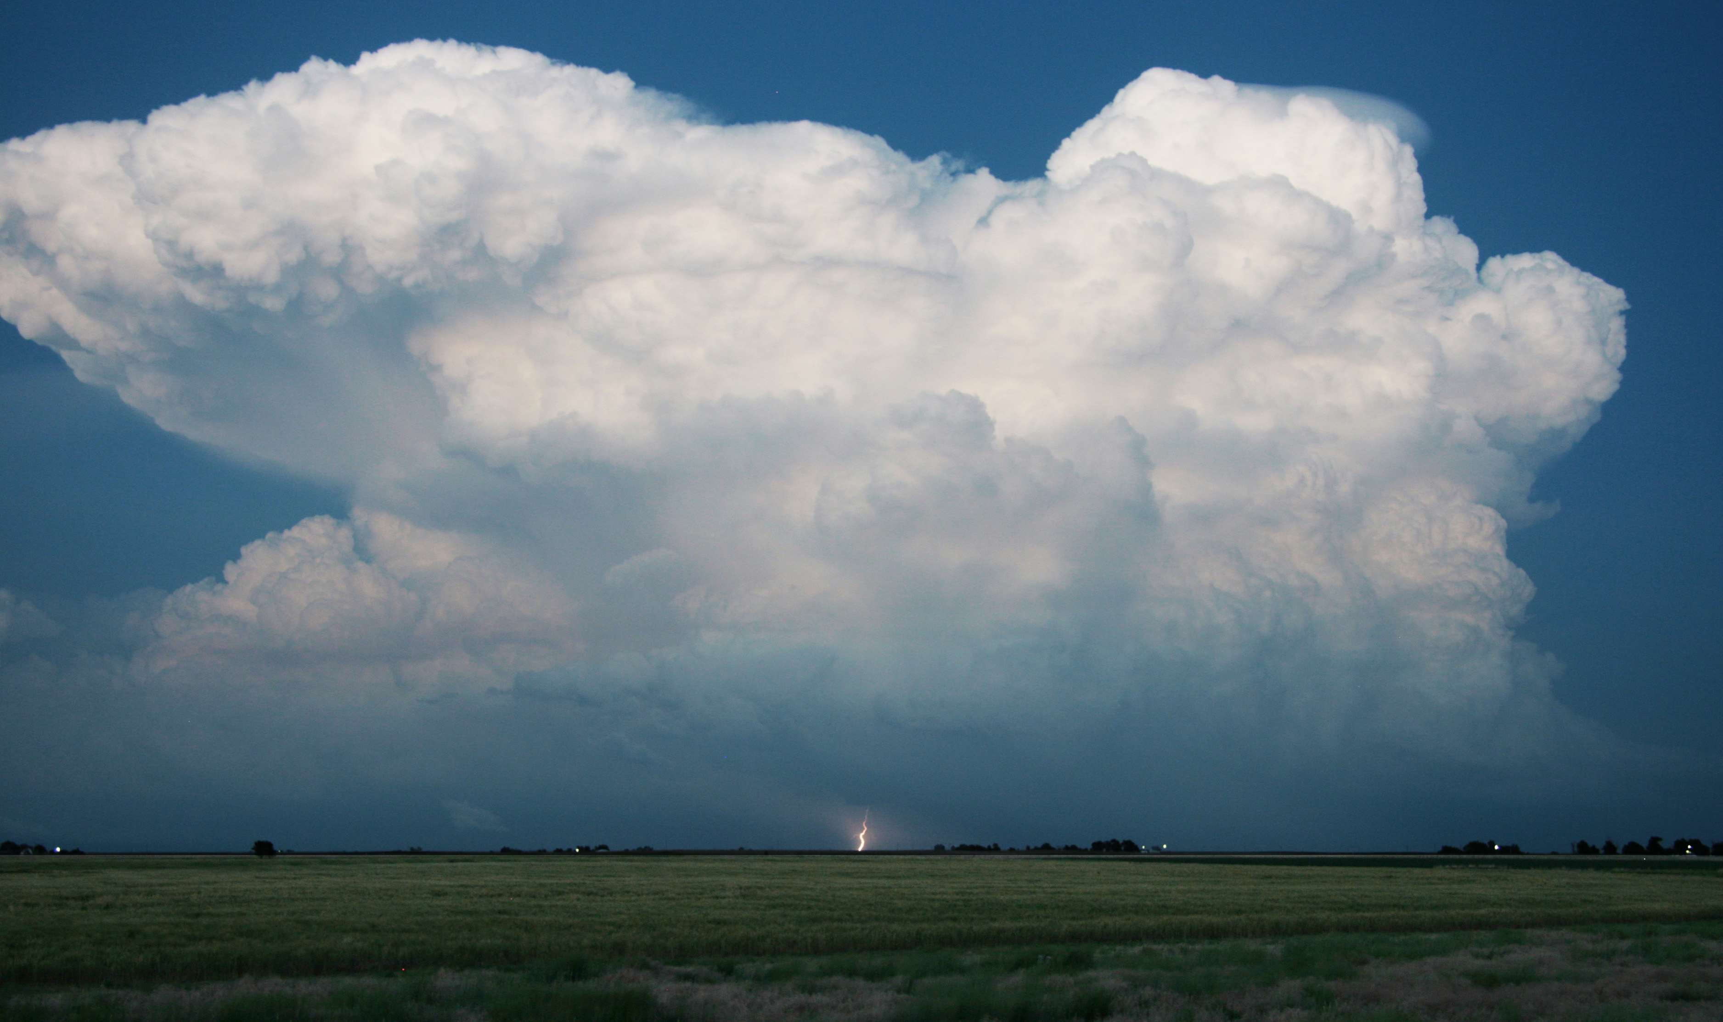
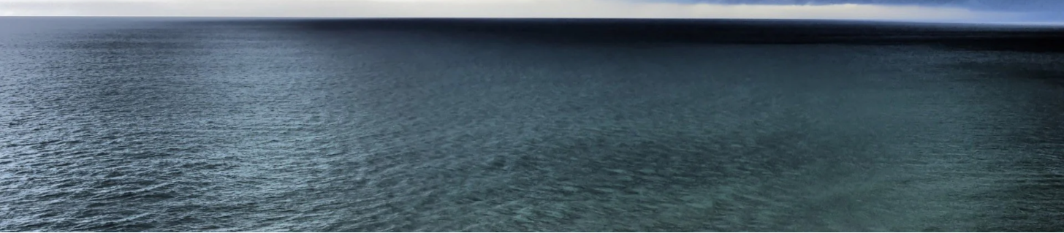
INCUS - INvestigation of Convective UpdraftS
Overarching Goal:
To understand why, when and where tropical convective storms form, and why only some storms produce extreme weather.
First global systematic investigation into CMF and its evolution within deep tropical convection
Convective Mass Flux (CMF) = the vertical transport of air and water
CMF
Image: NASA Earth Observatory (https://www.flickr.com/photos/nasa2explore/14991571998/)

Slide 5
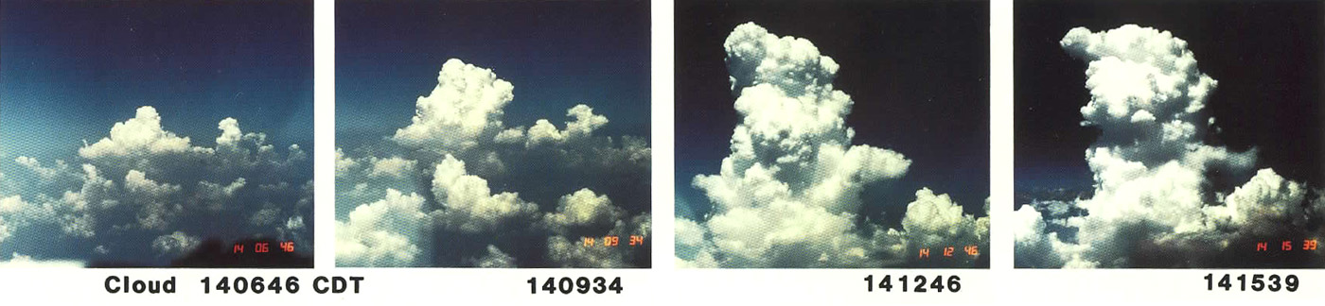
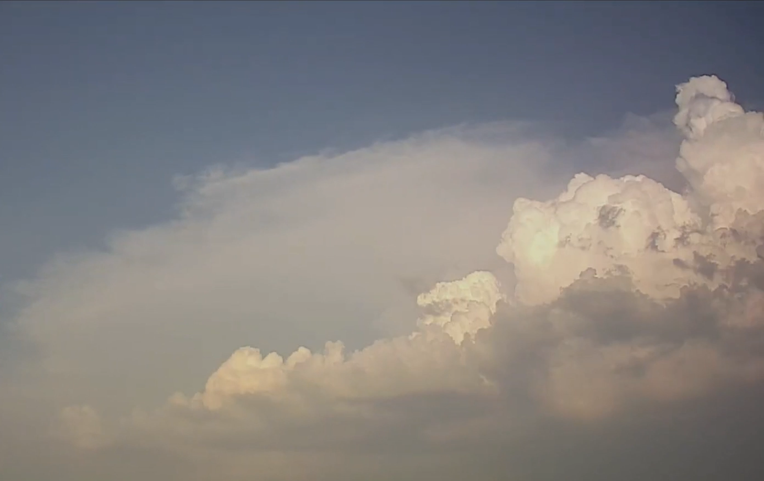
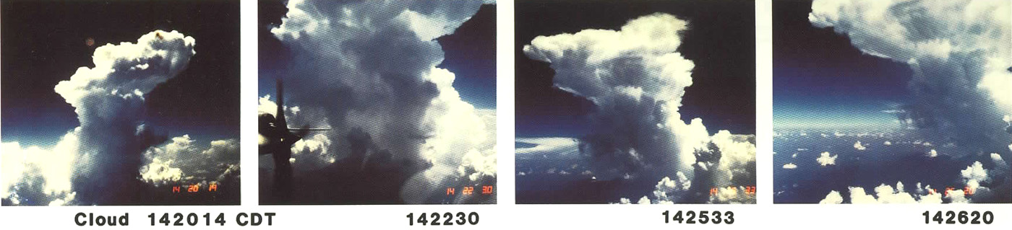
Convection Evolves Rapidly
Development of a deep convective cloud over 20 minute time period (images: Ted Fujita)
Convective development - 30 min period
Convective storms vertically transport and mix the atmosphere

Slide 6
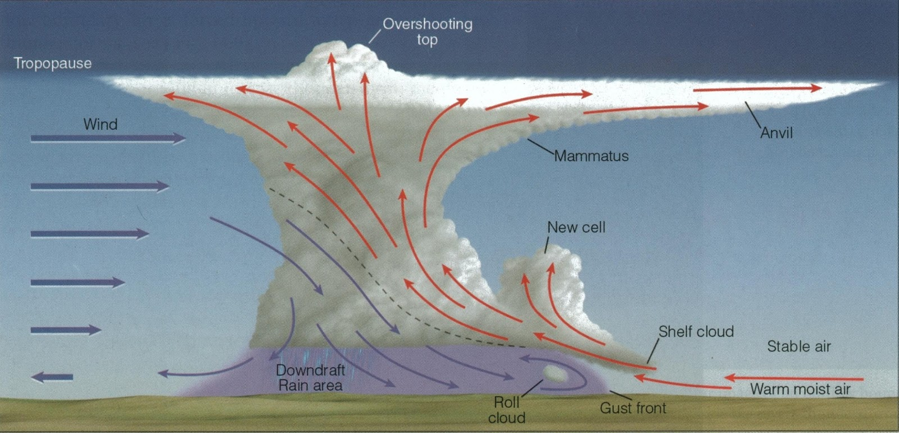

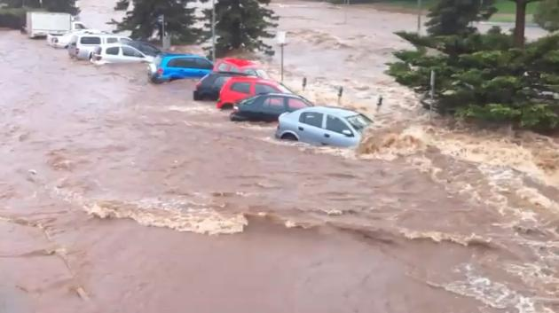
Convective Mass Flux – Storm Scales
FRESH WATER
Image: Thomson
Rising and sinking motion connects the boundary layer and upper troposphere
SEVERE WEATHER

Slide 7
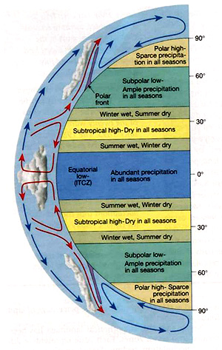
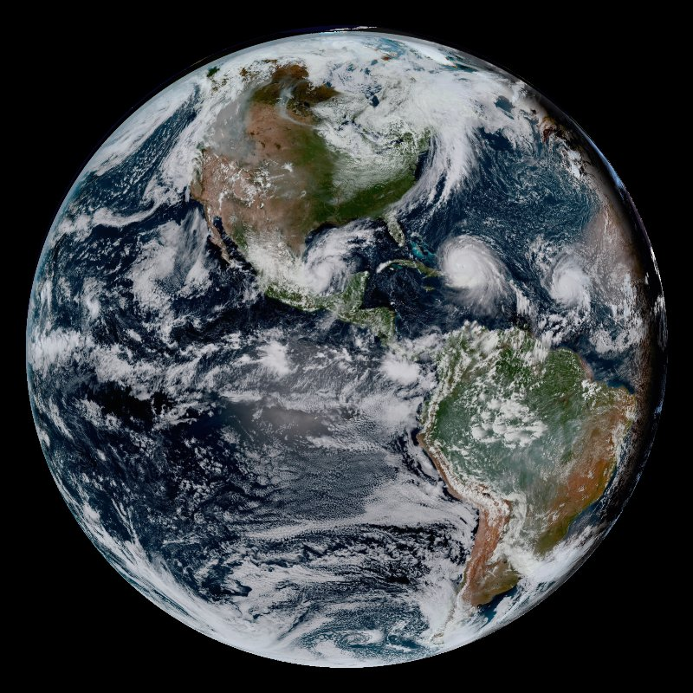

Convective Mass Flux – Large Scales
Air sinks establishing dry regions
Dry Regions
Dry Regions
Air rises within storms establishing moist regions
Moist Regions
Moist Regions

Slide 8







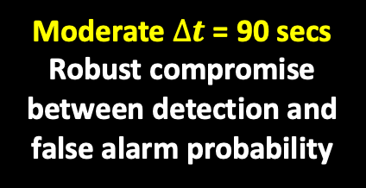

Long $∆t$ = 120 secs
95% updrafts detected with low false alarm probability
$∆t$=120secs
$∆t$Approach:
To study different parts of the CMF intensity spectrum
To quantify duration of the vertical transport
Evolution of storm structures
$∆t$=30secs
$∆t$=90secs
Short $∆t$= 30 secs
Best estimate of strongest updrafts
Moderate $∆t$ = 90 secs
Robust compromise between detection and false alarm probability
Flight Direction
  Space Craft: 100kg
  Inclination: tropical (22.5 to 39$°$)
  7 km s⁻¹, 95 minute orbit, 15x per day
  Launch: 2026
  Duration: 2 years
  ~330,000 convective cores at 39$°$

Slide 9
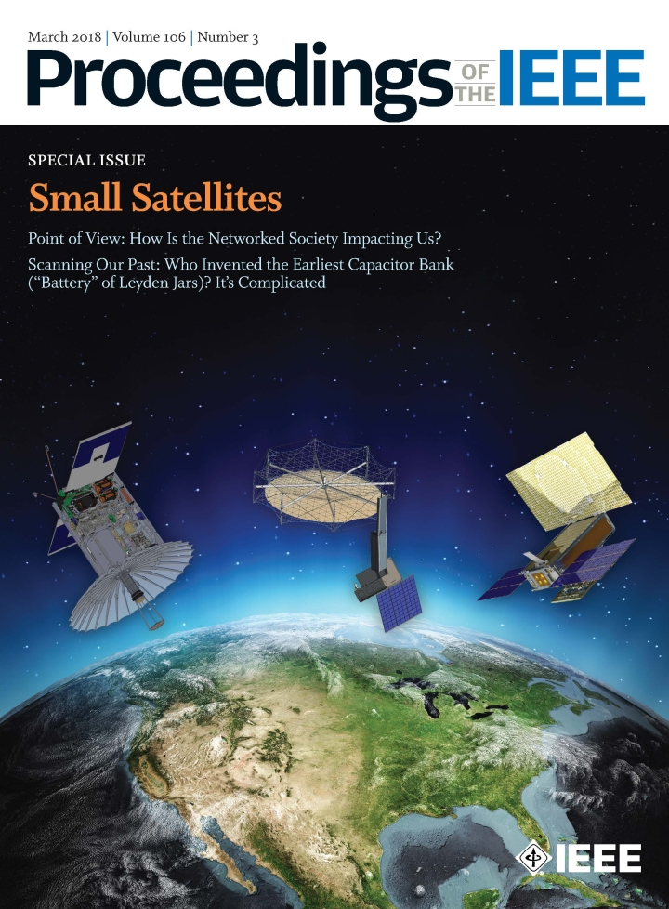
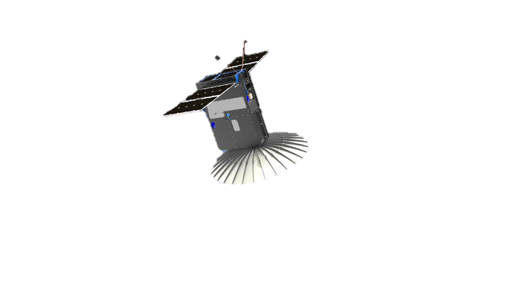
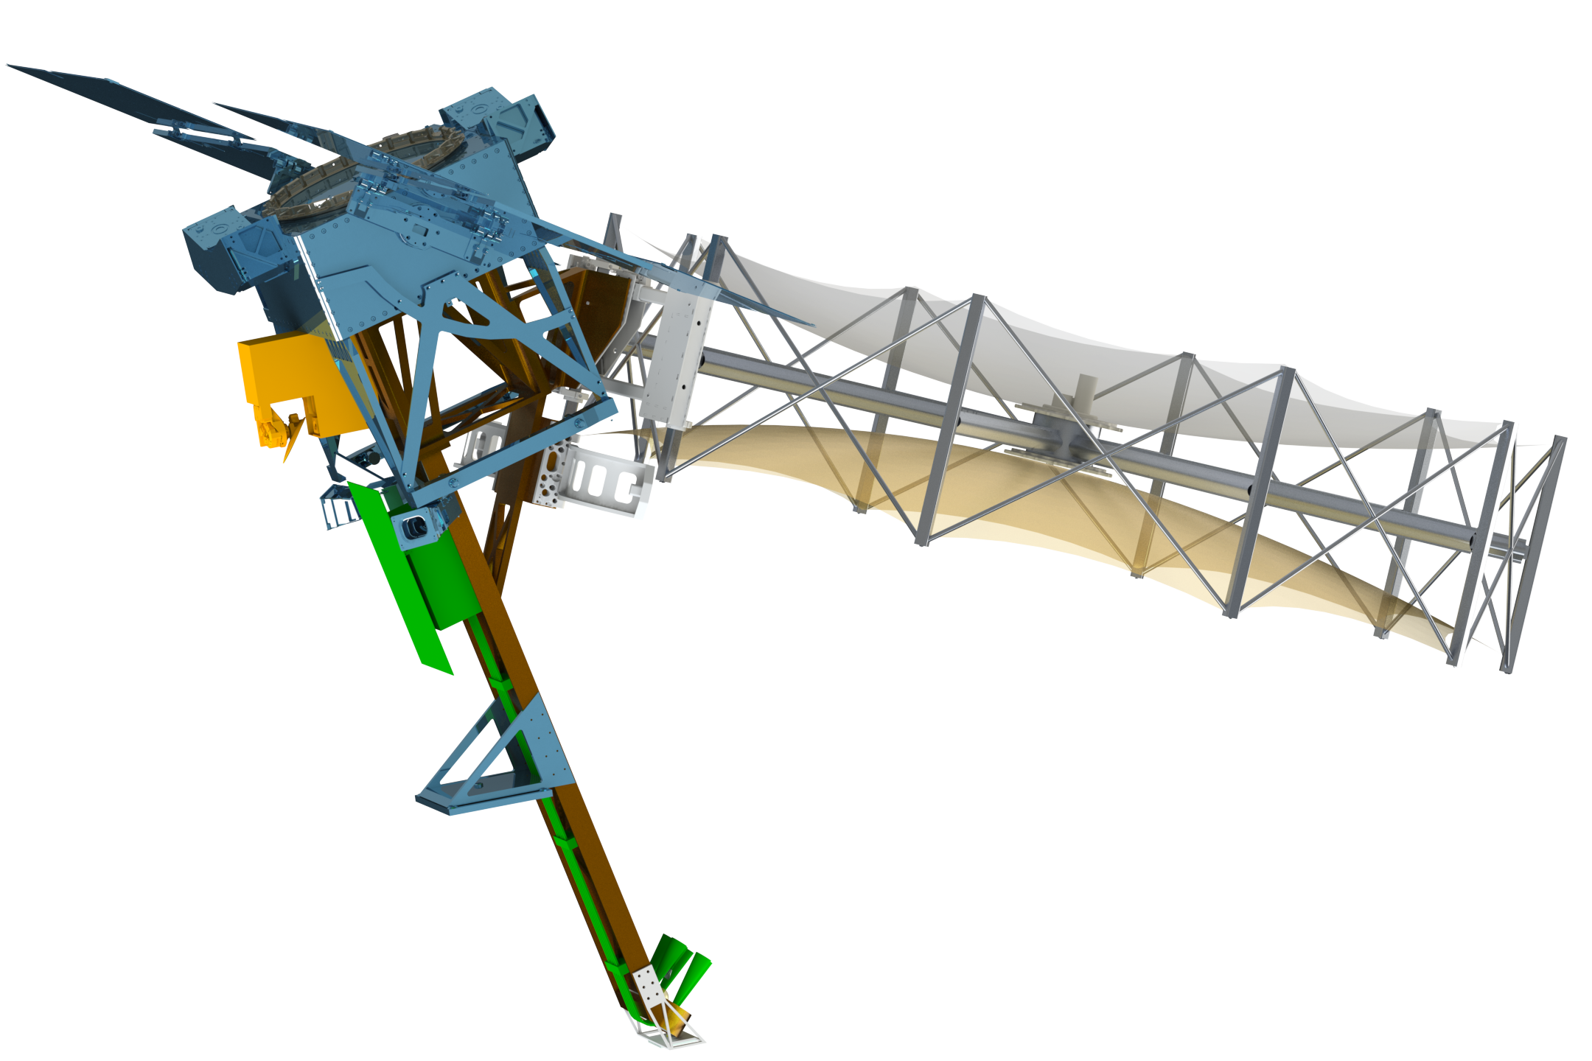
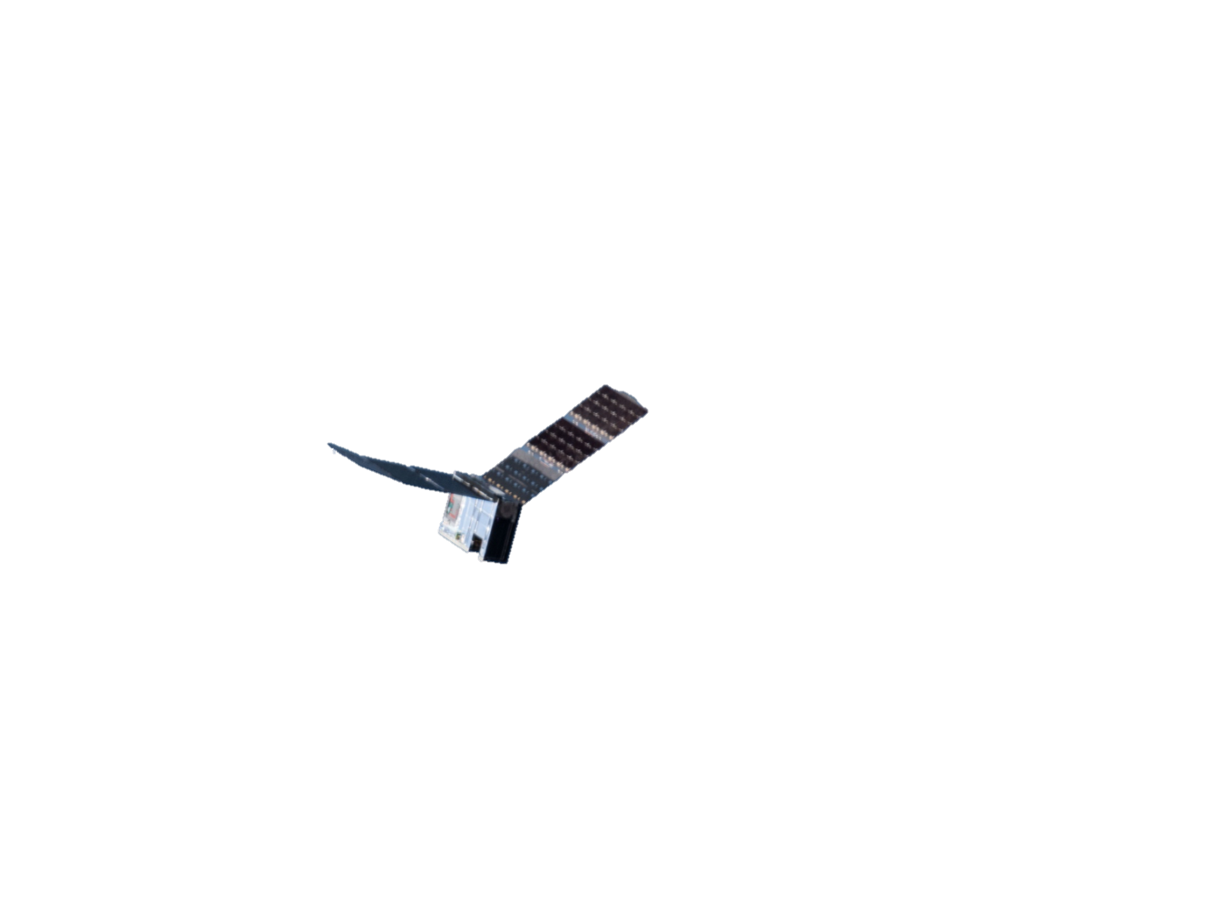

INCUS Made Possible by Miniaturization
3 RainCube Ka-band radars
INCUS
Deployable Antenna
Deployable Antenna
+
TEMPEST-D mm-wave radiometer
RainCube and TEMPEST-D implemented as tech demos by NASA’s ESTO

Slide 10
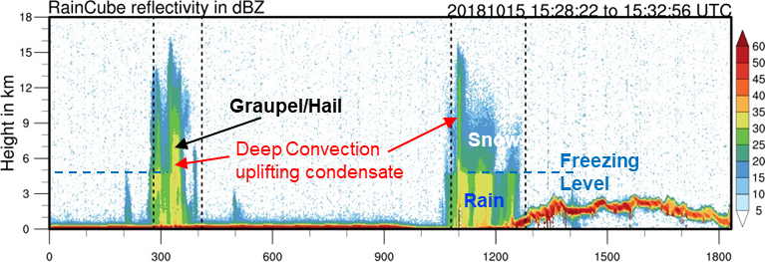
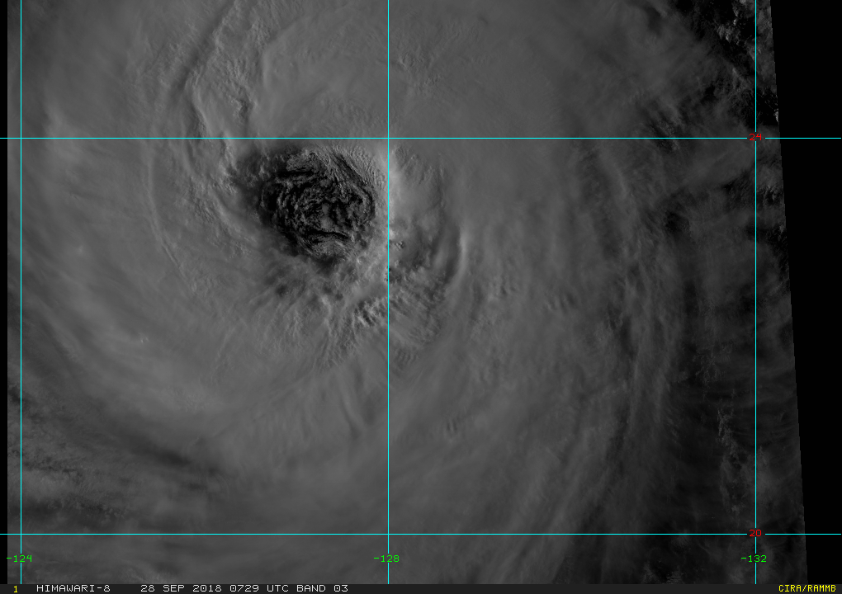
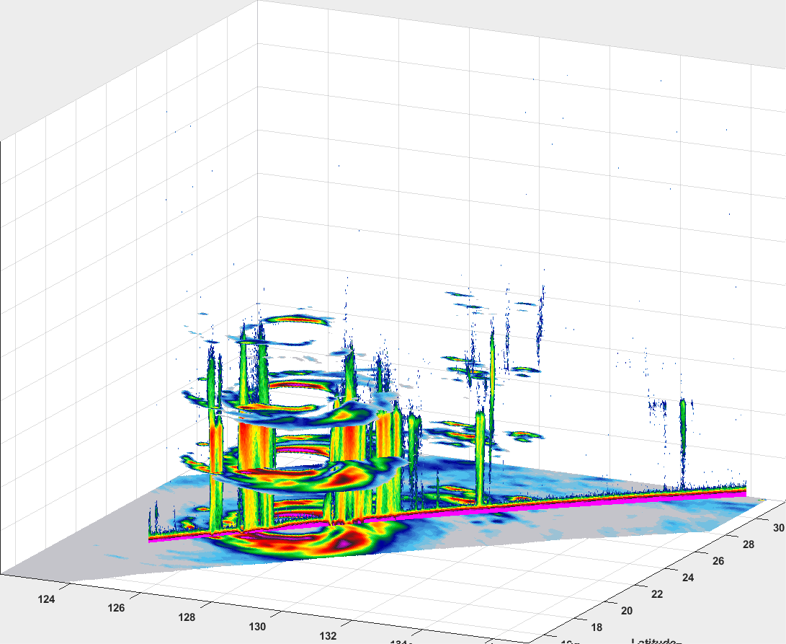
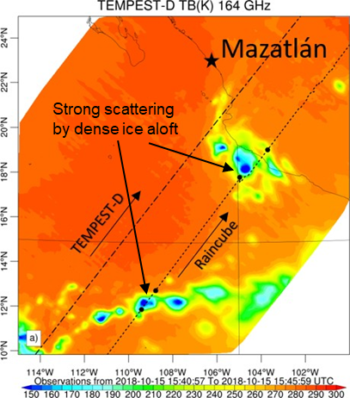
INCUS - Unprecedented 3D Views of Storms
RainCube
6U Ka-band (35.7GHz) nadir pointing radar
TEMPEST-D
6U multi-channel microwave radiometer
~5 min apart
2D Vertical structure
250 m vertical resolution
2D Horizontal structure 4 vertical levels
Radar reflectivity
Correlated storm measurements from RainCube radar and TEMPEST-D radiometer over Texas, Mexico and Pacific Ocean
Images and Animations: Simone Tanelli, Shannon Brown and Steve Reising
eye
Brightness temperatures
Typhoon Trami on Sept. 28, 2018
On September 28, 2018, TEMPEST-D and RainCube overflew Typhoon Trami < 5 minutes apart

Slide 11
The INCUS Team
LEADERSHIP | Role | Inst
Susan van den Heever | PI | CSU
Ziad Haddad | DPI | JPL
Simone Tanelli | PS | JPL
Yunjin Kim | PM | JPL
SCIENCE TEAM | Role | Inst
George Huffman | Co-I | GSFC
Shannon Brown | Co-I | JPL
Pavlos Kollias | Co-I | SBU
Mark Kulie | Co-I | NOAA
Z. “Johnny” Luo | Co-I | CCNY
Gerald Mace | Co-I | UTAH
Walter Petersen | Co-I | MSFC
Derek Posselt | Co-I | JPL
Kristen L. Rasmussen | Co-I | CSU
Steve Reising | Co-I | CSU
Courtney Schumacher | Co-I | A&M
Graeme Stephens | Co-I | JPL
INTERNAT COLLABS | Role | Inst
Alessandro Battaglia | Collab | UofL
Richard Forbes | Collab | ECMWF
Christopher Holloway | Collab | UofR
Alain Protat | Collab | ABM
Thota Narayana Rao | Collab | NARL
Rémy Roca | Collab | CNRS
Philip Stier | Collab | UofO
Daniel Vila | Collab | INPE
5 universities, 3 NASA labs and NOAA
Early career scientists
Student collaboration – 10 students
INDUSTRY | Role
Tendeg | Deployable Antenna
BCT | Spacecraft, Mission Ops
ADVISORY BOARD | Role | Inst
Christian Jakob | Collab | Monash
John Knaff | Collab | NOAA
Mitchell Moncrieff | Collab | NCAR
David Romps | Collab | Berk
Wei-Kuo Tao | Collab | GSFC
JPL Engineering Team
8 international partners in 5 different countries
Proposal development
Seminars
DATA CENTER | Role | Inst
Phil Partain | SDC | CIRA

Slide 12
INCUS
The INCUS mission provides the first tropics-wide investigation of the evolution of the vertical transport of air and water by convective storms, one of the most influential, yet unmeasured atmospheric processes. These measurements are central to improving our capability to better predict extreme weather and their changes with warming climates.

Slide 13
Questions?

Slide 14
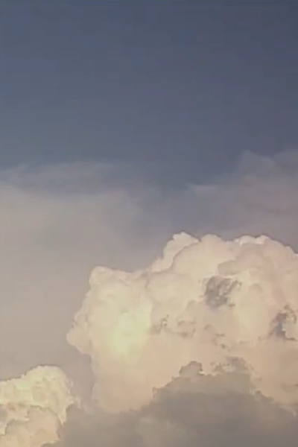
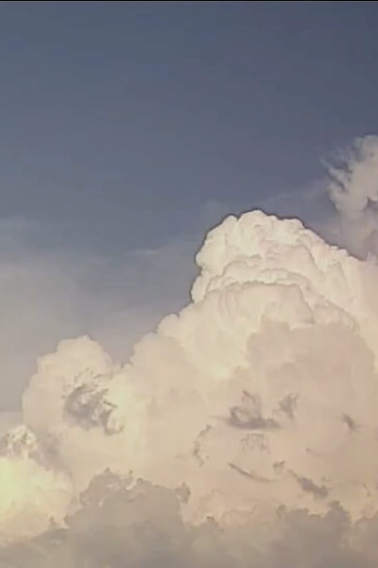
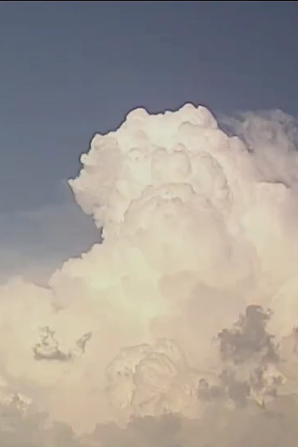
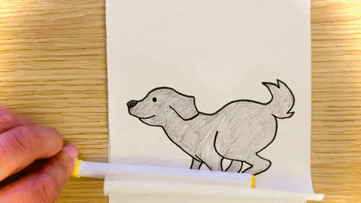
Unique Time Differencing (∆𝒕) Approach
t-2 min
t=0 min
t+2 min
Rapidly sampling the cloud state in time provides information on the storm motion and hence CMF
~10,000 m
~8,500 m
~7,000 m
Exploratorium.edu
Time Evolution of Convection
W of 15 m/s corresponds to ~1km/min

