Slide 1
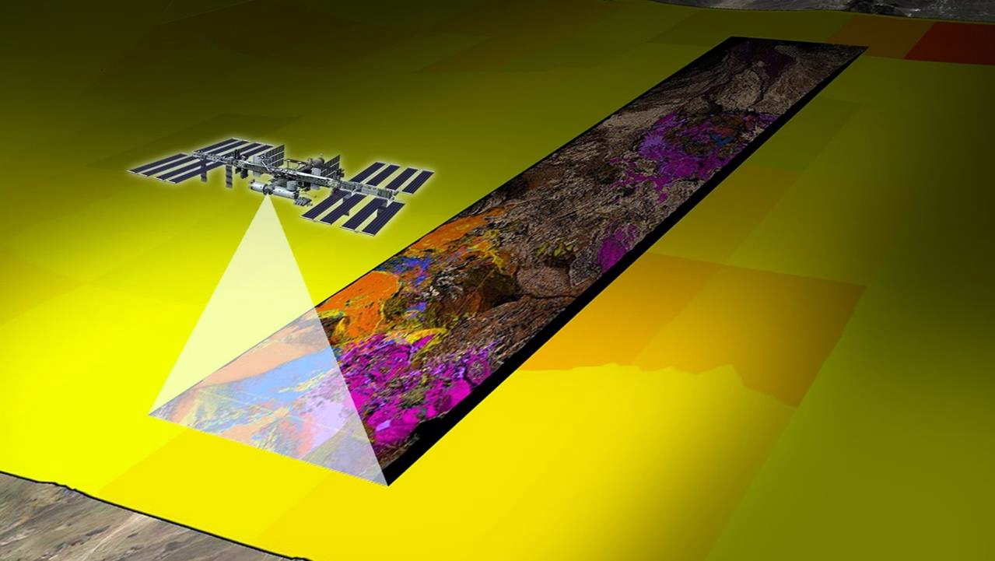
Copyright 2023 California Institute of Technology. All Rights Reserved. US Government Support Acknowledged.
Earth Surface Mineral Dust Source Investigation (EMIT)
Robert O. Green, Charlene Ung, David R. Thompson, Natalie Mahowald, and Science/Engineering Teams
Jet Propulsion Laboratory, California Institute of Technology, Pasadena, CA, USA

Slide 2
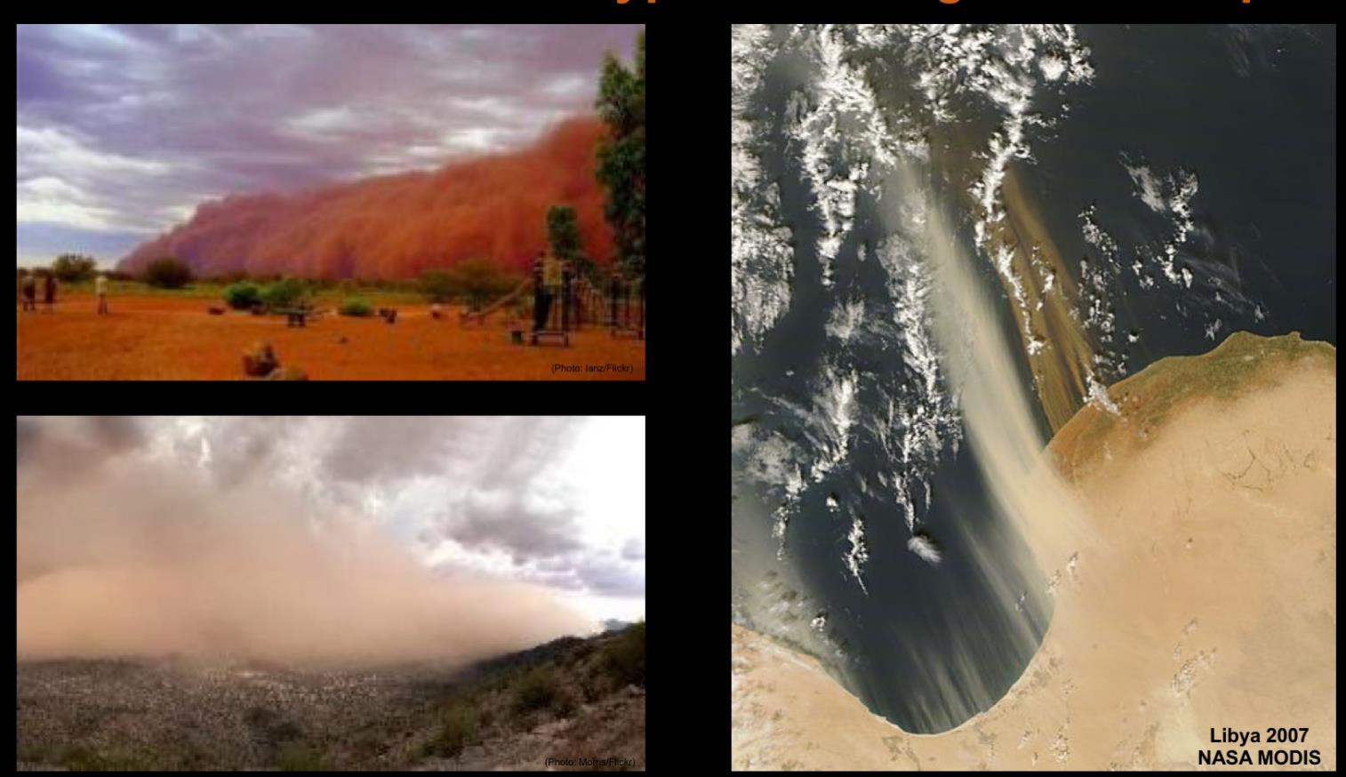
Mineral Dust is Emitted into the Atmosphere with Different Compositions Impacting Radiative Forcing

Slide 3
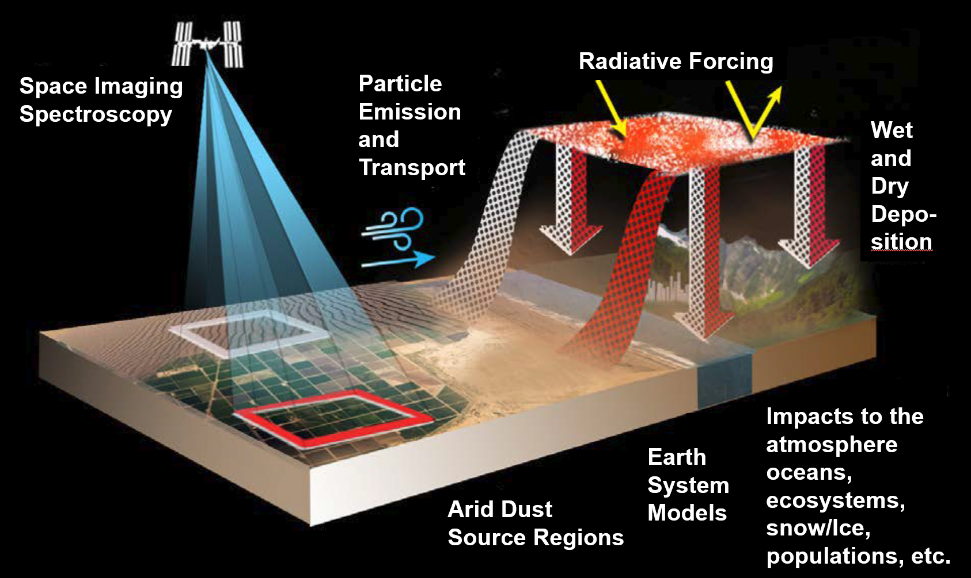
The Earth’s Dust Cycle has Impacts Throughout the Earth System

Slide 4
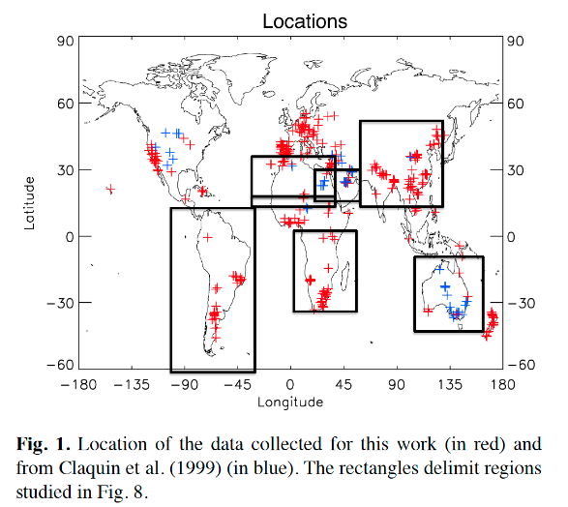
The Radiative Forcing Impact is Uncertain
Earth System Model Constraints are Traced to < 5000 Samples

Slide 5
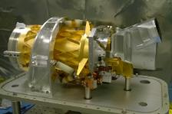

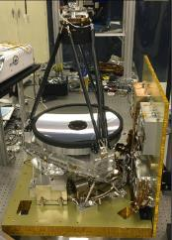
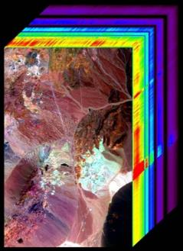
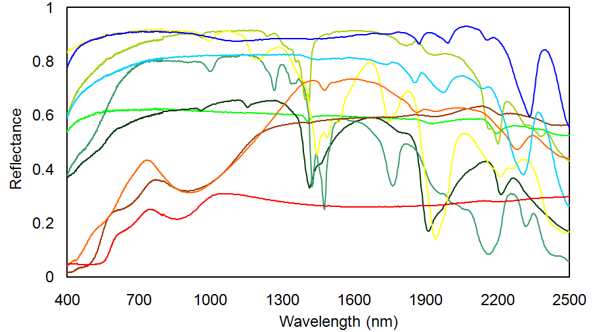


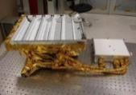
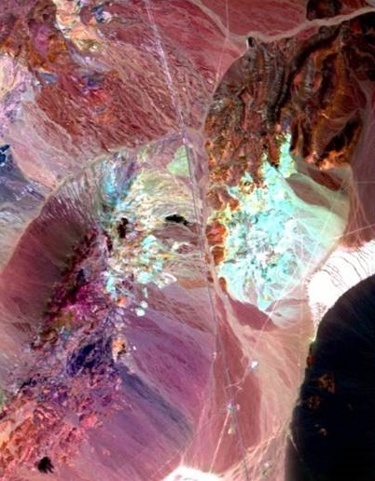
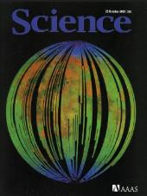
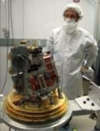
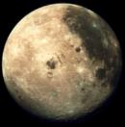
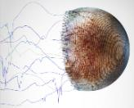
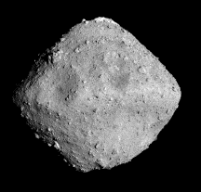
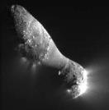
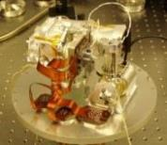
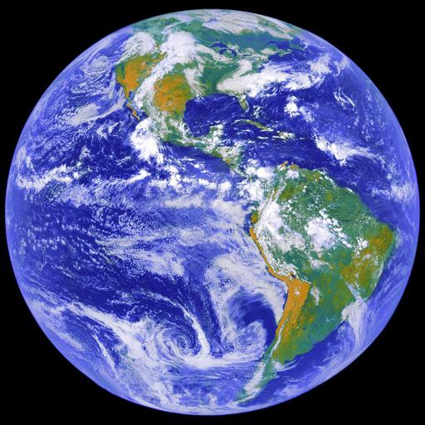
EMIT uses Imaging Spectroscopy to Deliver more than 1 Billion Observations of Mineral Composition of the Earth’s Arid Lands
Calibrated
Image Cube
Quantifiable Units and Uncertainties
Minerals
Detector Array
Spectrometer
Slit
Telescope
Material Map
Each imaging spectrometer is different based on requirements and
technologies.
Google Scholar reports >35,000 results on “AVIRIS”

Slide 6
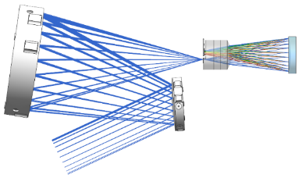
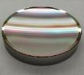
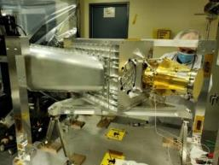
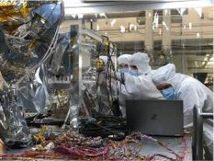

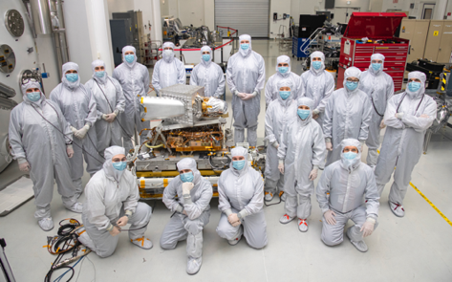
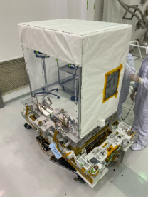
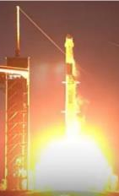
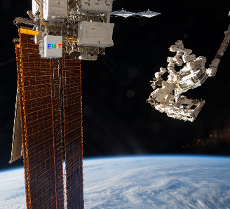
The EMIT Imaging Spectrometer is State-of-the-Art (41 Months)
Decades of Lesson Incorporated: Signal-to-Noise Ratio, Uniformity, Coverage…
Optically Fast F/1.8 Dyson Imaging Spectrometer
Optical Bench
Alignment
Telescope
Spectrometer
M2
FPA
Dyson Block
Grating
M1
On the ExPA
Complete at JPL
Launch 14 July 2022
Installation 26 July 2022

Slide 7
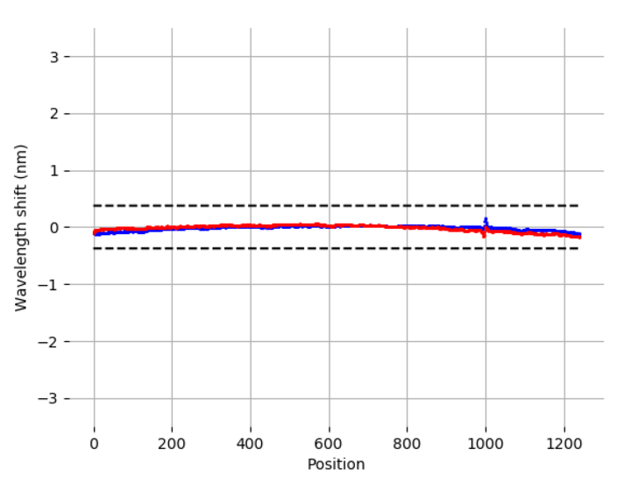
First On-orbit Imaging Spectrometer Detector Array Clocking
Requirement
Before in-flight adjustment
After in-flight adjustment

Slide 8
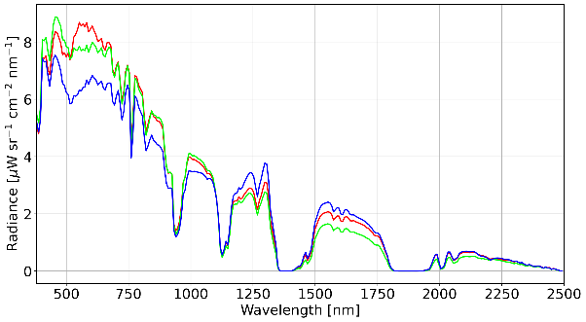
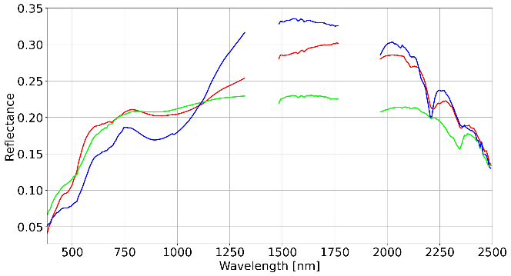
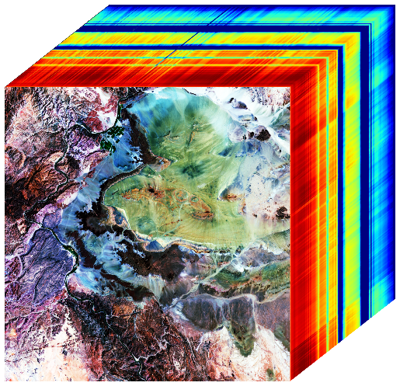
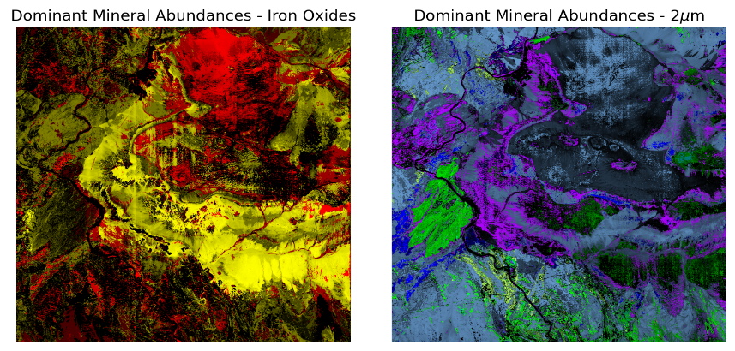
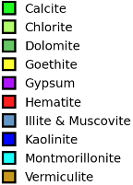
EMIT Imaging Spectrometer Observations East of Cape Town South Africa 7 January 2023
Calibrated Radiance Spectra of the Earth-Atmosphere System
2500
Spectral Image Cube
Wavelength [nm]
2000
1500
1000
500
Surface Reflectance Spectra with Diagnostic Mineral Absorptions
Mineral Maps

Slide 9
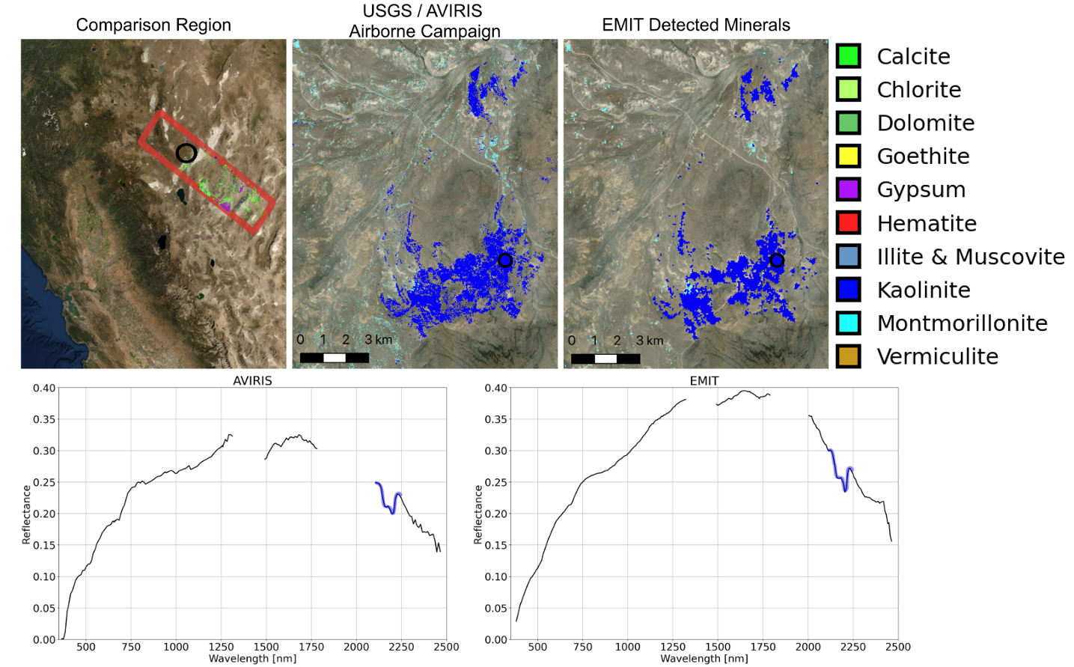
Mineral Validation with USGS Team

Slide 10
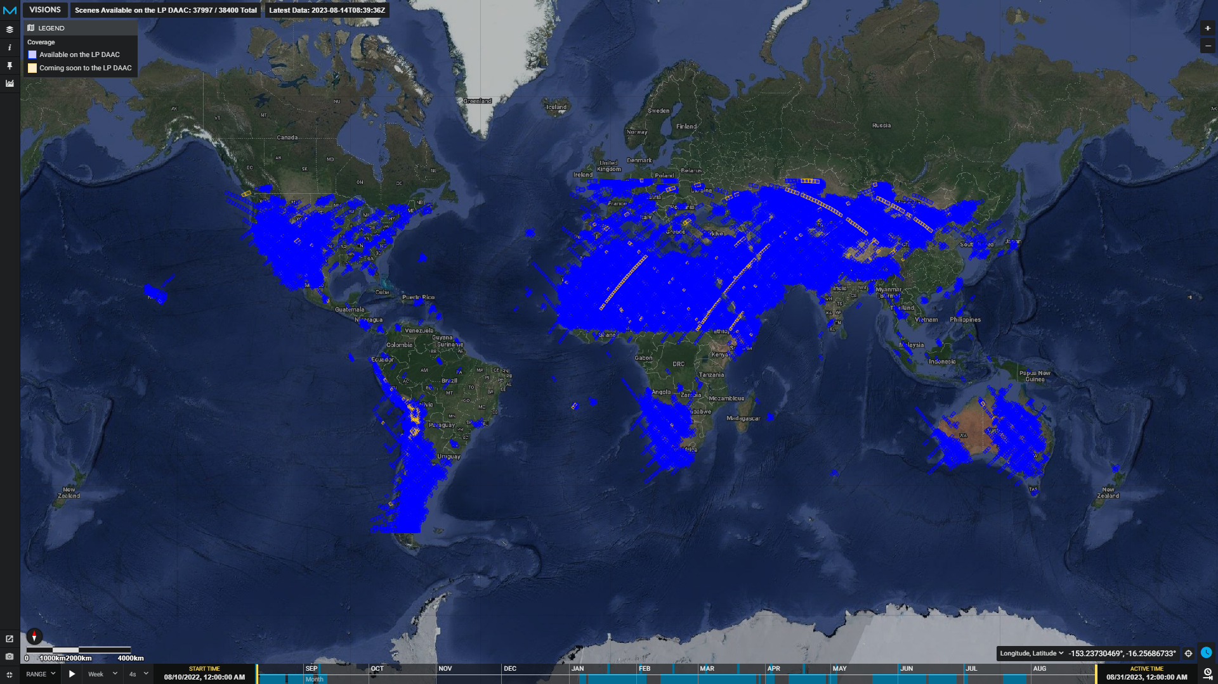
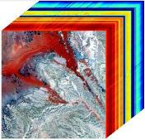

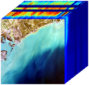
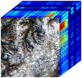
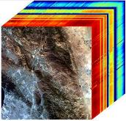
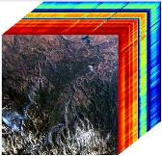
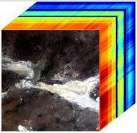
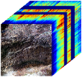
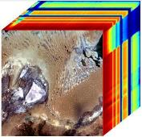
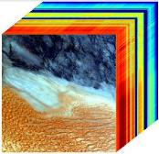
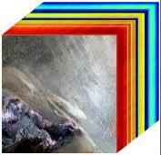
Current EMIT Coverage from the ISS >40,000 Image Cubes https://earth.jpl.nasa.gov/emit/data/data-portal/coverage-and-forecasts/

Slide 11
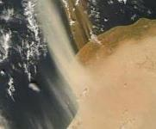
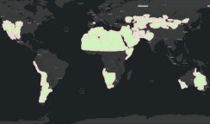
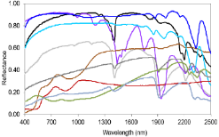
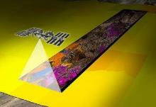
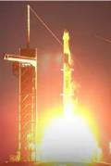
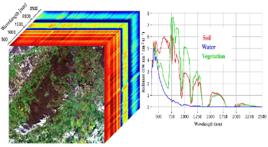

EMIT is On Track to Achieve its Science Objectives
Science Goal
Mineral Dust Emission
Dust Source Regions
Advanced Spectroscopy
Global Arid Land
Mineral Composition
Close the gap in our understanding of mineral dust heating or cooling of the Earth now and in the future.
Launch
14 July 2022
First Light 28 July 2022
Meets or Exceeds all Expectations
Building Coverage
EMIT to Achieve Science
Mineral Mapping with EMIT Spectra
Next Step
Initialize Earth Models
Science Objectives
1) Constrain the sign and magnitude of dust-related RF at regional and global scales.
2) Predict the increase or decrease of available dust sources under future climate scenarios.

Slide 12






Value Added: EMIT Greenhouse Gasses
EMIT Methane Plumes
Methane
EMIT
Methane Plume Complex
Carbon Dioxide

Slide 13

EMIT Contribution to the U.S. GHG Center https://earth.jpl.nasa.gov/emit/data/data-portal/Greenhouse-Gases/
100s of plumes and plume complexes across six continents

Slide 14

EMIT Installed on the ISS
Thank You
EMIT

