Slide 1
Orbital: Feedback and Discussion on EV Structure
Michael Kaszyca
ESSP Mission Manager
2023 ESSP Program Forum

Slide 2
Session Overview
In Mid-2022 the National Academies released a report*, “Lessons Learned in the Implementation of NASA’s Earth Venture Class” that recommended NASA consider discontinuing the distinction between EV Mission (EVM) and EV Instrument (EVI) efforts. Per this recommendation, the Academies suggested that NASA should solicit proposals that provide the full mission architecture as is currently done with EVM, with the AO listing any specific hosting or launch opportunity that NASA offers to provide (and appropriate costs for these opportunities for teams to account for in their proposals if they do not take advantage of these NASA opportunities).
A discussion around this suggestion from the National Academies is being held to give the projects and the ESSP team an opportunity to share initial reactions, potential strategies, and general thoughts around this idea.
*https://nap.nationalacademies.org/catalog/26499/lessons-learned-in-the-implementation-of-nasas-earth-venture-class

Slide 3
Earth Venture Concept
2007 Earth Science Decadal Survey Characterized Venture Class Concept
To restore more frequent launch opportunities and to facilitate the demonstration of innovative ideas and higher-risk technologies, NASA should create a new Venture class of low-cost research and application missions (~$100 million to $200 million). These missions should focus on fostering revolutionary innovation and on training future leaders of space-based Earth science and applications.
Priority for cost-effective, innovative missions rather than those with excessive scientific and technological requirements.
Key to success is maintaining a steady stream of opportunities for community participation in the development of innovative ideas, which requires that strict schedule and cost guidelines be enforced for the program participants.
Assumed $200 million for a new start (or multiple new starts within this value) every 2 years, and each mission assumed to phase in over a 5-year period.
2017 Earth Science Decadal Survey Noted Successes & Desired Assessment
Program has succeeded in fostering innovation and stimulating a vibrant Earth science community through the provision of multiple opportunities.
Fully support the continuation of the EV program in its present form; recommend, however, examining the value of each Venture strand and determine whether the cadence or number of selections of any strand should be modified.

Slide 4
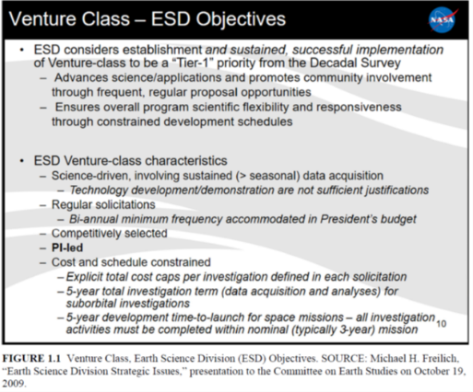
Earth Venture Foundations
Restore more frequent launch opportunities, facilitate demonstration of innovative ideas and higher-risk technologies, and expand pool of well-qualified PIs and PMs.
Competitively selected, PI-led, and implemented under strict cost- and schedule-constraints; adherence to cost caps/schedule constraints critical to success.
No single EV-class selection be an “essential” element of the ESD flight program.
Recommend cadence of ~1 solicitation every 18 months to allow institutions to maintain proposal teams and ensure broad community engagement.
*Summary from May 2022 National Academies’ “Lessons-Learned in the Implementation of NASA’s Earth Venture Class” found here: http://nap.naptionalacademies.org/26499

Slide 5
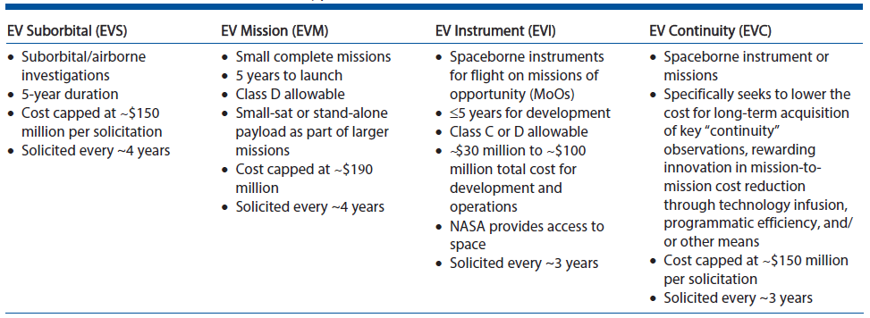
Current Earth Venture Structure
Focus of discussion is on EVM and EVI

Slide 6
EV Lessons Learned Report
Background
In 2020, NASA requested the National Academies examine the EVI and EVM elements of Earth Ventures and report on lessons learned.
In 2022, the National Academies issued the report “Lessons Learned in the Implementation of NASA's Earth Venture Class.” (https://doi.org/10.17226/26499)
EV Structure Recommendation (Recommendation 3.3 in Report)
In future EV Announcements of Opportunity (AOs), NASA should consider discontinuing the distinction between EVM and EVI proposals.
NASA would then solicit proposals that provide the full mission architecture as is currently done with EVM.
The AO should list any specific hosting or launch opportunity that NASA offers to provide; EV teams would have the option to incorporate these opportunities in their proposals, accounting for their cost to ensure a level competition against proposals that do not take advantage of such NASA-provided accommodation(s).
NASA Response Provided (March 2023)
To ensure the impacts to both NASA and the broader science community are fully understood, NASA will assess and study this recommendation in anticipation of the next EVI or EVM AO release.

Slide 7
Difference Between EVI and EVM
Primary Differentiation is Related to Access to Space (ATS)
ATS includes spacecraft, integration, launch, on-orbit operations support.
EVI: NASA provides spacecraft (if applicable) and launch vehicle and covers costs for integration of instrument to NASA-selected platform (i.e., these “accommodations” costs excluded from PI-managed cost cap).
EVM: Considered “complete missions” where PI is generally* responsible for arranging entire effort, including spacecraft, launch, and associated integration requirements (costs of which are within the PI-managed cost cap).
*Current EVM AOs do allow for proposers to choose between NASA-provided launch services, with an associated reduction to the PI-managed cost cap, or to choose a non-NASA launch service through a PI-arranged and managed approach.
Original Vision for Differentiation
To provide PI’s an opportunity to develop an instrument (only) to obtain the desired science without directly managing the complexities of an entire mission (under an EVI) or to manage the entire mission (under an EVM).
Help develop depth and breadth of PI community by allowing PIs with greater experience to take on the more complex management aspects of EVM efforts if so desired.

Slide 8
Discussion Topics
Thoughts on current EVI and EVM structure. Good? Bad? Ugly?
Ideas for potential future structures
Thoughts on cost cap amounts versus number of selections per round (budget driven).
Cadence of opportunities (e.g., more frequent, potentially smaller cost caps or less frequent, potentially larger cost caps)?
Access to space implications (e.g., costs, flexibility, opportunities).
Who should provide spacecraft?
Should NASA provide alternatives in AO and allow PI’s to choose approach or should NASA dictate singular approach?

Slide 9
Backup: Earth Science/EV Portfolio Snapshot

Slide 10
Earth Science Flight Opportunities​
Open solicitation/In review | Completed solicitation
Mission | Mission Type | Release | Selection | Major Milestone
EVS-1 (EV-1) (AirMoss, ATTREX, CARVE, DISCOVER-AQ, HS3) | 5 Suborbital Airborne Campaigns | 2009 | 2010 | Completed KDP-F
EVM-1 (CYGNSS) | Class D SmallSat Constellation | 2011 | 2012 | Launched Dec. 2016
EVI-1 (TEMPO) | Class C Geostationary Hosted Instrument | 2012 | 2012 | Launched Apr. 2023
EVI-2 (ECOSTRESS & GEDI) | Class C & Class D ISS-hosted Instruments | 2013 | 2014 | Launched June & Dec. 2018
EVS-2 (ACT-America, ATOM, NAAMES, ORACLES, OMG, CORAL) | 6 Suborbital Airborne Campaigns | 2013 | 2014 | Completed KDP-F
EVI-3 (MAIA & TROPICS) | Class C LEO Hosted Instrument & Class D CubeSat Constellation | 2015 | 2016 | MAIA Inst. Delivered Oct. 2022 TROPICS Launched May 2023
EVM-2 (GeoCarb) | Class D Geostationary Hosted Instrument | 2015 | 2016 | N/A Mission Cancelled in Nov. 2022
EVI-4 (EMIT & PREFIRE) | Class C ISS-hosted Instrument & Class D Twin CubeSats | 2016 | 2018 | EMIT launched to ISS July 2022; PREFIRE delivery NLT 2023
EVS-3 (ACTIVATE, DCOTSS, IMPACTS, Delta-X, SMODE) | 5 Suborbital Airborne Campaigns | 2017 | 2018 | Post-deployment phase.
EVI-5 (GLIMR) | Class C Geostationary Hosted Instrument | 2018 | 2019 | Delivery NLT 2024
EVC-1 (Libera) | Class C JPSS-Hosted Radiation Budget Instrument | 2018 | 2020 | Delivery NLT 2025
EVM-3 (INCUS) | Full Orbital | 2020 | 2021 | Launch ~2026
EVI-6 (PolSIR) | Class D CubeSats | 2022 | 2023 | Delivery NLT 2027
EVS-4 | Suborbital Airborne Campaigns | 2023 | 2024 | N/A
ESE | Explorer Mission | 2023 | 2025 | Launch ~2031 & ~2033
EVC-2 | Continuity Measurements | 2024 | 2025 | Delivery NLT 2029
EVI-7 | Instrument Only | 2025 | 2026 | Delivery NLT 2030
EVM-4 | Full Orbital | 2025 | 2026 | Launch ~2031
ESE | Explorer Mission | 2025 | 2027 | Launch ~2034 & 2036
EVC-3 | Continuity Measurements | 2027 | 2028 | Delivery NLT 2032
EVS-5 | Suborbital Airborne Campaigns | 2027 | 2028 | N/A
EVS
Sustained sub-orbital investigations
(~4 years)
EVM
Complete, self-contained, small missions
(~4 years)
EVI
Full function, facility-class instruments Missions of Opportunity (MoO)
(~3 years)
EVC
Complete missions or hosted instruments targeting “continuity” measurements
(~3 years)
ESE (NEW)
Medium-size instruments and missions
(~2 years)

