Slide 1
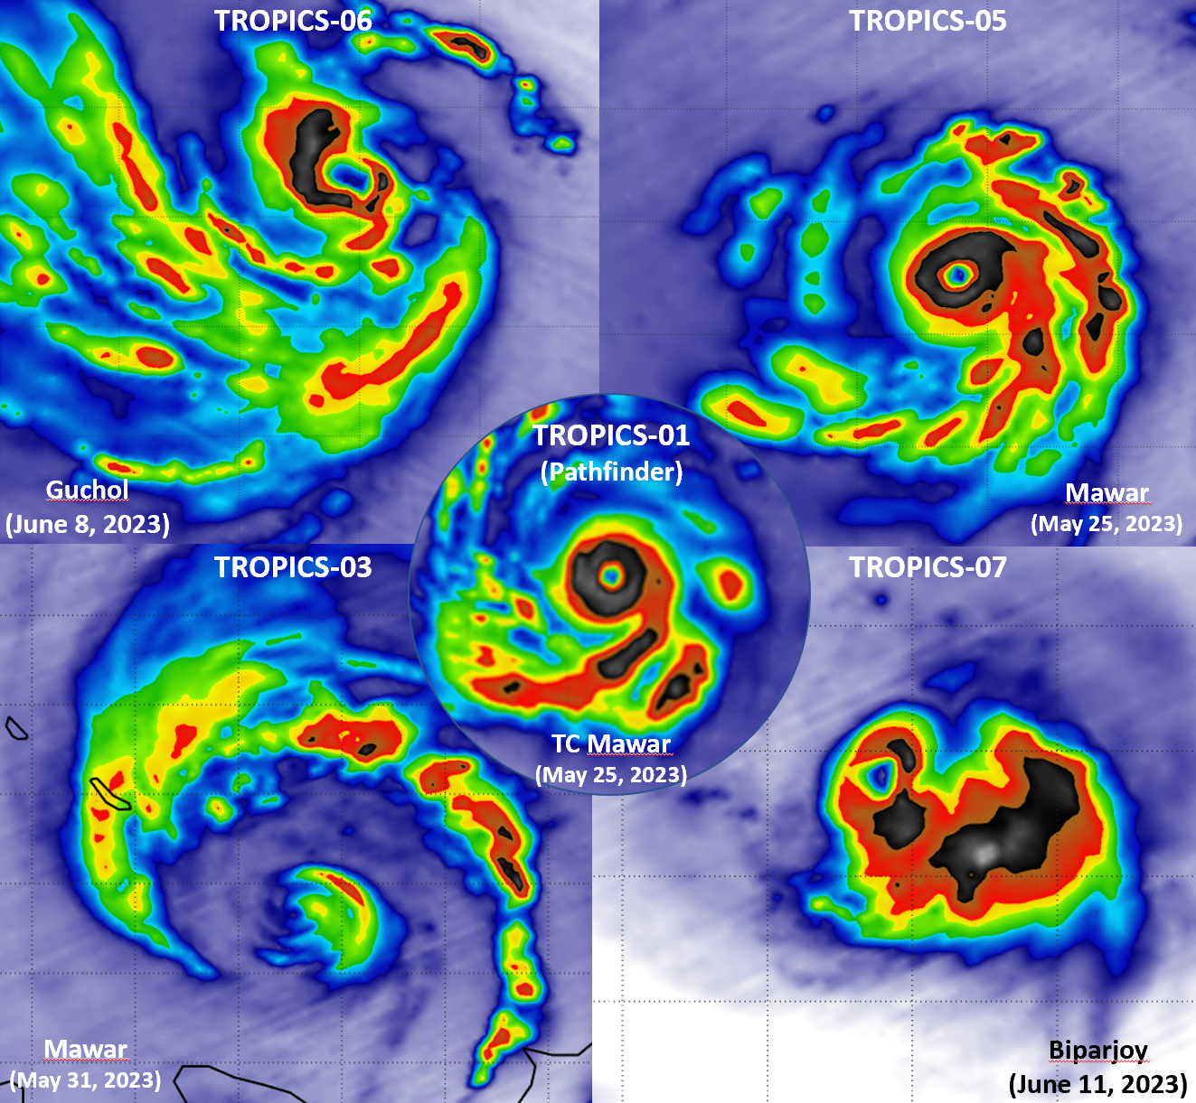
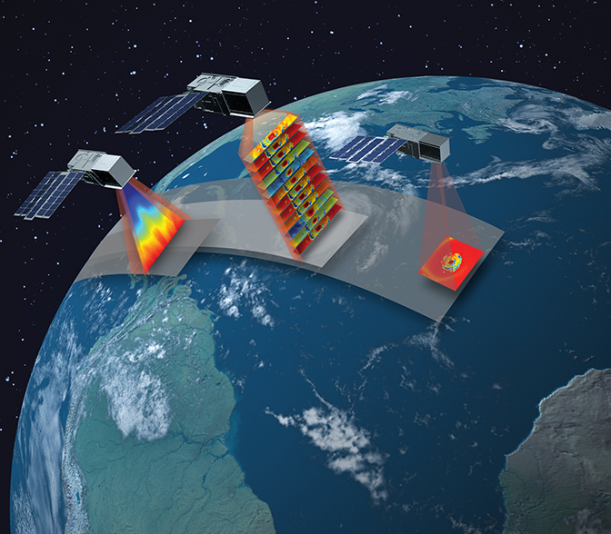
R. Atlas
R. Bennartz
G. Chirokova
H. Christophersen
B. Dahl
M. DeMaria
J. Dunion
T. Greenwald
D. Herndon
F. Marks
R. Rogers
C. Velden
B. Annane
V. Leslie
T. Matsui
C. Kidd
P. Duran
2023 NASA ESSP Forum
Overview of the NASA TROPICS Earth Venture Mission
DISTRIBUTION STATEMENT A. Approved for public release. Distribution is unlimited. This material is based upon work supported by the National Aeronautics and Space Administration and Department of the Air Force under Air Force Contract No. FA8702-15-D-0001. Any opinions, findings, conclusions or recommendations expressed in this material are those of the author(s) and do not necessarily reflect the views of the National Aeronautics and Space Administration and Department of the Air Force. © 2023 Massachusetts Institute of Technology. Delivered to the U.S. Government with Unlimited Rights, as defined in DFARS Part 252.227-7013 or 7014 (Feb 2014). Notwithstanding any copyright notice, U.S. Government rights in this work are defined by DFARS 252.227-7013 or DFARS 252.227-7014 as detailed above. Use of this work other than as specifically authorized by the U.S. Government may violate any copyrights that exist in this work.

Slide 2
TROPICS Data Addresses Critical Science Questions
What is the relationship between environmental conditions and storm intensification?
What is the relationship between structural features of the storm and intensification?
• TROPICS will be the first demonstration that science payloads on low-cost CubeSats can push the frontiers of spaceborne monitoring of the Earth to enable system science.
• TROPICS will fill gaps in our knowledge of the short time scale—hourly and less—evolution of tropical cyclones. Our current capabilities are almost an order of magnitude slower.
• TROPICS will complement CYGNSS by making direct measurements of temperature, humidity and precipitation, in rapidly developing tropical cyclones.
• TROPICS has the potential to make frequent precipitation measurements, expanding on the coverage of the GPM mission.
Changing environmental conditions near edge of tropical cyclone
Convective cores
Strong eyewall convection on other side of storm
Spiral “arm” on one side of storm
TC Emnati, Feb 10, 2022, 92 GHz
TROPICS 183-GHz channels measure atmospheric moisture
TC Batsirai, Feb 5, 2022, 205 GHz

Slide 3
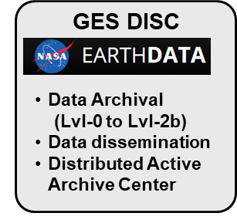
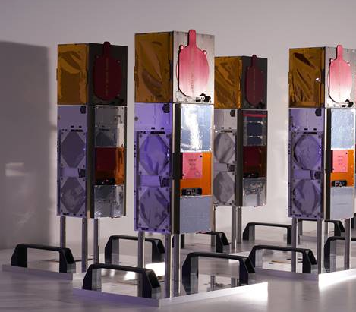
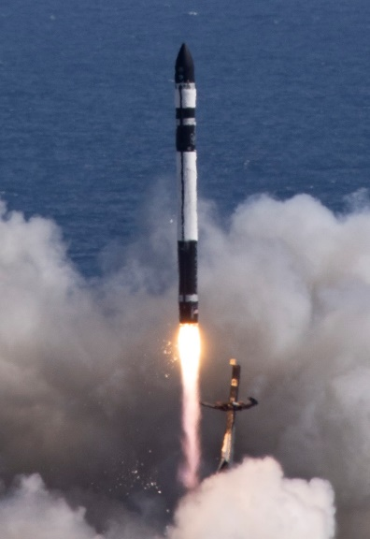
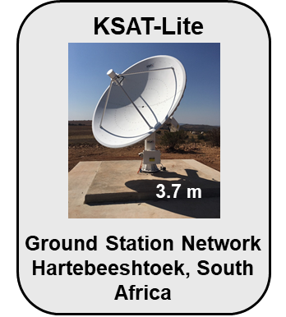
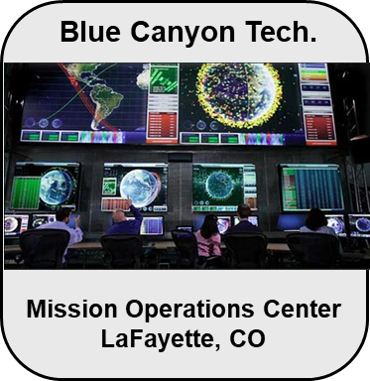
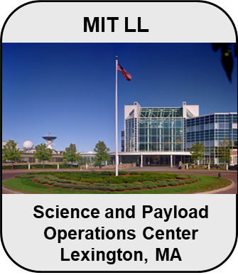
TROPICS Mission Overview
Two orbital planes (30° inclination at 550 km altitude) with two Cubesats in each will provide < 60 minute median revisit rate
Rocket Lab was awarded two launches from Mahia, NZ into two orbital planes
Launched on May 6th & 28th, 2023
Mission has four CubeSats with a year-long science operations
Backup Ground Stations: Mauritius, West Australia, & Puertollano

Slide 4
TROPICS Space Vehicle Overview
Articulating
Solar Array

