Slide 1
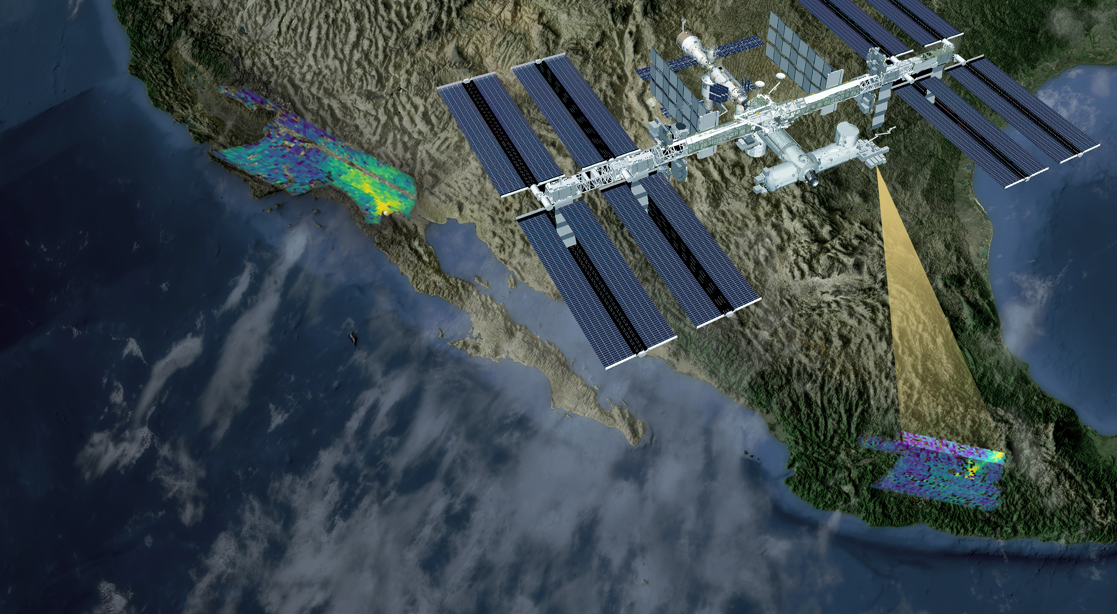
LOS ANGELES
Orbiting Carbon Observatory-3 (OCO-3)
MEXICO CITY
Abhishek Chatterjee (OCO-3 PS), Vivienne Payne (OCO-3 DPS), OCO Science Team

Slide 2
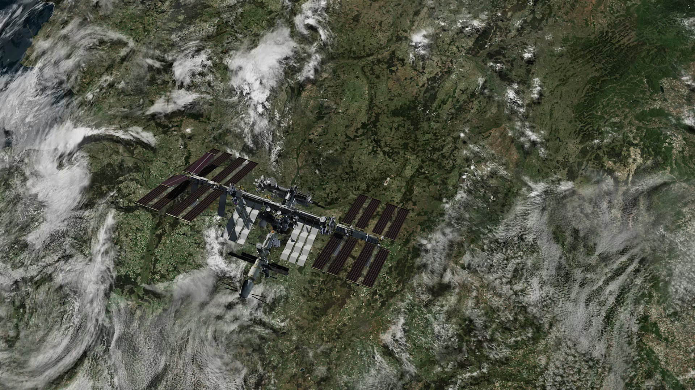
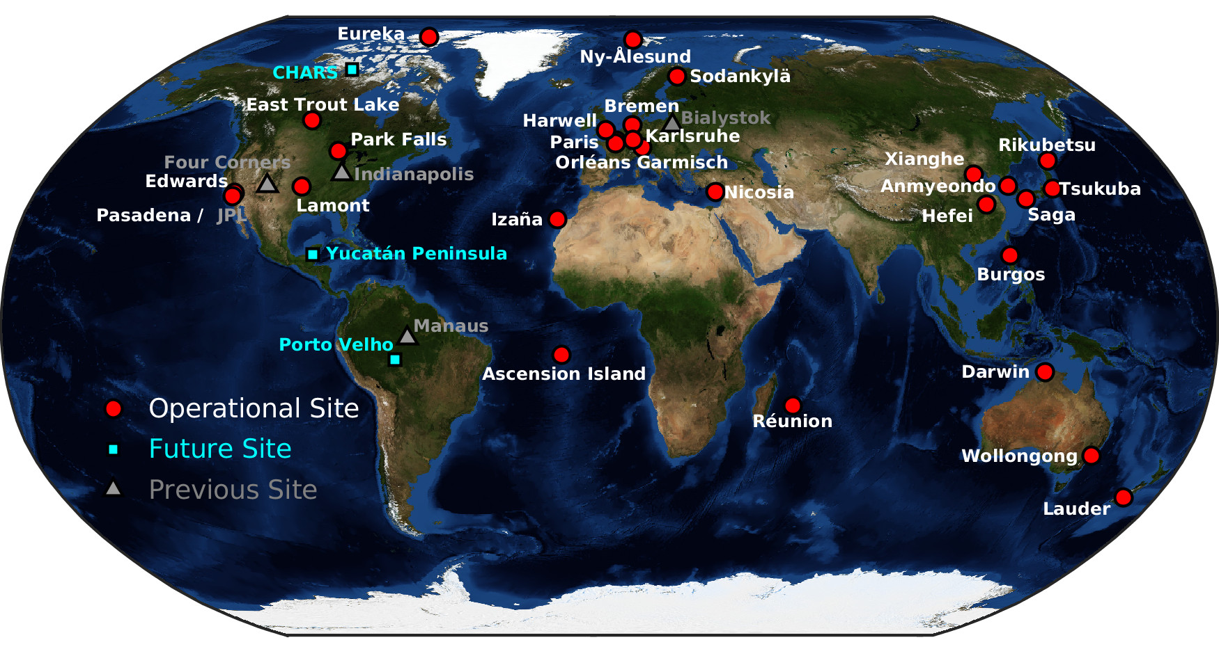
OCO-3 has a unique fourth observing mode
Snapshot Area Mapping (SAM) mode
OCO-3 data has a precision & accuracy of < 0.3% (~1.2 ppm) to enable both natural and anthropogenic carbon cycle studies
 | OCO-3 vs. TCCON
Bias [ppm] | 0.09
RMS [ppm] | 0.85

Slide 3
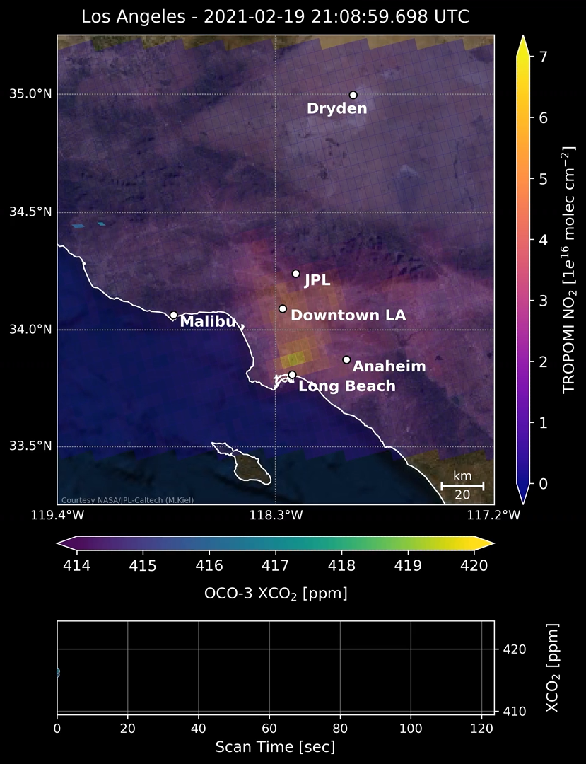
OCO-3 tracks emissions from hotspots globally
Washington DC - Baltimore
Salt Lake City
Chicago
Indianapolis
Los Angeles
+ ongoing studies for Mexico City, Paris, Seoul …
Kiel et al. 2021 (RSE); Wu et al. 2022 (ACP); Lei et al. 2022 (RSE); Roten et al. 2022, 2023 (ACP, in review); MacDonald et al. 2023 (ACP); Yang et al. 2023 (JGR-A); Nassar et al. 2023 (Frontiers in RS); Hakkarainen et al. 2023 (ERL)
Notes:
With the SAM mode, we are not only able to see all the major cities but more importantly exceedingly fine variations within the cities. This video is showing actual OCO-3 data collected over the Los Angeles metropolitan area. Note the high CO2 concentrations spanning from downtown Los Angeles to southern LA and Long Beach. This lines up with the I-710 corridor, which is a major trucking route connecting the port of Long Beach to downtown LA
Being able to resolve these intra-urban CO2 variations has immense implication for identifying sectors that are responsible for CO2 emissions within the city boundary and generating a plan to reduce CO2 emissions.
There are a slew of studies capturing this now.
Bottomline - Measurements of atmospheric CO2 at the right scale, the right time is needed for decision making!

Slide 4
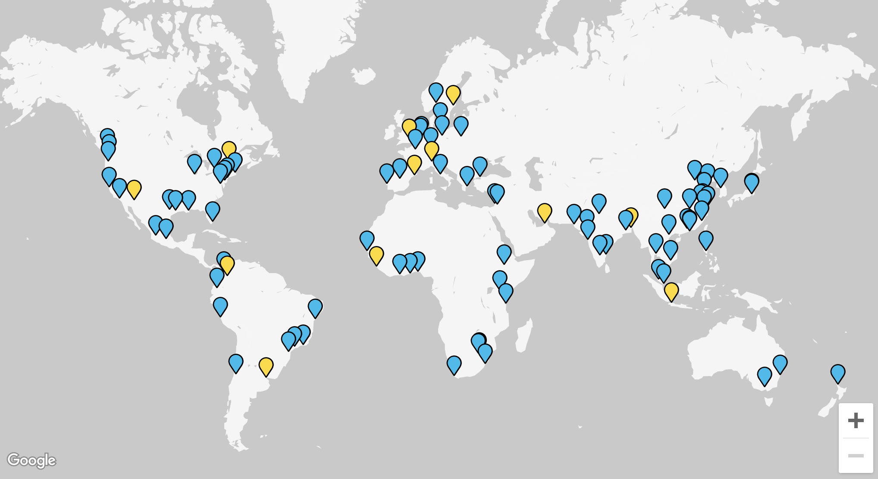
Tracking urban emissions is policy relevant
OCO-3 SAM data is being used to provide an independent check on estimates derived from bottom-up inventories, book-keeping and modeling studies for C40 group of cities.
http://www.c40.org/c40_research
Notes:
A key motivation for the C40 group has been - “If all cities with a population over 100,000 took ambitious climate action, they could collectively deliver 40% of emission reductions needed under the Paris Agreement.”
The map on the inset shows all the locations participating in this programme.
OCO-3 SAM data is collected over all these cities.
One of the questions we have been interested in – can the OCO-3 SAM data provide a path for independently verifying city emission estimates, setting targets for urban mitigation and assessing mitigation outcomes?

Slide 5
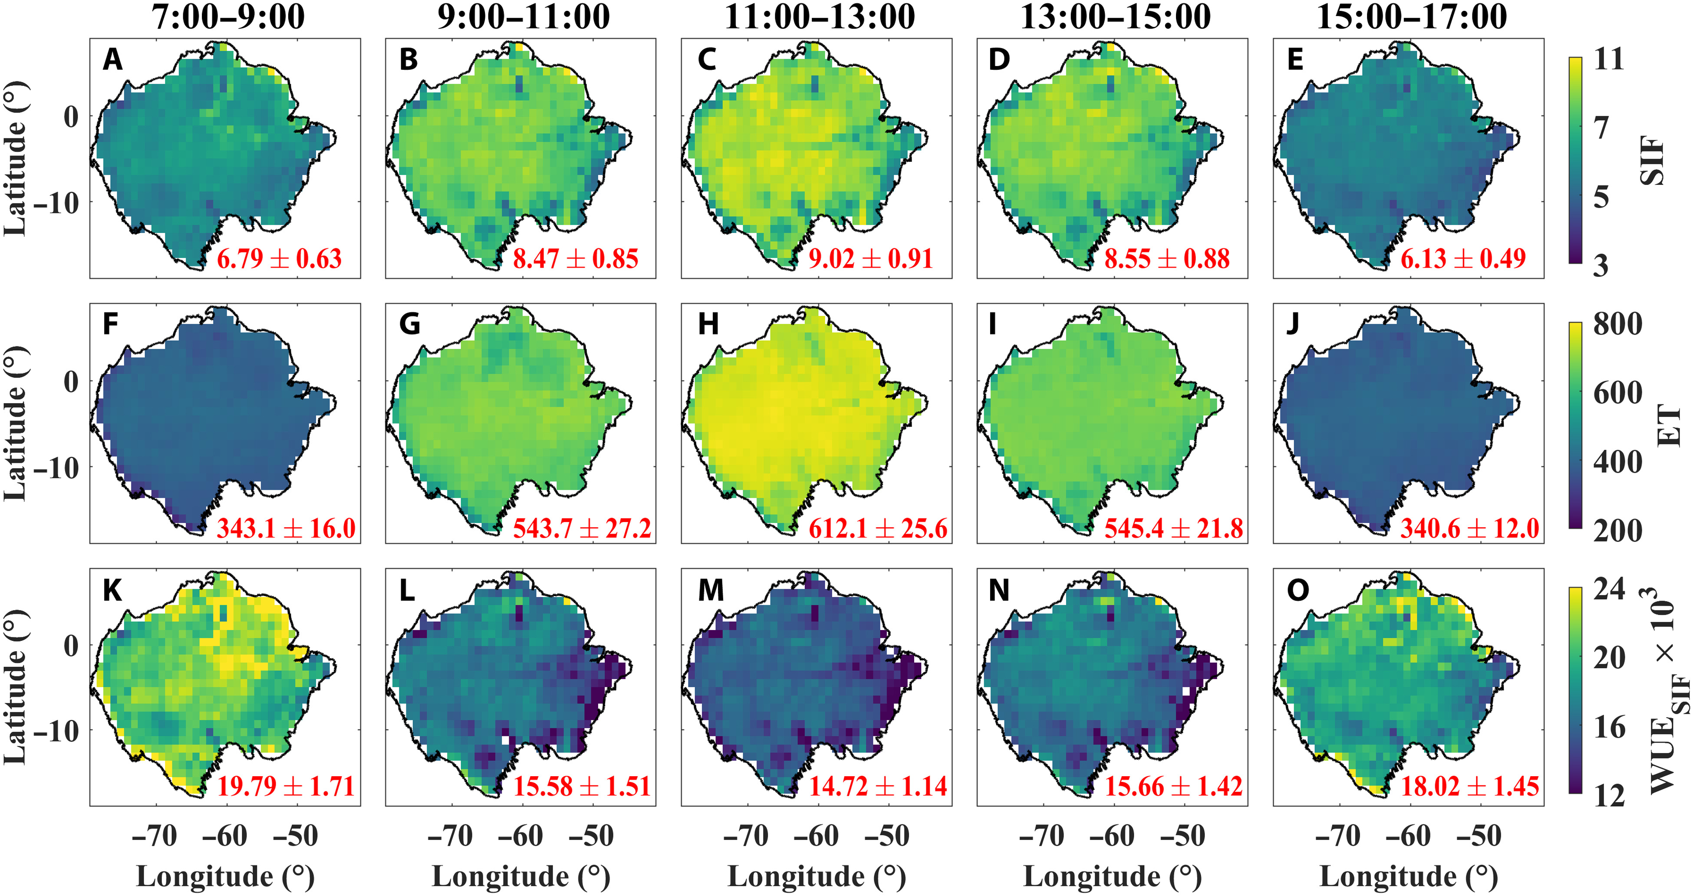
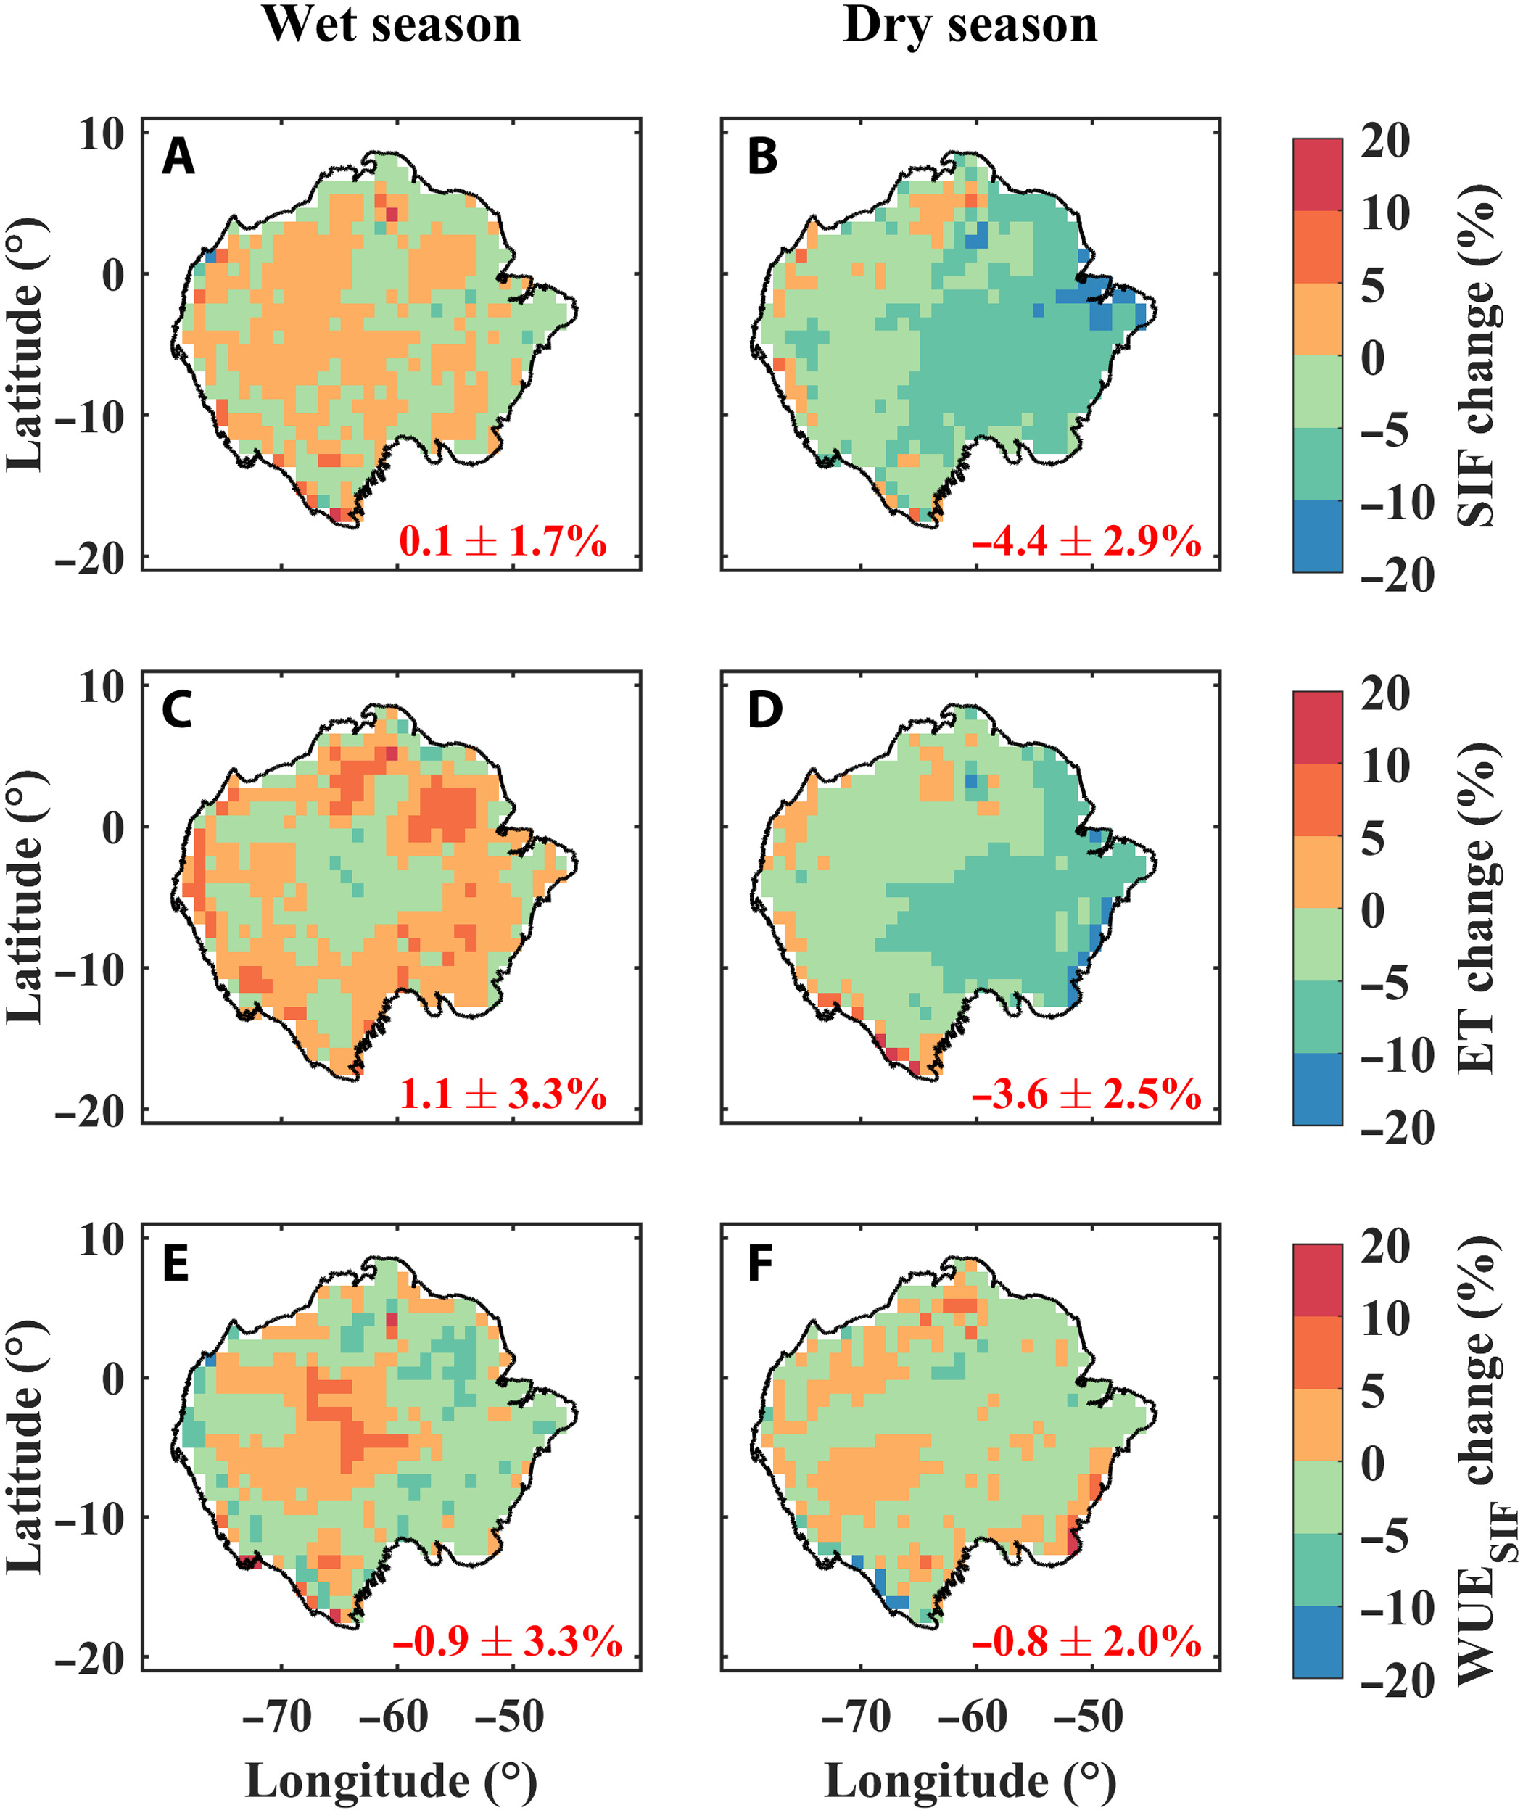
OCO-3 tracks diurnal patterns of photosynthesis
OCO-3 SIF data (along with ECOSTRESS and other ecosystem process data) is being used to improve our understanding of the direction and magnitude of ecosystem fluxes and how plants respond to extreme events and climate change.
Zhang, Z. et al., 2023, Science Advances, doi:10.1126/sciadv.abq4974

Slide 6
Key Takeaways
OCO-3 is a key element of NASA’s greenhouse gas observational network to meet the needs of scientific understanding and mitigation policies.
Snapshot Area Mapping (SAM) mode measurements, which are unique to OCO-3, provide an innovative map-like dataset for monitoring emissions at sub-regional, urban and facility scales - scales that are relevant to policy and decision making.
OCO-3 SIF measurements, in conjunction with evapotranspiration and other ecosystem measurements, assist in understanding process details of terrestrial ecosystems.
OCO-3 Status
Planning for uninstallation and storage on the ISS around November 2023
Will be in storage for ~6 months to let ILLUMA-T complete its nominal mission
Expected to resume operations around May-June 2024 and continue till “lifetime of ISS” (2029-2030)
Notes:
On the first bullet point –
continuation of global CO₂ measurements, thereby expanding upon the science made possible by OCO-2
fundamentally advance how space-based measurements can constrain rapidly changing anthropogenic emissions
On the second bullet point – Studies using the SAM mode observations demonstrate that these measurements have the information content and the ability to quantify emission changes happening at the urban scale, even at the sectoral level within cities
detecting these small changes is a fundamental requirement if we want to boost transparency in carbon accounting and support efforts to reduce anthropogenic emissions
On the OCO-3 Status – once we resume operations, we will have good overlap with CO2M and GOSAT-GW as well as other missions that going after the anthropogenic component. And we look forward to working with all those mission teams.

Slide 7
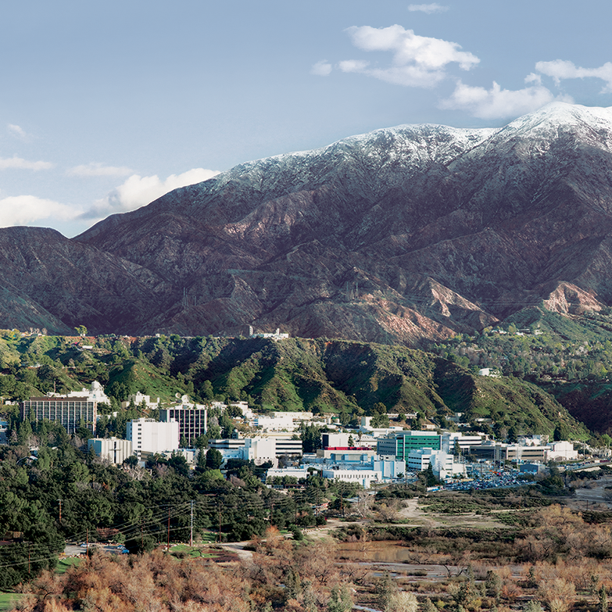
QUESTIONS?
Email: abhishek.chatterjee@jpl.nasa.gov
OCO3 Webpage - https://ocov3.jpl.nasa.gov/
OCO3 SAM Webpage - https://ocov3.jpl.nasa.gov/sams/

Slide 8
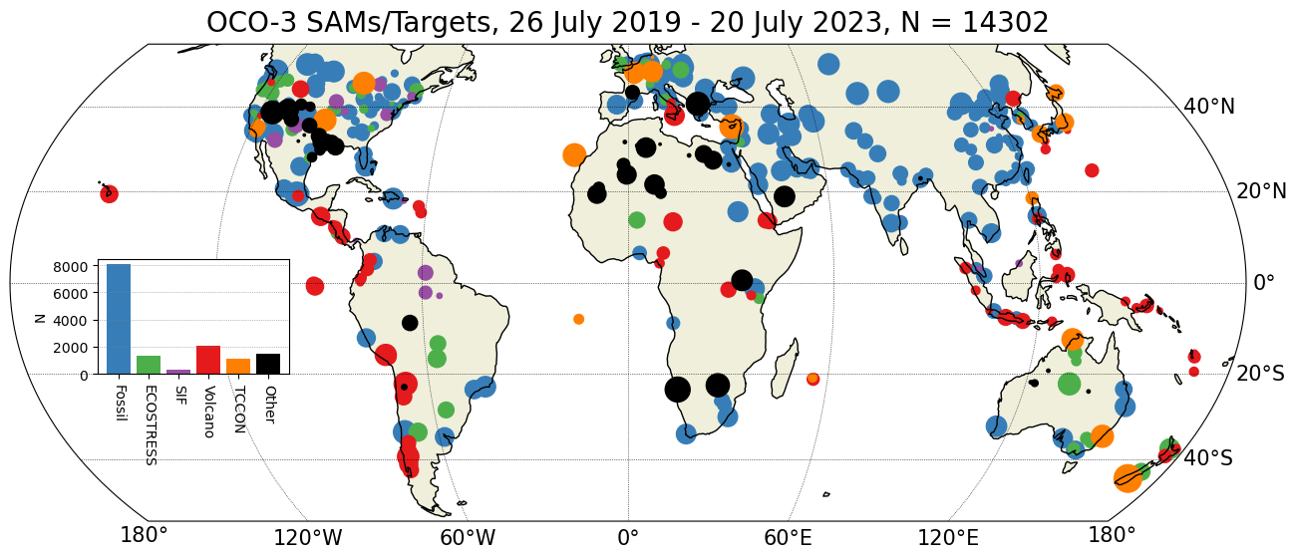
Locations of OCO-3 SAMs across the globe
BACKUP
60% of our SAMs are over fossil fuel targets – these include the top hundred urban areas/megacities, power plants, etc.
We retain flexibility in adjusting and prioritizing SAMs – either over a specific region or during a certain time period, supporting ground and airborne campaigns.

Slide 9
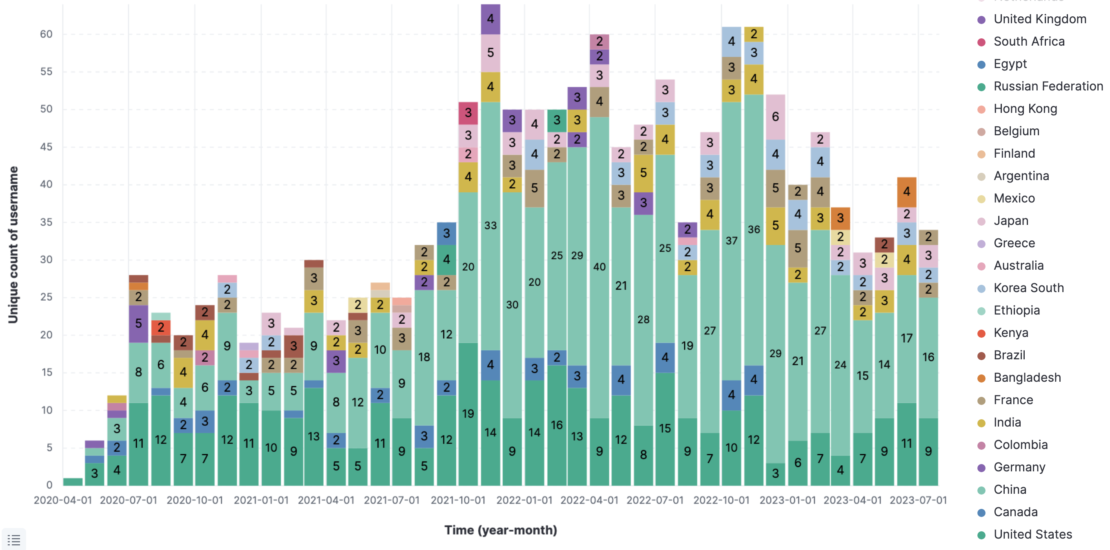
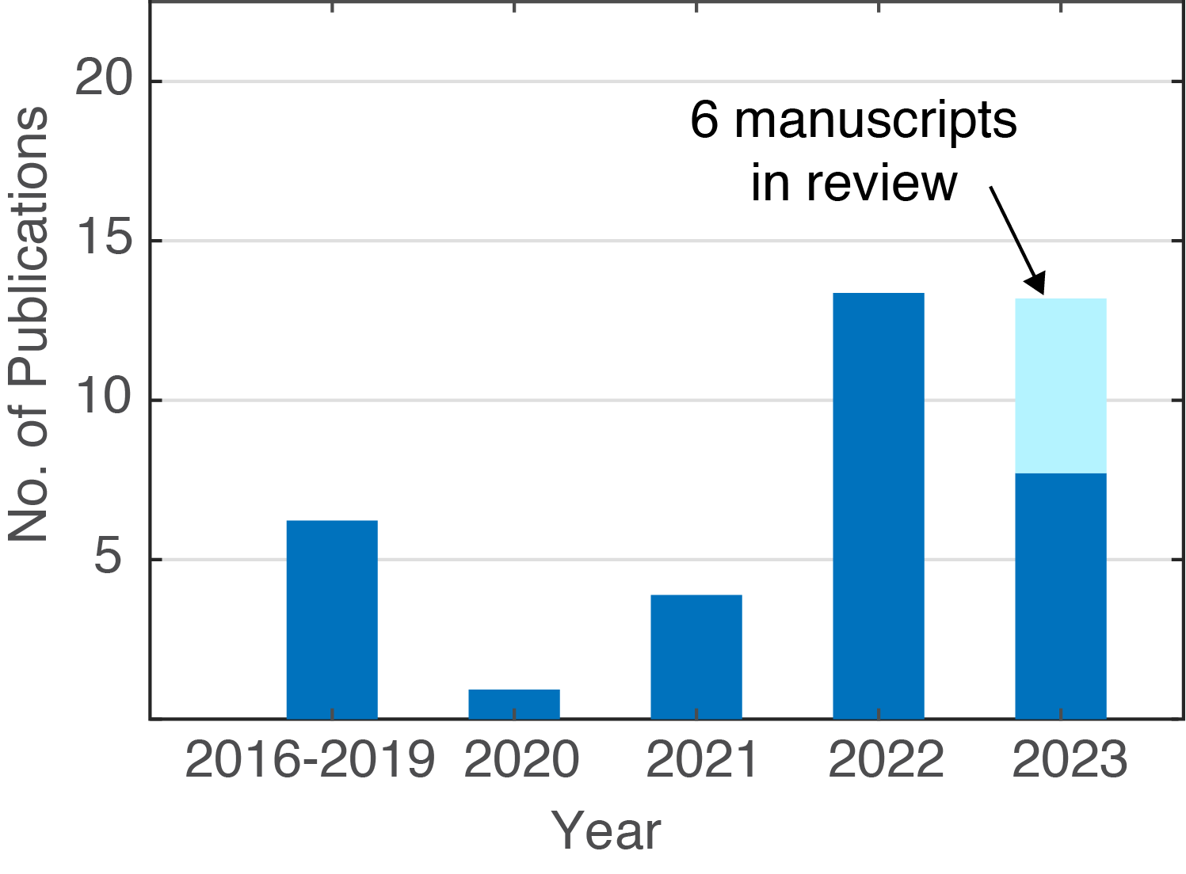
Data downloads and publication statistics
BACKUP

