Slide 1
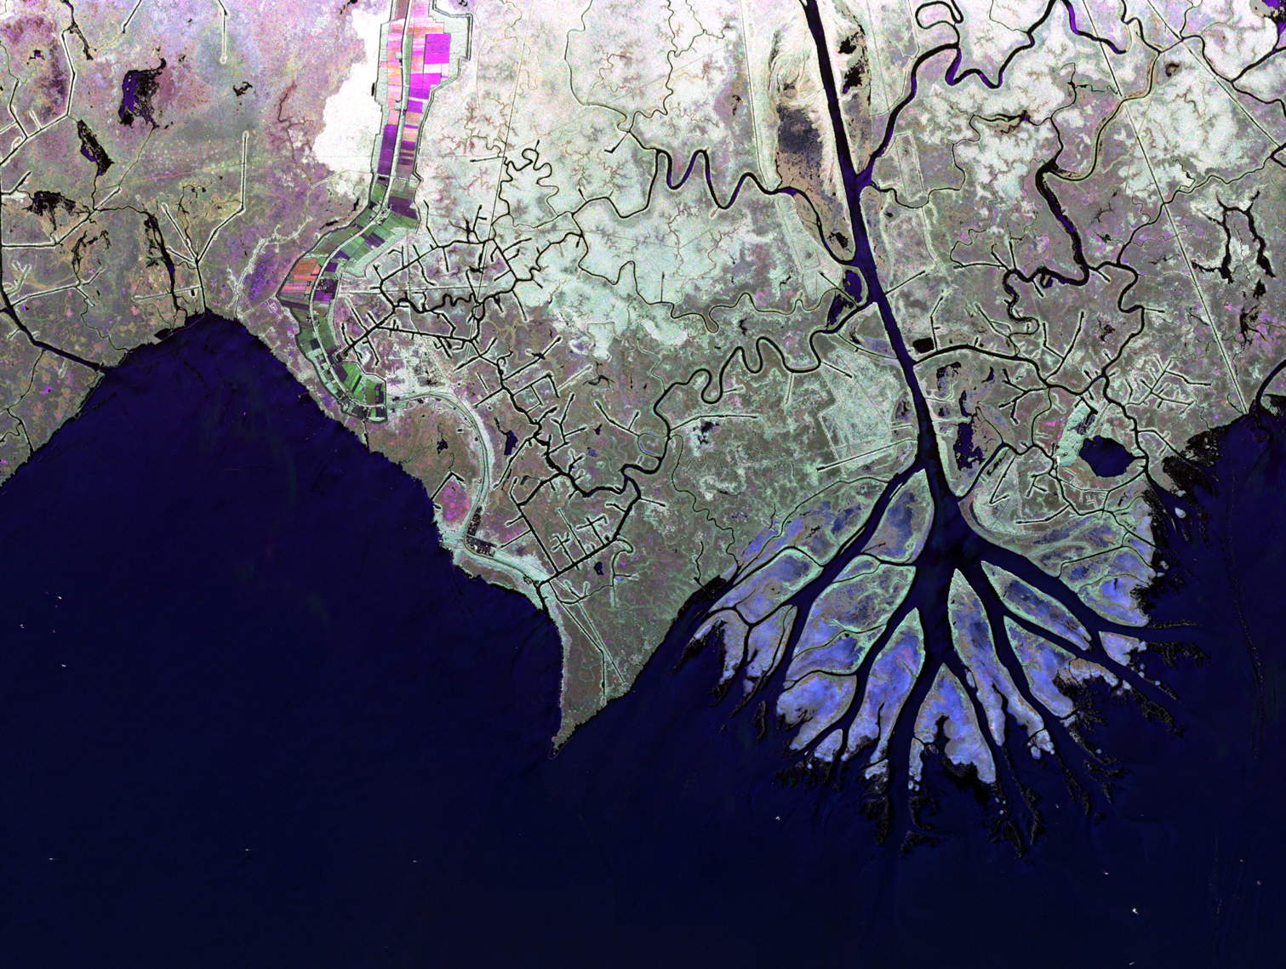
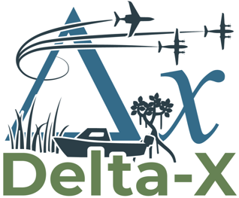
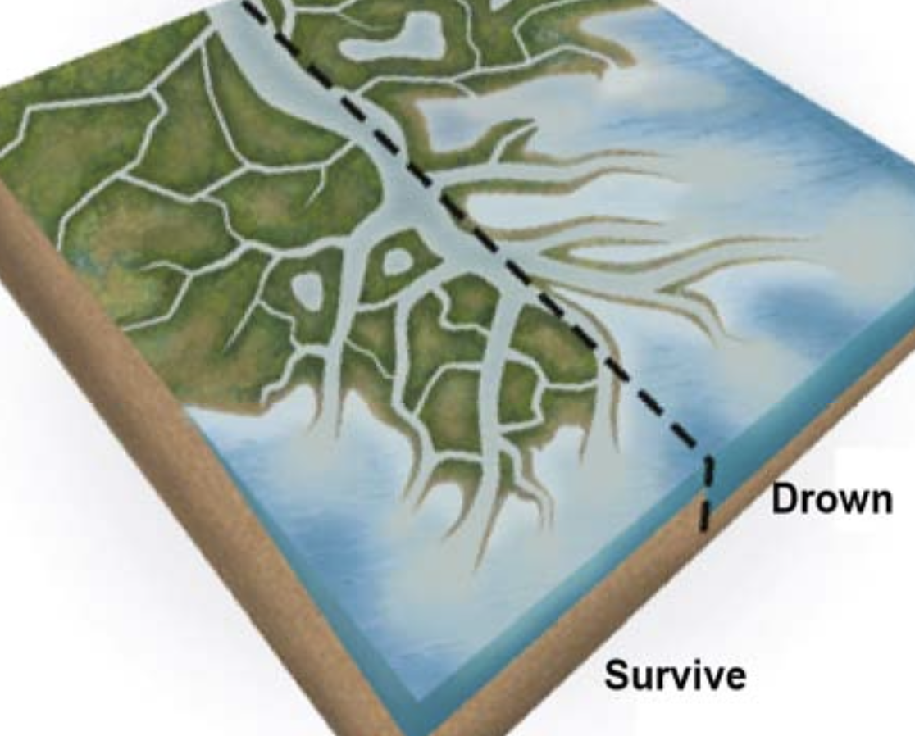
MOST LARGE & MEDIUM-SIZED DELTAS CANNOT GROW FAST ENOUGH TO KEEP UP WITH SEA LEVEL RISE IN THE NEXT CENTURY.
UPSTREAM DAMMING REDUCES THE SEDIMENT INFLUX FURTHER, ACCELERATING LAND LOSS.
DELTA-X STUDIES THE PROCESSES THAT CONTROL LAND LOSS & LAND GAIN IN DELTAS.
Delta-X Applications Workshop 2022
Take Aways & Lessons Learned
Cathleen Jones (JPL)
https://deltax.jpl.nasa.gov
© 2023 California Institute of Technology. Government sponsorship acknowledged.
Notes:
Delta-X makes breakthrough advances in the study of deltaic evolution, moving beyond coarse areal averaging of delta mass balance, to resolve mesoscale features using remote-sensing and in situ measurements. This cross-disciplinary study, encompassing hydrology, ecology, and geomorphology, calibrates numerical models of sediment transport, ecological production, and soil accretion.
Delta-X overarching Science Question: What are the hydrological and ecological processes responsible for the resilience and vulnerability of river deltas to Relative Sea Level Rise (RSLR), and what are their relative contributions to soil elevation?
Delta-X objectives: To evaluate the roles of 1) vegetation on soil accretion rates; and 2) channel-network density and deltaic island size on soil accretion rates.

Slide 2

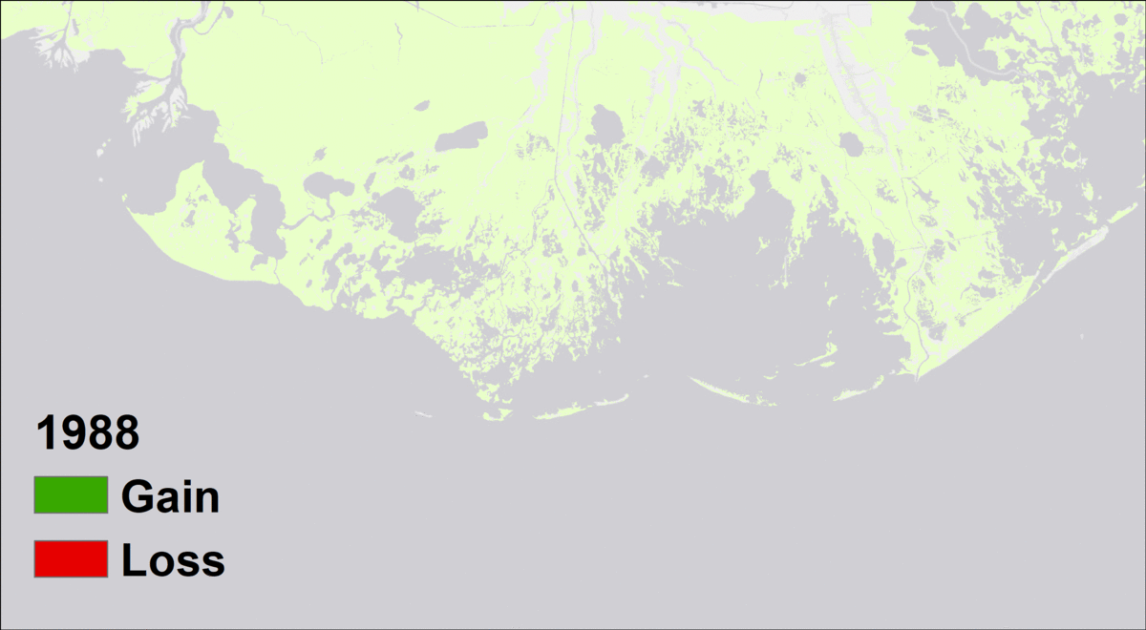
Land Loss & Gain in the Mississippi River Delta
(Delta-X Study Area)
ATCHAFALYA BASIN
WAX LAKE DELTA
ATCHAFALAYA DELTA
TERREBONNE BASIN

Slide 3
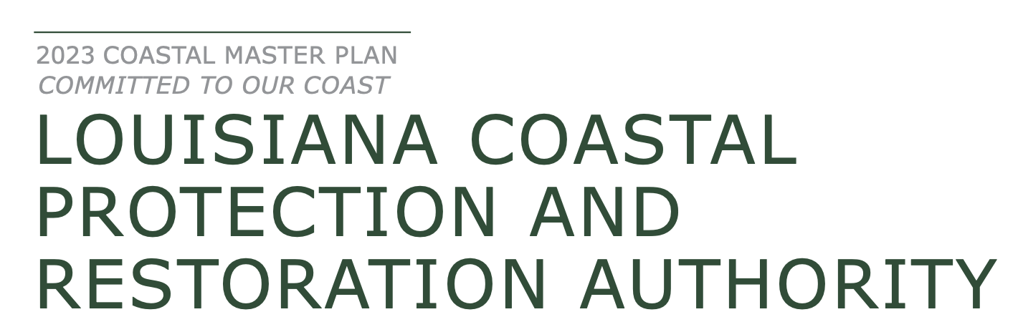
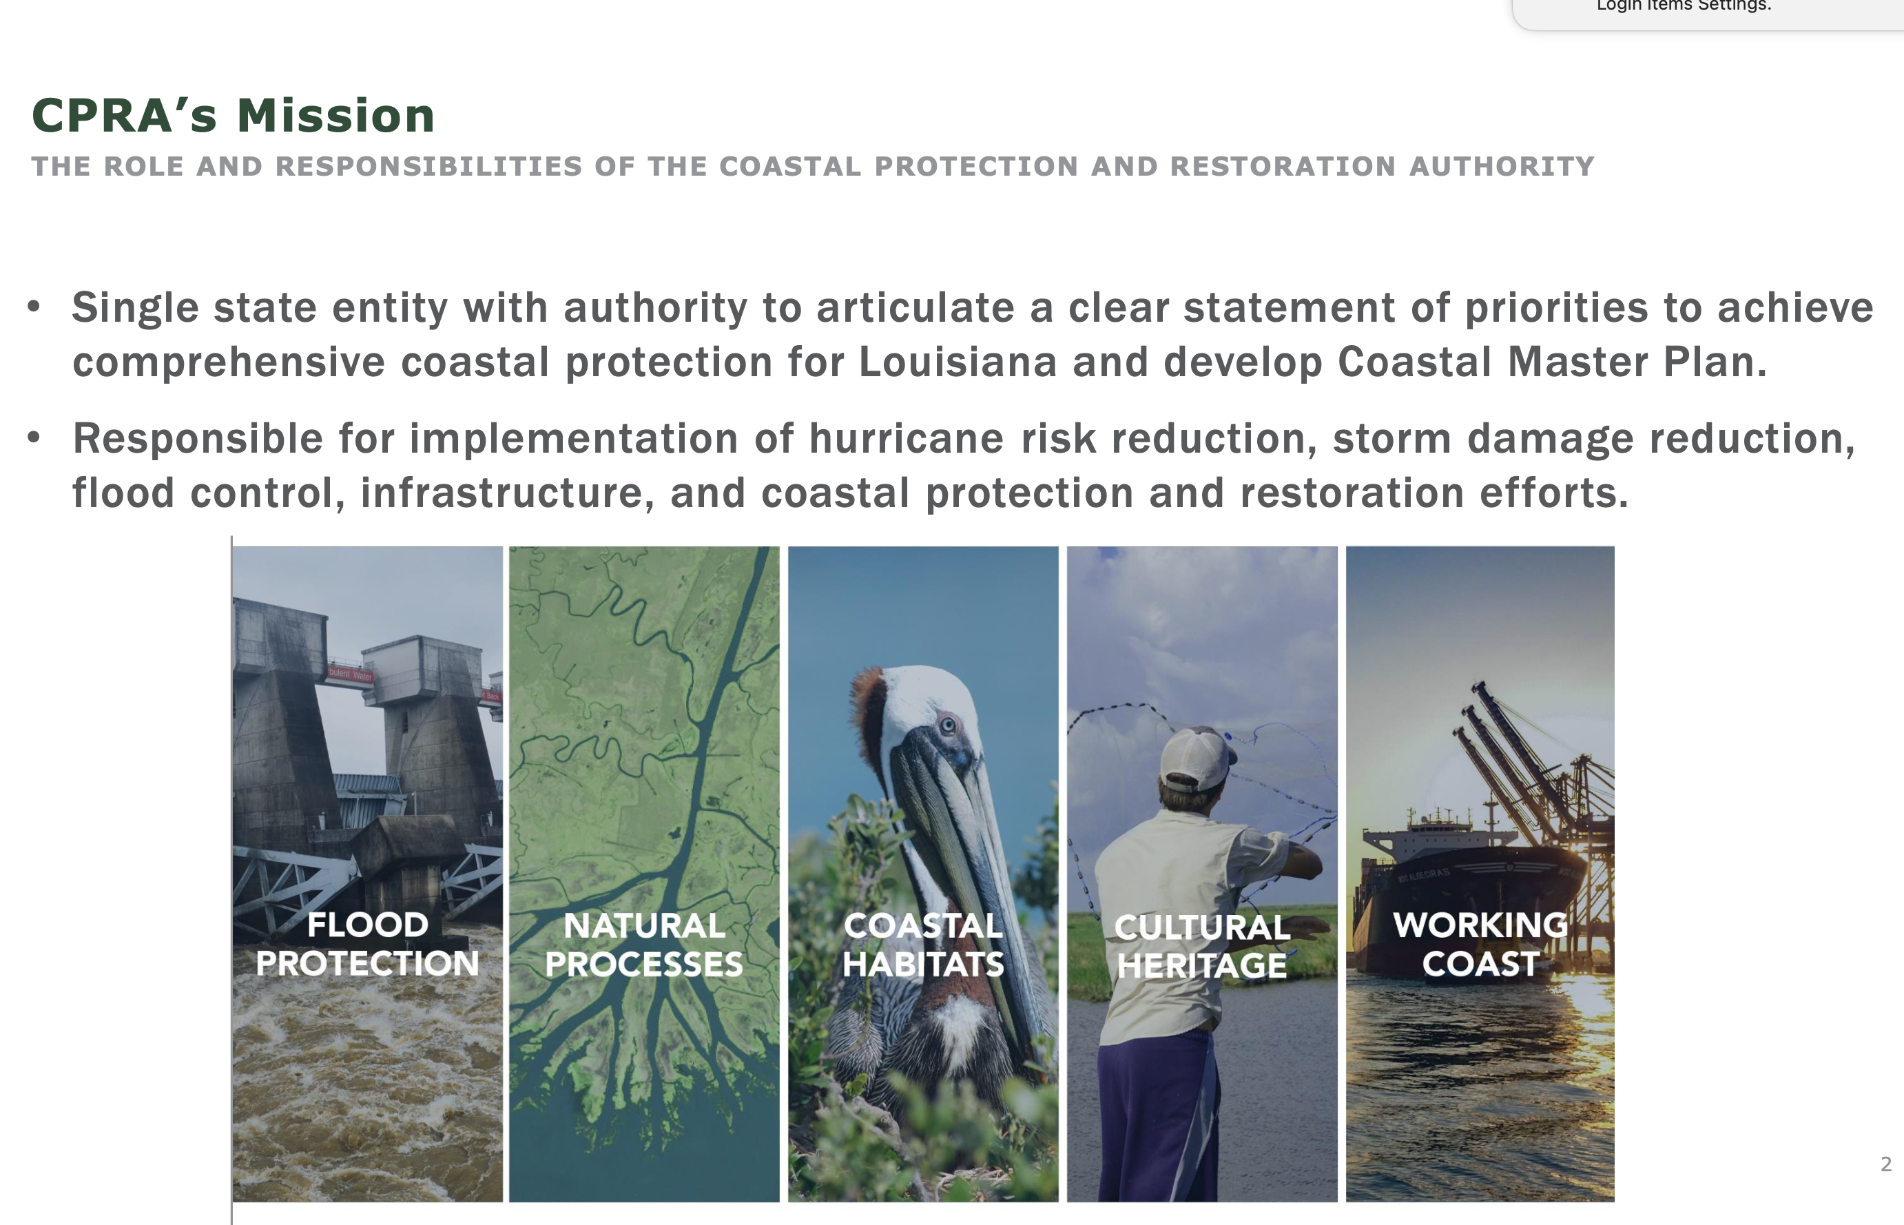
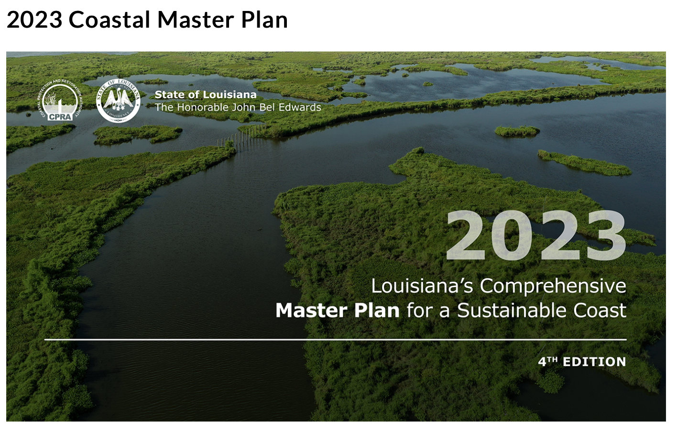
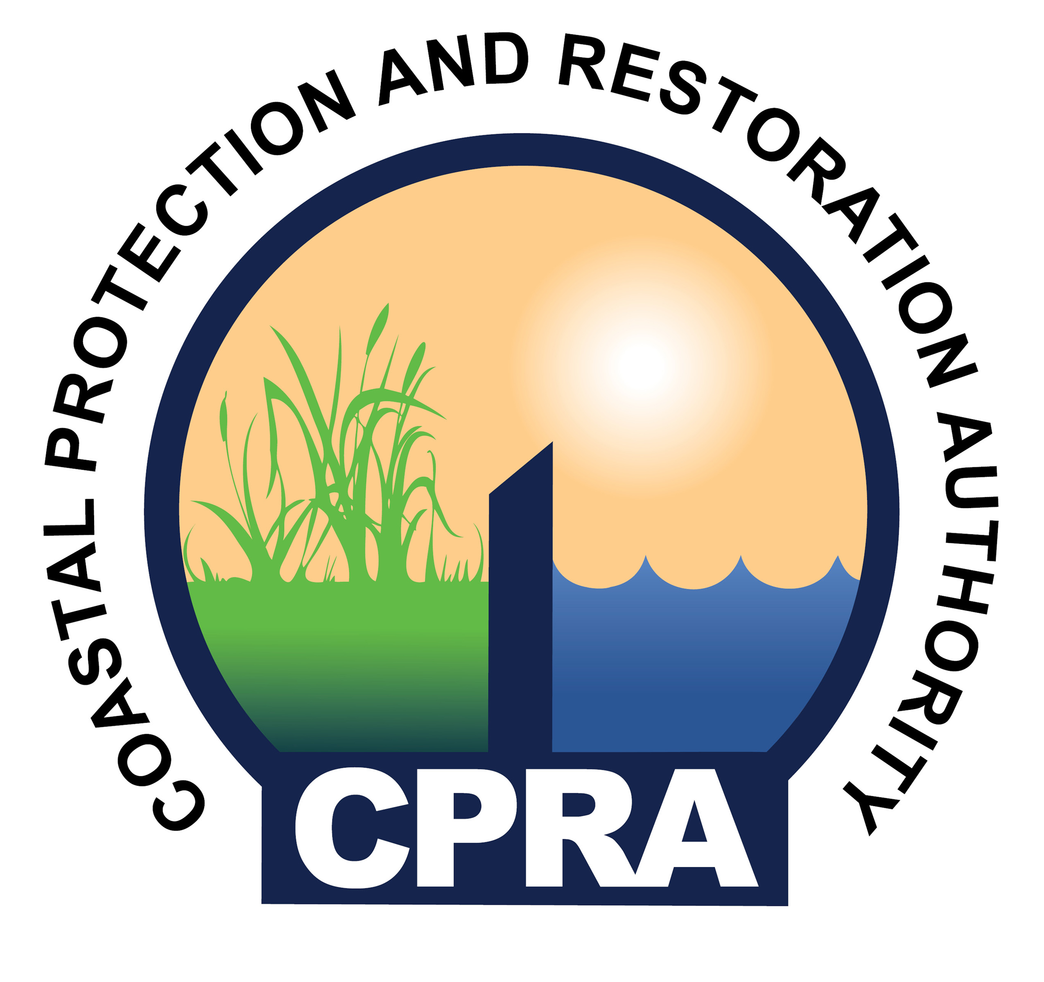
KEY STAKEHOLDER IN LOUISIANA

Slide 4
Delta-X Applications Workshops
Purpose: Engage the applications community by demonstrating how to access and utilize Delta-X campaign data and hydrodynamic models.
2022 Applications Workshop: Focus on data
2024 Applications Workshop: Focus on models
Delta-X develops calibrated and validated models of soil accretion (organic soil production & sediment deposition) for the Mississippi River Delta, an exemplar temperate delta under threat from relative sea level rise.
Provide all the data and models, plus tools for working with the data sets and training on how to use them to stakeholders in Louisiana and elsewhere.
https://deltax.jpl.nasa.gov
Notes:
Delta-X makes breakthrough advances in the study of deltaic evolution, moving beyond coarse areal averaging of delta mass balance, to resolve mesoscale features using remote-sensing and in situ measurements. This cross-disciplinary study, encompassing hydrology, ecology, and geomorphology, calibrates numerical models of sediment transport, ecological production, and soil accretion.
Delta-X overarching Science Question: What are the hydrological and ecological processes responsible for the resilience and vulnerability of river deltas to Relative Sea Level Rise (RSLR), and what are their relative contributions to soil elevation?
Delta-X objectives: To evaluate the roles of 1) vegetation on soil accretion rates; and 2) channel-network density and deltaic island size on soil accretion rates.

Slide 5
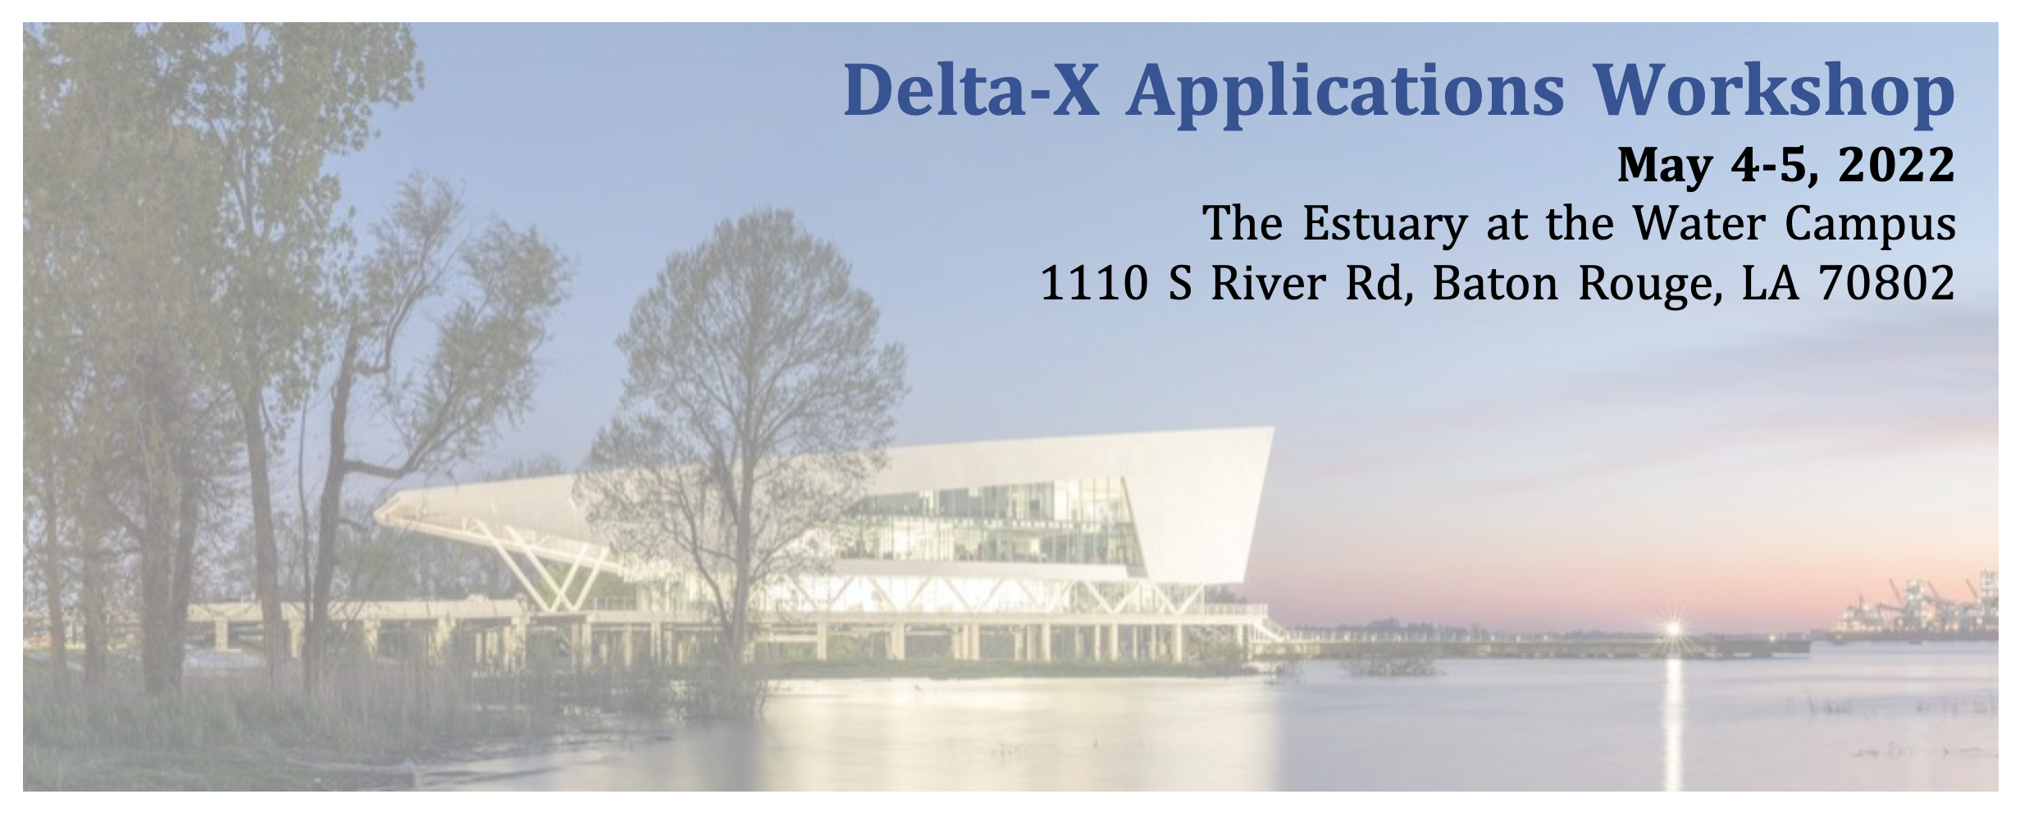
COMMUNITY ENGAGEMENT
DELTA-X APPLICATIONS WORKSHOP 2022
56 total attendees from 21 different institutions
State of Louisiana Coastal Protection & Restoration Authority Louisiana Geological Survey NGO Water Institute of the Gulf Federal Oak Ridge National Lab USACE USGS Wetland Center, Lafayette, LA Private Baird Duplantis Design Group FTN Associates, Ltd. University Louisiana State University Southern University A&M College Tulane UCLA University of Louisiana at Lafayette University of Rouen Normandy All Delta-X Institutions
Organized with input from key stakeholders, Water Institute of the Gulf and Louisiana Coastal Protection & Restoration Authority

Slide 6
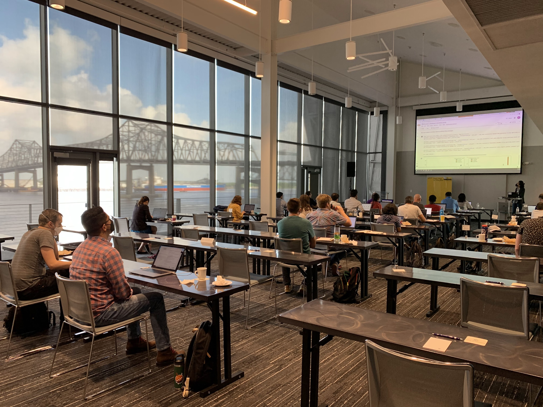
COMMUNITY ENGAGEMENT
WORKSHOP FORMAT
Developed analysis Python Notebooks for all data sets (in situ & airborne)
Attendees used the Notebooks through Google CoLab to process the Delta-X data themselves
All training material available online

Slide 7
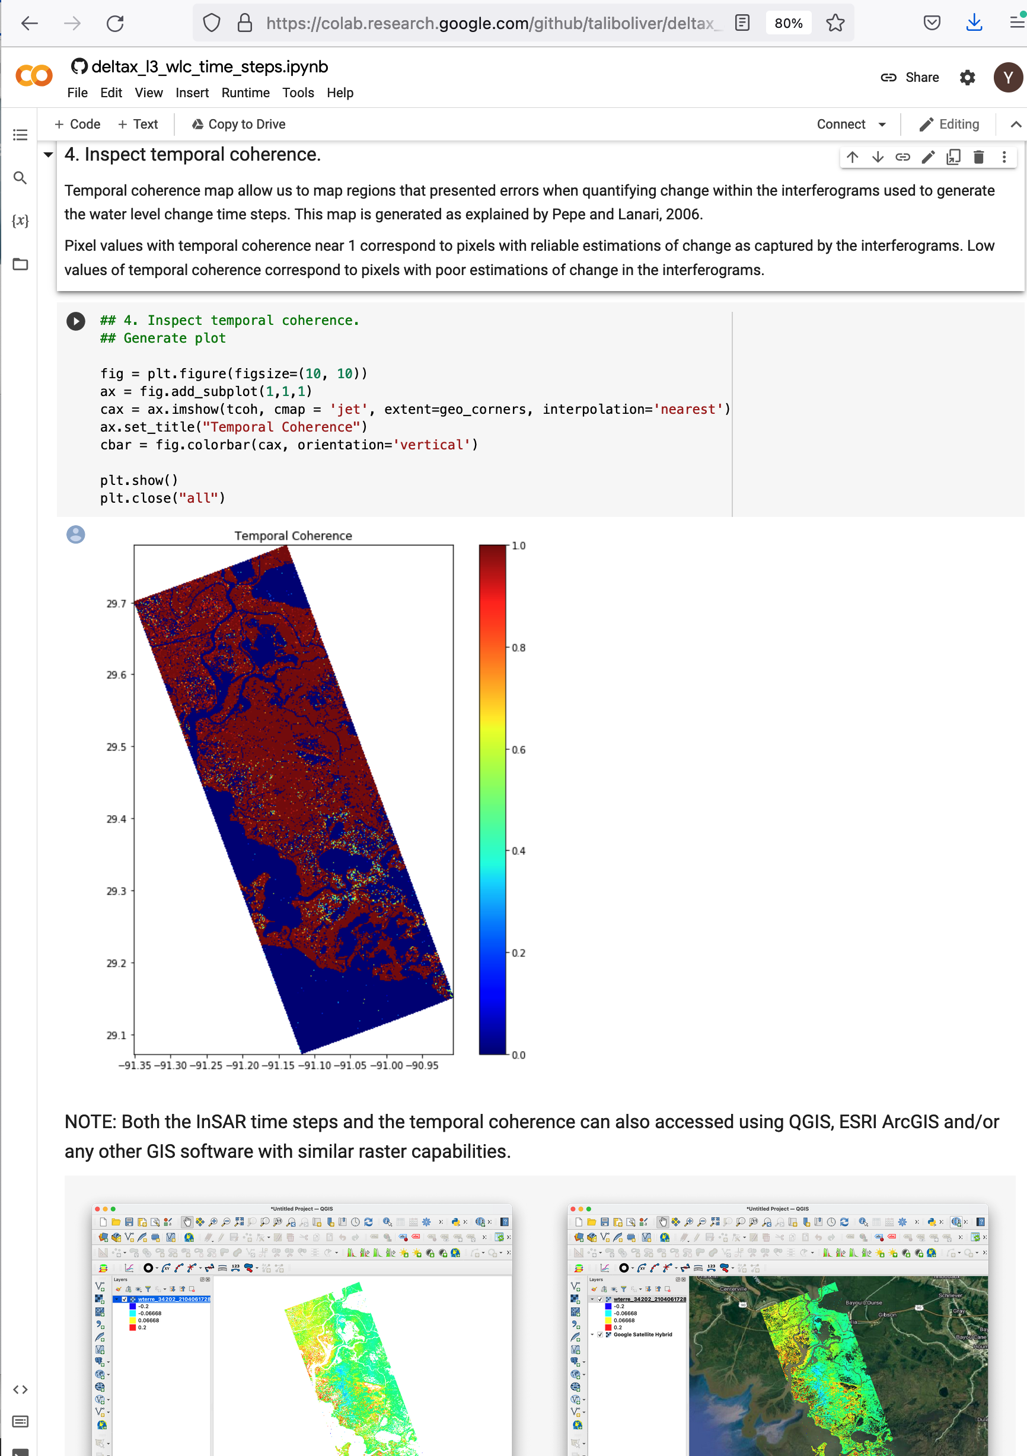
COLAB ALLOWS USERS TO WRITE/EXECUTE PYTHON THROUGH THE BROWSER
Rich text
Provided detailed set-up instructions 2 weeks prior to the workshop to get Earthdata login, data downloaded, Google Drive setup, python+libraries+JNB installed*.
Asked attendees to go through the set-up before the workshop to make sure everything worked
*Hosted the Jupyter Notebooks in Google CoLab
Runnable/editable python code
Jupyter notebook: interactive python computational environment, in which code execution, rich text, mathematics, plots and media can be combined
Plots generated within notebook
Imbeddable images

Slide 8
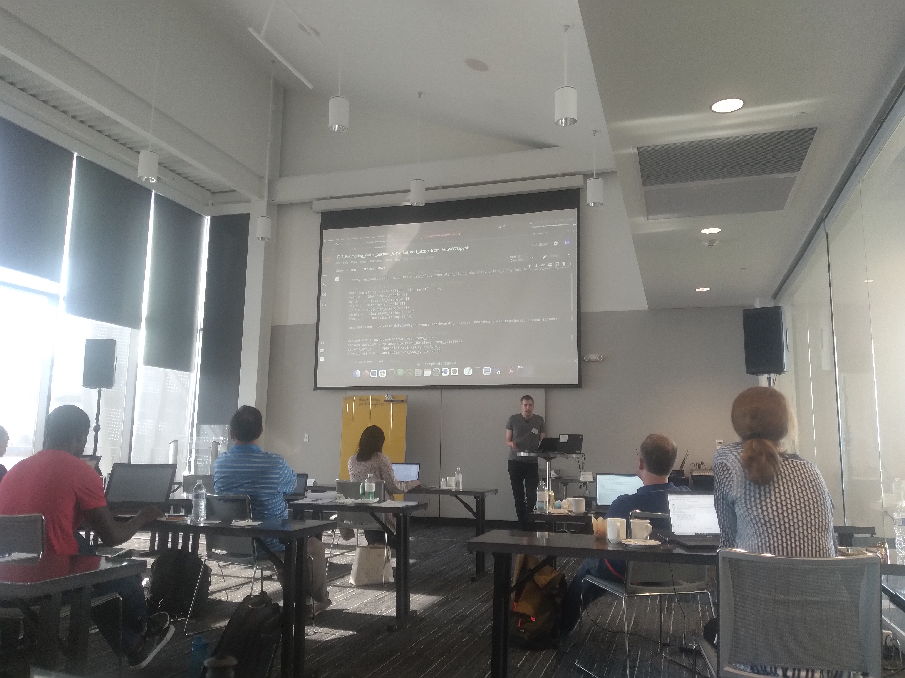
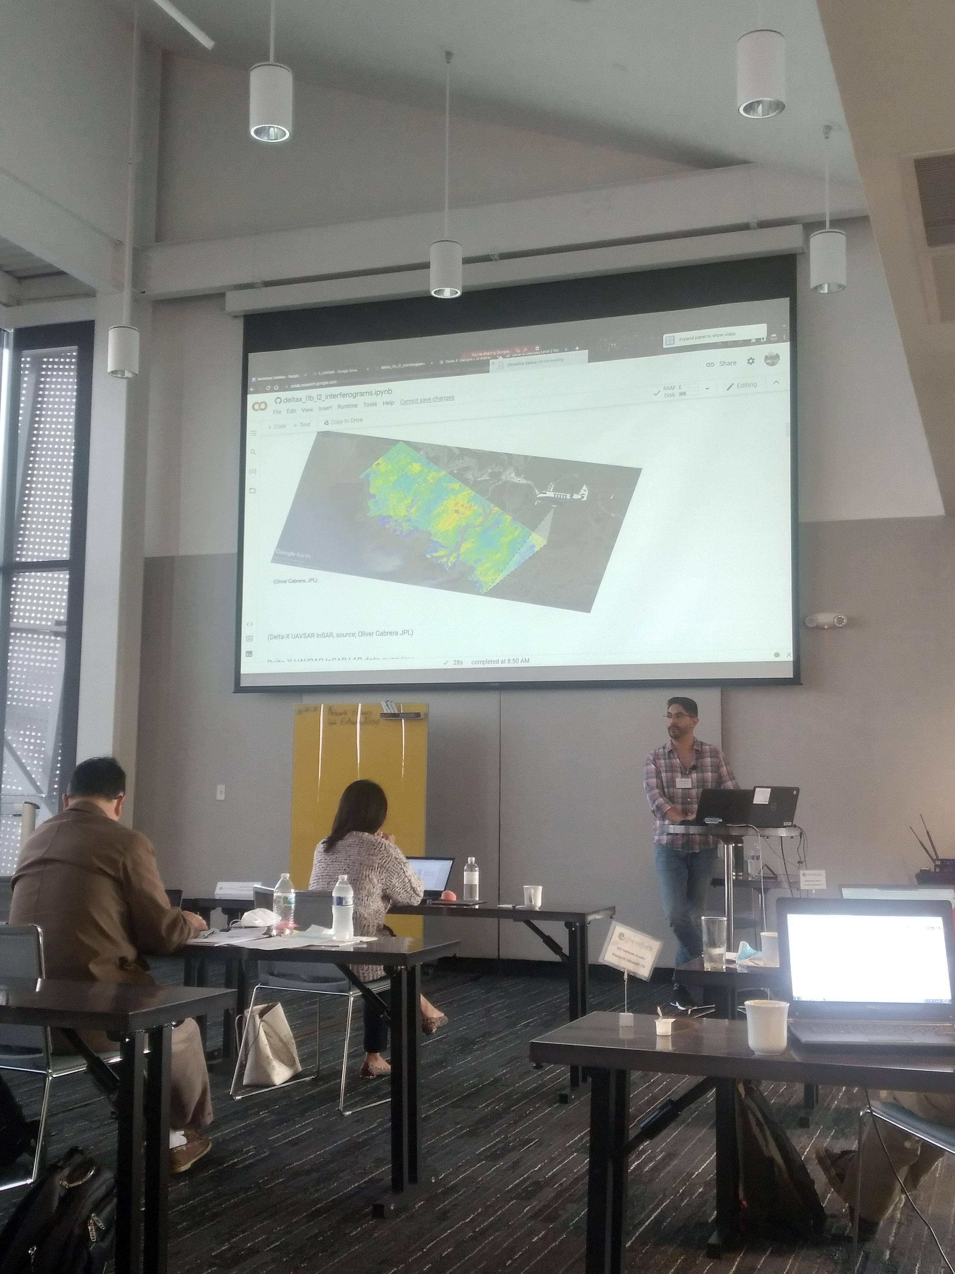
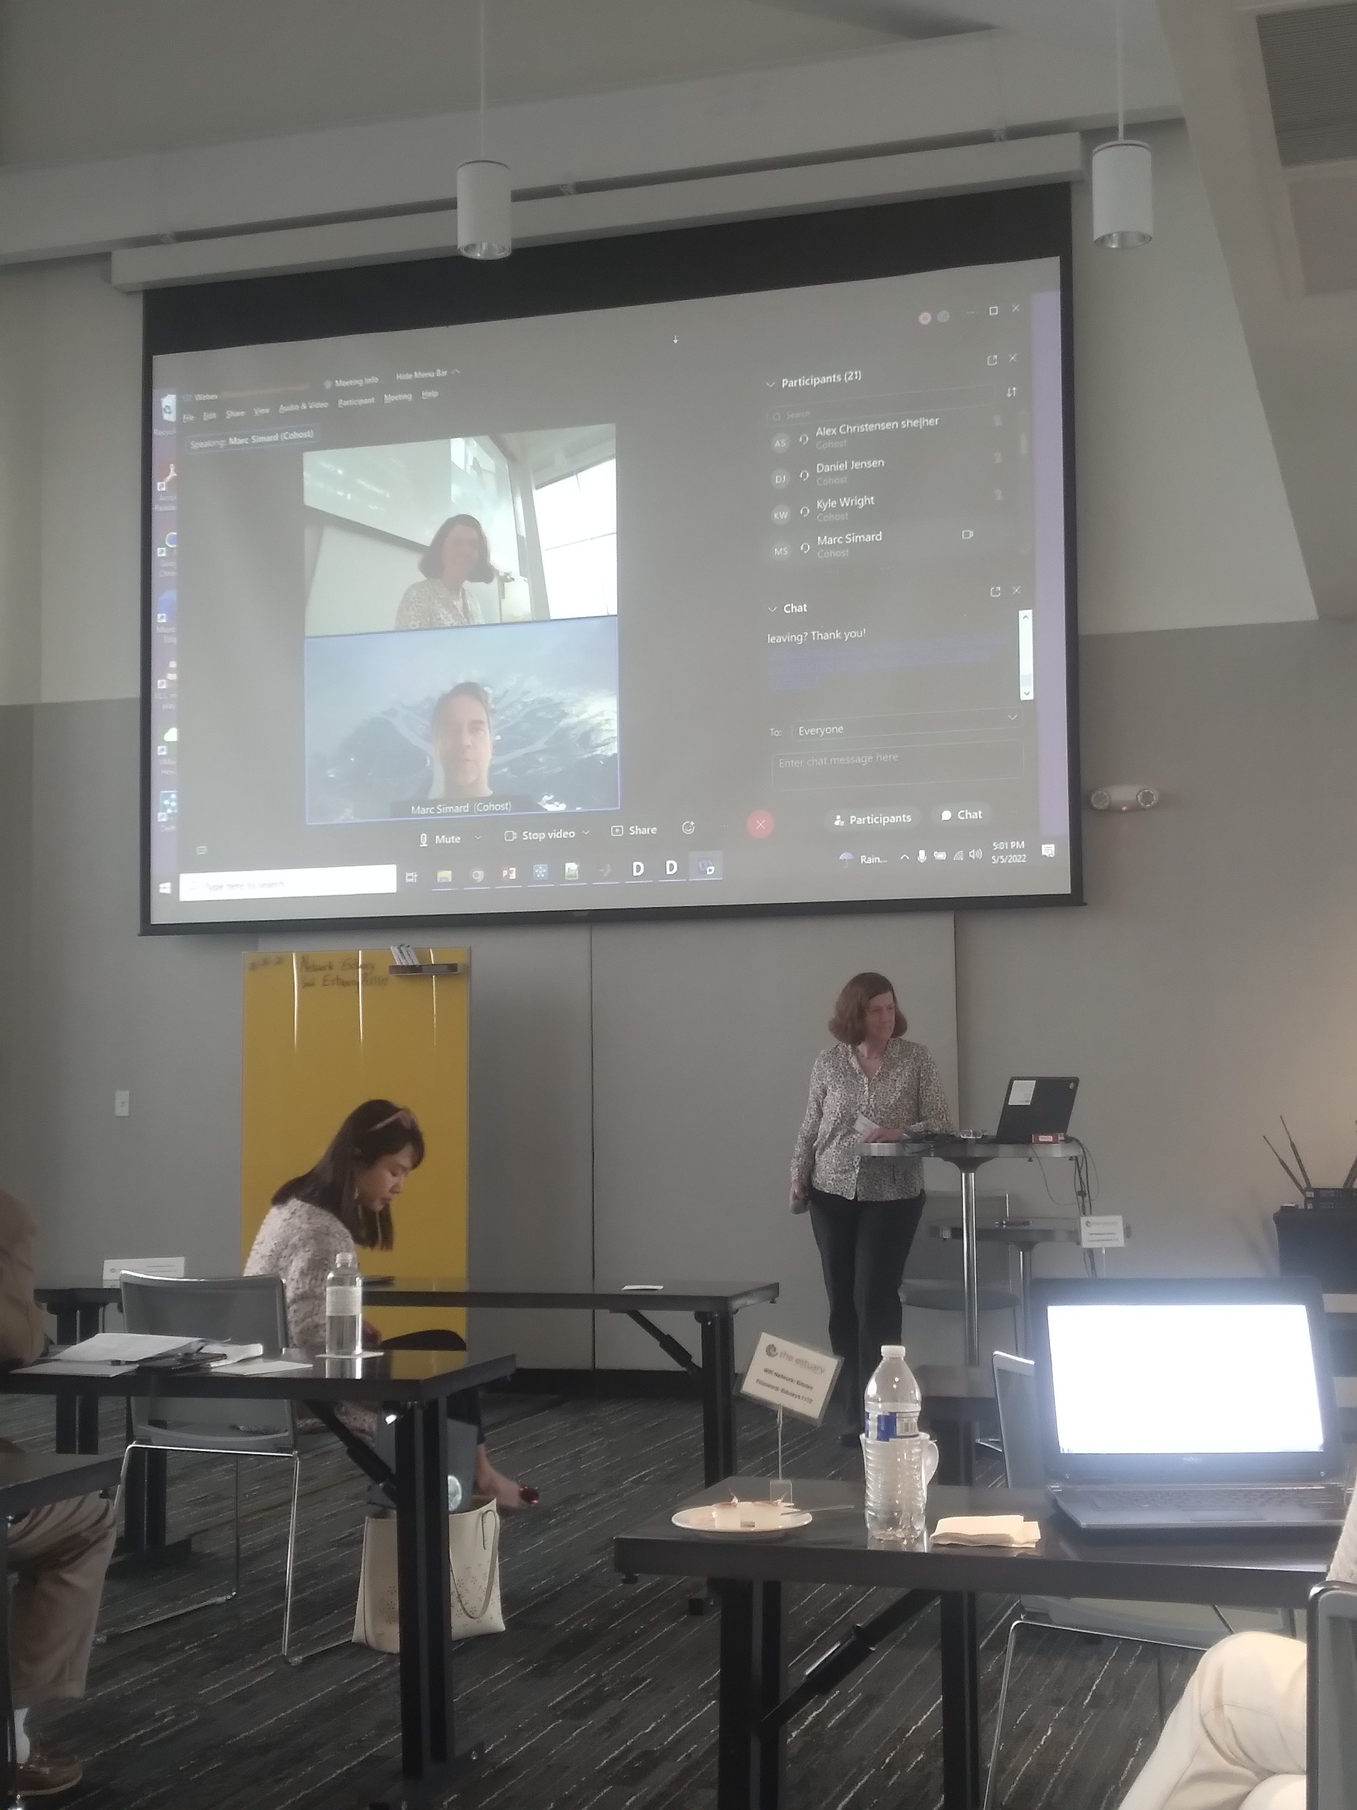
GUIDED TUTORIALS FOR DATA ANALSIS
https://deltax.jpl.nasa.gov

Slide 9
ATTENDANCE RECORDS
 |  | Day 1 | Day 2
In-person | Non-Delta-X | 15 | 13
 | Delta-X | 10 | 10
 | All | 25 | 23
Virtual | Non-Delta-X | 22 | 19
 | Delta-X | 9 | 7
 | All | 31 | 26
Total | Non-Delta-X | 37 | 32
 | Delta-X | 19 | 17
Grand Total | All | 56 | 49
DAY 2 ATTENDANCE WAS HIGH, PARTICULARLY FOR IN-PERSON ATTENDEES
- DAY 2 SURVEY TO GET FEEDBACK IMMEDIATELY
https://deltax.jpl.nasa.gov

Slide 10
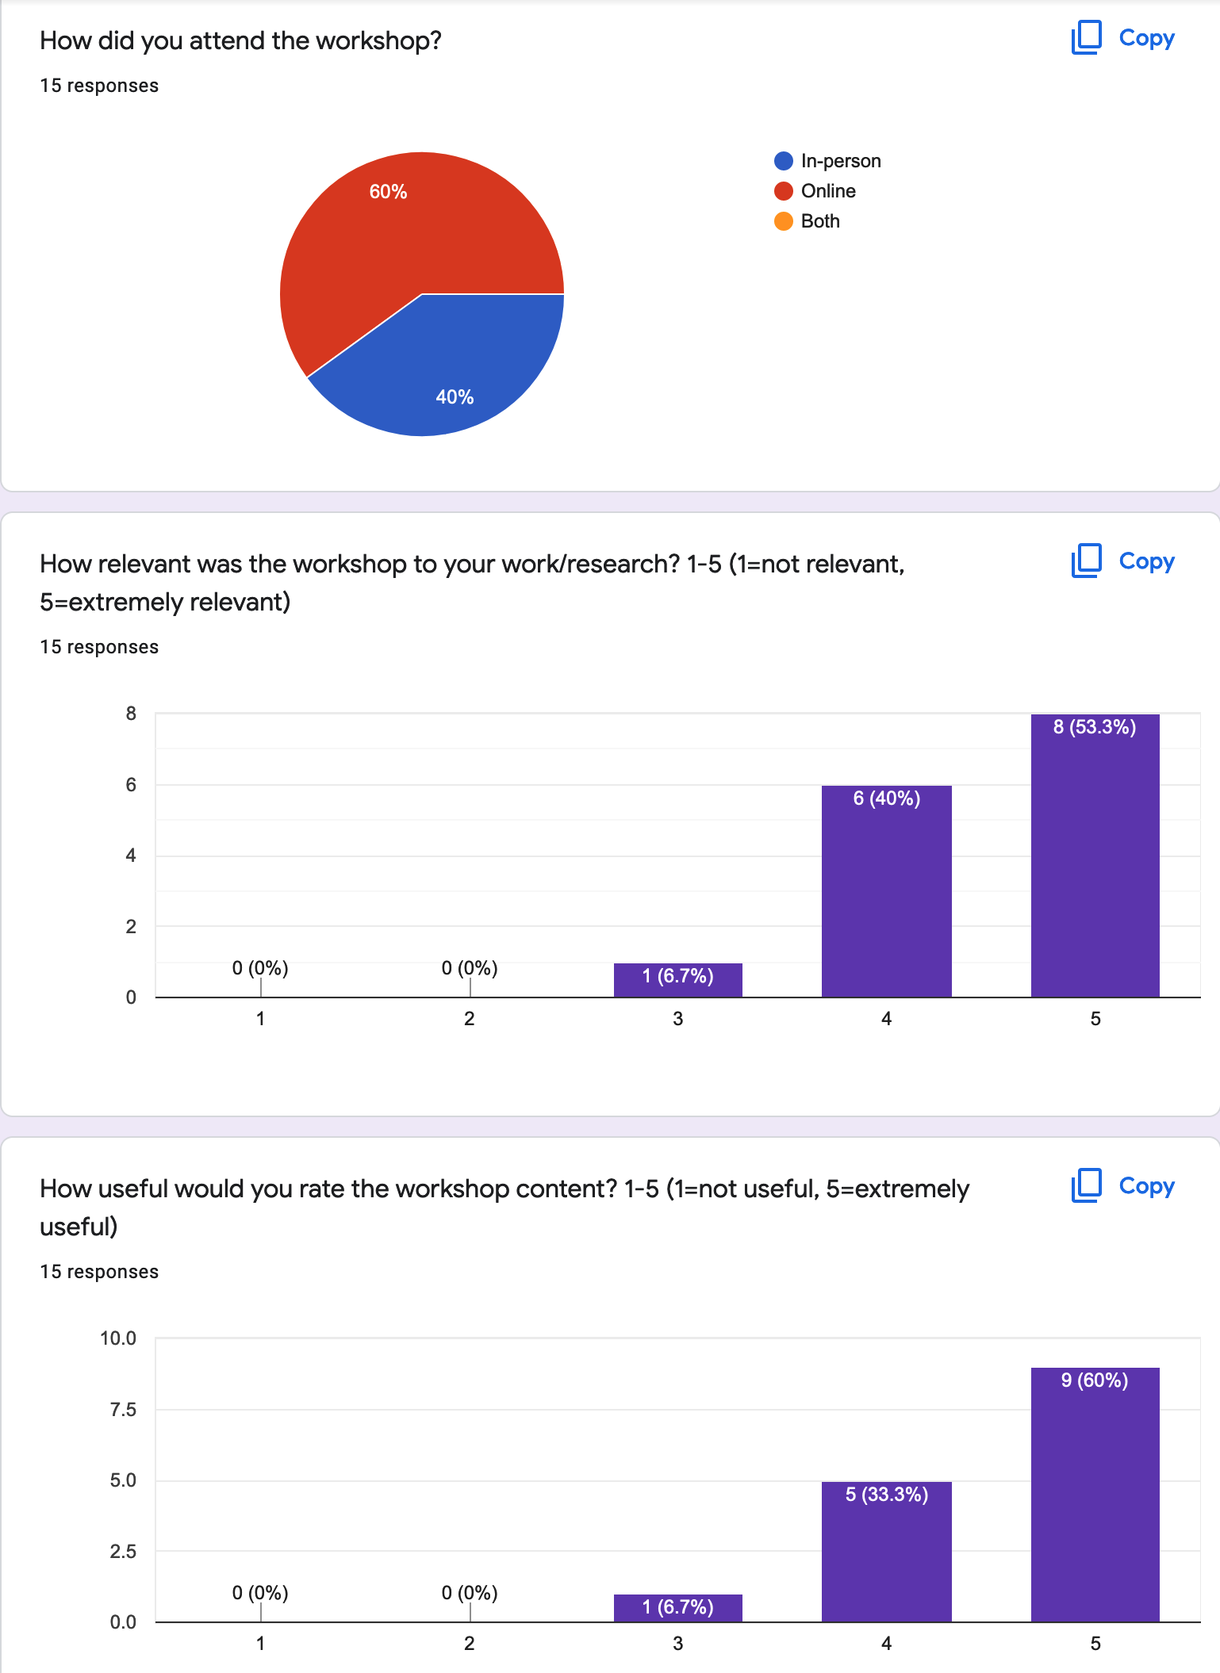
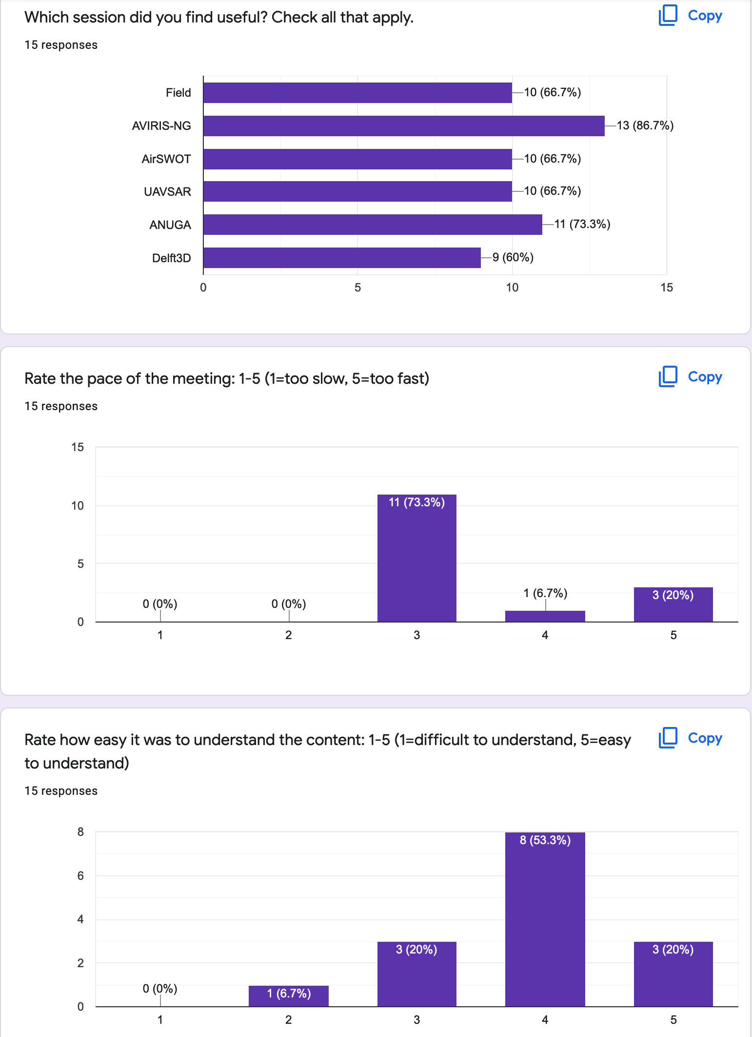
DAY 2 SURVEY (Mentimeter)

Slide 11
Take Aways
  FROM SURVEY:
  Most attendees found the material relevant and useful for their work.
  All of the sessions were of high value to a significant portion of the attendees.
  The pace of training sessions was about right for most attendees.
  The material was well presented, a bit challenging but the material could be followed
  Attendees wanted to see more details on models input preparation, calibrating models using campaign data, and comparison of models (getting there!)
  People interested in seeing expanded work into other coastal regions
  GENERAL:
  Many agencies did not allow or were unable to install python + libraries on their computers.
  More dedicated time and training for software setup and data download would be needed if not using Colab. Will not be possible for some agencies.

Slide 12
Post-Workshop
Host workshop recordings and instructions permanently on ORNL DAAC Learning Resources pages (and linked on Delta-X webpage) and maintain Jupyter notebooks on github.
Continue to engage workshop attendees
  Added all attendees to the delta-x_newsletter mailing list
  Invite key stakeholders from Coastal Protection & Restoration Authority to attend annual Science Team meetings
https://deltax.jpl.nasa.gov

Slide 13
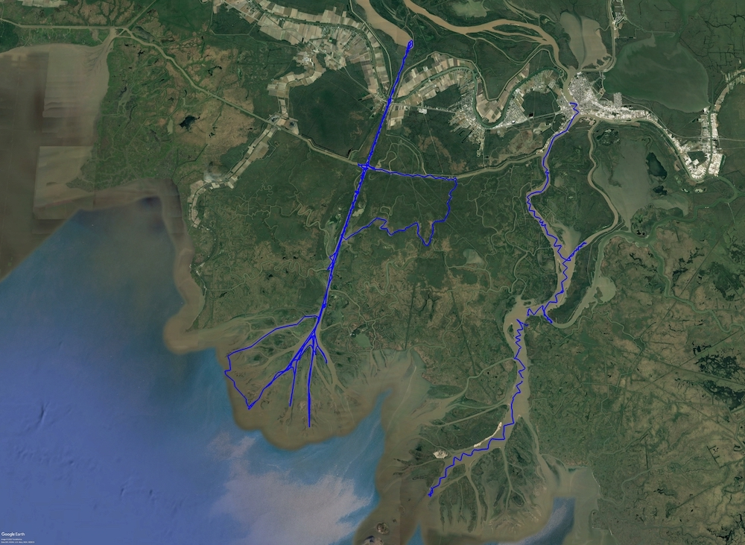
What Worked Well
Big Picture
Hold the workshop where the stakeholders are.
Identify key stakeholder organizations. Get to know specific people there and make sure that they send people to attend the workshop in person.
Record the workshop & post online
https://deltax.jpl.nasa.gov

Slide 14
What Worked Well
Details
Provide practical tools that the attendees work with during the workshop. Post them online so they have them for later use.
Send out detailed instructions for set-up at least 2 weeks before the workshop and send reminders, respond to issues.
Have people with different skill levels run through the instructions in advance.
https://deltax.jpl.nasa.gov

Slide 15
Lessons Learned
For Next Time
Expect less people to attend in-person than say they will & expect last minute no-shows.
  Can pad the list with students from local universities
Don’t expect attendees to do full linux + libraries installation. Google Colab worked well for the workshop format since it is easier to setup.
The participants were a bit hesitant to raise discussions. A mixer on Day 1 would have warmed up instructor-student connections. Attendees from CRPA and Water Institute of the Gulf (key institutions) did join us for lunches.
https://deltax.jpl.nasa.gov

Slide 16
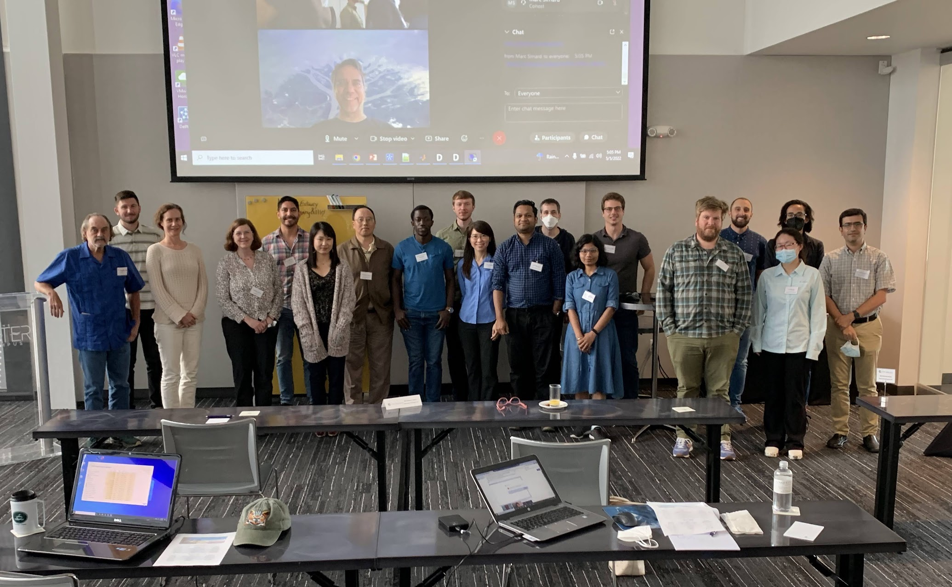
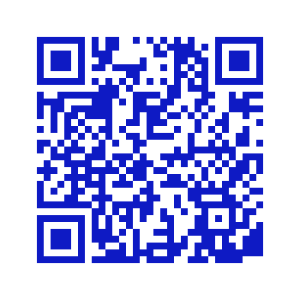
THANK YOU TO DELTA-X POSTDOCS & TEAM MEMBERS WHO WORKED VERY HARD TO DEVELOP TOOLS AND PRESENT TUTORIALS!!!
Alexandra Christensen
Daniel Jensen
Talib Oliver-Cabrera
Michael Denbina
Kyle Wright
Luca Cortese
https://daac.ornl.gov/cgi-bin/dataset_lister.pl?p=41

