Slide 1
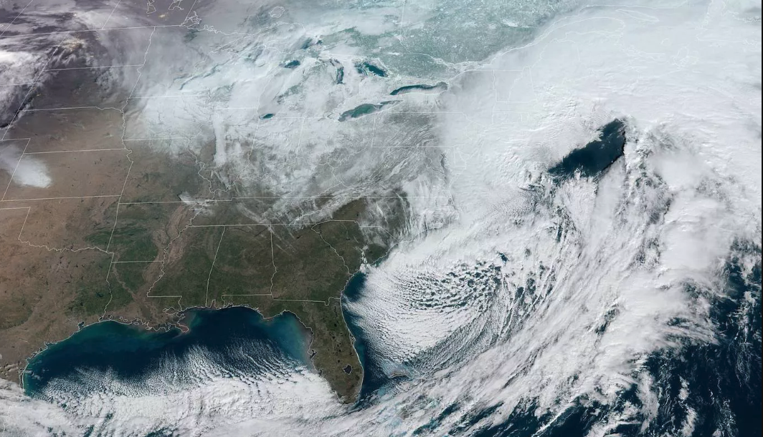
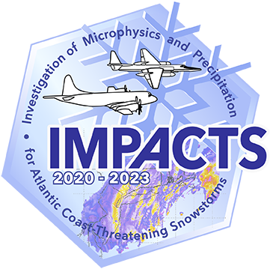
Chasing Snowstorms: The Investigation of Microphysics and Precipitation for Atlantic Coast-Threatening Snowstorms (IMPACTS)
Gerry Heymsfield, Deputy-PI
NASA Goddard Space Flight Center
Lynn McMurdie, PI
University of Washington
IMPACTS Science Team
lynnm@uw.edu gerald.m.heymsfield@nasa.gov
2023 ESSP Program Forum

Slide 2
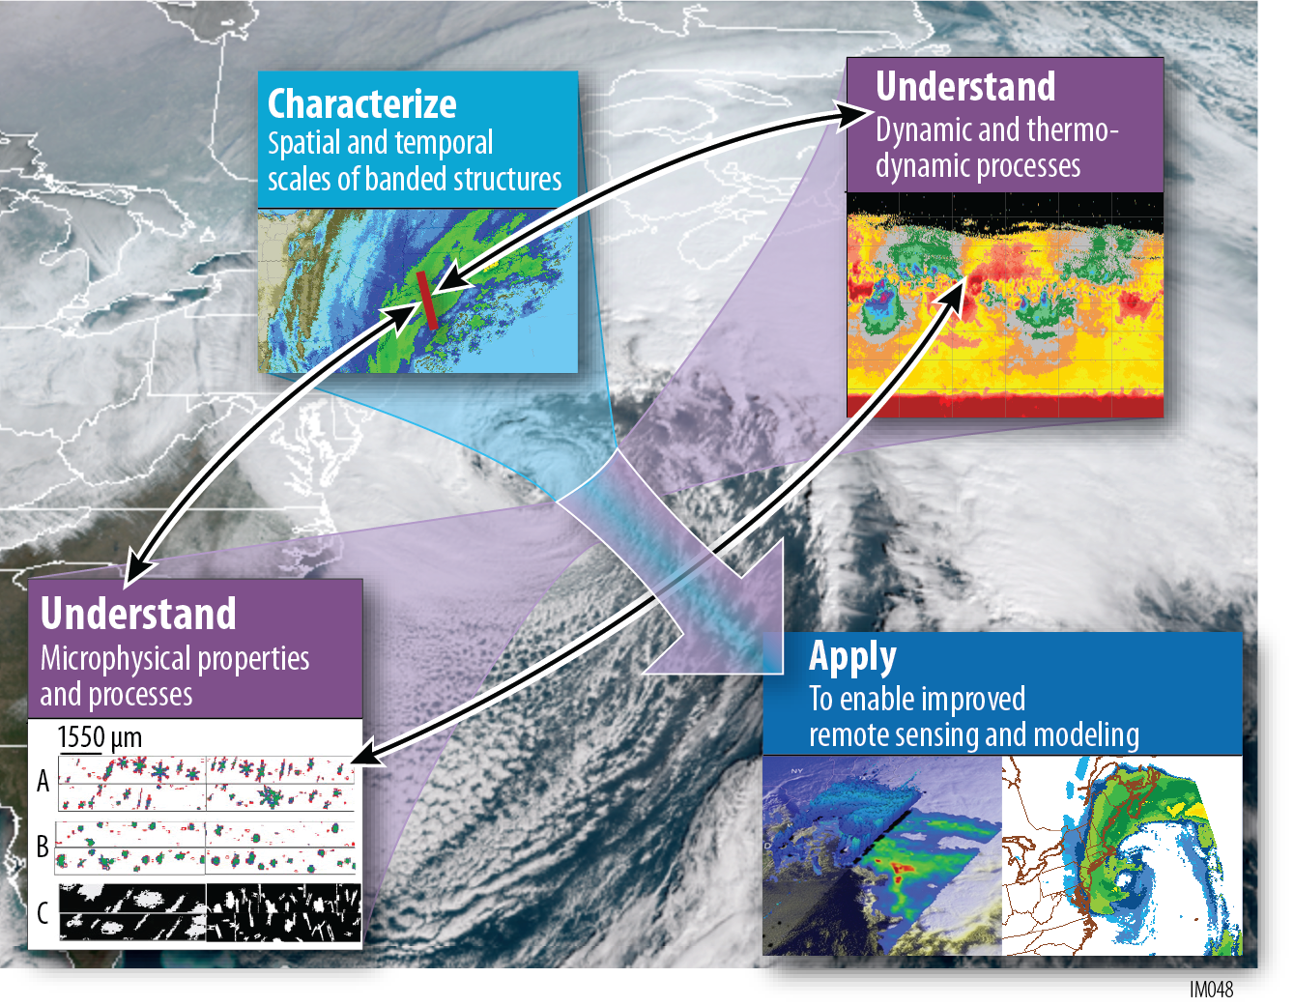
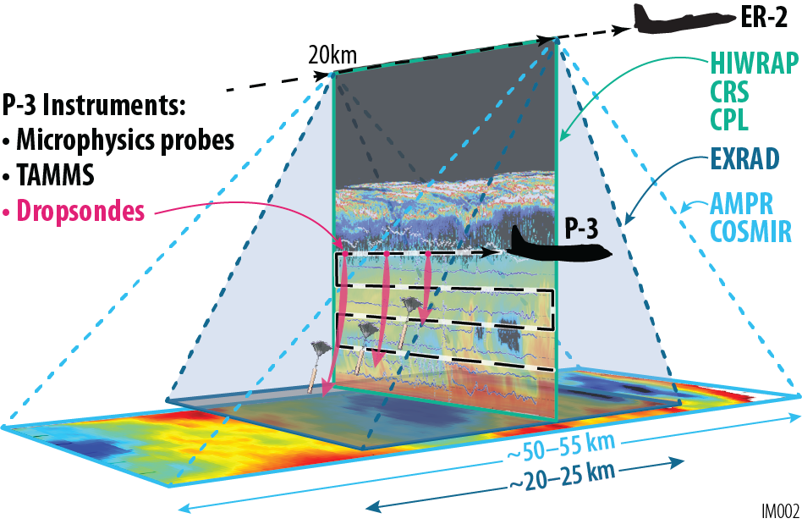
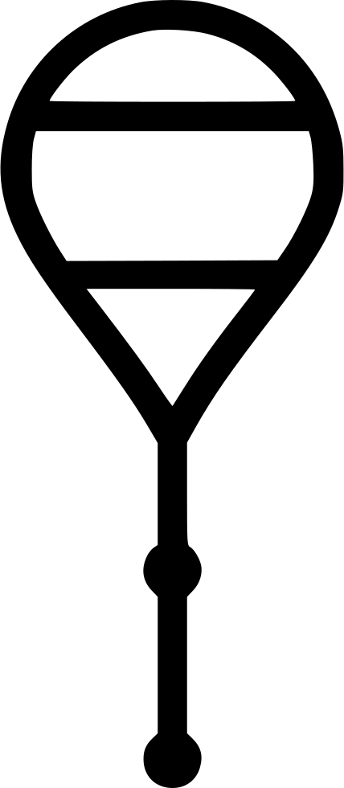

IMPACTS is an EVS-3 field campaign to study Snowstorms
Observational Strategy: Aircraft coordination
ER-2: satellite simulating, remote sensing
P-3: in situ microphysics, environment, dropsondes
Ground: Mobile and NWS rawinsonde launches, mobile and fixed ground radar and other instruments
Science Goals
Characterize snowbands
Understand dynamics, thermodynamics, microphysics
Apply to remote sensing and modeling of snowfall
McMurdie et al. 2022, BAMS

Slide 3
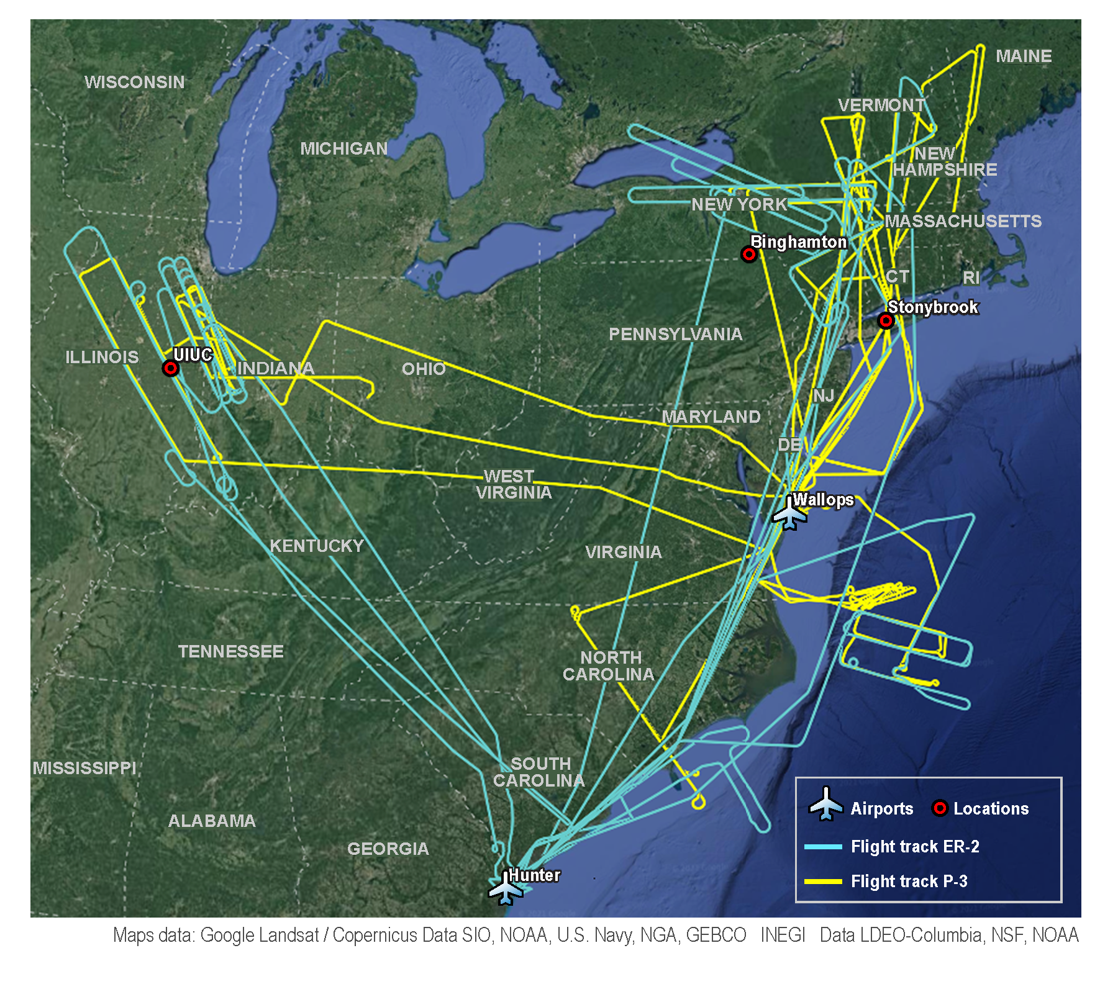
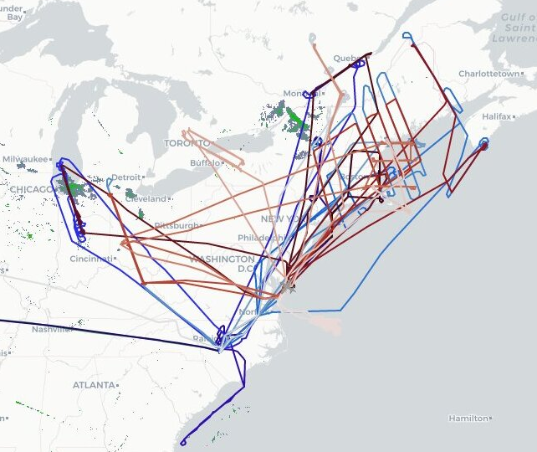
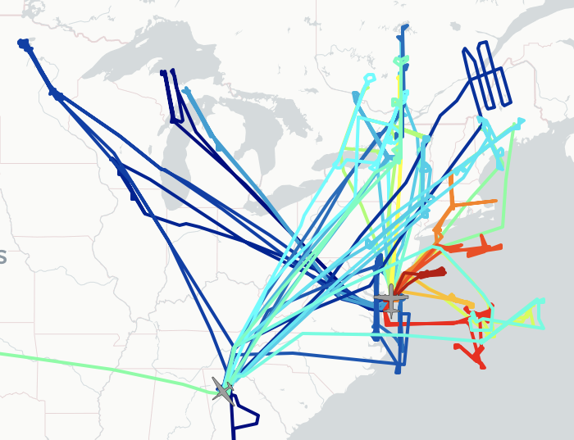
IMPACTS: What we observed: Flight tracks three seasons
2020 flight tracks
2022 flight tracks
2023 flight tracks
2020 Flight Stats
P-3: 10 Flights (61.3 hrs)
ER-2: 9 Flights (62.6 hrs)
Coordinated: 5 Flights
1 cal flight P-3, ER-2
2022 Flight Stats
P-3: 11 Science Flights (87.8 hrs)
ER-2: 9 Flights (74.3 hrs)
Coordinated: 8 Flights (3 limited coordination), 1 cal flight P-3, ER-2
2023 Flight Stats
P-3: 13 Science Flights (93.8 hrs)
ER-2: 11 Flights (81.5 hrs)
Coordinated: 10 Flights
6 calibration flights P-3, 2 ER-2

Slide 4
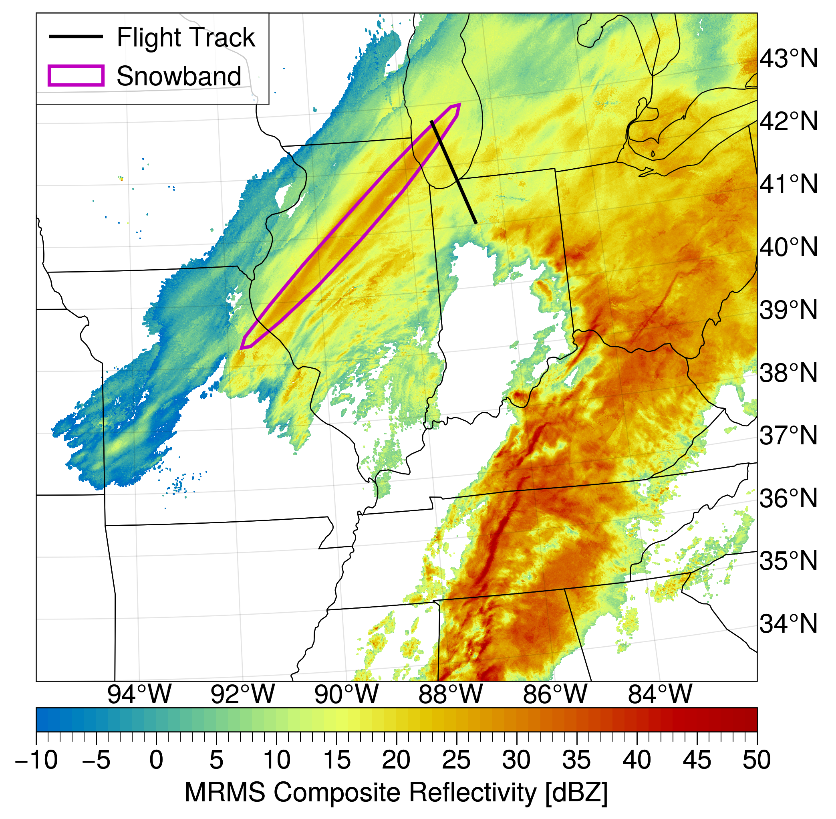
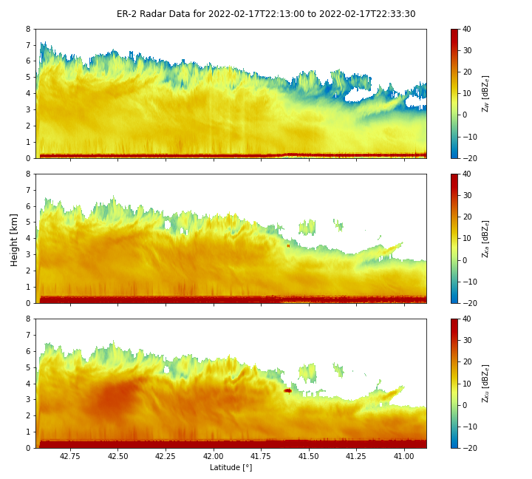
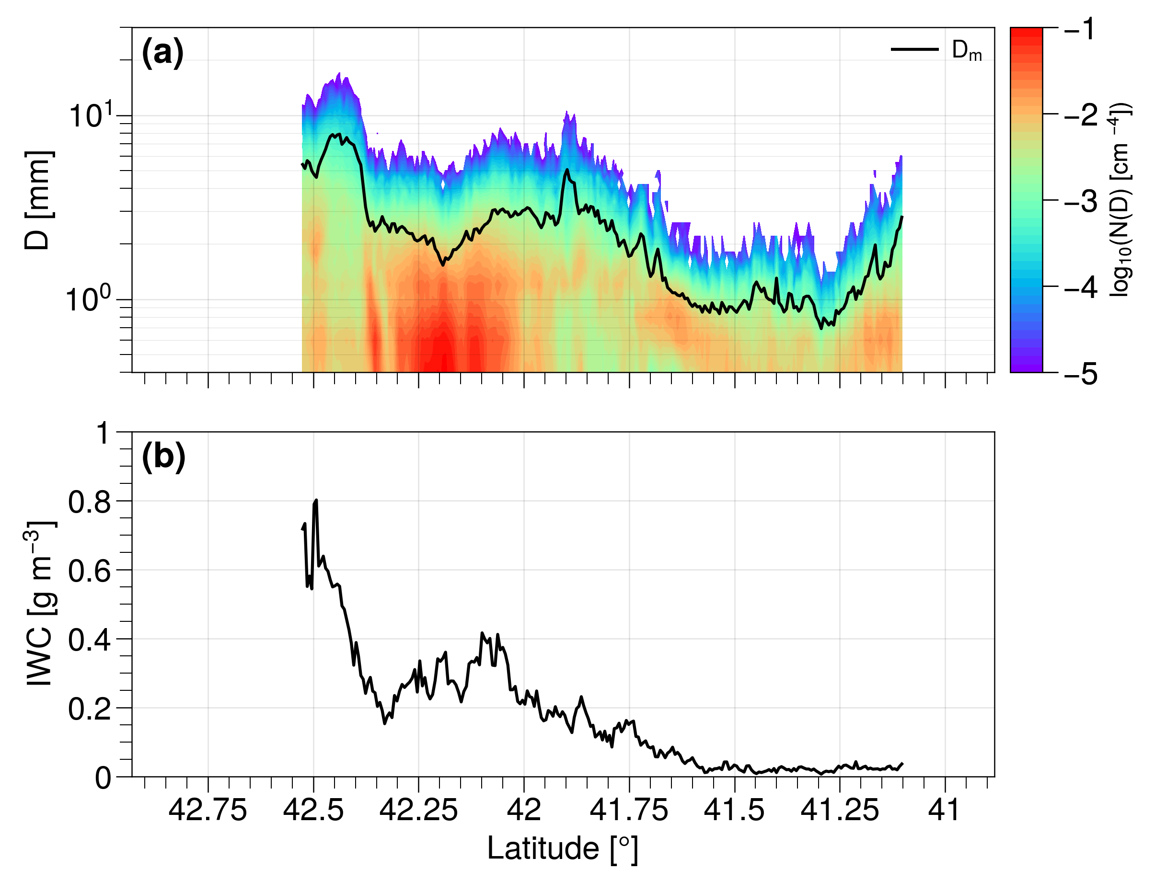
IMPACTS: What we observed: Example
CRS W-band
PSD and Dm
HIWRAP Ka-band
Estimated Ice Water Content
MRMS
HIWRAP Ku-band
P-3
Aircraft flew through a snowband
In region of high reflectivity
Outside of region of high reflectivity
more aggregates, few smaller particles, high IWC
smaller particles and lower IWC
McMurdie et al. 2022, IEEE

Slide 5
IMPACTS: Addressing our science goals
Publications:
Characterize Snowbands
Varcie et al. 2023
McMurdie et al. 2022
Tomkins et al. 2022
Varcie, M. Masters, 2021
McDonald, V., Masters, 2022
Understand Snowbands
Heymsfield et al. 2023
Dunnavan et al. 2022
Hueholt et al. 2022
McMurdie et al. 2022
Miller et al. 2022
Heymsfield et al. 2021
Schultz et al. 2021
Richter, A., Masters, 2022
Burris, K., PhD, 2023
Publications:
Apply to remote sensing and modeling of snowfall
Dunnavan et al. 2023
Colle et al. 2023
Heymsfield et al. 2023
Chase et al. 2022
Finlon et al. 2022
McLinden et al. 2021
McLinden et al. 2021
Bold – IMPACTS Science team lead author

