Slide 1
GeoCarb Mission:
Challenges and Opportunities
2023 ESSP Program Forum
22-23 August 2023
Berrien Moore III
Sean Crowell

Slide 2
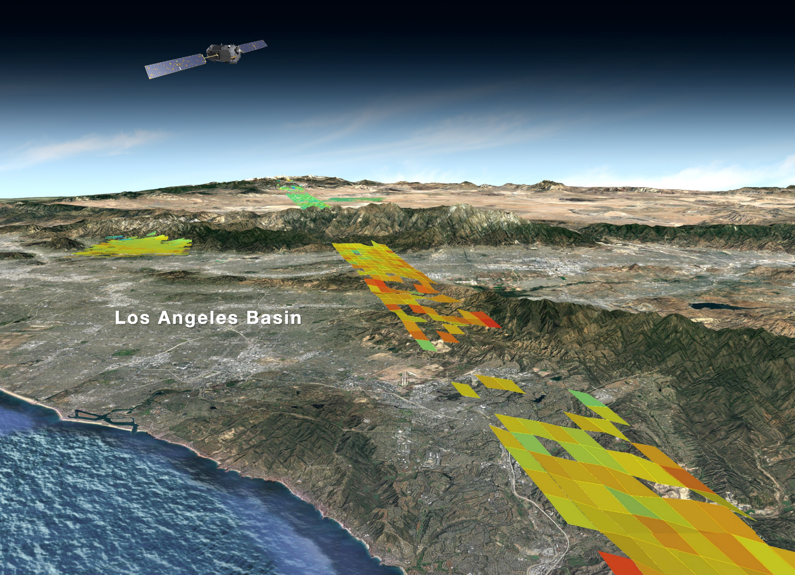
OCO-2: The Foundation for GeoCarb
Jet Propulsion Laboratory
California Institute of Technology
August 19, 2017
Copyright 2017 California Institute of Technology. Government sponsorship acknowledged.
Notes:
As carbon dioxide it added to the atmosphere by a multitude of human and natural processes, it is blown around by the winds.
As CO2 is removed from the air by plants on land or the ocean, the CO2-poor air is also blown by the winds.
quick tour of sources and sinks, using the video
To find the sources emitting carbon dioxide into the air, or the natural “sinks” absorbing this gas from the air, we need far more measurements.
Finding carbon dioxide sources and sinks with measurements from only 100 ground based stations is hard as trying to predict the whether using only 100 surface weather stations. With that, we could only predict the weather as well as we did a century ago.
One way to do this is go to space, and take not hundreds, but hundreds of thousands of observations every day.
But this is a very challenging measurement to take from space because the largest difference seen in these maps are no larger than 2%.
Measurements with unprecedented accuracy and precision are needed.

Slide 3
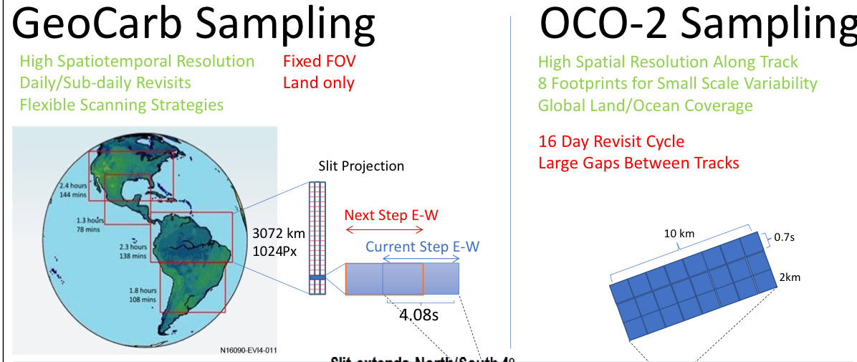
From a Narrow Swath to a Scanning Slit
9s

Slide 4
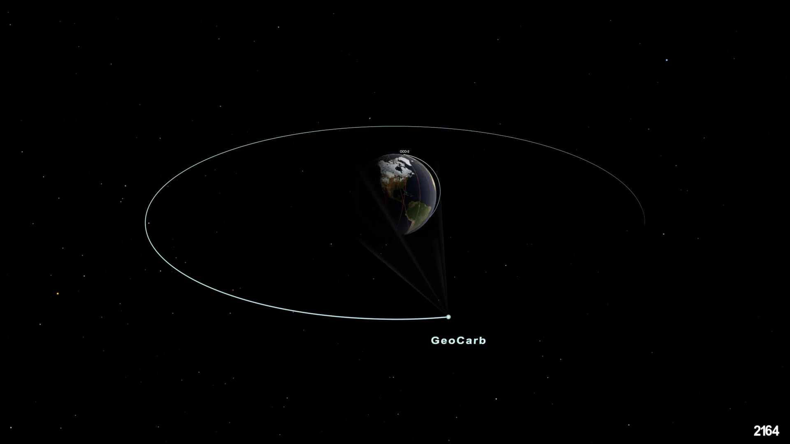
GeoCarb and OCO-2

Slide 5
GeoCarb Mission: Overview
The Goal of the GeoCarb Mission is to produce a transformational advance in our scientific understanding of the global carbon cycle and also to demonstrate a GreenHouse Gas monitoring system that supports verification of national and international targets on GHG emission reductions.

Slide 6
Measurement Objectives
NO CHANGE
Science Measurement Objective 1:
Provide high precision daily measurements of X_{CO2} (0.3%), X_{CO} (10% or 12ppb) over sunlit, cloud free terrestrial regions at spatial scales of 5-10 km. Note: X_{CO2} denotes column integrated concentration of CO₂ (i.e., dry-air mixing ratios). We achieve concentration by measuring both total column CO₂ (at wavelengths 1.61µm, 2.06µm) and CO (at at wavelengths 2.32 µm), and total column O₂ in the 0.76 μm wave-length.
Science Measurement Objective 2:
Provide high precision daily measurements of X_{CH4} (0.6%) over sunlit, cloud free terrestrial regions at spatial scales of 5-10 km using observations at 2.32 μm for methane.
Application Measurement Objective:
Study vegetation health (e.g., photosynthesis, stress, yield, etc) by measuring daily Solar-Induced Fluorescence (SIF). Cloud cover is not an issue in the wave-length of interest (0.76 μm).

Slide 7
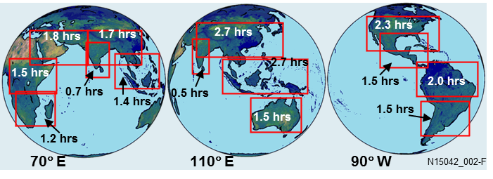
Important Views from GEO
Example GEO slots: 70°E, 110°E, and 90°W
GeoCarb is using the 90 degree West Slot

Slide 8
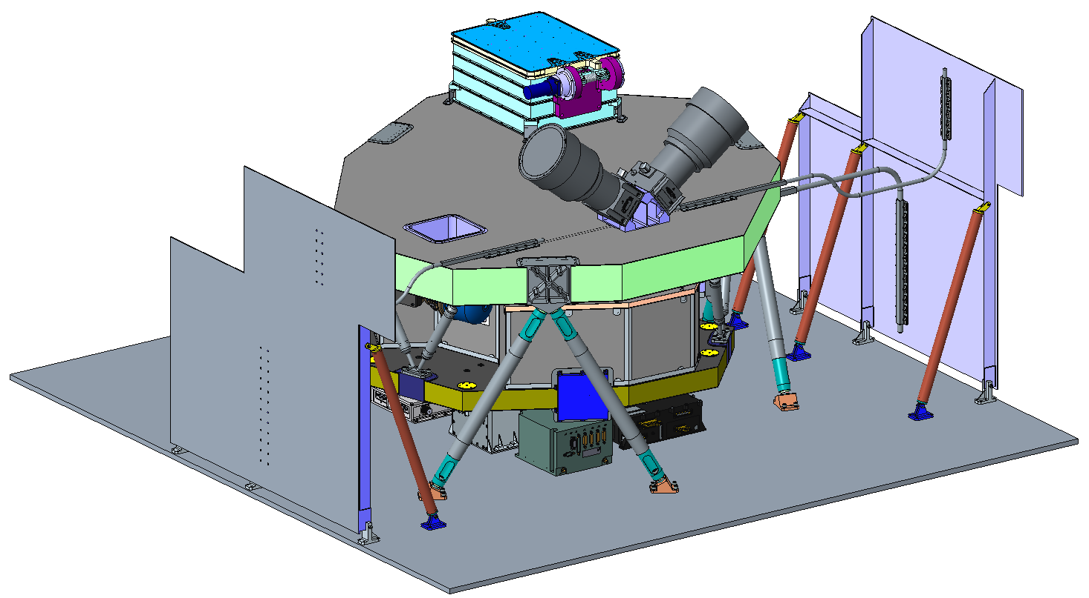
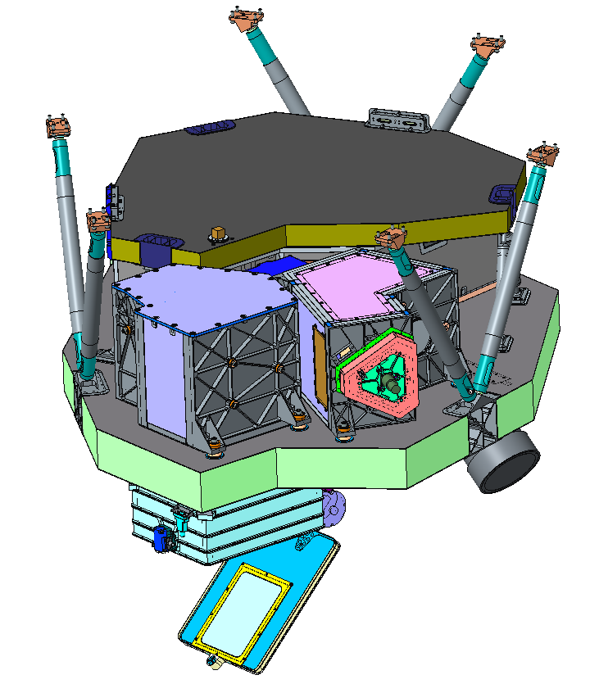
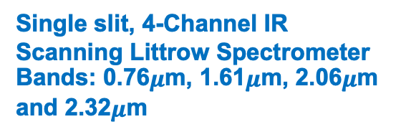
Instrument Configuration
Single slit, 4-Channel IR Scanning Littrow Spectrometer
Bands: 0.76$μ$m, 1.61$μ$m, 2.06$μ$m and 2.32$μ$m
Star Tracker
Optical Heads
Entrance Baffle & Door Assy
South
Radiator
Cryocooler Thermomechanical Unit (TMU)
Spectrograph Assy
Spectrograph
Scan Box Assy
North
Radiator
S/C Nadir Panel
+Z (nadir)
Nadir Panel Mounted Components
GeoCarb Electronics Box (GEB)
Focal Plane Electronics Box (FPE)
Star Tracker Electronics Unit (STEU)
Decoder Electronics Box (DEB)
Cryocooler Electronics (CCE)
W
S (+Y)
N
E (+X)
Main Bench
Telescope Assy
N
E (+X)
Entrance Baffle
W
S (+Y)
+Z (nadir)
Door Assembly

Slide 9
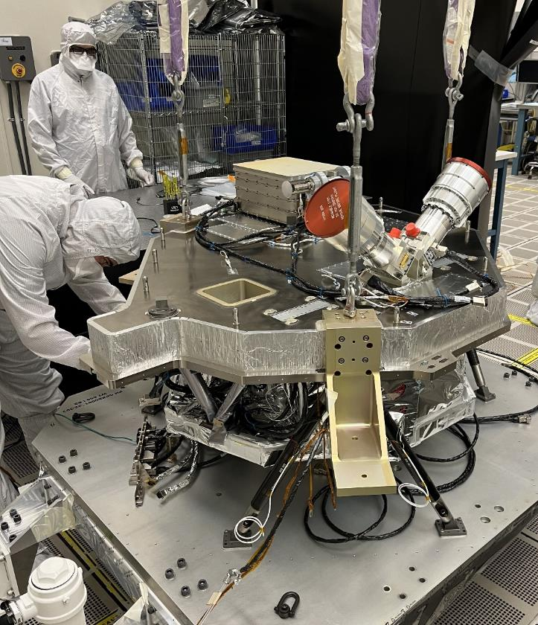
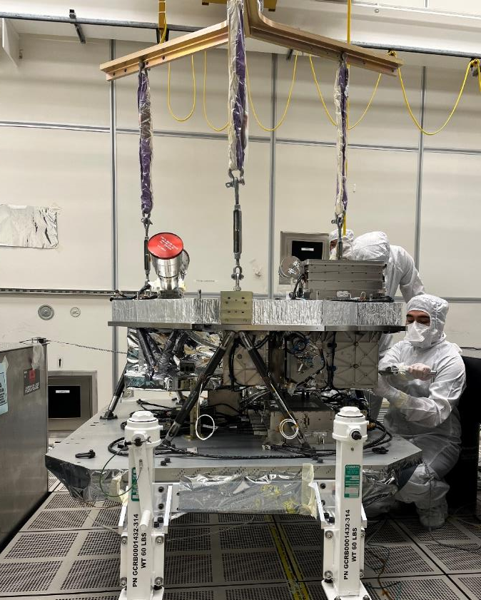
Subassemblies are Integrated
CUI//SP-EXPT
Main Bench Lift to Nadir Plate Top view
Main Bench Lift to Nadir Plate Side View
CUI//SP-EXPT

Slide 10
Instrument Status Today and Tomorrow
Optics (spectrometer, telescope, slit, scan mirrors) fully integrated and aligned and staked.
Electronic boxes completed and in the later stage of being integrated on the instrument support plate for ThermoVac and Vibration.
ThermoVac testing of the fully integrate instrument (Optics, Electronic Boxes, Cabling, thermoblankets etc) to begin 8 September with a planned 30-40 day test. The beginning of Instrument Calibration and Characterization
Ship to NASA in November 2023

Slide 11
Remaining Challenges
Characterization and Calibration: After delivery of the GeoCarb Instrument to NASA, there remains the need for further instrument characterization and calibration—two to three 30-day ThermoVac Cycles plus analysis. Six-month effort. Who and When would this be accomplished?
Elephant in the Room: Access to Space and Operations
Potential Pathways: a) Wait for a Ride on a Host; the commercial communication business from Geo is recovering; b) A Public – Private Partnership in which the Private Partner provides an investment (e.g, a spacecraft, and/or launch, and/or on-orbit management, downlink, and data processing) in return for data exclusivity rights for the Private Partner for ~30-60 days.

Slide 12
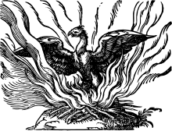
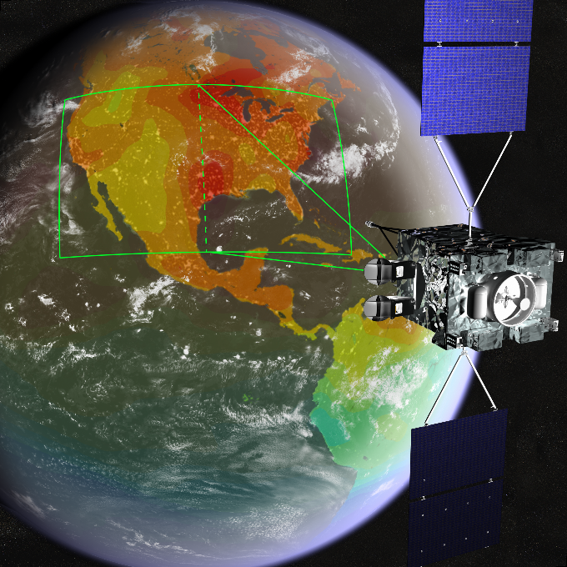
GeoCarb = Phoenix Bird

