Slide 1
2023 ESSP Program Forum
NASA Langley Research Center
Science Lightning Talk
22 August 2023
CYGNSS
NASA Earth Venture Mission
Chris Ruf
University of Michigan

Slide 2
CYGNSS Mission Overview
Flight Segment Design
Eight satellites in low Earth orbit at 520 km altitude / 35º inclination carrying bistatic GPS radar receivers
Science Objectives
Over ocean: Near surface wind speed under all precip
Over land: Soil moisture and inland water mapping under all vegetation
Mission Timeline
Launch 15 Dec 2016
Science Phase E since Mar 2017; currently in extended Phase E
7 of 8 spacecraft still operational

Slide 3
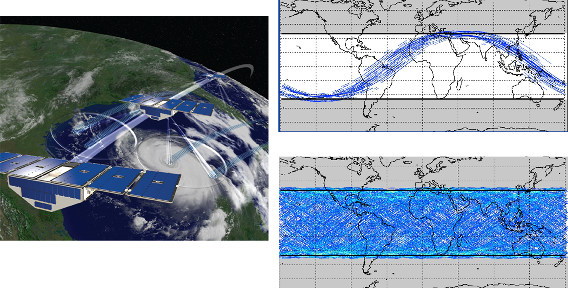
CYGNSS Coverage

Slide 4
CYGNSS Global Wind Speed Product
Typical 24 hours of v3.1 L3 FDS Winds

Slide 5
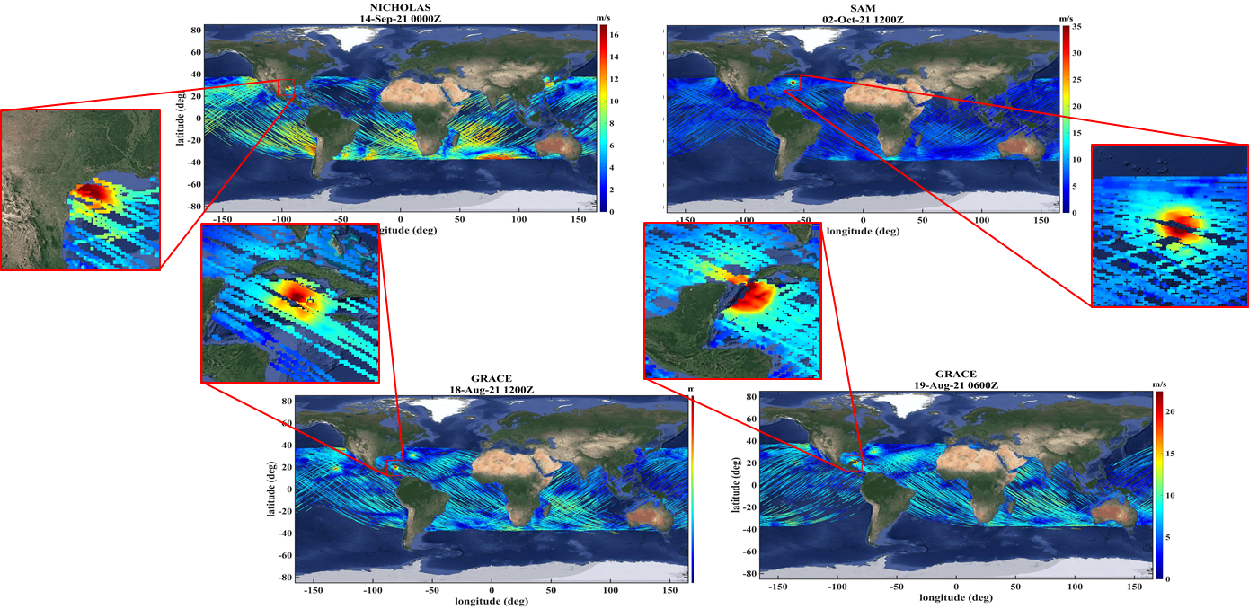
CYGNSS L3 Merged Wind Speed Global Coverage Examples
TCs Nicholas, Sam and Grace

Slide 6
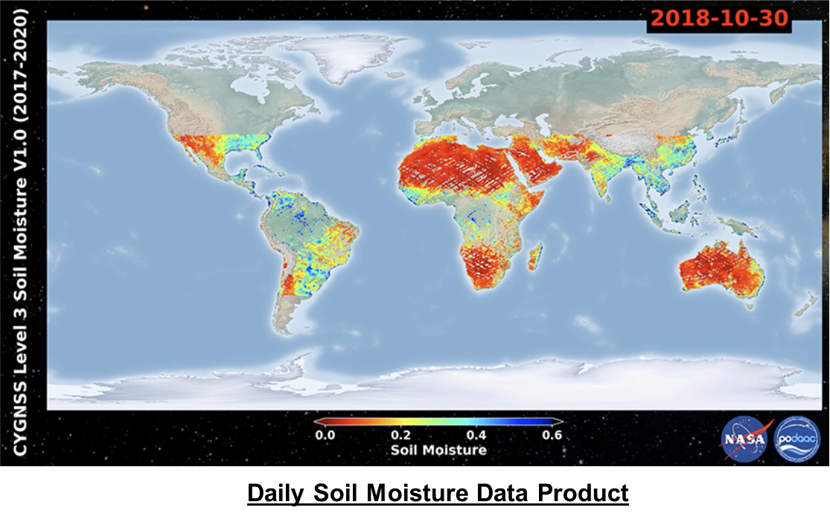
Released Soil Moisture Data Product (6 hr and daily versions available)
CYGNSS soil moisture data product released by the PO.DAAC

Slide 7
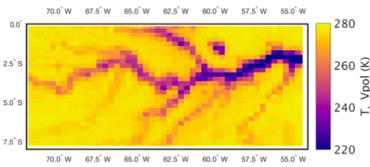
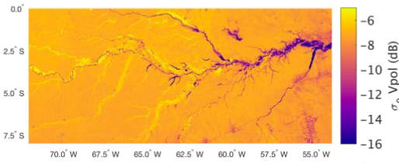
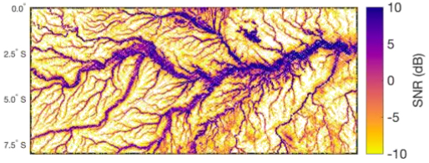
CYGNSS Land Imaging Capability
High res land imaging from coherent specular scattering
Images of the same section of the Amazon River by:
SMAP passive microwave
~30 km resolution
SMAP active radar
~3 km resolution
CYGNSS GNSS-R
<< 3 km resolution

Slide 8
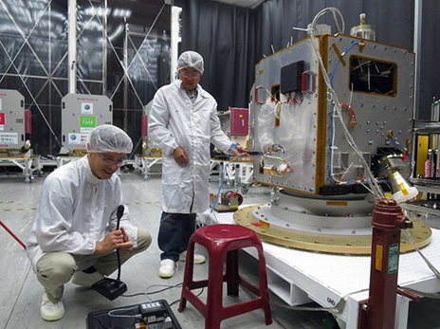
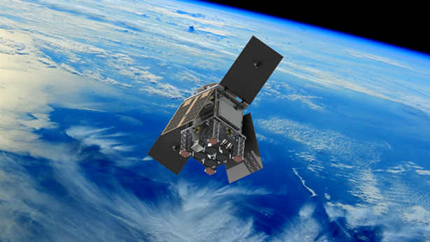
“Follow On” Gov’t Missions
TRITON, Taiwanese National Space Organization (NSPO)
Single spacecraft
Launch later in 2023
HydroGNSS, European Space Agency (ESA)
Two spacecraft constellation
Launch 2024

Slide 9
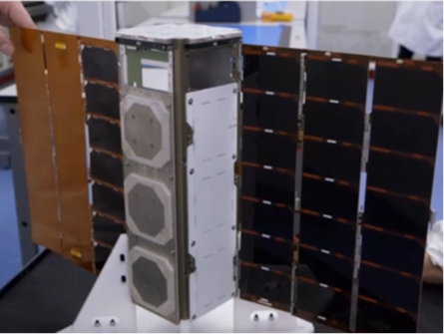
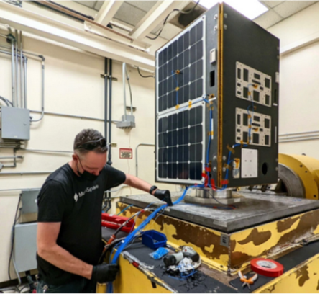
“Follow-On” Private Sector Missions
Spire, GNSS-R 3U CubeSats
2 Batch-1 s/c launched 2019
2 Batch-2 s/c launched 2020
1 Batch 3 s/c launched 2023
Muon Space, Mountain View, CA
MuSat-1 launched 2023 (bus only)
MuSat-2,3 launch 2024 (GNSS-R payload)

