Slide 1
Orbiting Carbon Observatory-2 (OCO-2)
Vivienne Payne (OCO-2 PS), Abhishek Chatterjee (OCO-2 DPS), OCO Science Team

Slide 2
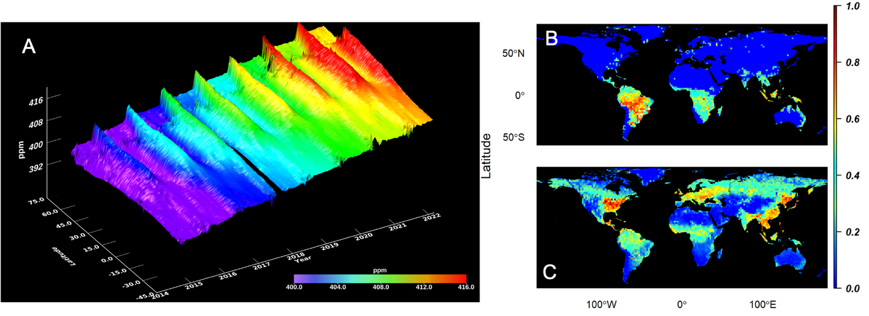
The relentless rise of CO₂ in our atmosphere
OCO-2 provides measurements with the accuracy and precision required to quantify the sources and sinks that control the growth and variability of CO₂ in our atmosphere.
The stable, long-term, global, high-quality data record from OCO-2 makes it unique among all greenhouse gas sensors.
The OCO-2 instrument and spacecraft remain in excellent health!
Notes:
Talk about the science objectives of OCO-2: Regional scale sources and sinks
From a remote sensing perspective, CO2 is a really challenging measurement to make.
Small variations against a large background.
Huge amount of expertise, effort and dedication has gone into producing this CO2 product that we are looking at today.

Slide 3
SIF shows where and when carbon uptake by plants is occurring
Northern Hemisphere Winter
Northern Hemisphere Summer
Figure: Maps of SIF in March (left) and July (right) 2021 showing strong growth in July over the northern hemisphere and strong growth in the tropics and southern hemisphere in March.
Measurements of solar induced fluorescence (SIF)
  provide direct information on carbon uptake by plants.
OCO-2 shows the spatial distribution and how this is changing in time.
SIF is an excellent complement to XCO₂ for constraining carbon fluxes

Slide 4
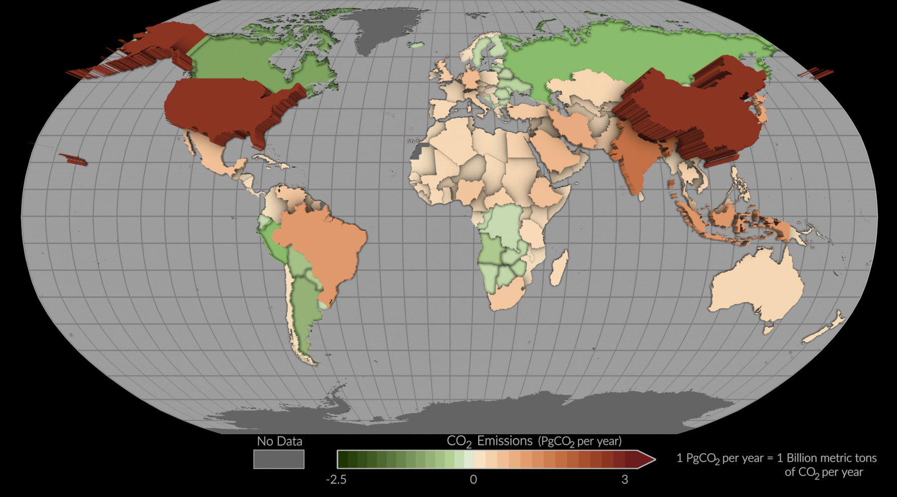
Taking stock of national contributions to global CO₂ from space
OCO-2 contributions to the Global Stocktake under the Paris Agreement
https://www.jpl.nasa.gov/news/nasa-space-mission-takes-stock-of-carbon-dioxide-emissions-by-countries
Byrne et al., 2023
This map shows mean net emissions and removals of carbon dioxide from 2015 to 2020 using estimates informed by NASA’s OCO-2 satellite measurements. Countries where more carbon dioxide was removed than emitted appear as green depressions, while countries with higher emissions are tan or red and appear to pop off the page. Credit: NASA’s Scientific Visualization Studio
Notes:
International study involving a team of 60 researchers, that used OCO-2 measurements together with surface obs, to quantify CO2 fluxes at national scales between 2015 and 2020.
Explain the map.
This pilot dataset was contributed to the Global Stocktake. Under the Paris agreement, the first global agreement on climate change, countries set their own carbon emissions targets and the global stocktake process provides a means to take stock of the world’s collective progress towards those goals.
National Greenhouse Gas Inventories
Are submitted as part of the Global Stocktake.
Tally how much CO₂ is being emitted across all facets of an economy
Are needed to track changes in emissions in response to climate policy.
“Bottom-up” methods used to construct them rely on
accurate and timely activity data – such as the area of deforested and intact forests
models that relate this activity data to net emissions or removals.
Lack of data and resources are major challenges for inventory development in the Global South
More than 50 countries have not reported emissions in 10 years.
Impossible to construct these type pf inventories for unmanaged lands
OCO sees the impact of all these changes

Slide 5

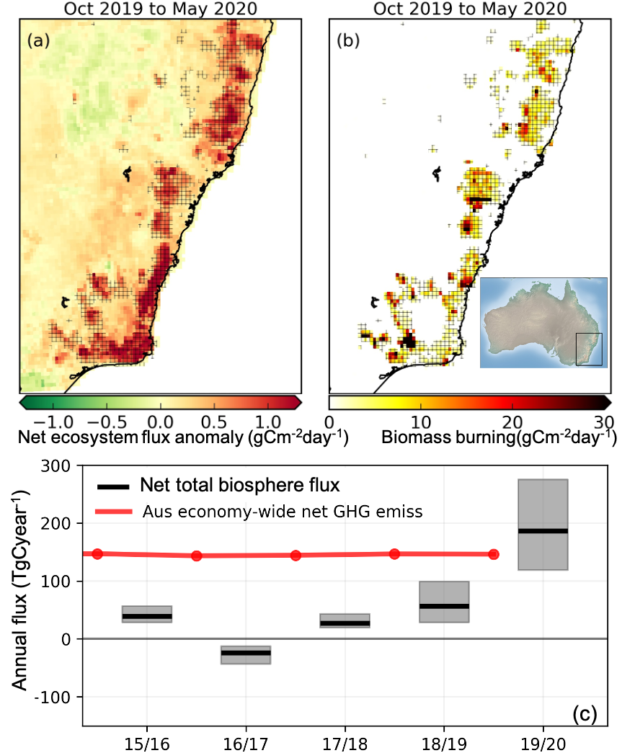
Australian drought and fires, 2019-2020
Extreme climate events play an outsize role in the global carbon cycle
OCO-2 has shown that carbon flux anomalies caused by extreme Australian drought and fires in 2019–2020 were larger than the country’s annual fossil fuel emissions.
Will increasingly frequent extreme climate events in future years cause a tipping point in the regional carbon cycle?
Byrne et al., 2021

Slide 6
Summary
OCO-2 has transformed understanding of the carbon cycle
  Especially in key regions, such as the tropics and high latitudes, where in situ obs are sparse
OCO-2 has revealed the outsize impact of extreme climate events on ecosystem health and regional carbon budgets
  Flood, drought, fires
OCO-2 is a key element of a greenhouse gas observational network to
  Enhance scientific understanding
  Inform climate mitigation efforts, assess mitigation goals
Notes:
First bullet: OCO-2 and OCO-3 provide unique and complementary forms of coverage. In the near term, with OCO-3 going into storage and the launch of the European CO2M postponed until 2026 OCO-2 will be the primary satellite that provides global sampling of XCO2 observations

Slide 7
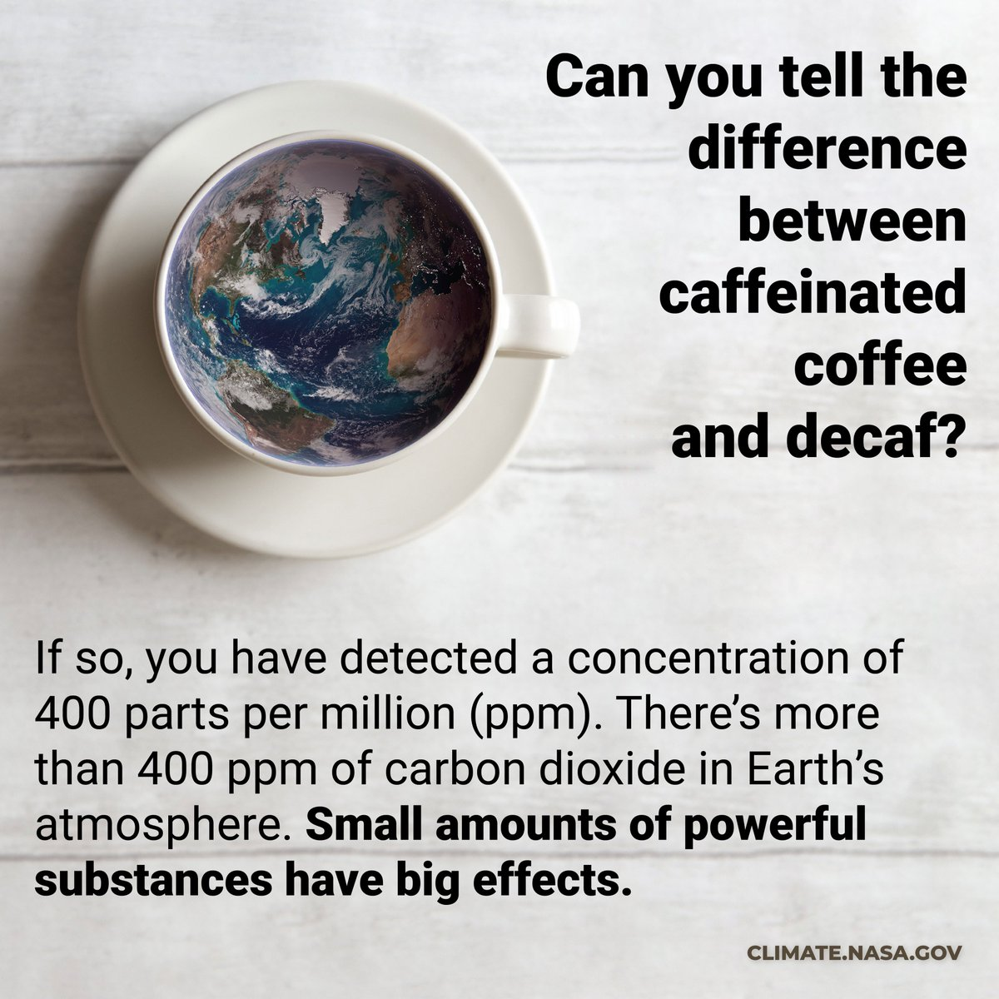
QUESTIONS?
Email: vivienne.h.payne@jpl.nasa.gov
OCO-2 Webpage - https://ocov2.jpl.nasa.gov/

Slide 8
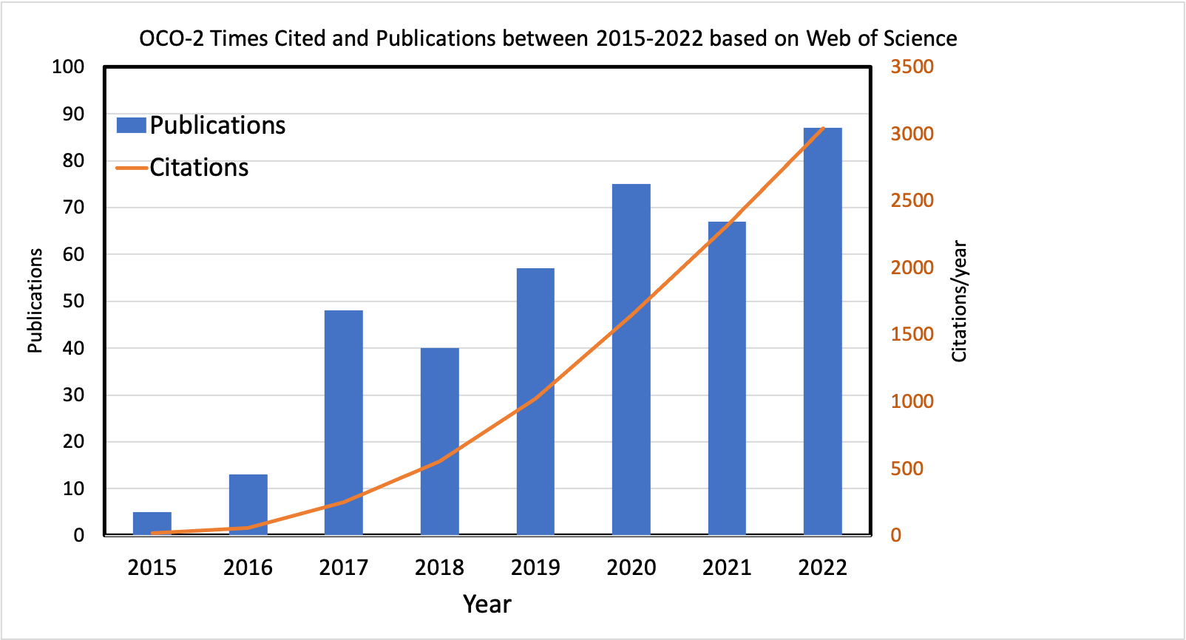
Publication statistics
BACKUP

